Slide 1

Technological characterization of West African iron ores in order to predict their performance in the beneficiation process
Liesbet DUBRON
Eric PIRARD
Arnaud PIRSON

Slide 2
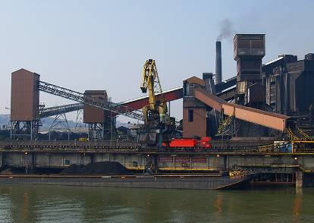
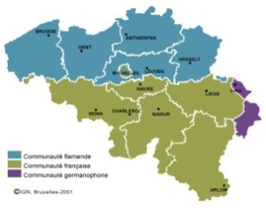
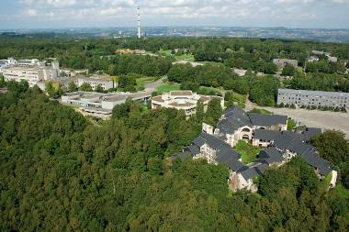
About Liege
A millenary city
    Liege City
      The cradle of coal mining, steelmaking and zinc metallurgy in Europe...
    Liege University
      A major research partner in Belgium
      4000 researchers; 1800 PhD students
      500+ professors
      Large network of spin off companies ( > 70)

Slide 3
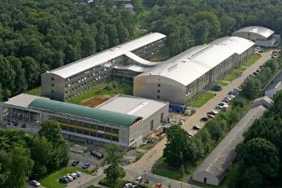
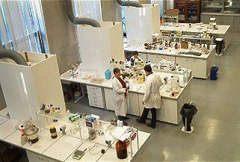
About Us
A long tradition in Georesources Engineering
  GeMMe
    Minerals Engineering, Materials & Environment
      3 research units; 40⁺ researchers
        Building materials
        Minerals engineering & recycling
        Georesources & Geo-Imaging
GeMMe operates on the characterization, valorization, transformation, use and recycling of mineral materials at any stage of their life cycle.

Slide 4
Synopsis
Introduction
Geology of Nimba County
Tokadeh Deposit
  Quantitative Ore Microscopy
Process Mineralogy
  Modal analysis from chemical data
  Inference of optimal beneficiation
Conclusions

Slide 5
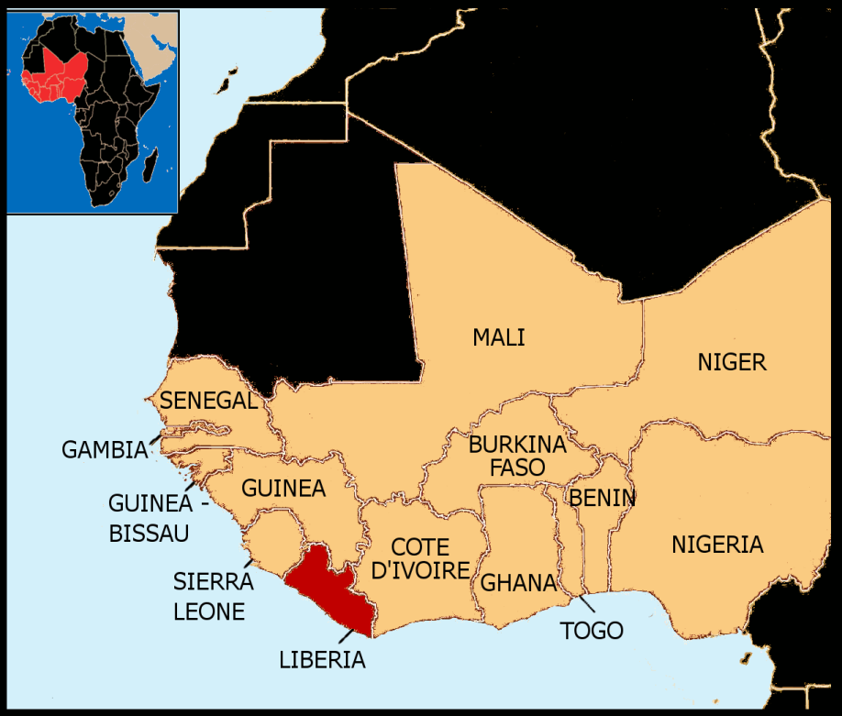
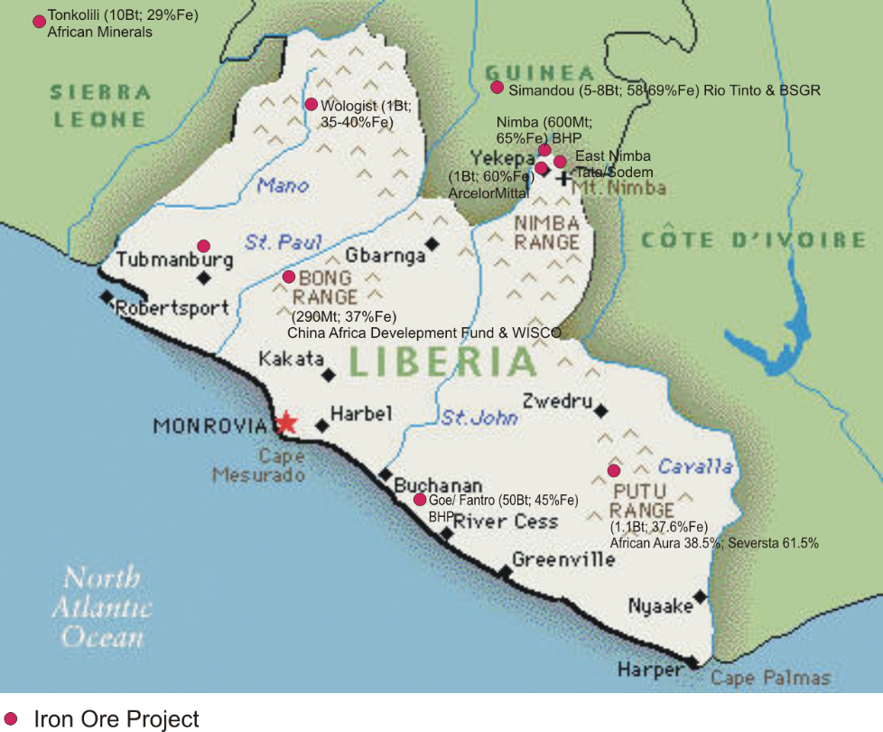
Iron Ore Projects in Liberia and around
After http://www.proactiveinvestors.co.uk (2010)

Slide 6
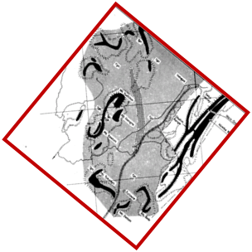
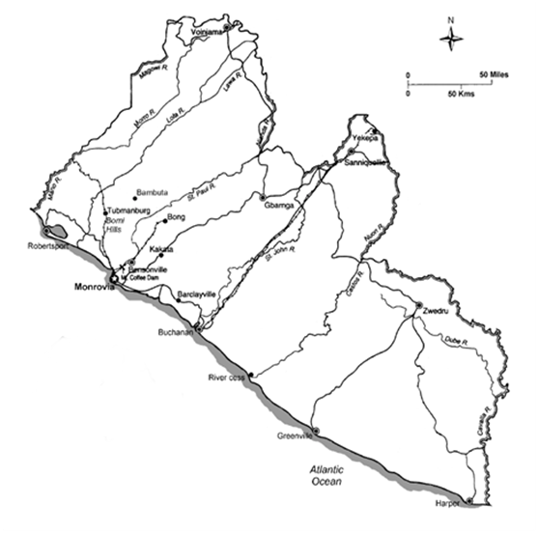
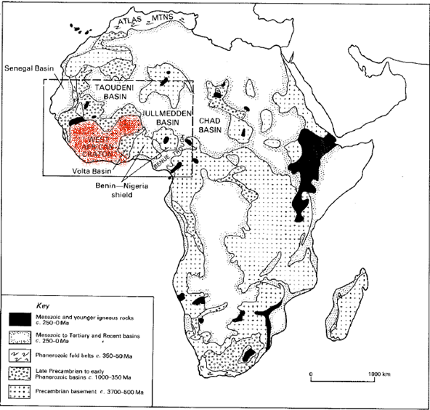
Geology of the Nimba Range
  West African Craton

Slide 7
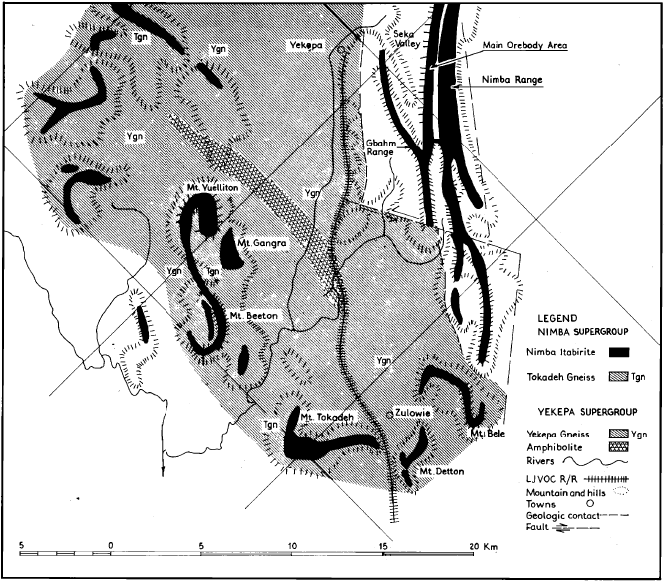
Geology of the Nimba Range
Nimba Range Geology
  Precambrian basement
    3700 -500 Ma
      Qz-Fsp-Bt gneisses / migmatites
  Supracrustal belts (metamorphic event)
    2750 Ma
      Elongate belts of phyllites, greenstone, schists
  Granitic intrusions (basement + supracrustal)
      Mineralisations ⇔ granitic intrusions
  Granite-greenstone association
      Greenstone
      = metamorphosed/altered mafic volcanic rocks
_{Berge et al.} ₍₁₉₇₄₎

Slide 8
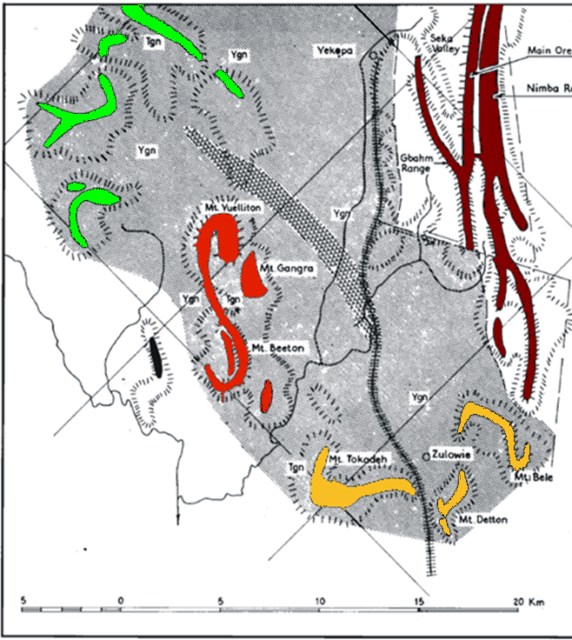
Geology of the Nimba Range
Nimba Supergroup
  Nimba Itabirite:
    U-shaped series of ridges
      E: Nimba Main Orebody
      S: Bele - Detton - Tokadeh
      NW: Beeton - Gangra - Yuelliton
      N: More Itabirite ranges
  Tokadeh and Yekepa gneisses
    Amphibolite zone in the middle
  Increasing metamorphism from E to W
    E: Upper epidote amphibolite facies
    W: Amphibolite lower-granulite facies
_{Modified from Berge et al.} ₍₁₉₇₄₎

Slide 9
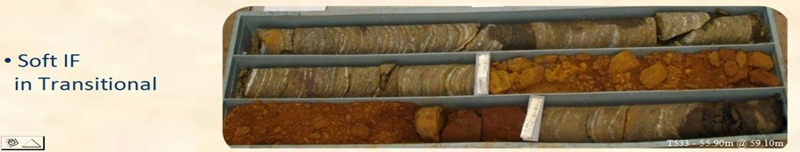
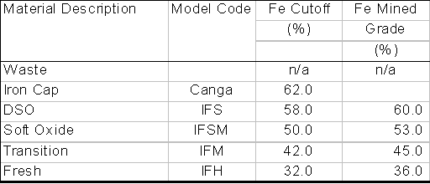
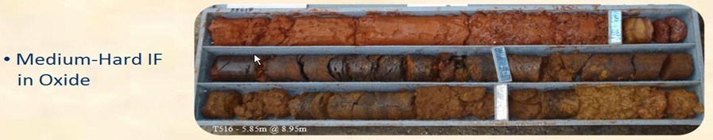
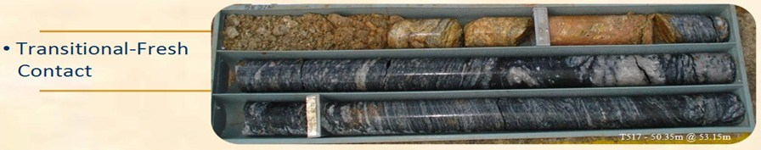
Tokadeh Deposit
Banded (silicate) iron formation
Upper amphibole to lower granulite metamorphism
Ore Classification

Slide 10
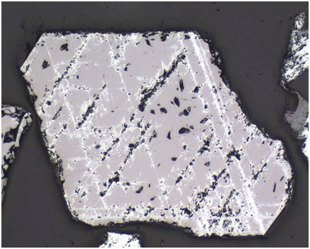
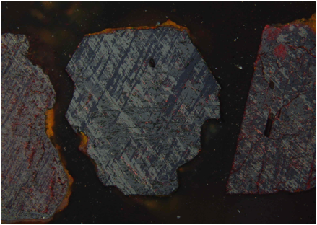
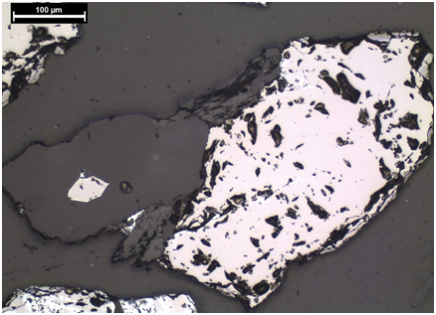
Quantitative Ore Microscopy
12 classes based on mineralogical phases and textures:
  Monomineralic:
    Pure magnetite (MGT)
    Martite with >50% magnetite (Mar MGT)
    Martite with >50% haematite (Mar HEM)
    Pure haematite (HEM)
    Goethite: varying texture and composition (Goethite)
    Gangue minerals: mainly Qz (Gangue)
  Polymineralic:
    Composite grain MGT/ Gangue
    Composite grain MGT/ Mar- Gangue-Goethite
    Composite grains MGT-HEM
    Composite grains Martite HEM-Gangue
    Composite grain Martite MGT-Gangue
    Composite grain Martite-Goethite

Slide 11
Quantitative Ore Microscopy
OX
53% Fe
UT
45% Fe
LT
36% Fe

Slide 12
Quantitative Ore Microscopy
Tokadeh iron ore profile:
  Downward increase of magnetite
  Upward increase of martite, hematite and goethite

Slide 13
Quantitative Ore Microscopy
Tokadeh iron ore profile:
  Upper transition zone:
    High level of composite grains
    Low degree of liberation Fe-phase and gangue

Slide 14
Process Mineralogy
Tokadeh samples from all 3 zones (OX UT, LT)
Spiral concentrates
  Chemical analysis
  Optical microscopy
  XRD
Simulation behaviour during mineral processing
  Expected Optimal Beneficiation

Slide 15
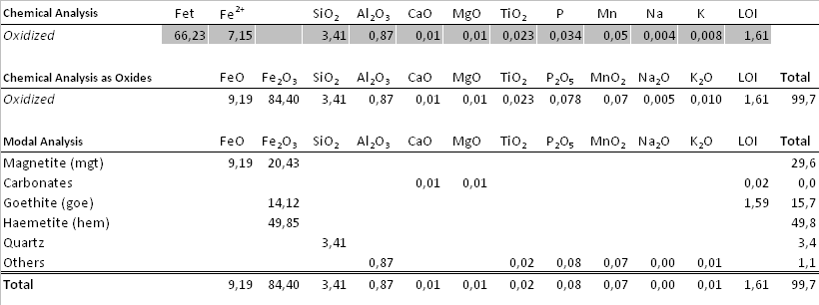
Process Mineralogy
Quantitative Mineralogy from Chemical Data:
 | Total (/100%)
Magnetite | 29,7 %
Haematite | 50,0 %
Goethite | 15,8 %
Gangue | 4,5 %
Mineral species confirmed by XRD

Slide 16
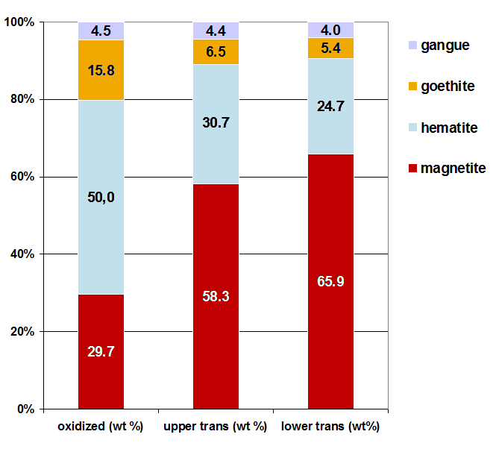
Process Mineralogy
Quantitative Mineralogical Analysis
  Constrained by microscopy / XRD
Limits:
Kenomagnetite has not been considered.
Potential contaminations of goethite by silica, alumina and manganese have not been considered.
Mineralogical Analysis of Spiral Concentrates
obtained for the 3 different ores

Slide 17
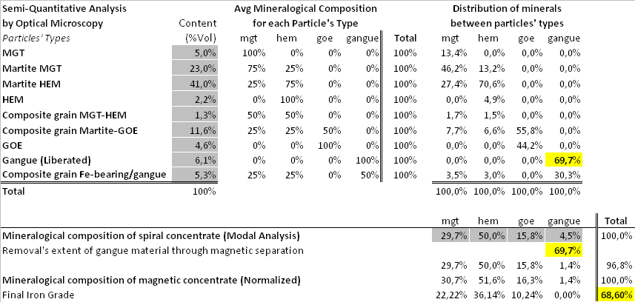
Process Mineralogy
Inference of magnetic separation concentrates from modal analysis:

Slide 18

Process Mineralogy
Theoretical upgrading potential
Estimated modal analysis of concentrates
after an additional magnetic separation
Potential upgrading of spiral concentrates
by magnetic separation.

Slide 19
Conclusions
Liberia hosts several world class deposits
Importance of mineralogical data at exploration stage
Simple estimates of quantitative mineralogy can (often) be obtained by combining microscopy, chemistry & XRD
Understanding of mineral beneficiation
Inference of optimal beneficiation

Slide 20
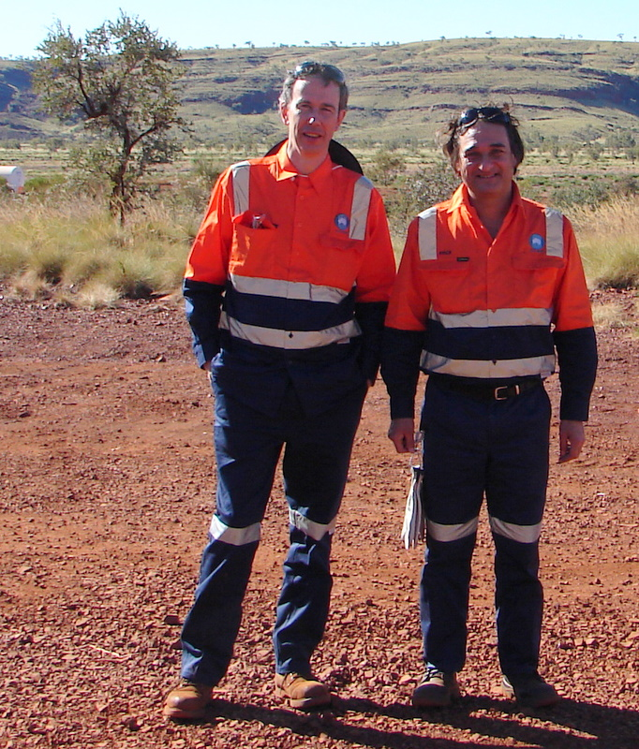
Thank You

