Slide 1




Policy dialogue makes
Universal Health Coverage happen!
An EU-Luxembourg / WHO collaborative agreement towards UHC
UHC 2017 Forum, Tokyo
December 2017

Slide 2
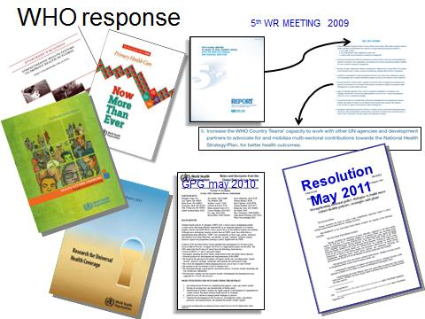
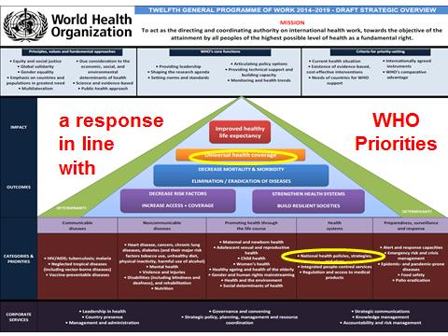
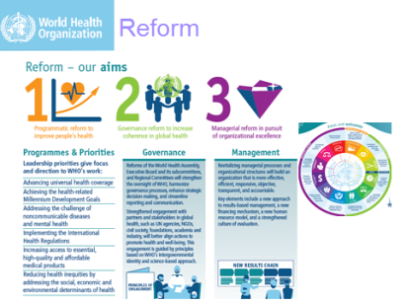
Comprehensive approach to UHC is key
and MoHs should take a significant share
of the leadership
Better shape partners' interventions at country level towards effective development cooperation
The UHC-Partnership relies on a country-led identification process
Balance between seed money and senior technical expertise

Slide 3
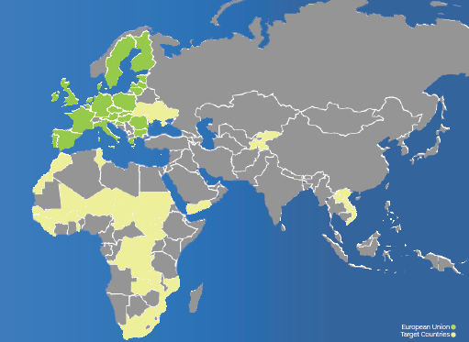
By end of 2017,
35 countries
28 countries

Slide 4
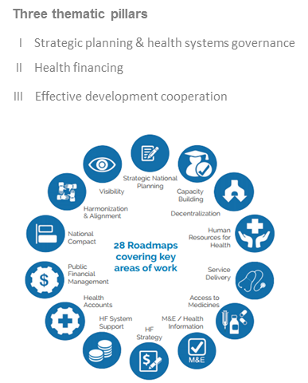
Activities: 15 areas of work around 3 pillars

Slide 5
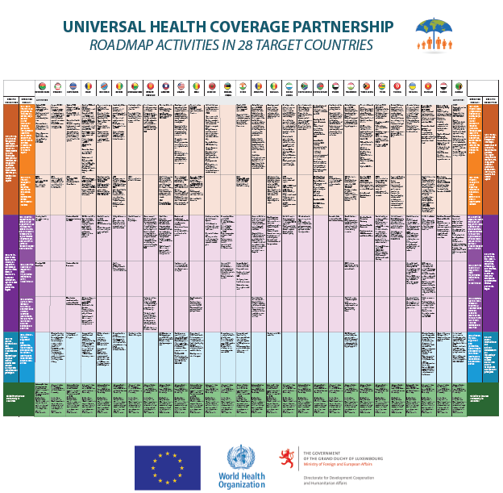
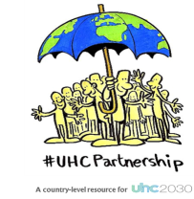
Roadmaps: hundreds of activities
Roadmaps (summary table of roadmaps at a glance

Slide 6
Major areas of work
AREAS of WORK
LEVELS of ACTIVITIES
TYPES of ACTIVITIES
MoH Institutions Capacity Building
Major focus
Strategic National Planning
National level
National Policy/Political
objectives
Aid Effectiveness – IHP+
Decentralization
Laws & regulation
Strategic work
Provincial level
Monitoring & Evaluation
Health Financing, HA
Financial Management Systems
Support for more technical areas of work
(Health Accounts, HIS, Drug pricing,…)
Local level
Human Resources for Health
Service delivery
Medicines
Visibility

Slide 7
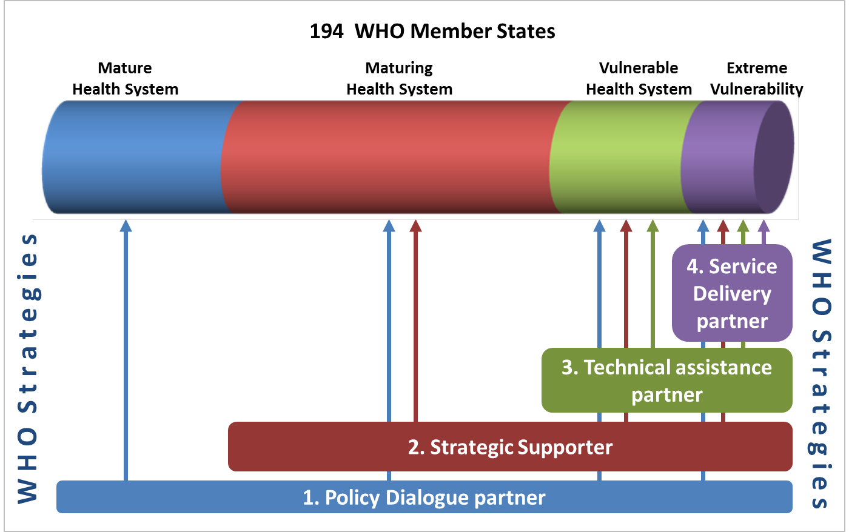

Slide 8
Concretely in countries…
Modality 1 – Policy dialogue
Greece: Policy dialogue on
health reform in Greece: public health in the 21st century
Modality 3 – Technical assistance
Burkina Faso: Health financing strategy (with P4H)
Guinea: Health workforce pre-service education (with HWF)
Sierra Leone: Health Workforce strategy
Modality 4 – Service Delivery
Yemen: Health sector support programme with WB, Unicef & WFP
South Sudan: donor coordination; national health policy
Modality 2 – Strategic Support
Tunisia: Citizen jury & public accountability
Moldova: PHC & Hospital reform
Morroco: Institutional review of the health sector agencies

Slide 9
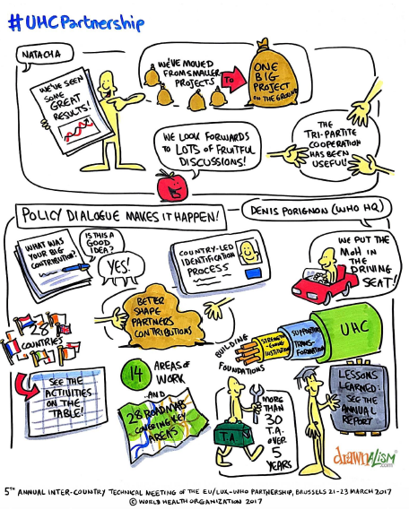
And also…
Country learning programme
Global UHC and health
financing products for HF
advocacy in countries
Scientific publications:
BMC series on policy
dialogue (AFRO), others
at regional and country level
Backup missions
Collaboration with many
departments at HQ, regional
and country level.

Slide 10
Other aspects…
UHC-P and WHO reform: from country focus 70% of the resources are at country level
Long term TA in about 20 countries
The role of the country office: better positioned to fulfill its mandate with MoH and partners
Collaboration between the 3 WHO levels
An operational arm for implementing WHO DG's priority on UHC
UHC 2030

Slide 11
Other aspects…
Collaboration with the EU Del., Luxembourg and (recently) Ireland Representations.
Evaluation: internal integrated evaluation of HGF department (WHO), ROM, external evaluation (KIT), and verification mission (June 2017), EU Court of Auditors (November 2017)

Slide 12
Lessons learned
UHC Partnership is a strong enabler
Coordination and alignment between plans at national, regional and district level is crucial for success
Countries have recognised increased need in leveraging other aspects like legal frameworks and healtrh security
Civil Society and citizens engagement are key and need to be fostered
In order to leave no one behind, we need to improve on benefit package design

Slide 13

Lessons learned
There is a need to strengthen the governance and stewardship of health purchasers in respective countries
UHC Partnership seed funding has aided in attracting core substantial funding
Flexible funds to add activities according to MOH interest and priorities
It is instrumental to ensure the way forward by enhancing support on the implementation side
Long term TA in countries: need for more in some of them.

Slide 14
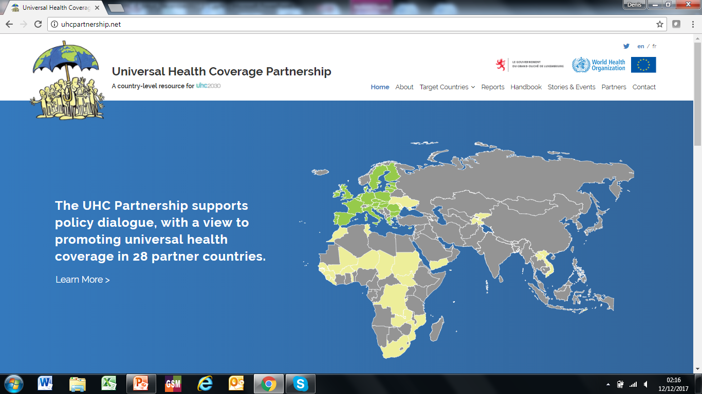
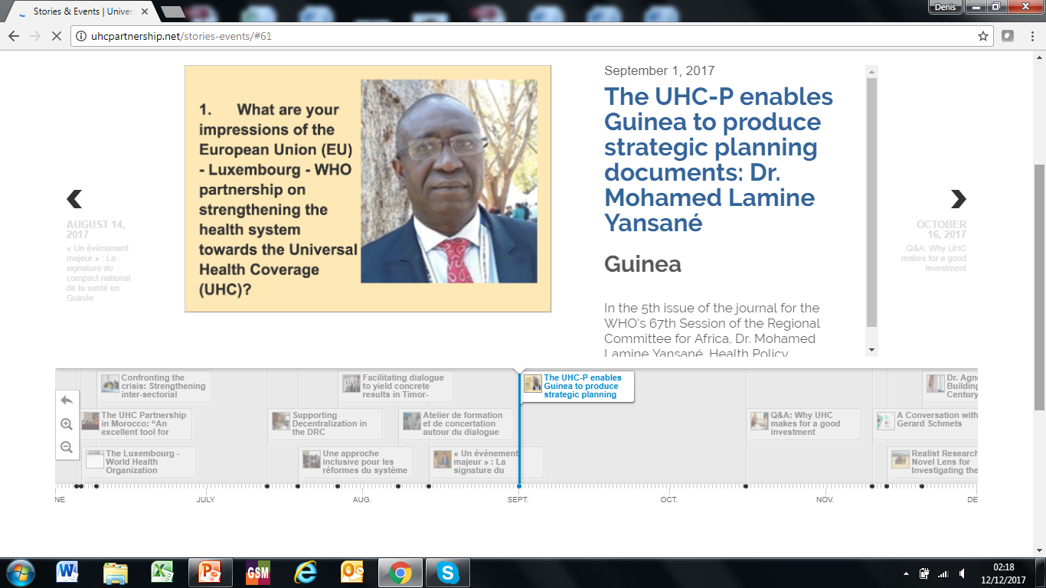
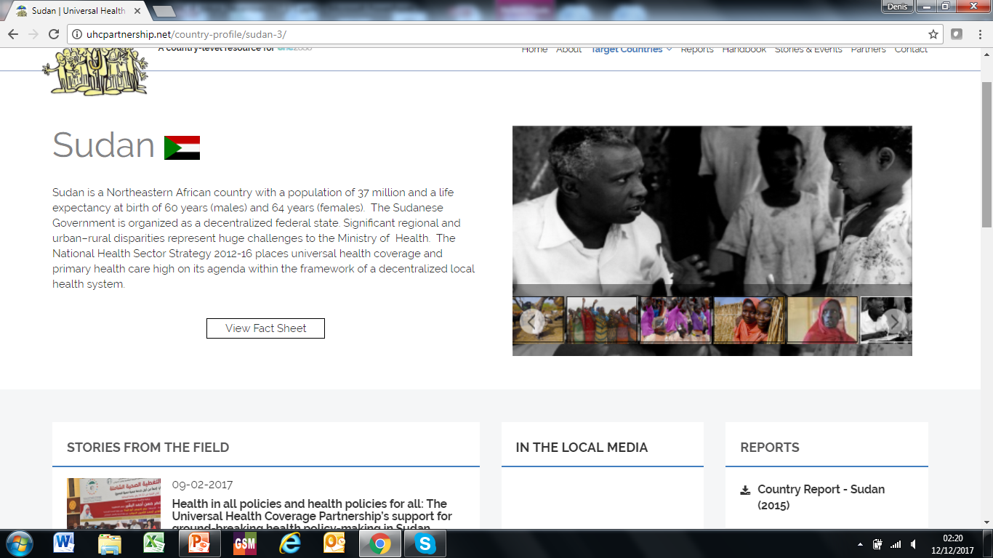
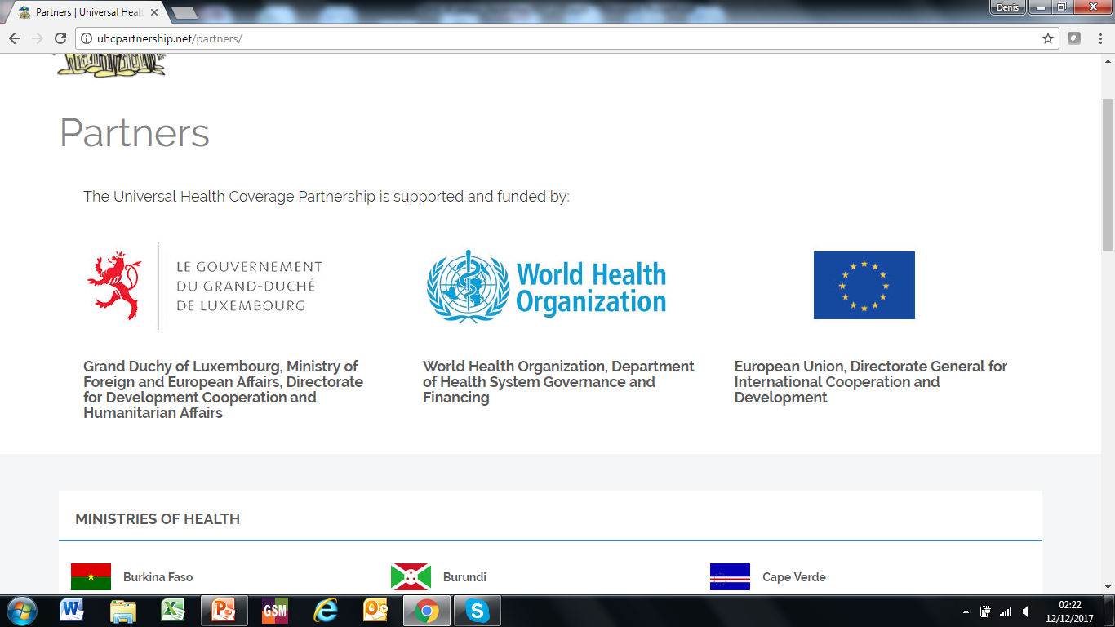
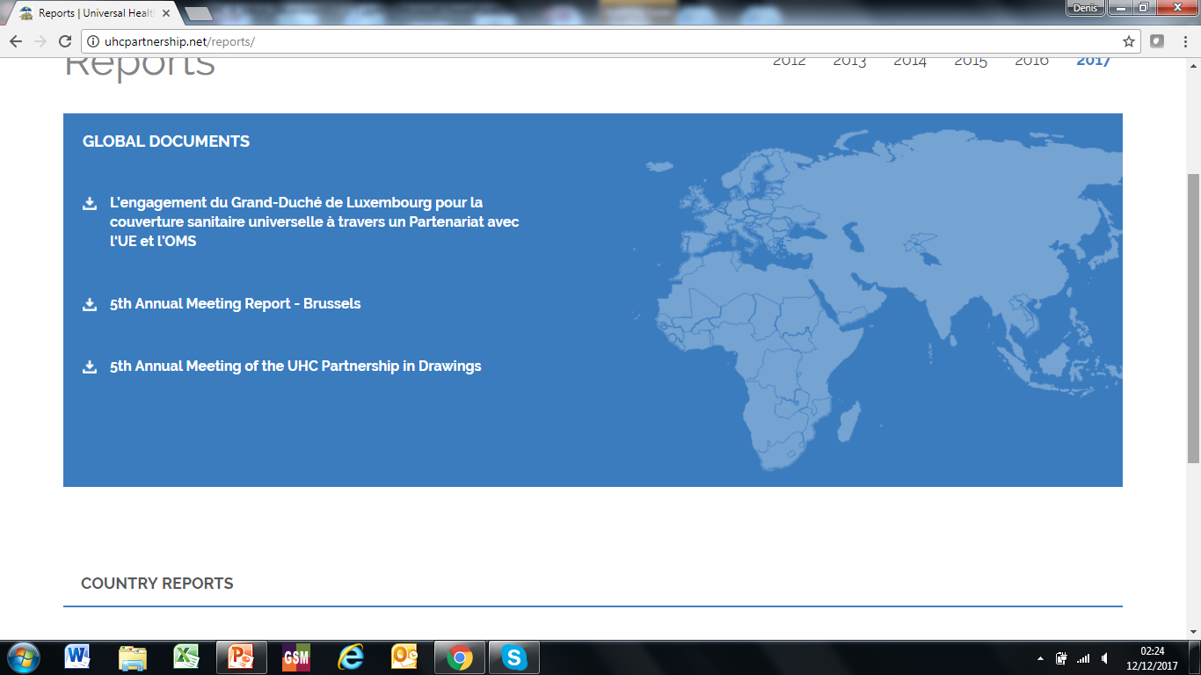
The website
The website
Publications
Handbook

Slide 15



Notes:
KK: Needs to be updated. I will check which publications we would like to show

Slide 16
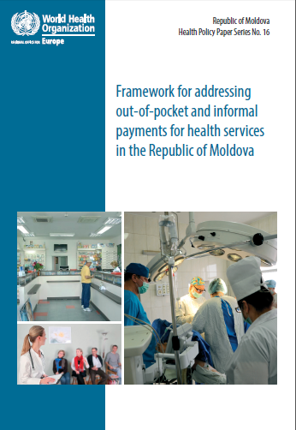

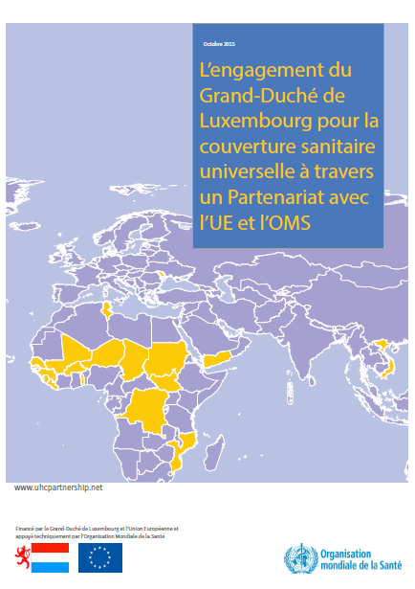
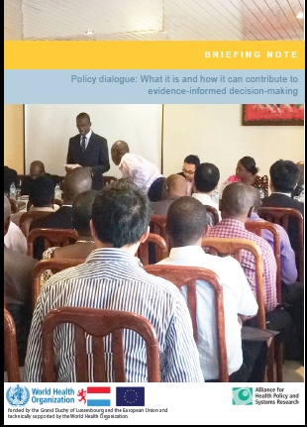
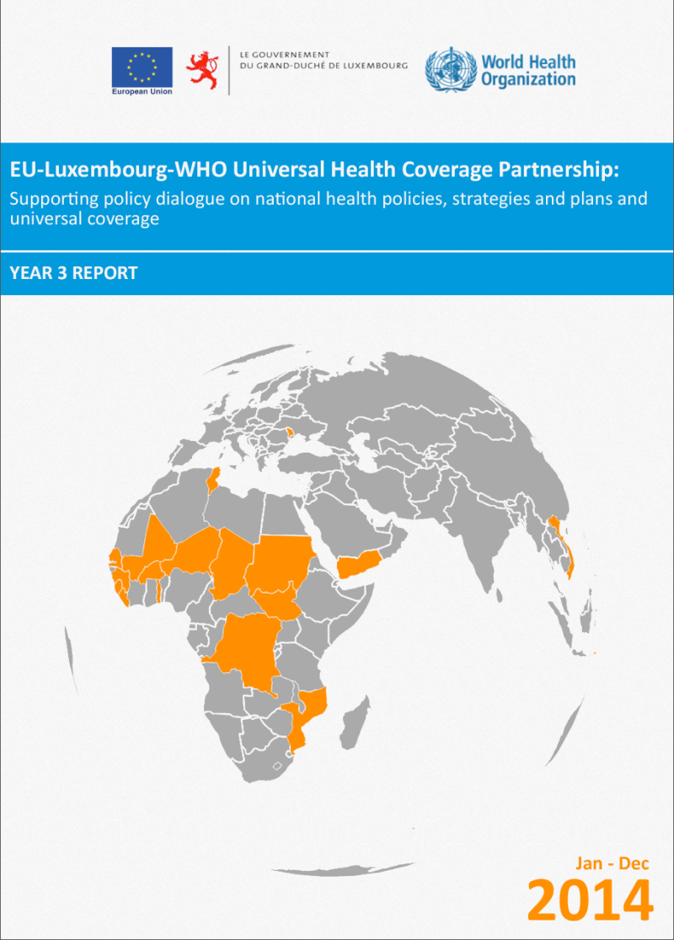


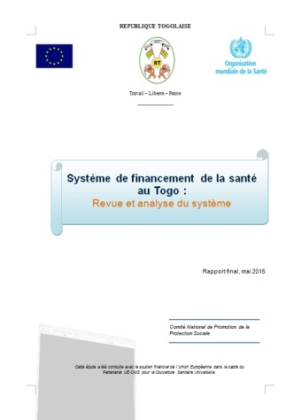
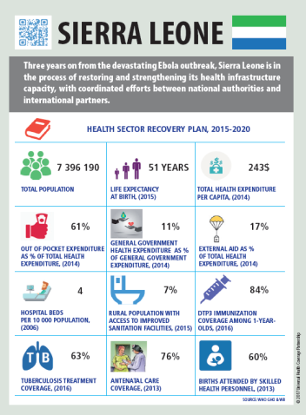

Slide 17
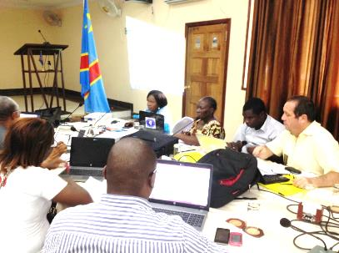

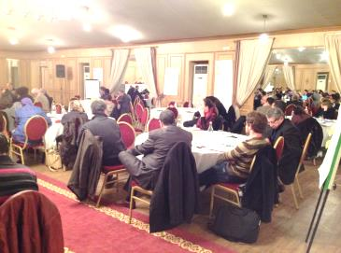
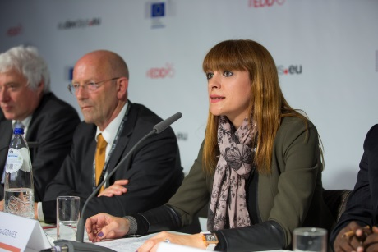
Others…
Annual meetings
Annual reports (2012-2016)
Scientific conferences (Vancouver,…)
Stories from the field (see website)
Special events: EDD, WR meetings, Devco days,
Country specific events to launch the UHC-P (in most of the countries)
Country specific material: Moldova, Tunisia, Vietnam, Togo, Guinea, Ukraine,…
Twitter, cartoons,
Trailers You Tube

Slide 18

Rosters
Realist research
Community of practice…
Country learning programme
Flexibility and adaptation to the
evolving global health landscape

Slide 19
And for today?
Bold moves towards partnering in the 21st century
No simple answers, but we are here to move forward…
Make sure that we take the public interest into account
Better capacity of local actors
The money is there in most of the countries

Slide 20
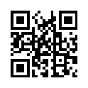
Thank you!
Visit us:
www.uhcpartnership.net
Follow us:
@UHCPartnership

