Slide 1
Taking extrasolar planet imaging to a new level with vector vortex coronagraphy: the ERC/ARC VORTEX project
Olivier Absil
F.R.S.-FNRS Research Associate
University of Liège

Slide 2
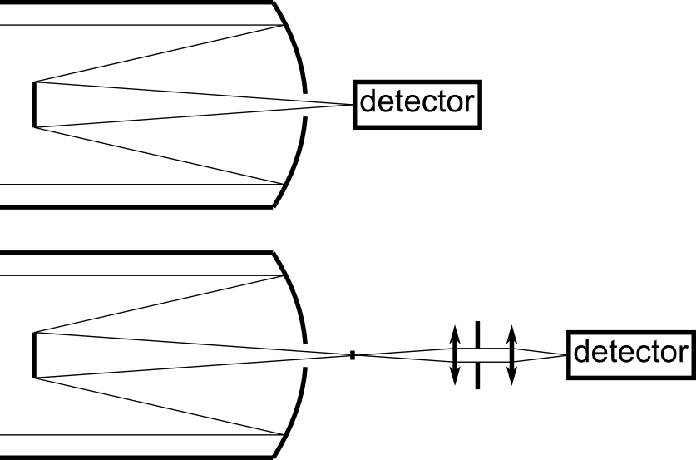
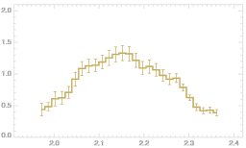
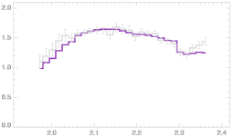
Let there be (no) light!
Konopacky et al. 2013
Marois et al. 2008

Slide 3
Which planets?
E-ELT
VLT
current imaging surveys

Slide 4
Coronagraphy
Opaque mask
Phase mask

Slide 5
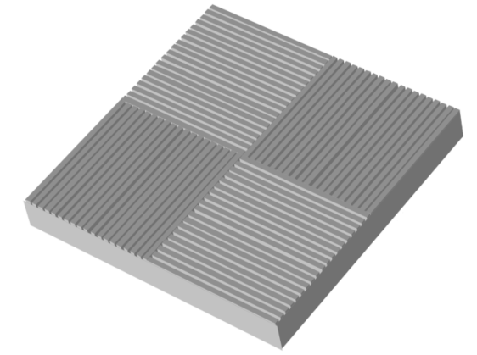
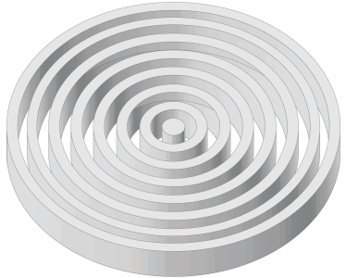
The birth of a concept
Mawet, Riaud, Absil & Surdej 2005
1997: phase mask (PM) for on-axis light cancellation
Four Quadrant PM → ZOG FQPM → Annular Groove PM
Advantages of the “AGPM” (first vortex coronagraph)
Inner working angle ≈ 1 λ/D
Clear 360° discovery space
Achromatic thanks to ZOG design
Easy to implement
π
0
0
π
Notes:
Continuous FQPM, creating a phase ramp around the optical axis
Serendipitously created an optical vortex! → the first vortex coronagraph
Recognized as a key technology by NASA (space missions) and ESO (E-ELT)

Slide 6
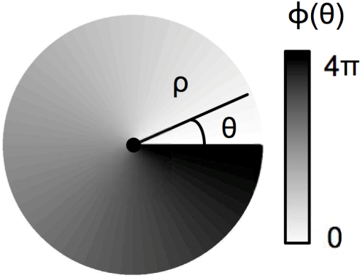
The AGPM, an optical vortex
Notes:
For an incoming horizontal polarization (blue arrow), the output polarization (red) turns twice as fast as the optical axis, represented in dashed line and perpendicular to the grating lines. The angle of rotation of the polarization vector corresponds to a “geometrical phase”. Upon one complete rotation about the center, it has undergone a 4 pi phase ramp. The center of the vortex is an optical singularity, which is optically equal to a point of zero intensity, which make it an ideal tool for coronagraphy !
Textbook HWP effect: input linear polarisation rotates by twice the angle between the polarisation and the fast axis
a-e-i-m: equivalent to the 4QPM effect, with 0, pi, 2pi and 3pi phase shift

Slide 7
Manufacturing process
Preparation of the diamond substrate
Moulding of the silicon stamp with PDMS
Plasma etching
Nanoimprint
Diamond: optical / IR transmission, mechanical / thermal properties

Slide 8
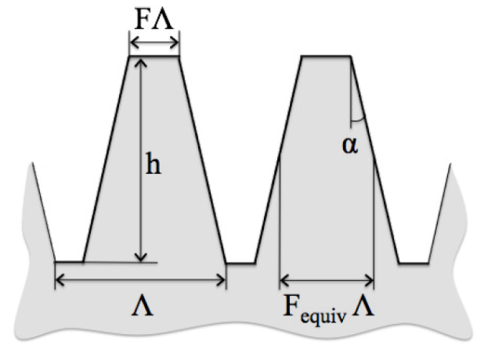
Grating design/optimization

Slide 9
A long, iterative process
E-beam master
Univ. Joensuu
Nano-imprint + plasma etching
Univ. Uppsala
Tests + integration
Univ. of Liège
Aluminum coating
Univ. Uppsala
Design selecting optimal parameters
Univ. of Liège
B: manufacturing
A
C
Laser writing master
Univ. Uppsala
Iterative process

Slide 10
1st step: N-band AGPMs (λ=10µm)
November 2009
October 2010
February 2012
Perfect profile of the central annular grooves
Improved roughness → reduced scattering
N band: - IR background too high
- no test-bench available

Slide 11
2nd step: L-band AGPMs (λ=4µm)
December 2010
September 2012
4.7 µm
1.4 µm
☺ Close to optimal design
☺ Testbench available in Paris-Meudon

Slide 12
Setting up the bench
“Yacadire” @ Paris-Meudon

Slide 13
Anguish…

Slide 14
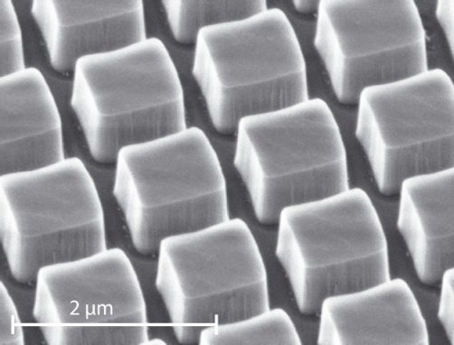
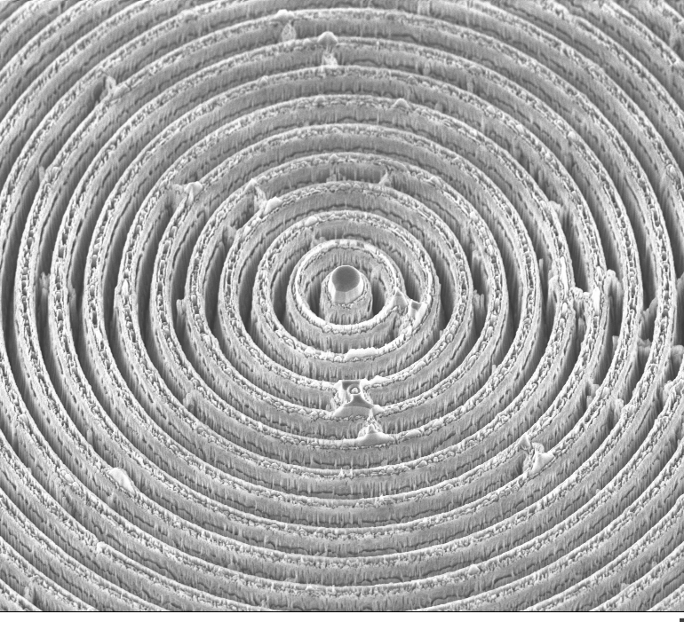
Getting closer…
Notes:
First

Slide 15
Bliss!

Slide 16
Outstanding performance!
Delacroix et al. 2013

Slide 17
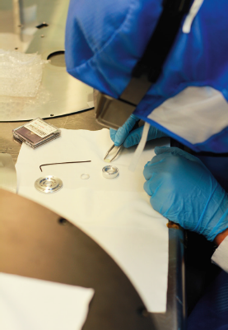
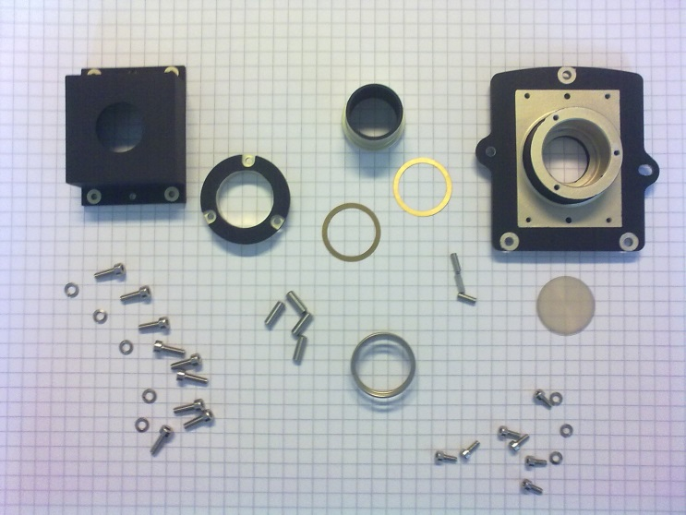
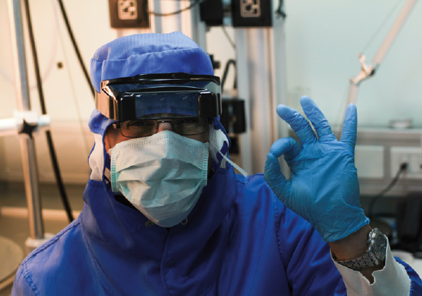
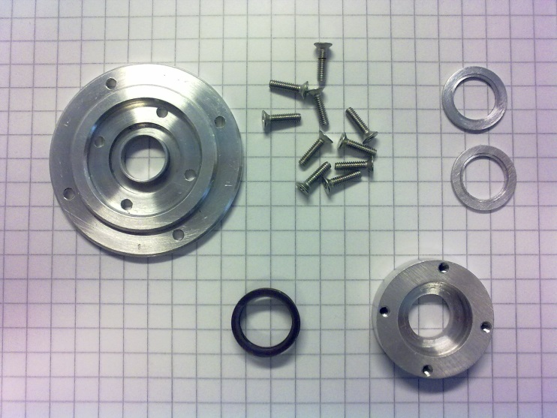
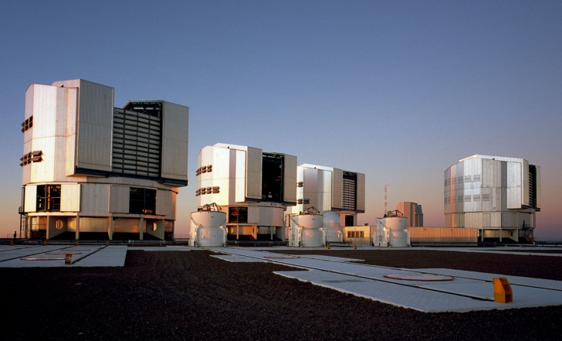
Installation at VLT

Slide 18
NACO: science demonstration
Raw image
Post-processed image
Absil et al., submitted

Slide 19
NACO: sensitivity to planets
Absil et al., submitted

Slide 20
The VORTEX project
Action de Recherche Concertée (ARC, ULg)
European Research Council Starting Grant (ERC StG)

Slide 21
The VORTEX project
WP1: Exploitation of 1st generation AGPMs
Install, test and optimize AGPMs on world-class telescopes
Perform the observations / analyze the data
Astrophysical interpretation
WP2: Development of 2nd generation AGPMs
Better L- and N-band AGPMs
Shorter wavelengths (K, H, … down to λ=1µm?)
Beyond topological charge = 2
WP3: Test and validation of new ideas
Exploitation of photon orbital angular momentum (OAM)
Post-vortex speckle cancellation techniques
Optimal apodization

Slide 22
VORTEX project strategy
WP1
Exploitation
WP2
Next generation
PhD student #1
Postdoc #1 (2014)
PhD students #2, #3
Postdocs #2, #3
Highest gain
WP3
New ideas
PhD student #4
Postdoc #4 (2014)
Notes:
All 3 workpackages will be investigated in parallel
Each one has its own purpose and could be seen as a project in itself, but only the combination of the 3 will lead to the highest gain, and enable the long-term objective to image Earth-like planets in the habitable zone of sun-like stars
Increasing level of risk from WP1 to 3
Message: management plan changed wrt to proposal (more manpower in WP3, longer term)

Slide 23
The VORTEX team
Université de Liège
Coordinator: Olivier Absil
Academic: Jean Surdej (AEOS), Serge Habraken (Hololab), Marc van Droogenbroeck (INTELSIG)
Postdoc: Christian Delacroix
PhD students: Brunella Carlomagno, Carlos Gomez, Aïssa Jolivet, Valentin Christiaens (U. Chile)
Uppsala Universitet
Academic: Mikael Karlsson
Postdoc: Pontus Forsberg
PhD student: Ernesto Vargas
Collaborators
Dimitri Mawet (ESO), Denis Defrère (Arizona), Pierre-Antoine Absil (UCLouvain)

Slide 24
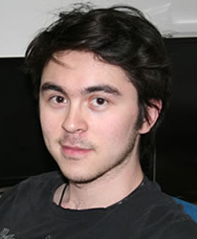
PhD project #1: search for planets in young disks
Valentin Christiaens (U. Chile / ULg)
(+ 1 postdoc in 2014)

Slide 25
Planet formation in disks

Slide 26
Combining ALMA with NACO
Cassassus et al. 2013
Notes:
First detection of gas/dust filament connecting the star/inner disk to the outer disk

Slide 27
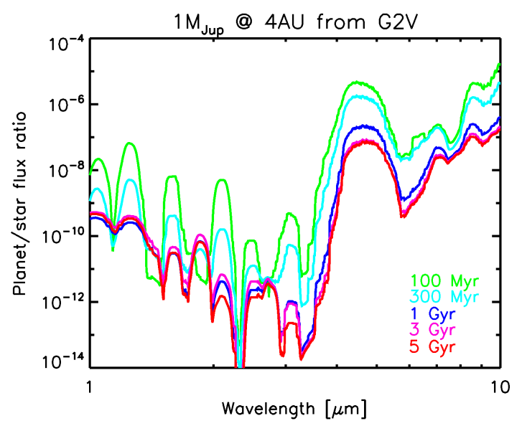
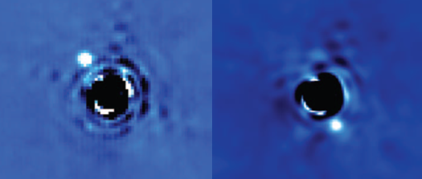
Advantages of NACO/AGPM
L-band = sweet spot for planet imaging
Access to new parameter space → surveys
Complementary to near-IR imagers → characterization
L
β Pic with VLT/NACO at L band (no AGPM)
VLT/NACO + AGPM-L
New search region
2003
2009
0.4”
Habitable zone
2013
Lagrange et al. 2010 (discovery paper)
Absil et al. (submitted)

Slide 28
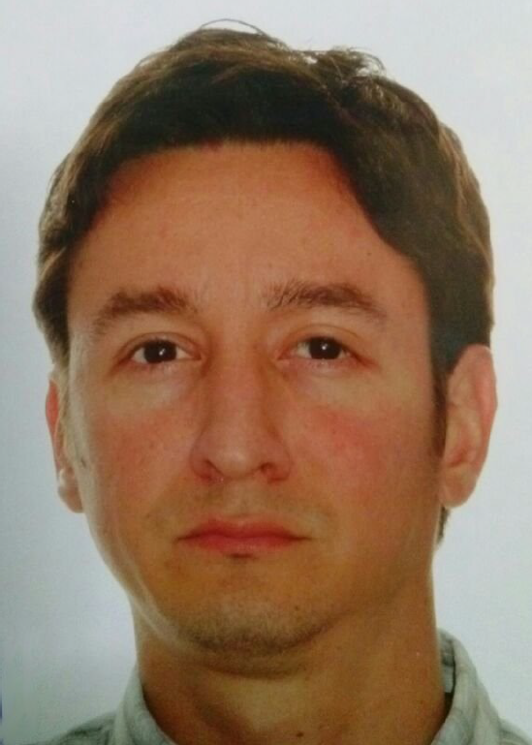
PhD project #2: optimal image processing
Carlos Gomez

Slide 29
Detection in speckle noise?
ESO-3.6m/ComeOn+ (1994)
S = 0.21

Slide 30
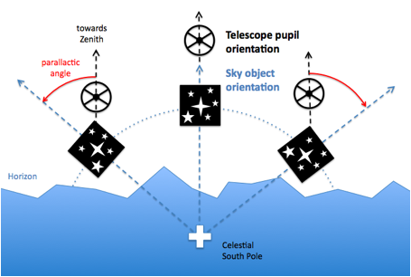
Angular differential imaging
Marois et al. 2006
Principle: use field rotation
Stop field stabilization (e.g., derotator)
Let sky rotate in front of telescope
Keep quasi-static speckles fixed while planet moves

Slide 31
ADI in practice

Slide 32
Principal Component Analysis
Soummer et al. 2012; Amara & Quanz 2012

Slide 33
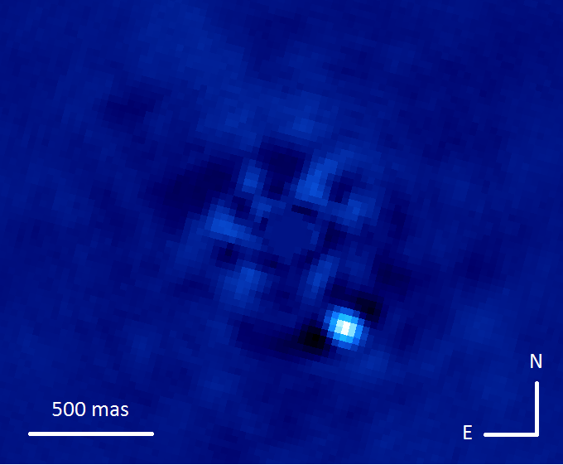
Main goals of PhD project #2
Build upon state-of-the-art
Advanced use of Principal Component Analysis
Investigate new approaches
Background subtraction techniques
Machine learning / dictionary learning

Slide 34
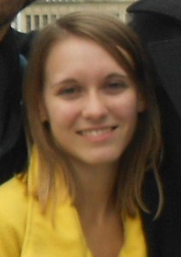
PhD project #3: design of 2nd generation AGPM
Brunella Carlomagno & Christian Delacroix (postdoc)
(+ Ernesto Vargas & Pontus Forsberg @ Uppsala)

Slide 35
2nd generation mid-IR AGPMs
Improvement of the grating parameters
Improved anti-reflective solutions
Goal: meet the specs for E-ELT/METIS
R > 1000 over full L, M and N bands

Slide 36
AGPMs at shorter wavelengths
Cover near-infrared window (1 – 2.5 µm)
More a technology challenge than a design issue
Goal 1: installation on VLT/SPHERE by 2016
Goal 2: prepare for E-ELT
1st light infrared camera (MICADO)
Dedicated high contrast imaging camera (PCS)
May require higher topological charges
Goal 3: space applications

Slide 37
Higher topological charges
l_{p}=2
l_{p}=3
l_{p}=4
1λ/D
2λ/D
3λ/D
4λ/D
Guyon et al. 2006
l_{p}=2
l_{p}=6

Slide 38
“AGPMs” with various l_{p}

Slide 39
New challenges
Discretization of the grating seems mandatory
Require new 2D modeling tools
Pioneered by Technion (Israel) for mid-IR applications
Adaptation to diamond not straightforward
Niv et al. 2006

Slide 40
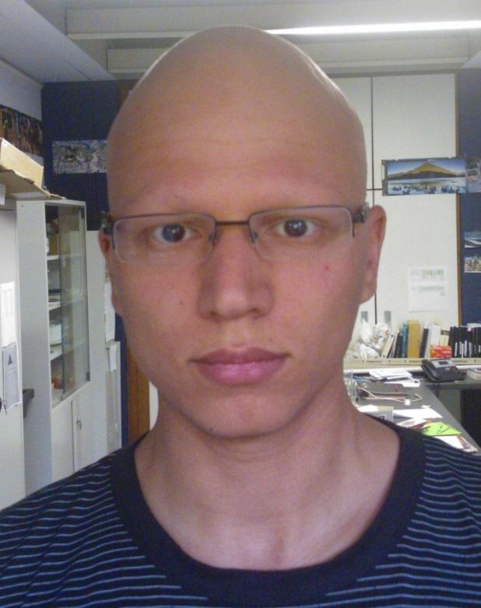
PhD project #4: testing AGPM + new instrumental ideas
Aïssa Jolivet
(+ 1 postdoc, early 2014)

Slide 41
Coronagraphic test bench
Develop in-house coronagraphic bench
Main goals
Test AGPMs designed for the 1 – 4 µm range
Become independent
Test new concepts and ideas
Need clean(er) room

Slide 42
Orbital angular momentum

Slide 43
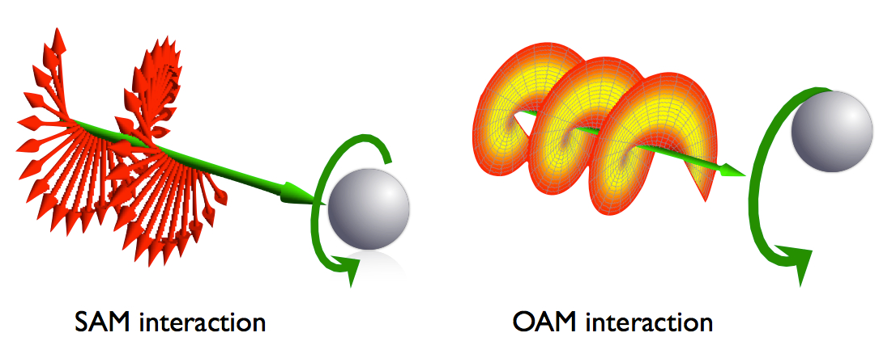
OAM: history
Predicted by Poynting (1909)
Observed by Allen et al. (1992)

Slide 44
Effect of the AGPM
Biener et al. 2002; Mawet et al. 2005; Marucci et al. 2006
AGPM

Slide 45
AGPM in convergent beam?
No OAM
No OAM
No OAM
OAM=2ħ

Slide 46
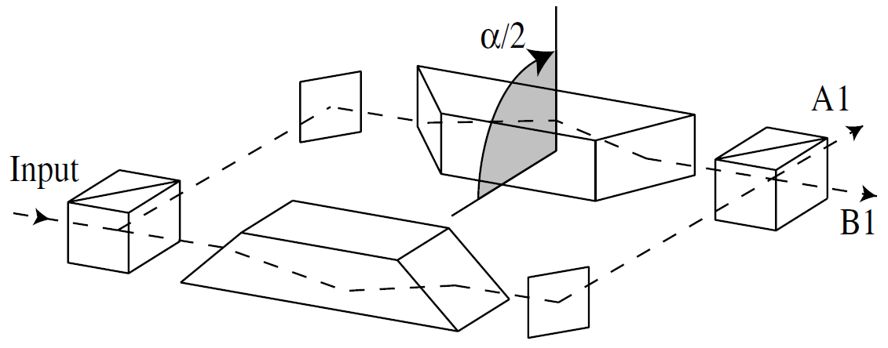
Photon sorting based on OAM
Beam rotation → phase shift
Separate OAMs with constructive and destructive interferences
Isolate planetary signal!

Slide 47
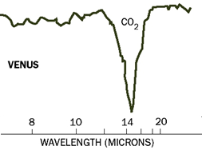
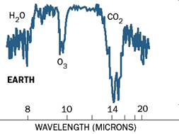
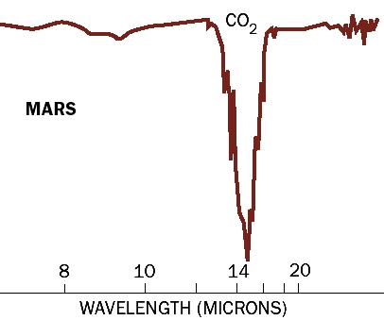
Long-term goal

