Slide 1



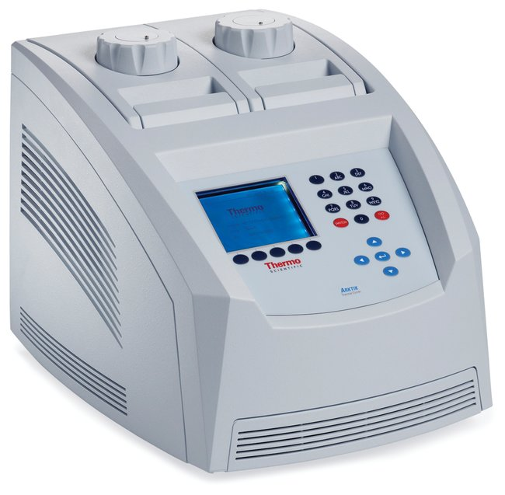
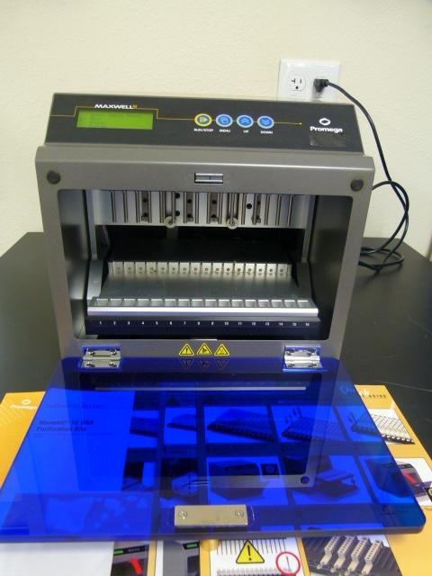
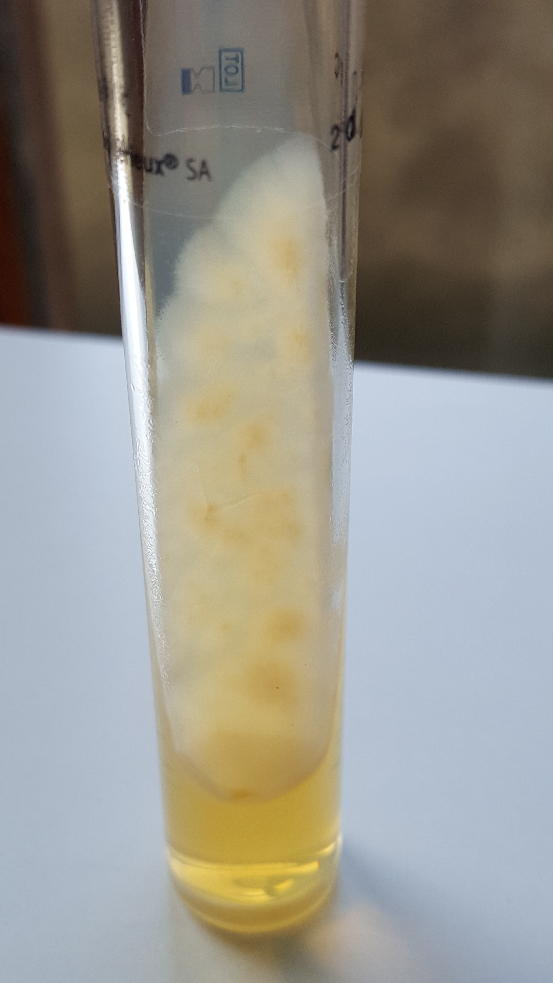
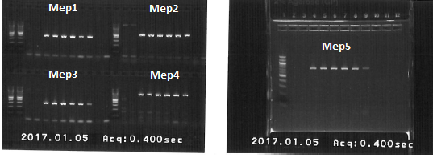
Molecular characterisation of five metalloproteases (Mep1-5)
in Microsporum audouinii strains circulating in Belgium
P291
Aouini Imen^{2, 3}, Sacheli Rosalie^{1,2}, Rajae Darfouf^{1,2}, Caroline Adjetey², S. Bontems², P. Melin²,
Aly Raies³, Marie Pierre Hayette^{1,2}.
¹National Reference Center for Mycosis, ²Department of Clinical Microbiology, Center for Interdisciplinary Research on Medecines, University Hospital of Liège Belgium ³Laboratory of Microorganisms and active biomolecules, University of Tunis El Manar II, Tunisia
mphayette@ulg.ac.be
Coorresponding author : mphayette@chu.ulg.ac.be
Poster nr P291
Objectives
Microsporum audouinii (M. audouinii) is an anthropophilic dermatophyte responsible for tinea capitis in young children. Infections caused by this species are very contagious and are responsible for outbreaks in schools and communities. Different proteases are produced by dermatophytes to digest tissue keratin. Among these proteases metalloproteases (Mep) have already been described as potential virulence factors in different zoonotic species such as Trichophyton mentagrophytes and Microsporum canis. In the present study, primers targeting five metalloproteases Mep1-5 have been designed to screen a large scale of Microsporum audouinii strains isolated in Belgium.
Methods
Strains: 82 clinical strains collected in the National Reference Center, Liège (Belgium)/2 reference IHEM strains (BCCM, Brussels)
Culture on Sabouraud dextrose agar–Identification by macroscopic and microscopic characteristics (+ITS sequencing if necessary)
Culture on Sabouraud Dextrose Broth →DNA extraction by Maxwell 16 cell DNA purification kit preceded by enzymatic lysis using proteinase K for 20 minutes
Primers were newly designed based on nucleotide sequences of the genes MEP1-5 available in GenBank database for the close related species M. canis and using primer Blast (NCBI-NIH) (See Table 1)
MEPs | Primers |  | Size (Bp)
 | Forward | Reverse
MEP1 | 5’AACTCTGCTACATGGCTAAG | 5’CATAGTCATTACCGCCATCT | 398
MEP2 | 5’CAGATGGTTCAATCCTTTGC | 5’ATCCTTCTGGATGTAGACGA | 514
MEP3 | 5’ACCTCTACTCCACTAACCTC | 5’GTTGCATGGTTGACTAGAGA | 304
MEP4 | 5’CCTCTATTTTCCGTGGTTCA | 5’AACATACATGAGAGGGTTCG | 801
MEP5 | 5’CCTACGTTGATGCTAAAAGC | 5’TTACGGCCATGAGTGTATTC | 730
Incubation at 30°C during 10 days
Proteinase K treatment
Sabouraud agar broth
Table1 : Primers used for PCR amplification of Meps1-5 and expected size of amplicons
35 Cycles
DNA purification (Maxwell, Promega)
Results
Among the 84 strains, the presence of at least one gene encoding for Mep1-5 was revealed in 93% (78/84) of the M. audouinii strains with 80 % (67/84) being positive for the five Meps (1-5).
The percentage of detection was as followed:
89% (75/84) for Mep1
88% (74/84) for Mep2 and Mep 5
85% (71/84) for Mep3
92% (77/84) for Mep4
In total, 7% (6/84) of the strains did not express any Mep gene. An internal control of amplification (ITS sequence) was also included to exclude a false negative result due to amplification inhibitors (See fig. 1,2).
Comparing with the Portuguese study (A. Lemsaddek.Microbiol, 2010) the screening of metalloproteases genes concerning M.audouinii Mep4 was also the most expressed (100%).Mep1 and Mep5 were detected in 96%,Mep3 was positive for 91% and finaly Mep2 was detected in 87% of the isolates
398bp
514bp
730bp
304bp
801bp
Figure 1 : Picture showing the fragment size of amplifying Mep1-5 on agarose gel.
Figure 2 : Occurrence of Meps1-5 genes among the 84 M. audounii analysed strains
Conclusion
The presence of the Mep1-5 genes in M. audouinii strains circulating in Belgium was confirmed in this study with 80% of the strains being positive for the five Meps. Next step will be the biochemical characterization of their expression. Another class of endoproteases called subtilisins have been recently considered to be involved in virulence process. Their presence will also be further checked in M. audouinii strains.

