Slide 1
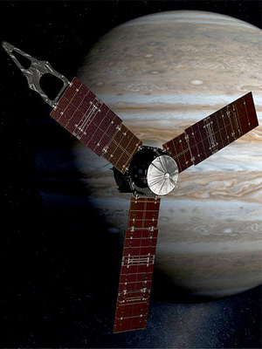
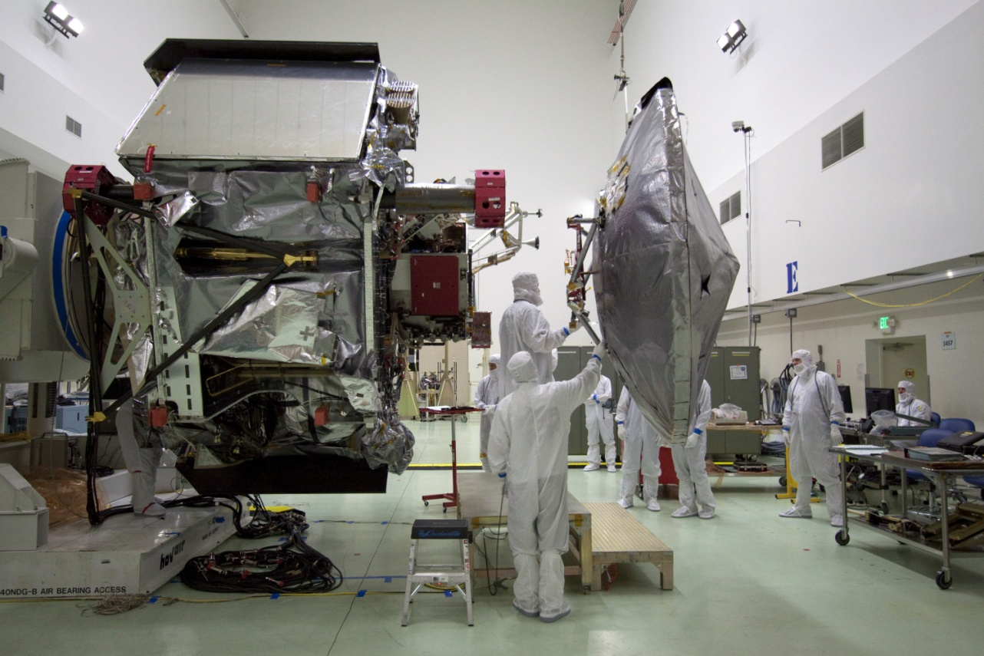
Exploring Jupiter: JUNO
Notes:
Orientation: sun-pointed 3rpm spinner
Power: Solar, 2m x 7.5m arrays, ~300 W
Weight: 976kg (dry)
Downlink: 15 kbps

Slide 2
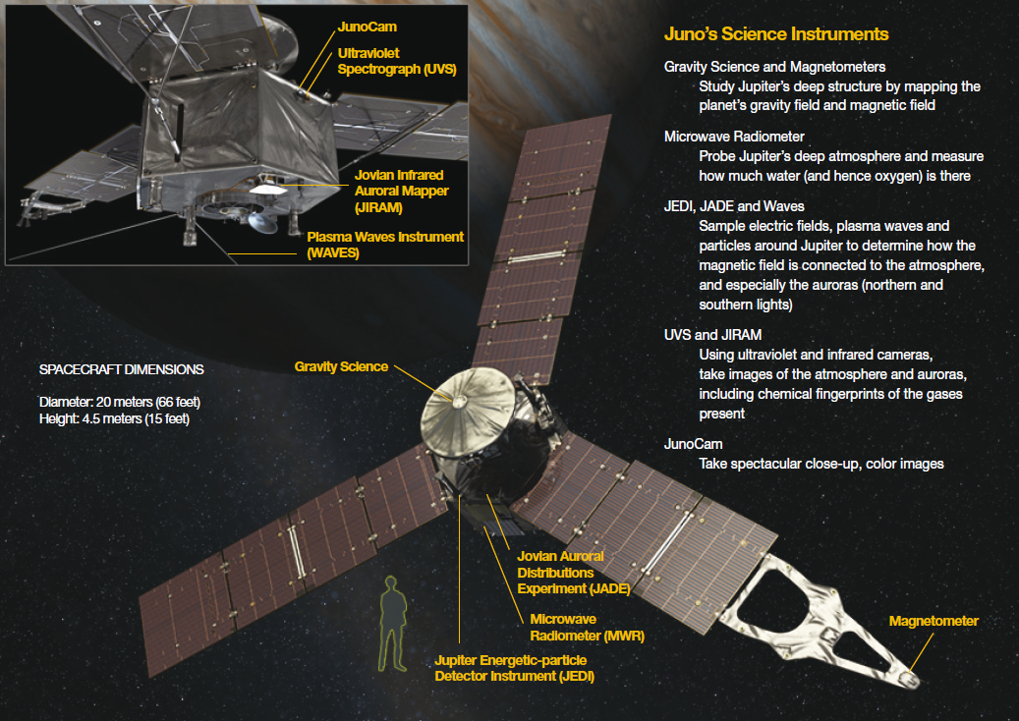
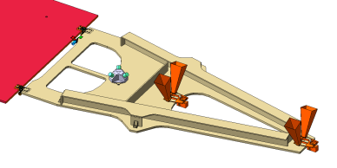
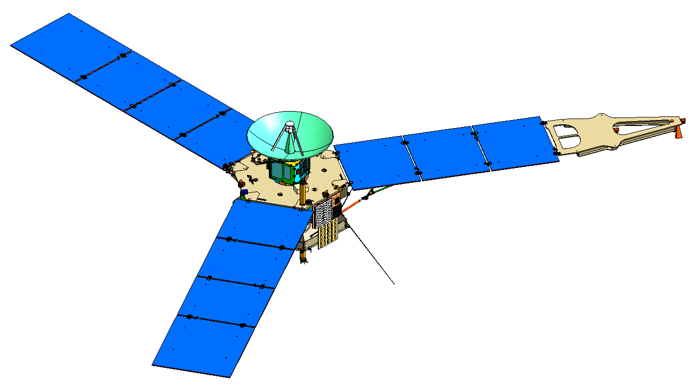
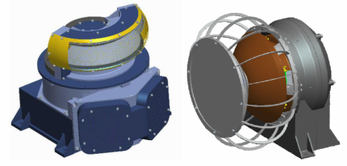
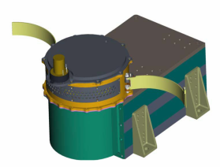
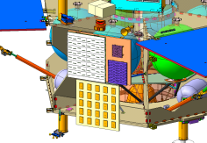
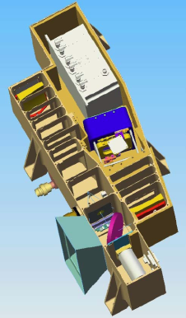
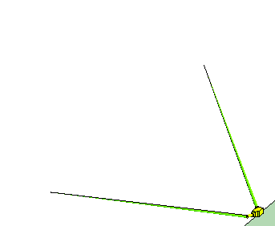
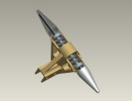
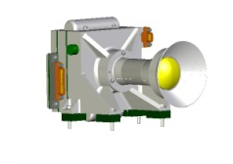
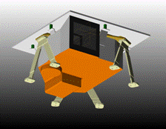
JUNO: vue globale
Advanced Stellar Compass (ASC)
ASC accurately measures the orientation of the magnetometers.
Jovian Auroral Distributions Experiment (JADE) - SWRI
Gravity Science
(GS) - JPL
Fluxgate Magnetometer
(FGM) - GSFC
Microwave Radiometer
(MWR) - JPL
Jupiter Energetic-particle Detector Instrument (JEDI) - APL
A6
A3
A5
A4
A2
Plasma Waves Instrument
(Waves) - U. Iowa
Ultraviolet Spectrograph (UVS) - SWRI
(On Aft Deck)
JunoCam - Malin
Jovian Infrared Auroral Mapper (JIRAM) - INAF Rome

Slide 3
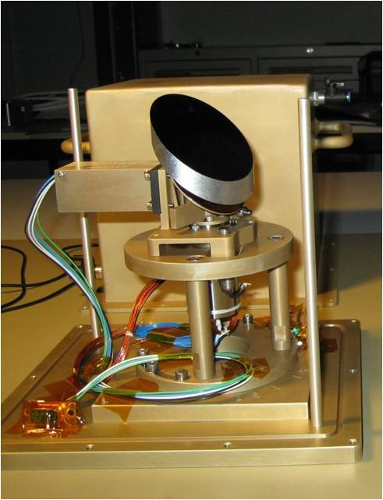
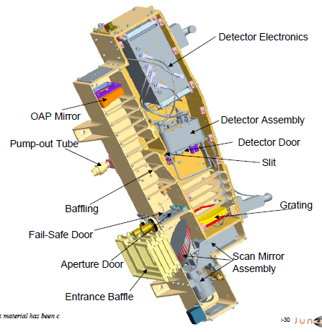
Juno-UVS and the CSL contribution

Slide 4
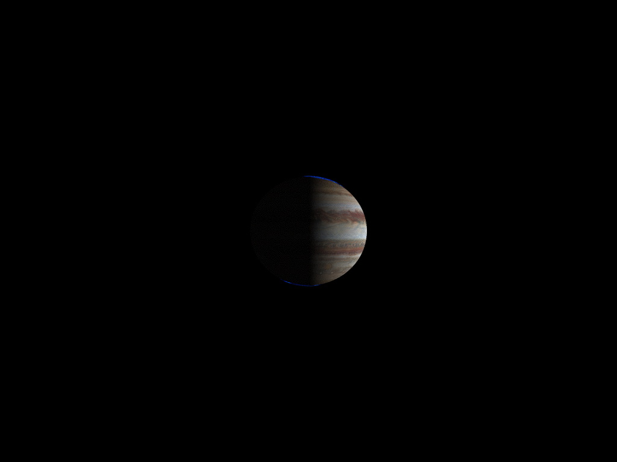

Slide 5
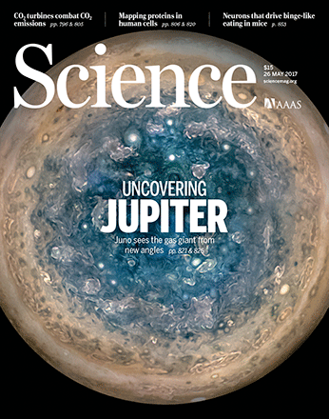
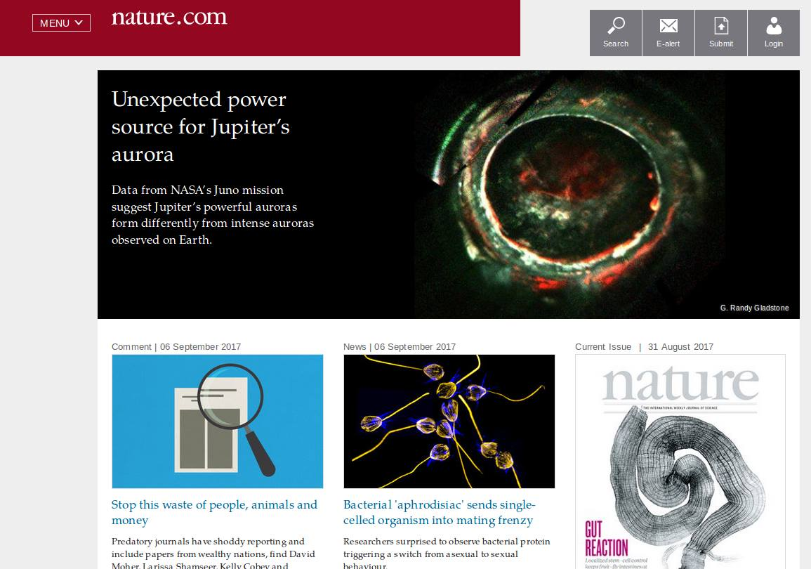

Slide 6
Bonfond et al. 2017

Slide 7
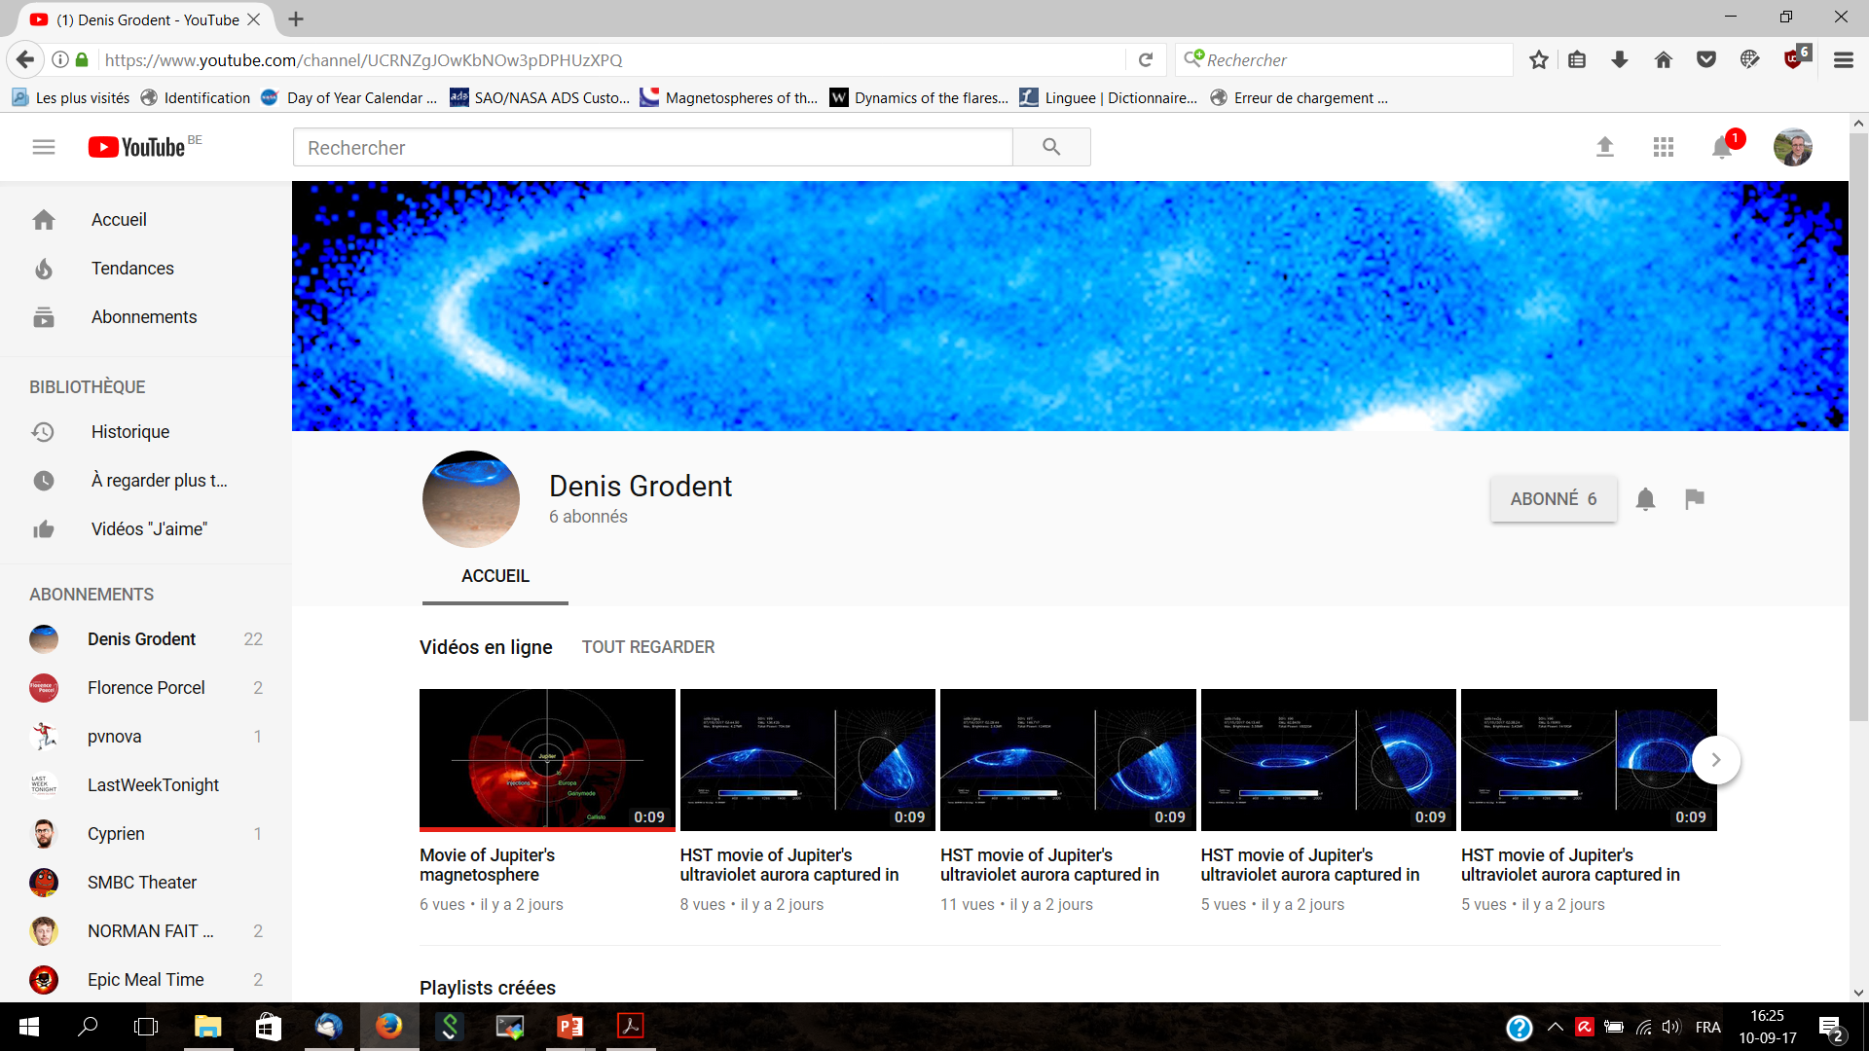
Large HST campaign:
The aurora live on Youtube

Slide 8
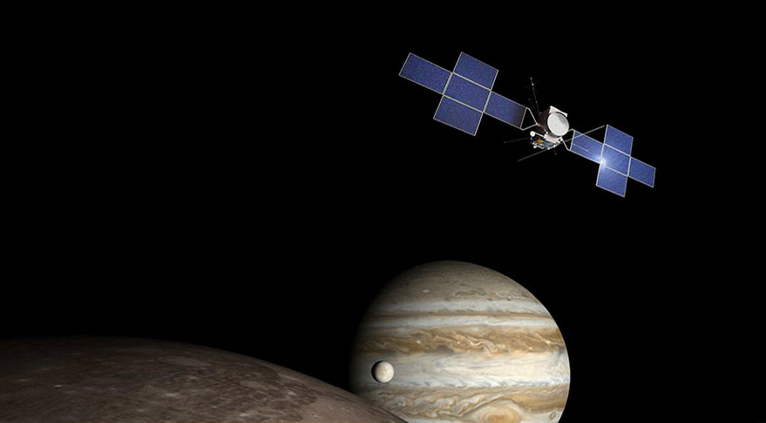
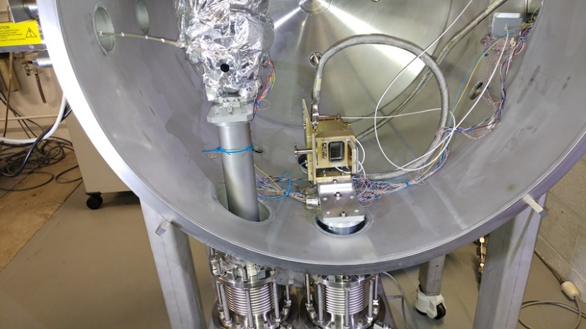
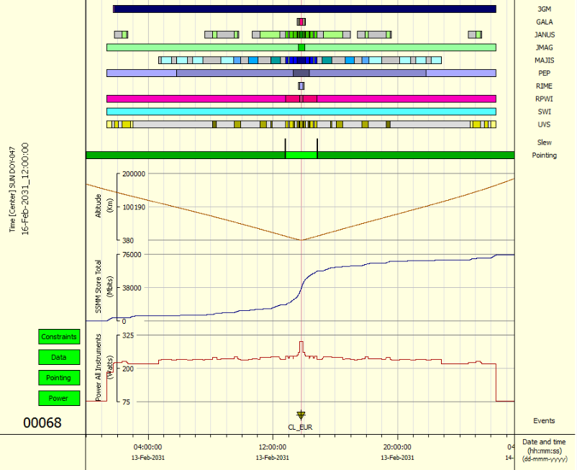
Next step: Juice
Jupiter Icy moons explorer
STAR is involved into 2 instruments: UVS and MAJIS
  CSL: radiation testing
  LPAP: observations strategy

