Slide 1
Managing and authenticating non-institutional users in Alma: two experiences
Helen Brownlie, University of Otago Library
Robert De Groof, University of Liège Library
François Renaville, University of Liège Library
http://hdl.handle.net/2268/214211

Slide 2
Abstract
The management of patron information within Alma is primarily reliant on two systems – the creation and updating of patron information by an external system such as student management or HR systems or internally within Alma itself. A recent survey of the Alma community indicated the majority of institutions utilize a mixture of these external and internal processes. In addition to providing access to affiliated staff and students more than 89% of institutions responded that they provided user accounts to non-affiliated users such as the general public, members of other academic institutions, alumni, etc. Providing authenticated access to library services for the latter group relies heavily on Alma for password management. This presentation will outline the processes in place at the University of Otago and at the University of Liège for managing and authenticating non-institutional users and the possible effect of Ex Libris' proposed changes to internal authentication.

Slide 3
At the University of Otago Library

Slide 4
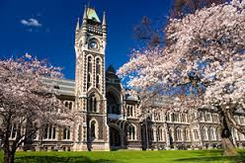
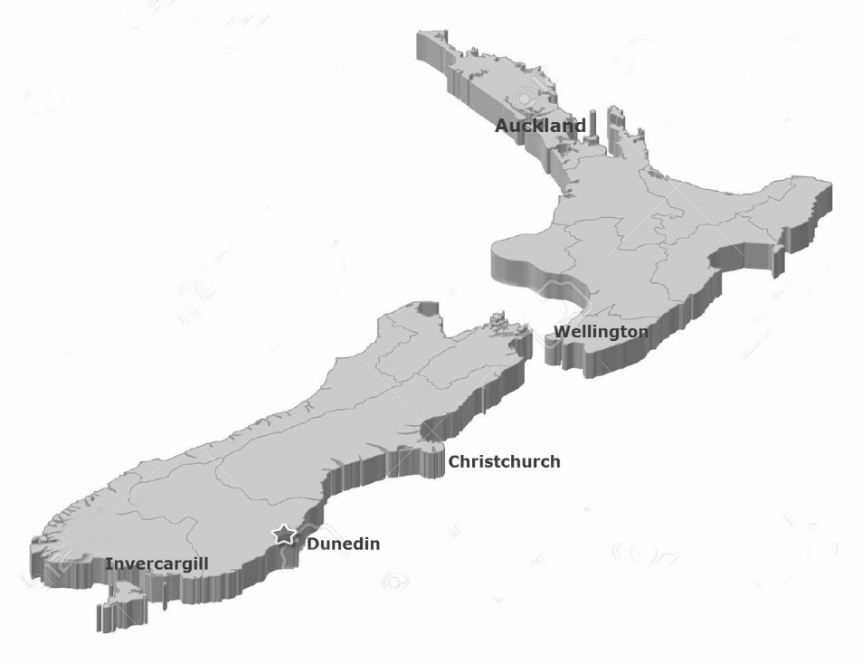
University of Otago
Founded in 1869 – New Zealand’s first University
Four academic divisions: Humanities, Sciences, Health Sciences and Business
20,814 students (18,547 EFTS)
3,862 (FTE) staff
More than 185 undergraduate and postgraduate programmes.
Campuses located in
Invercargill
Dunedin (Main campus)
Christchurch
Wellington
Auckland

Slide 5
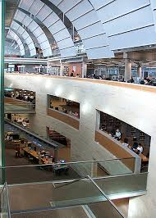
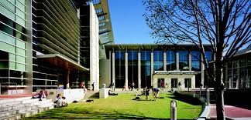
University of Otago Library
Dunedin campus
6 libraries and 2 storage buildings. One includes the bindery
Education Library is a joint library with the Otago Polytechnic
Libraries at
Southland campus
Christchurch Medical campus + 2 branch libraries at the District Health Board
Wellington Medical campus
Library systems
1988 Dynix
2003 Voyager + Serials Solutions products including Summon
2013 Alma + Primo + Primo Central
Library services to
University staff and students,
Otago Polytechnic
2 district health boards
Public

Slide 6
Otago’s user community
Notes:
Institutional members (ie University staff and students) only make up 45% of the Library’s user community
When it comes to managing non institutional library users, the main issue that we have encountered is getting them onto Alma.
Once on Alma they are managed as per any Alma user
Currently utilising three different authentication systems

Slide 7
Institutional Users - External
SIS Load
Match ID type: University username
Twice a day
Synchronisation type: Swap all
Record type: Public
Patron groups: Staff, Student, Student Distance
Notes:
Managing institutional members is relatively straightforward – the Library’s borrower load combines records from the student management system and the HR systems into a single file and delivers it to the Library. The file is picked up and loaded into Alma twice a day. The programming includes the assigning of patron groups and statistical categories based on library defined criteria.
Patron groups:
Staff
Student
Student Distance

Slide 8
Non Institutional Users - External
SIS Load (University)
Match ID type: University username
Twice a day
Synchronisation type: Swap all
Record type: Public
Patron groups: Staff, Student, External
SIS Load (Polytechnic)
Match ID type: Polytechnic username
Once a day
Synchronisation type: Swap all
Record type: Public
Patron groups: Staff, Student
Notes:
Otago Polytechnic:
A separate borrower load combines records from the Polytechnic student management system and the HR systems into a single file and delivers it to the Library. The file is picked up and loaded into Alma is once a day.
A separate borrower load for the Polytechnic predates our migration to Alma, however when we first went live we were unable to load two files of “external users” so had to set up and use an API loader. As these users were using internal authentication, staff had to manually add passwords to Alma records. As per the University programming patron groups and statistical categories are assigned based on library defined criteria. In 2015 the functionality changed and we could load two separate “external” files. Otago Polytechnic staff and students commenced authenticating against their ldap servers from December 2015.
Note: when there is a change to the SIS file format by Ex Libris we need to work with 2 different groups of programmers
AUTHDB
Is an database of external people who have an official association with the University. This includes Clinical staff (DHB staff who provide teaching services to the University), contractors, visitors, and the staff and students associated with Foundation Studies and Language Centre. The Library adds in any alumni wanting to use the Library. As these people are added to the University’s identity management system they are included in the University’s borrower load. The process for getting added to the database can take up to 5 days and involves completing an online form, getting it authorised by the sponsoring department, creating a record, notifying the user (by text) of the temporary password, and then the issuing of an ID card. The record would be picked up in the next library load.
University of Otago has tried to automate as much as possible, so as to minimise the need for the intervention of Library staff however this brings us to the remaining 14% ….

Slide 9
Non Institutional Users - Internal
Manual entry
Primary identifier: Email address
Notes:
The other 14%
The Hocken Library one of NZ’s most important historical research facilities and includes printer material, archives, photographs, art works, ephemera. Most importantly it is open to the public and this group who make up the biggest segment (52%). The Library is a closed stack, so anyone wanting to use the printed collection needs to be registered on Alma to be able to request items. This is normally done on the spot. As these users can only use the Hocken Library a special patron group is used.
Two of our Medical schools have Service Level agreements to supply library services to the staff of their respective district health boards. Done on demand, fill in membership form and a record is created on Alma. The DHB supplies weekly lists of staff who have left or moved positions and library staff update expiry and purge dates accordingly. For specified groups the DHB supplies the library with lists.
Email address is used as the primary identifier
Interloan library’s – required for lending material. No requirements for authentication
Staff: Used to login to Alma. Includes a large number of generic logins. Separation of roles as library staff and library user. Easier to manage roles, maintain statistics. Staff leave to work in other parts of the University

Slide 10
Authenticating
Notes:
Signing into “My Account” on Primo there are 3 forms of authentication being utilised
University of Otago staff, students and graduates (includes all those added to AUTHDB) directed to the University of Otago Federated Login Page (Shibboleth)

Slide 11
Other registered users
Notes:
Other registered Library users: Once they enter a username a password – the Otago Polytechnic ldap servers are checked first. If it fails the authentication request is directed to
the Alma internal authentication.

Slide 12
Library staff authenticating to Alma
Notes:
Generic logins
Know that other institutions successfully use other authentication methods to access Alma
Setting up another authentication method involves more that flipping a switch

Slide 13
Moving from Alma internal authentication The easy solution
Notes:
However we live in the real world, and need to provide for 2 main non affiliated uses groups with quite difference needs. And unfortunately the use of the University’s identity management system is not an option

Slide 14
Moving from Alma internal authentication
Otago’s “wish list”
Integration of workflows
Preference that is done from within Alma and can be initiated by all library staff
Alma expiry dates to be utilised
No requirement for the user to complete the registration
Authentication immediacy
Maintain separate logins for library staff.
This includes the continued use of generic logins
Automated process to transition existing internal usernames and passwords to the new authentication system
Notes:
Watching with interest the work of the External Authentication Focus Group(AFG)
Generic logins – service desks, student desk assistants, processing/spine labels,
Just on 11,000 internal users

Slide 15
At the University of Liège Library

Slide 16
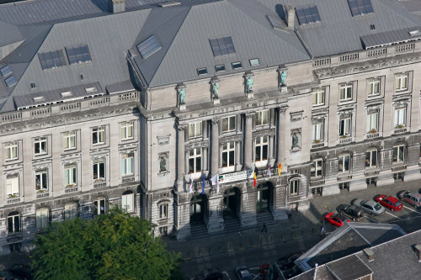
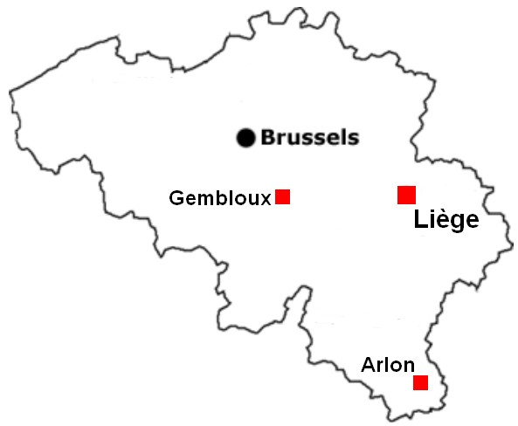
University of Liège (ULiège)
Founded in 1817 by William I of the Netherlands
10 Faculties and 1 School
More than 20,000 students
3,300 lecturers and researchers
38 bachelor and 193 master degrees
4 campuses:
Liège Sart-Tilman (main campus)
Liège City centre
Gembloux
Arlon
+ Library services to the University Hospital

Slide 17
University of Liege Library
Infrastructure
5 Main Libraries
→ 15 library branches spread on the 4 campuses
Registration everywhere…

Slide 18
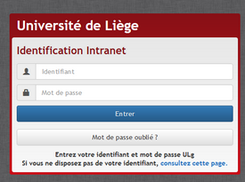
Authentication
Front end tools:
Primo: SAML
Library website (Drupal): CAS
What we wanted:
Users only sign in once
Drupal and Primo interconnected with SSO → automatic sign-in when already signed in on the other platform
Only one Sign-in page for all users (whatever their status/group)
Back end tool (Library staff only)
Alma: SAML
Institution Id used
1 person = 1 access (no generic accounts)
No Alma Internal accounts

Slide 19
User Management
SIS Load
Match ID Type: Internal key
Every day at 02:00
Synchronization Type: Swap All
User XSD Version 2
Students
Faculty
University Staff
Hospital Staff
Library Staff
Two integration profiles
1 profile for the “Library Staff” (Record type = Staff)
1 profile for the all other users (Record type = Public)
What about the 2,000-2,500 external patrons?

Slide 20
External patrons - what we did with Aleph (2006-2015)
Patron records locally created in Aleph at the Circulation Desk
Oracle trigger that:
Sent the barcode and the password to the LDAP
Replaced the password in Aleph by CHECK_AGAINST_LDAP (privacy)
→ External patrons added to the LDAP. Access granted to:
Primo MyAccount
Library computers
Wifi on the campus
With Alma, working with an Oracle trigger not possible anymore
→ Need for a new and easy workflow
No additional interface!

Slide 21
External patrons - what we do with Alma (2015-….)
Use of the Alma plugin, a bookmarklet developed to add new features to the current Alma screen.
Concretely, a bookmark placed on the bookmark bar of the browser acts as a button on which to click to launch new services.
Technically, the URL of the bookmark is a JavaScript code that retrieves the data stored in fields of the Alma page (form fields, MARC fields) and sends them to a Perl CGI script. This one analyzes the context in which the user is located and according to it, performs an action and/or displays a menu of actions in a new window. The data can be processed by the script, sent to other systems (e.g.. LDAP), or reintroduced in Alma via API.
All computers at circulation desks must have the Alma plugin placed in the bookmark bar of their browser (drag and drop of the button from http://mydelivery.lib.ulg.ac.be/alma).
If an update of the JavaScript code is required (e.g.. when the Alma UI changes), a similar re-installation procedure is proposed.

Slide 22
Scenario
Click on "Register New User"
Primary identifier field already filled in (Alma Configuration > User Management > General > User ID Generation)
Operator fills the necessary fields in
Click YES for "Patron has institutional record" and select appropriate Owning system (dummy Integration profile)
--> External patrons have an External Account Type!
When all fields have been filled in, the operator
does not click on "Update User"
clicks on the Alma Plugin in the Bookmarks

Slide 23
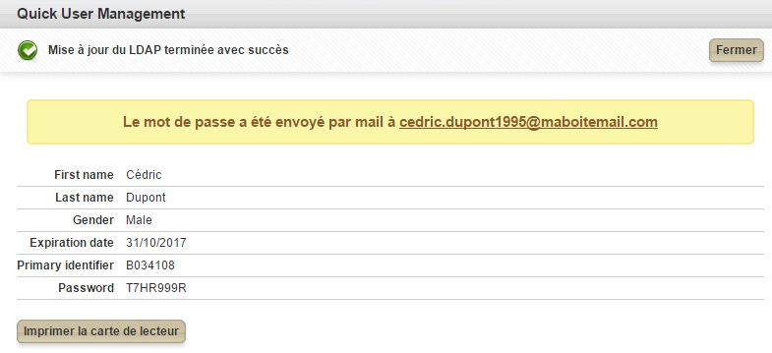
The Alma window closes (like the operator had clicked on Update User)
Data are stored in Alma, Purge date is added (Expiry date + 4 years)
A new popup window opens and:
Confirms that the user has been added to the LDAP
Confirms that a registration notification was sent by email to the user
Provides a password for the user
Allows the operator to print a library card for the patron
Patron can now:
use library services
connect to univ wifi
access library computers
Alma Expiry date = Expiry date in the LDAP!

Slide 24
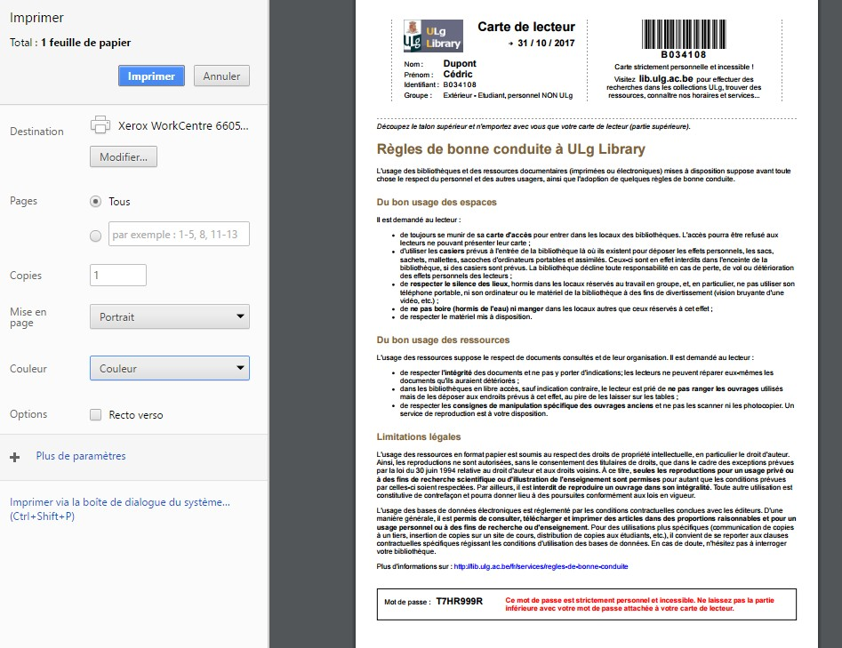
Demo at
https://youtu.be/2-YQ48w0cYs

Slide 25
Updates or Renewals?
Operator has to open the record for update
Warning message is out of scope (not really externally owned)
Operators update and correct the record (notably Expiry date)
And just activate the Alma plugin again:
LDAP updated
New password generated
New library card can be printed
Alma ‘Renew’ button not used!
Alma Expiry date = Expiry date in the LDAP!

Slide 26
Some last words
Not very logic to use the External Account type for external patrons, deprecated Internal with external authentication would have been better
Alma Plugin very easy for the Library staff…
Everything is done in Alma (like before with Aleph)
… and comfortable for patrons:
Direct and real-time process (no need to wait)
Can directly start using library services and network
Library card is cheap to generate
No Issue Library Card fee or Library Card Replacement fee
Also used with Self-Registration
Patrons are created in Alma with Inactive status
Operators change status to Active and use the plugin to finalize the registration process
Plugin will have to adapted with Alma New UI
Would be better if the Update User button could connect with an Integration Profile that would do the same action as the plugin

Slide 27
helen.brownlie@otago.ac.nz
r.degroof@ulg.ac.be
francois.renaville@ulg.ac.be
http://hdl.handle.net/2268/214211

