Slide 1
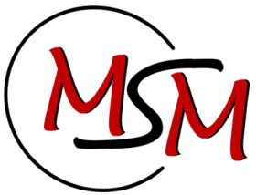



Quasicontinuum analysis of interaction between screw dislocation and coherent twin boundary
University of Liège
TRAN Hoang-Son
HAREESH Tummala
DUCHENE Laurent
FIVEL Marc
HABRAKEN Anne Marie
7 Septembre 2016
PAI Intemate P7/21

Slide 2
Outline
²
Introduction
1. Interaction screw dislocation – CTB
2. Triple Junction
3. Conclusion & Perspectives
2

Slide 3
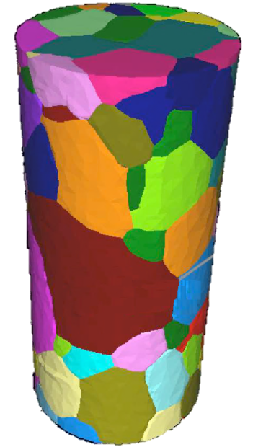
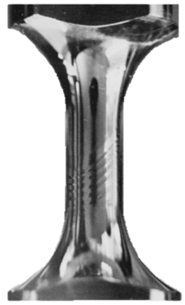
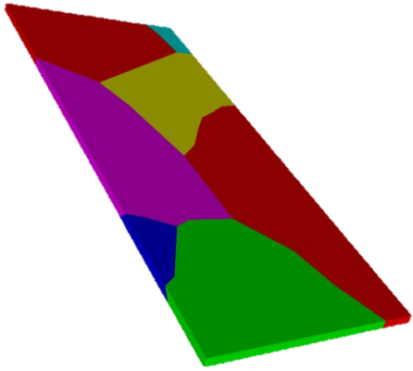
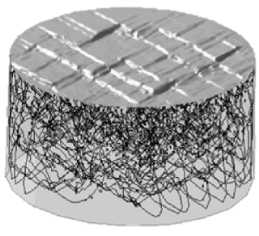
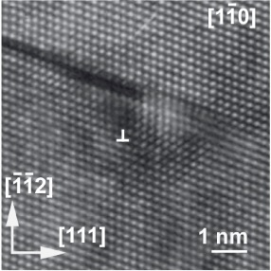
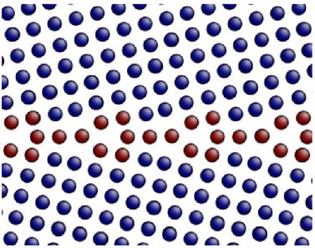
Introduction
²
Macro
Micro
Embouti Cruciforme projet européen CashForm 2000
Ludwig et al 2009
Tran 2013
Hanriot1993
Fivel 2008
Willems 2005
100µm
DM, Berbenni 2013
3

Slide 4
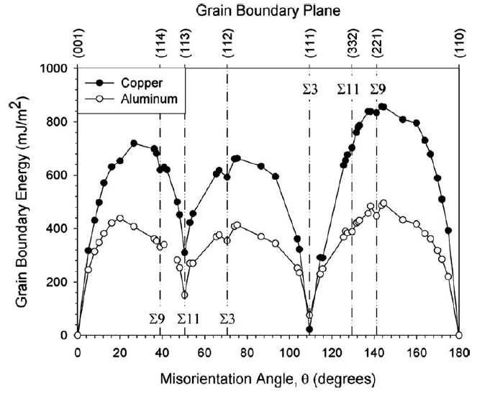
Introduction
²
Why are Grain Boundaries (GB) so important?
GB vary a great deal in their characteristics (energy, mobility, chemistry)
Many properties of a material - and its microstructural evolution - depend on the nature of GB.
Type of GB →good or bad corrosion properties, mechanical properties (creep)
Some GBs : good atomic fit → resistant to sliding, low diffusion rates, low energy, etc.
Coherent Twin Boundary studied
Bicrystal interface energy for copper and aluminum tilt [1-10] interface models (Tschopp, M.A. 2008)

Slide 5
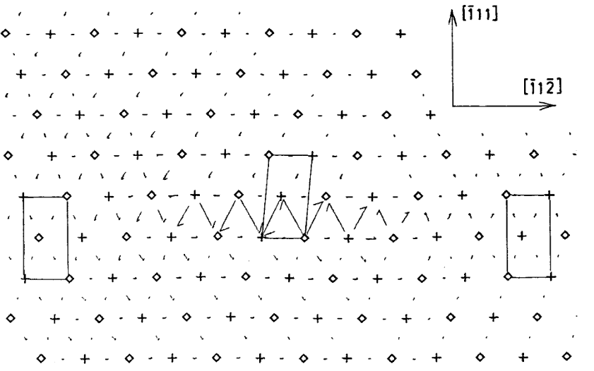
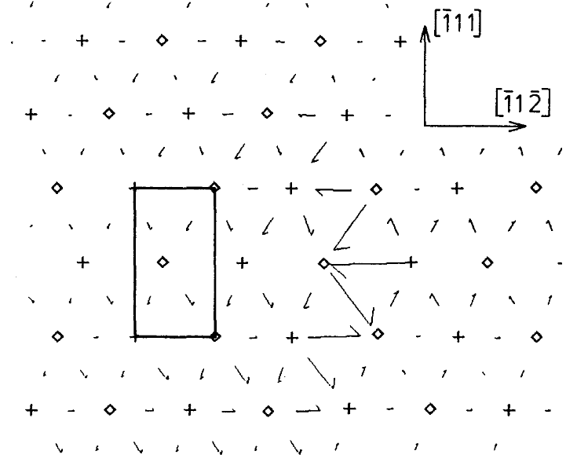
Introduction
²
Absorption of the screw dislocation in the boundary plane into two g.b.d.s in static simulation
Transmission of screw dislocation through the Σ3 boundary in Cu (Pestman et al. 1991)

Slide 6
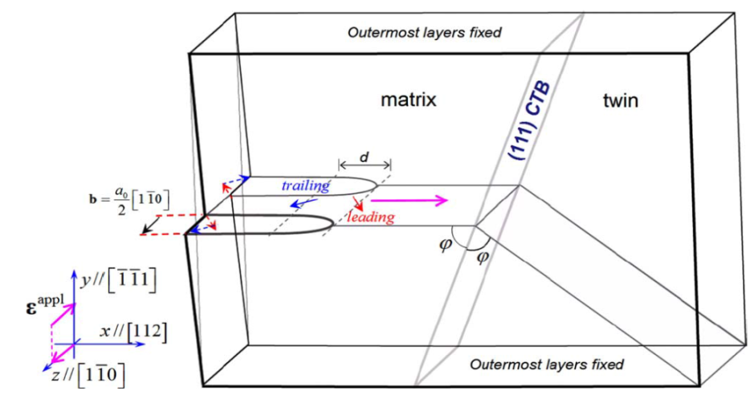
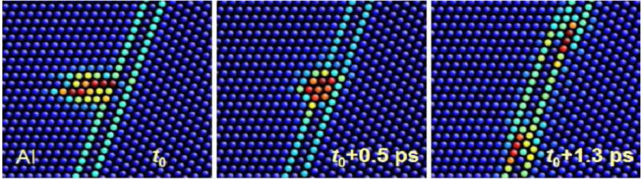
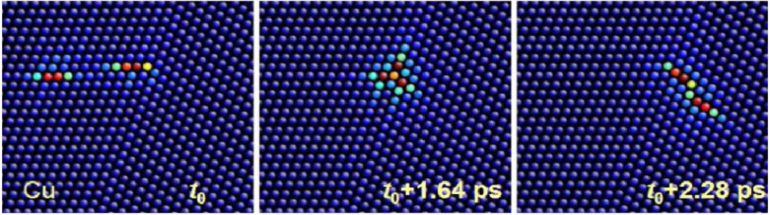
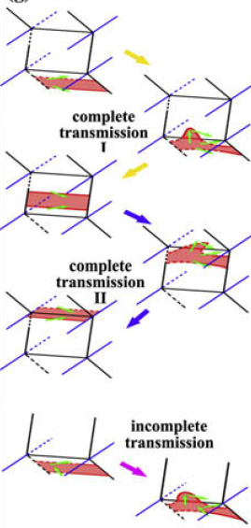
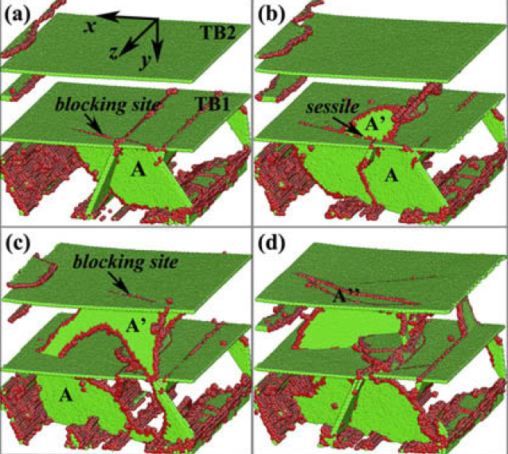
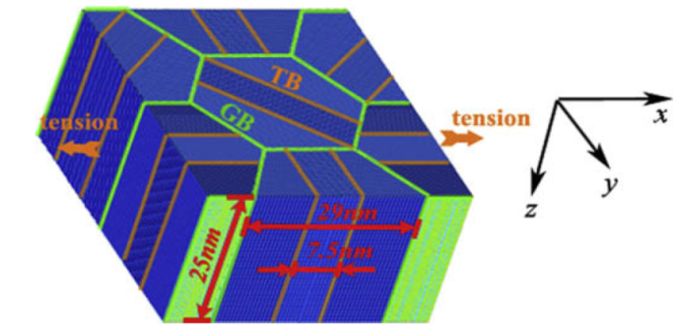
Introduction
²
The reaction modes between screw dislocation and CTB (Jin et al. 2006 )
The reaction modes between screw dislocation and CTB (Zheng et al. 2009)

Slide 7
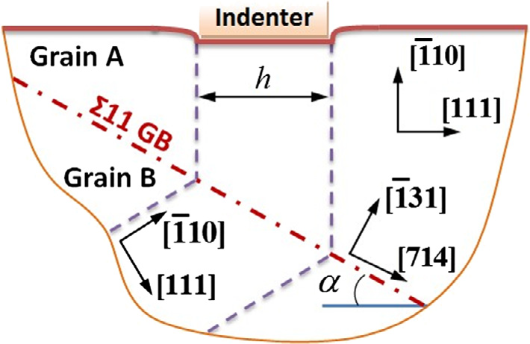
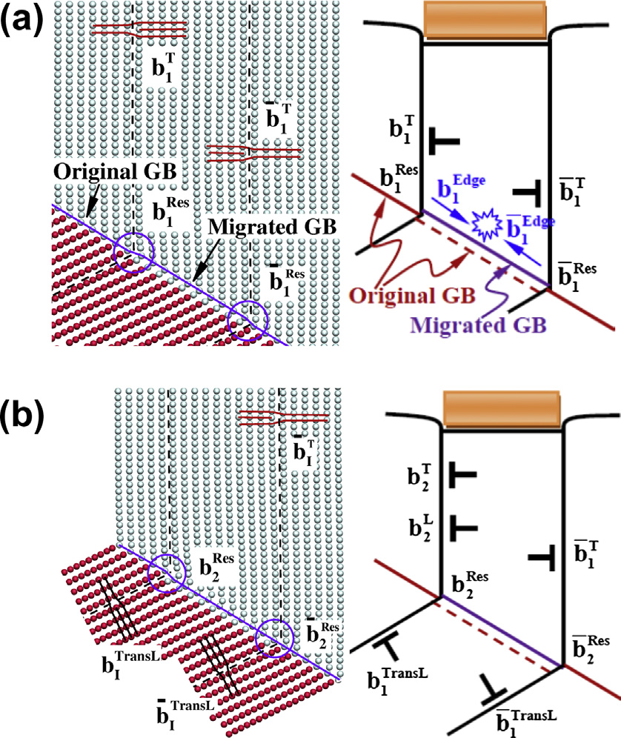
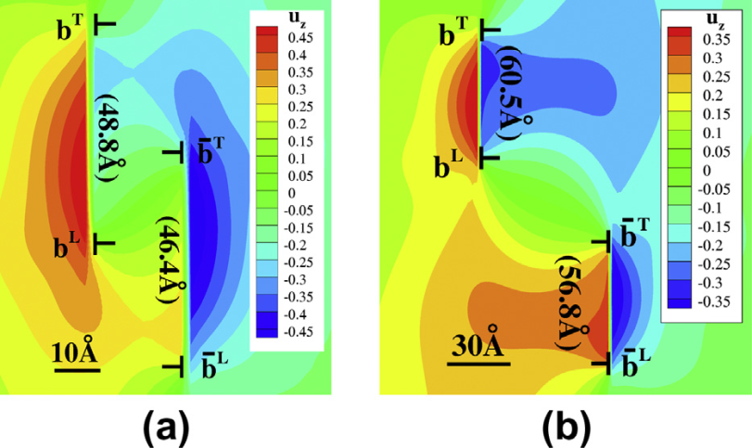
Introduction
²
Interactions Between Dislocations and GB by QC
Interaction of the lattice dislocations with a Σ=11 by QC (Wenshan et al. 2014)

Slide 8
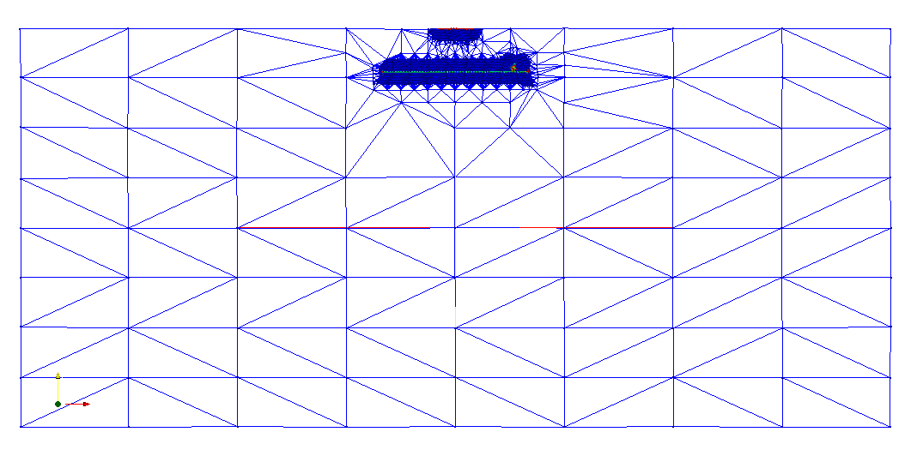
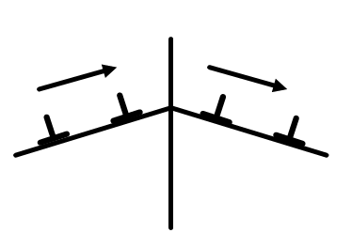
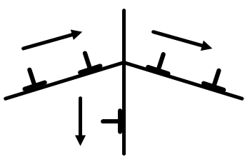
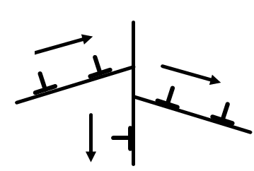
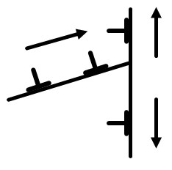
Introduction
²
Atomistic zones
Interaction between atoms based on Embedded atom theory (EAM)
y
Quasicontinum method provides to DDD :
Grain Boundary –Dislocation interaction mechanisms
Variation of Energy
Critical stress (generation, transmission..)
x
z
slip systems have the same Burgers vectors
(1)
Direct transmission
slip systems have different Burgers vectors (leaving a residual boundary dislocations)
(2)
Indirect transmission
FEM zonesCauchy-Born rule:
atoms mapped according to a continuum deformation field
slip systems have different Burgers vector (leaving a residual boundary dislocations)
(3)
+
Access to the core contribution
Degrees of freedom judiciously reduced
-
No Temperature effect (0K potentials)
No Strain-rate effect (quasi-static)
2D only
Still a size limit for polycrystalline structures
No transmission
(4)
the grain boundary acts as an impenetrable boundary,
Notes:
We apply the Quasi-Continuum Method (QCM) developed by Tadmor and co-workers to study the nucleation of dislocation and the interaction between dislocation and CTB coherent twin boundary in copper.
The QCM is a molecular static technique which find the solution of equilibrium atomic configurations by energy minimization, for external loads or displacements.
The problem is modeled without explicitly representing all the atoms in the cell; here the regions of small deformation gradients are treated as a continuum media by the finite element method
The key advantage of QC code is the automatic adaptation to ensure full atomistic resolution when dislocations are emitted as well as at the interactions between the dislocations and the grain boundaries
Here , i represent four main mechanism of interaction between dislocation and grain boundary.
There are two possibilities of direct transmission, indirect transmission an no transmission occur

Slide 9
Quasicontinuum model
Twin boundary
y
Orientation Grain 1 : X[-1-12], Y[111], Z[-110]
Grain 2 : X[ 1 1-2], Y[111], Z[1-10]
x
z
D
y₁
x₁
P
Grain1
Indenter
z₁
y₁
γ
x₁
d
H₁
B
C
z₁
Grain 1
δ
y₂
A
Plane of QC
x₂
Plane of TB
z₂
H₂
γ'
Grain2
Grain 2
D’
Orientation relation and several slip systems between a twin GB
and the matrix (Thompson tetrahedron). The CTB plane is defined as the (1 1 1) CBA plane

Slide 10
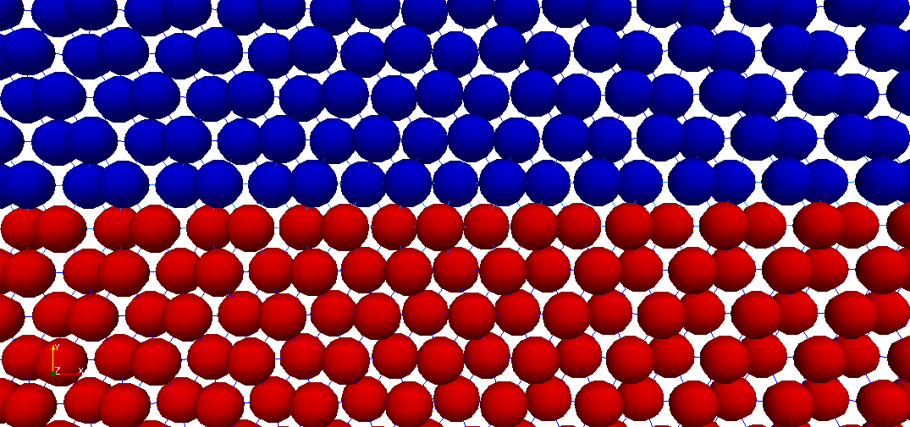
Quasicontinuum model
Twin boundary
y
Orientation Grain 1 : X[-1-12], Y[111], Z[-110]
Grain 2 : X[ 1 1-2], Y[111], Z[1-10]
x
z
y₁
Grain1
x₁
P
Indenter
z₁
d
H₁
Grain 1
y₂
x₂
z₂
H₂
Grain 2
Grain2
Coherent Twin Boundary structure (CTB)

Slide 11
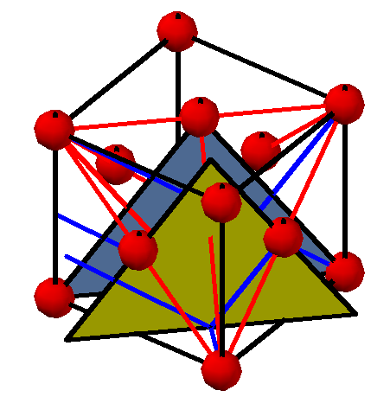
Quasicontinuum model
Orientation Grain 1 : X[-1-12], Y[111], Z[-110]
Grain 2 : X[ 1 1-2], Y[111], Z[1-10]
Twin boundary Σ3 {111l}
x₁
y₁
z₁
D
D
C
Grain1
y₁
x₁
γ
z₁
a -plane of (-110)
A
δ
C
Q
Plane of TB
B
Plane of QC
γ'
Grain2
b -plane of (-110)
B
Orientation relation and several slip systems between a twin
and the matrix (extended-Thompson tetrahedron). The CTB plane is defined as the (1 1 1) CBA plane

Slide 12
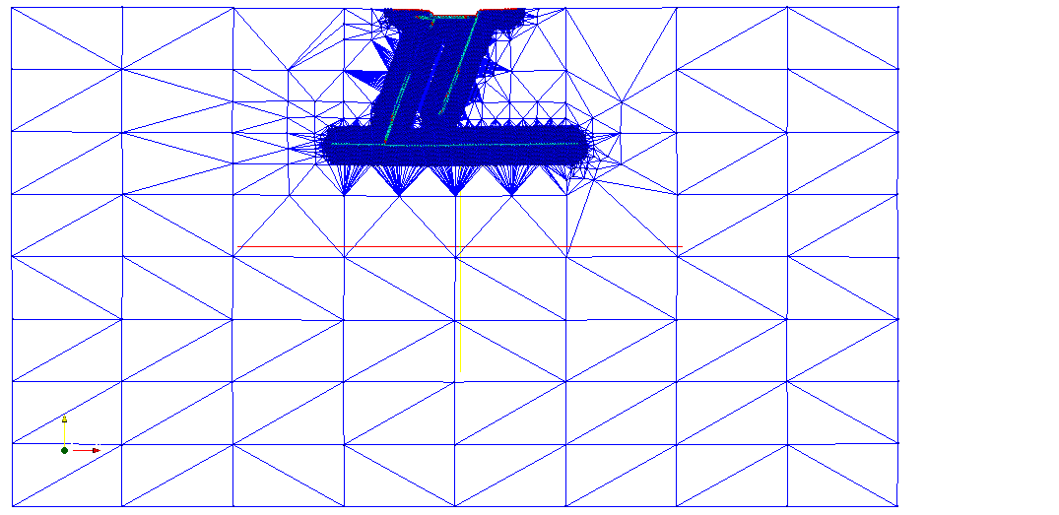
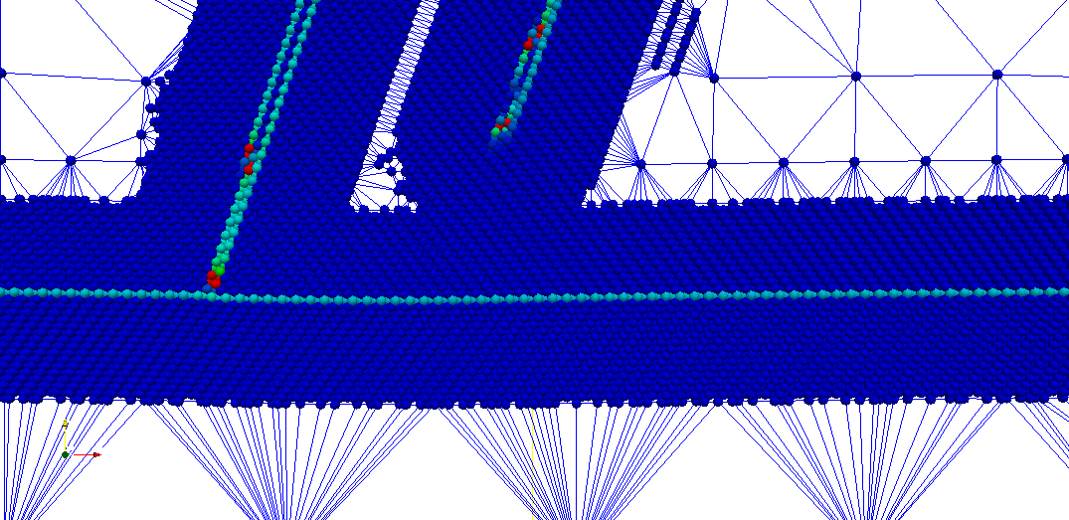
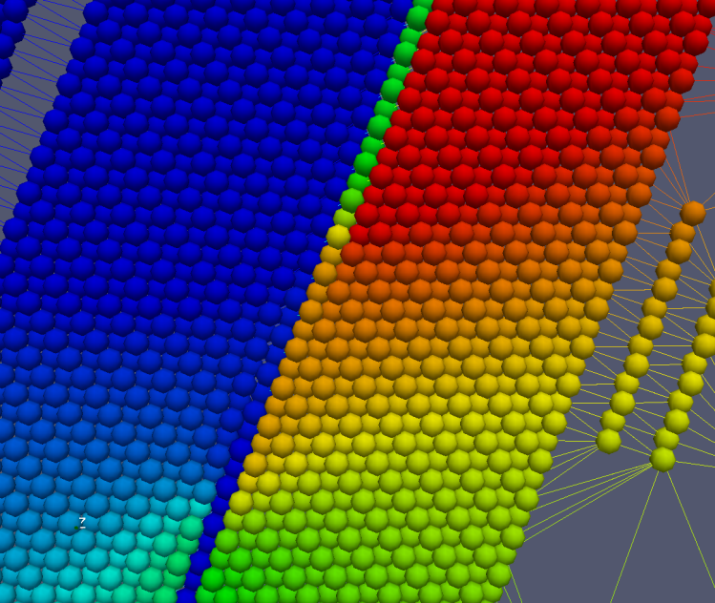
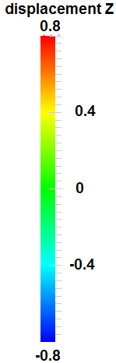
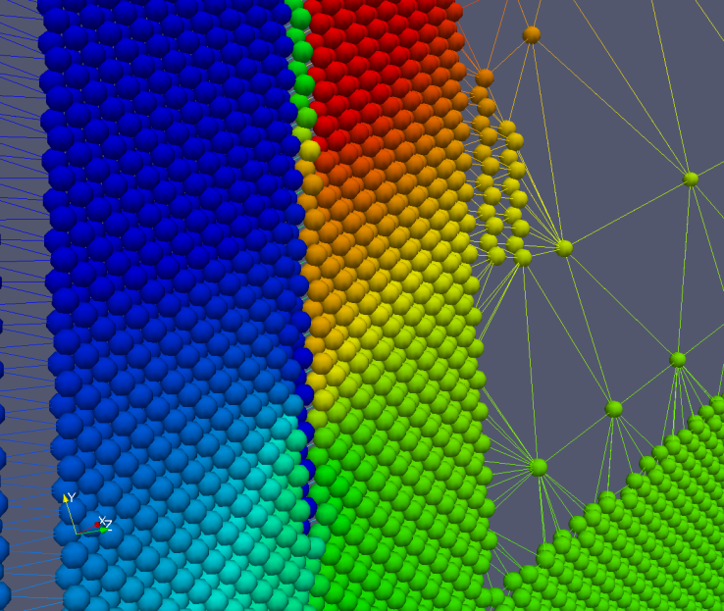
1.Interactions Between Screw Dislocations and Coherent GB
whole system with domain partition
Nucleation of screw dislocation
CSD parameter
Out of plane displacement field

Slide 13
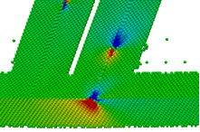
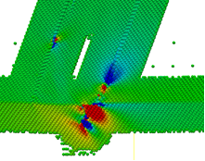
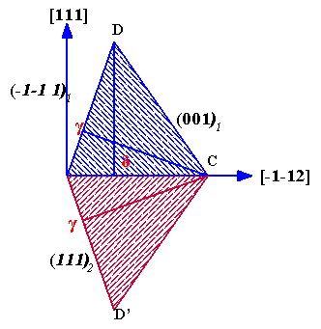
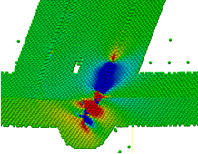
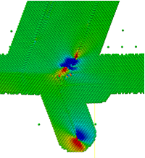
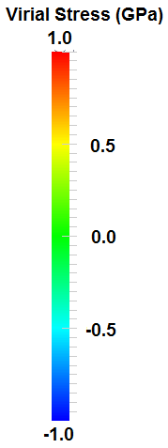
1.Interactions Between Dislocations and Coherent TB by QC
y
x
z
Distributions of the virial shear stress σ_{yz} near CTB

Slide 14
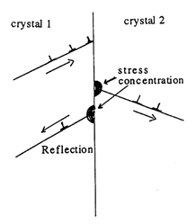
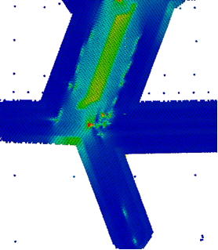
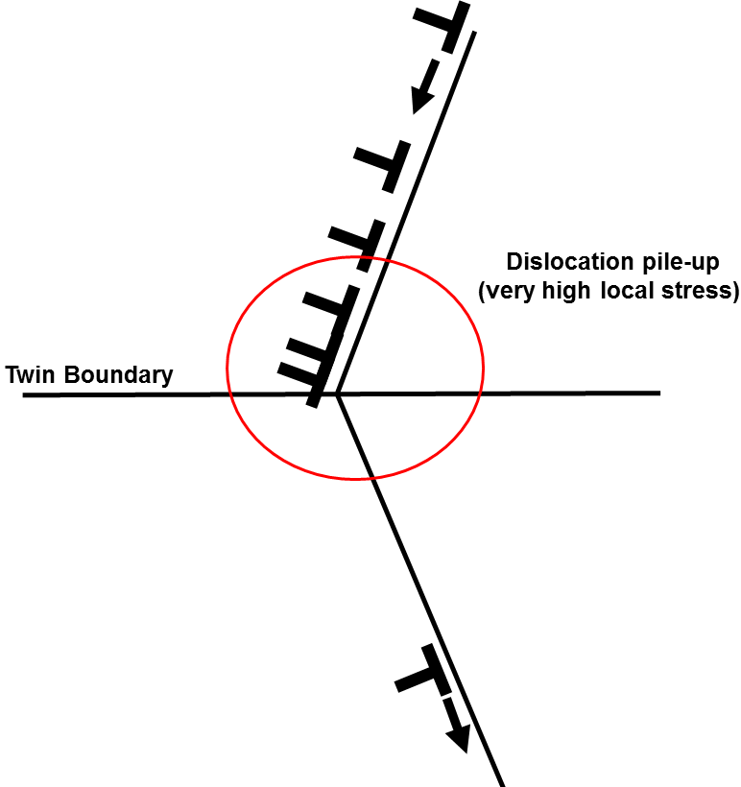
1.Interactions Between Screw Dislocations and Coherent GB
Detailed mechanism of transmission
y
x
Macroscopic view of transmission
(Energy field)
z
Schematic of screw dislocation – twin interactions

Slide 15
1.Interactions Between Dislocations and Coherent TB by QC
Ref | Material/T° | EAM/Mechanism | CRSS | Force Dislo/GB
(Pestman et al. 1991) | Cu/0K/ | Finis-Sinclair /Transmission/FE | 1500 MPa | 500 MPa
(Jin et al. 2006) | Al/10K Cu/10K | Mishin/Absortion/FE Mishin/Transmission/FE | 100 MPa 465-510 MPa | 100 MPa 300 MPa
(Chen et al. 2007) | Al/ Cu | Mishin/Absortion Mishin/Transmission/FE |  | 140MPa (Al) 220MPa(Cu)
(Dewald and Curtin 2007) | Al | Ecolessi-Adams Absortion/F
(Zhu et al. 2007) | Cu | Mishin/ 1st path Absorption-Desorption/FE 2nd path Transmission/F
(Zheng et al. 2009) | Cu/300K | Daw-Baskes-Mishin/ 1st Transmission/F 2nd Absortion/FE | No infos | No infos
(Chassagne et al. 2011) | Cu/300K | Mendelev/Transmision/FE Ackland/Transmission/FE Foiles/Transmission/FE | 510 MPa 540 MPa 460 MPa | 400 MPa 400 MPa 400 MPa
(Wei and Wei 2012) | Cu/0.1K | Mishin/Absortion/FE | 288.2 MPa | 288.2MPa

Slide 16
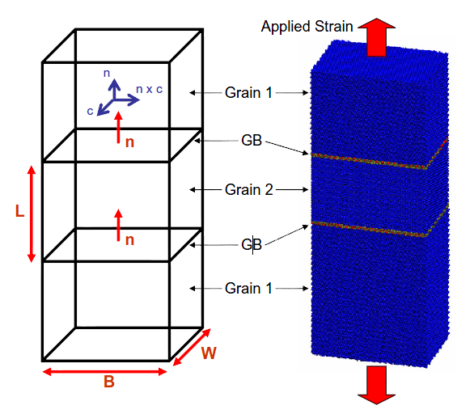
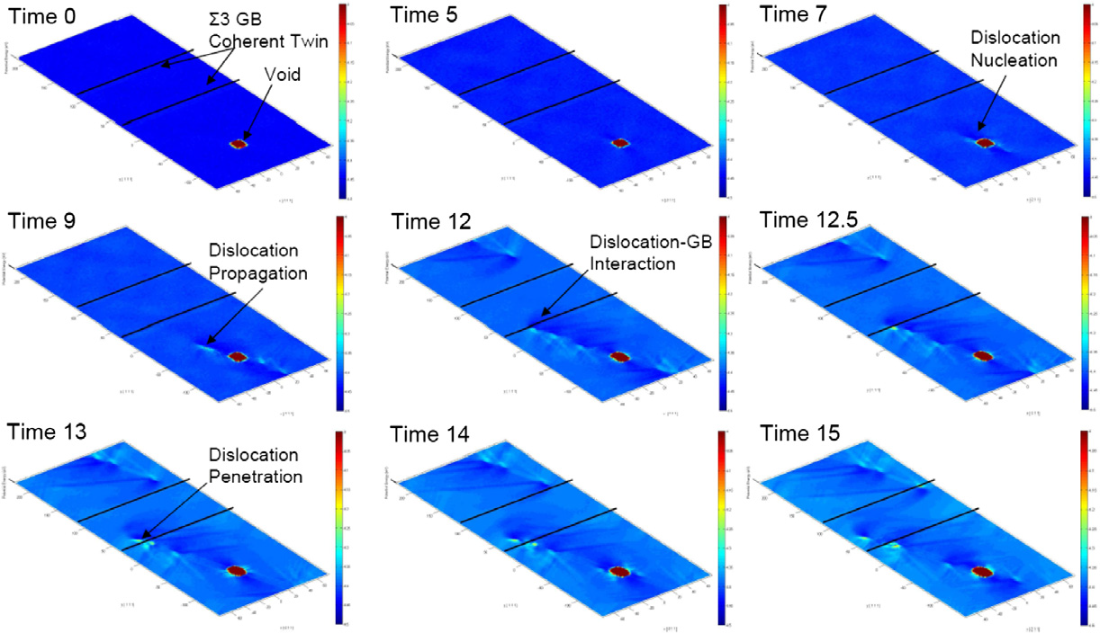
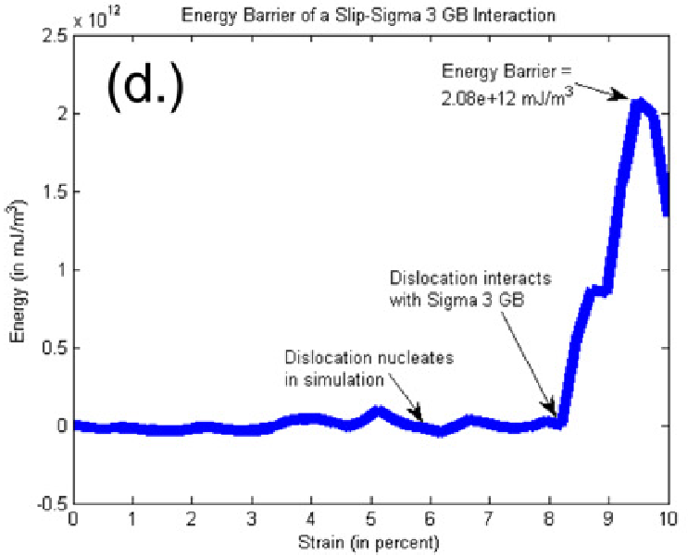
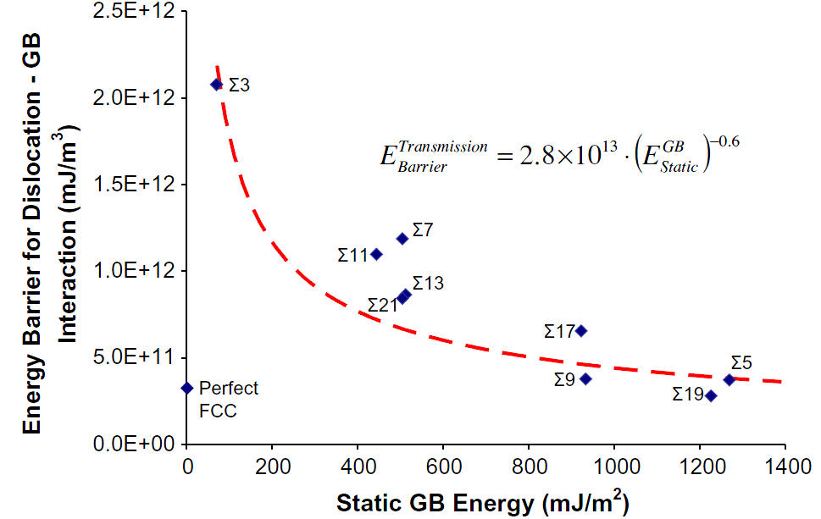
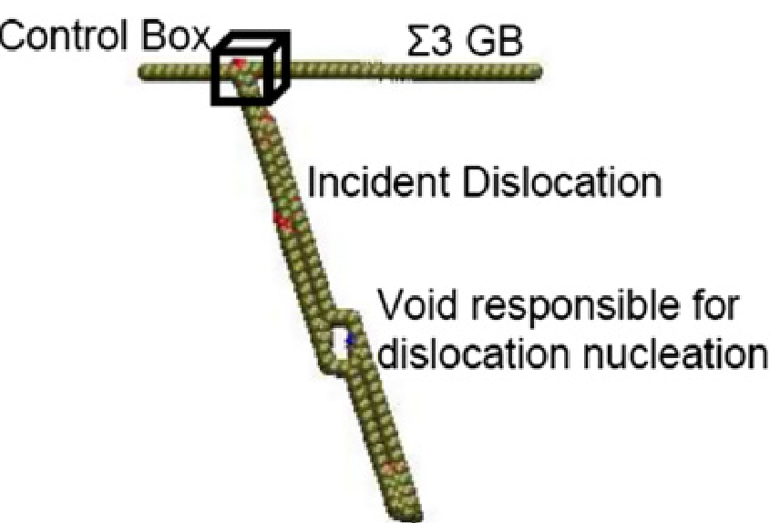
1.Interactions Between Dislocations and Coherent TB by QC
Idea of control box
Interaction of the lattice dislocations with a Σ=3 {111} (Sangid et al. 2007)

Slide 17
1.Interactions Between Screw Dislocations and Coherent GB
Critical shear stress (608 MPa)
Control box
Local stress evolution in control box at the interaction zone (virial stress)

Slide 18
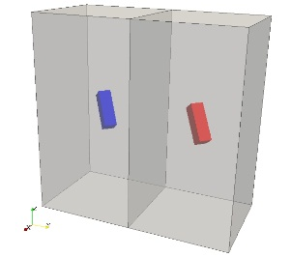
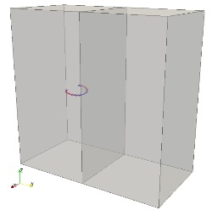
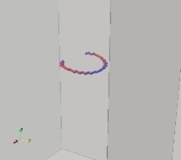
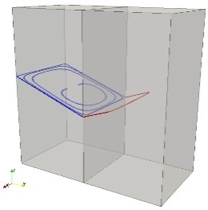
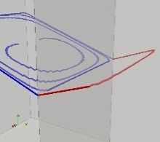










1.Interactions Between Dislocations and Coherent TB by QC
Bi-crystal microstructure
Dislocation Dynamics Algorithm (Bi-crystal)
Dislocation Dynamics loop
Procedures followed at every time step ($∆t$)
Segments
Edge + Screw
Edge (b perp l); Screw (b || l)
Crystal parameters (position, dimensions, orientation)
Grain boundary → Frame of reference
Real/lab ↔ Crystal/local
Stress-field
Planar defects
Twin boundary
Disorientation ($∆θ$)
Low Angle Grain Boundary
High Angle Grain Boundary
Procedure → Resultant Burgers vector (RBV)
Elastic isotropy
F_{pk}= σ.n.b
Dislocation microstructure
Mobility law
Linear defects
Dislocation loops; Realistic microstructures
Artificially pinned Frank-Read sources
Plastic strain
Pileup
Cross-slip
Crystal number
X-, Y- and Z- coordinates
Burgers vector (b) → [TT]
Glide direction (l) → [TT]
Annihilation
Hirth, Lomer
Collinear interaction

Slide 19

1.Interactions Between Dislocations and Coherent TB by QC
Dislocation transmission across CTB by DDD simulation

Slide 20

1.Interactions Between Screw Dislocations and Coherent GB
Schematic illustration of dislocation pile-up at a grain boundary
The Peach –Kohler force vanish at each point throughout the pile up in equilibrium
Dislocation density function
Condition can be represented by an the continuum theory
Transmission stress
Hall-Petch type law
Number of dislocation N
(Hirth and Lothe 1982)

Slide 21


1.Interactions Between Dislocations and Coherent TB by QC
High density of dislocation near Grain Boundary before transmission

Slide 22

1.Interactions Between Dislocations and Coherent TB by QC
Schematic illustration of dislocation pile-up at a grain boundary
Improved link with DDD
activation stress of source
The Peach –Kohler force vanish at each point throughout the pile up in equilibrium
Dislocation density function
Condition can be represented by an the continuum theory
Yield stress
Force on the leading dislocation
Number of dislocations

Slide 23


1.Interactions Between Dislocations and Coherent TB by QC
Schematic illustration of dislocation pile-up at a grain boundary
(Chakravarthy and Curtin, 2010)

Slide 24



1.Interactions Between Screw Dislocations and Coherent GB
Transmission electron micrograph of a dislocations a pile up
In Cu (Chassagne et al. 2011)
In Cu-4.5% Al (Swann and Nutting, 1961)
Transmission of dislocation by high stress concentration
Dislocation source
Notes:
Discussion
In Figure, transmission has not occurred (8 dislocation in the pile-ups), at this scale ( > 200nm) , the Figure indicated that at least 10 dislocation is necessary for the first transmission occurred.
On a larger scale in Figure needs more number of dislocation to initiate a transmission.

Slide 25
1.Interactions Between Dislocations and Coherent TB by QC
Schematic illustration of dislocation pile-up at a grain boundary
New model
New model
Classic model
Classic model
DDD results
Number of dislocation in pile up before transmission

Slide 26

2.Interactions Between Screw Dislocations and Coherent GB
Schematic illustration of dislocation pile-up at a grain boundary
w length of dislocation arrangement
(Delincé, M. et al. 2007)

Slide 27
1.Interactions Between Screw Dislocations and Coherent GB
Schematic illustration of dislocation pile-up at a grain boundary
L_{source}=0.1D
L_{source}=0.25D
Distribution of density of dislocation

Slide 28


2.Triple Junction by QC
Schematic representation of tricrystal model
Σ₁ Σ₂ = d² Σ₃
_{with d = 1} _{or 3}
y₁
Grain 1
x₁
Σ₁₃
z₁
α₁
Grain 3
Σ₁₂ = 9
Σ₂₃ = 27
Σ₁₃ = 3
α₁ = 163.14
α₂ = 125.10
α₃ = 71.76
H=164
L=160
H
Σ₁₂
α₃
y₃
U
Grain boundary
x₃
y₂
α₂
x₂
Σ₂₃
z₃
z₂
Grain 2
L
Atomic structure projected onto the x-y plane
Interfaces structures and Structural Unit Model (SUM) notation for [1-10] interface models

Slide 29



3.Triple Junction by QC
Global view centro symmetric deviation parameter map
Atomic configuration is stable
Nucleation of dislocations at TJ and GB
Atom shuffling at GB

Slide 30
5. Conclusion and perspective
Resume
Simulation results by QC in line with full MD simulation
CTB is a strong barrier to slip transmission
Highlight the interaction mechanism of dislocation and CTB
Quantitative estimation of local critical stress for transmission
Provide mechanism of interaction (absorption or transmission) and critical stress to DDD
Perpective
Dislocation – triple junction
HotQC
Materials?

Slide 31
Thanks for your attention !

