Slide 1
GFR measurement by a reference method
Dr Pierre Delanaye
Department of Nephrology Dialysis and Trnasplantation
University of Liège
CHU Sart Tilman
Liège
BELGIUM

Slide 2
Summary
Why?
How?
WHY?

Slide 3
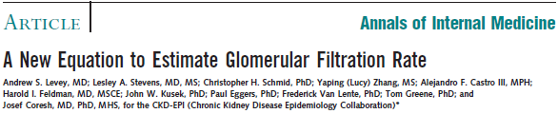
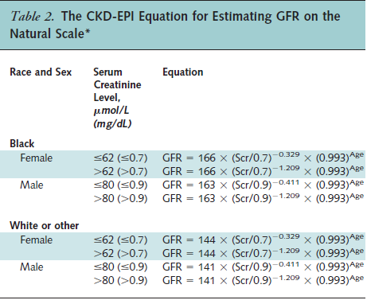
The new CKD-EPI equation
Development dataset: n=5504
Internal validation: n=2750
External validation: n=3896
Median GFR in the development = 68 mL/min/1.73 m²

Slide 4
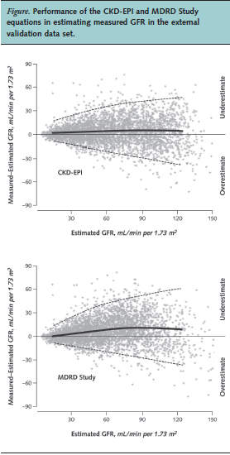
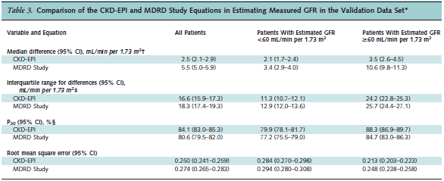

Slide 5
MDRD or CKD-EPI limitations = creatinine
Specific population: MDRD and CKD-EPI are not magic!!
Keep our clinical feeling!!
If creatinine is especially « bad » for reflecting GFR (most of time because abnormal muscular mass), your MDRD result won’t be accurate and the CKD-EPI equation won’t be more precise
Anorexia Nervosa (Delanaye P, Clin Nephrol, 2009, 71, 482)
Cirrhotic (Skluzacek PA, Am J Kidney Dis, 2003, 42, 1169)
Intensive Care (Delanaye P, BMC Nephrology, 2014, 15, 9)
Severely ill (Poggio ED, Am J Kidney Dis, 2005, 46, 242)
Heart transplanted (Delanaye P, Clin Transplant, 2006, 20, 596)
Kidney transplantation (Masson I, Transplantation, 2013, 95, 1211)
Obese (Bouquegneau A, NDT, 2013, 28, iv122)
Elderly (Schaeffner E, Ann Intern Med, 2012, 157, 471)
Hyperfiltrating (Gaspari F, Kidney Int, 2013, 84, 164)
Notes:
Gaspari: performance accuracy et precision un epu meilleures pour CKDEPI mais CKDEPI sous estime et aucun hyperfiltrant n’est détecté!
Killbirde : CKDEPI un peu mieux quand GFR haute…
Spithoven: quasi pas de différence en tout cas pas significative (bias meilleur)
Gaspari: performance un peu meilleur pour CKDEPI surotu si mGFR>70 mais accuracy 10% (et pas 30%) reste médiocre (50% au mieux)

Slide 6
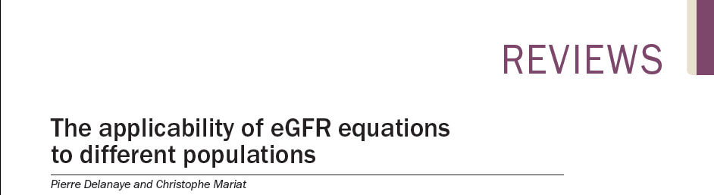
Today the true question is maybe not about which equation is the best but when measured GFR is required
Delanaye P, Nature Rev Nephrol, 2013, 9, 513

Slide 7
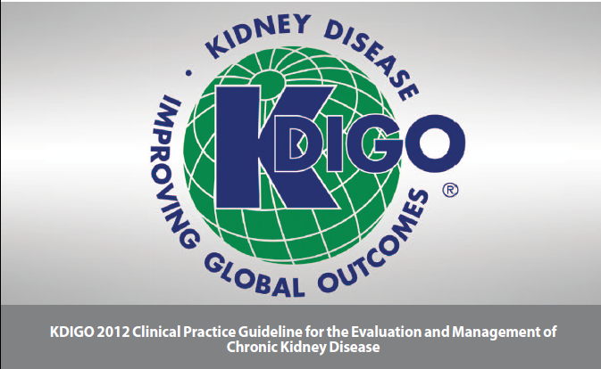
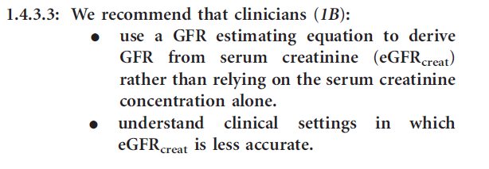

Slide 8
Indication = the patient
Serum creatinine is potentially incorrect
High Precision required (drug toxicity, kidney donation)

Slide 9
But also in clinical research…

Slide 15
6 months

Slide 19
Summary
Why?
How?
HOW ?

Slide 20
Renal function: concept of clearance
Clearance of a solute (ml/min):
volume of plasma cleared (« purified ») of this substance per time
Cl = [U] x [V]/ [P]
Ideal marker for GFR:
  No effect on GFR, non toxic
  Not bound to protein, freely filtrated through glomerulus
  No secretion, no absorption in the tubules
  No extra renal clearance
  Easy to measure

Slide 21
Available on the market…
Markers | Strenghts | Limitations
Inulin | Gold standard (or historic) Safe | Costly Dosage neither easy nor standardized Doubt with plasma clearance
Iothalamate | The most popular in USA Isotopic or “cold” method | Tubular secretion Cannot be used if allergy to iodine
Iohexol |  | Cannot be used if allergy to iodine
EDTA | Easy to measure | Only isotopic Not available in USA
DTPA | Easy to measure | Only isotopic Binding to proteins Short half-time
Stevens LA, J Am Soc Nephrol, 2009, 20, 2305
Cavalier E, Clin Chim Acta, 2008, 396, 80
Delanaye P, Clin Kidney J, 2016, 9, 700

Slide 22
We have biomarkers
Now, how to proceed?
Urinary clearance
Plasma clearance

Slide 23
Urinary clearance
Constant infusion, marker at equilibrium
Plasma measurement of the marker
Collect Urine (every half or every hour) and measurement of urine flow, urine measurement of the marker
Repeated 3 or 4-fold
Cl = [U] x [V]/ [P] (mean of three collections)

Slide 24
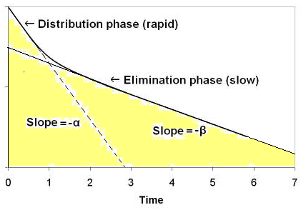
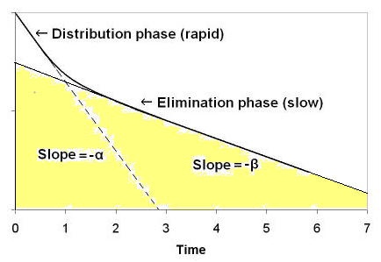
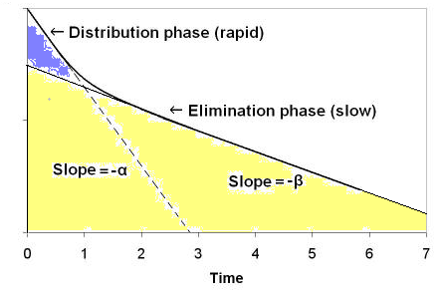
Plasmatic Clearance = Dose / AUC
Theoritically, α and β must be calculated
Not easy in practice (many samples)
Only slope ß after equilibrium is calculated
Brochner-Mortensen mathematical correction for estimation of distribution phase
= 0,990778 x C2 – 0,001218 C2²
M

Slide 25
Are they equivalent?

Slide 26
Plasma v urinary:
Are they equivalent?
A lot of studies showing a good correlation…
Few studies with Bland and Altman analysis

Slide 27
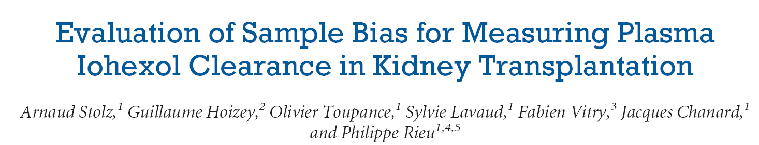
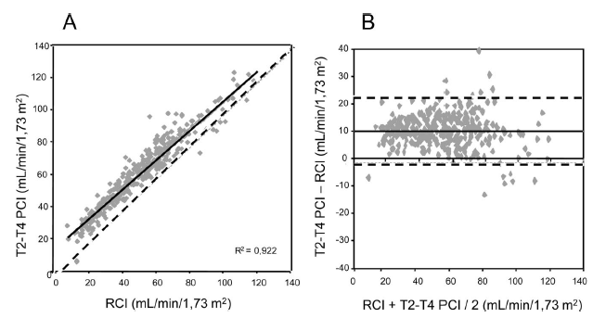
Plasma versus Urinary clearances
 | n | Bias ml/min/1.73m² (%) | Precision (SD) (ml/min/1.73m²)
T2-T4 | 342 | +10 (+27%) | ±6
T2-T6 | 342 | +8 (+21%) | ±6
T2-T24 | 215 | +3 (+8.8%) | ±5
Stolz A, Transplantation, 2010, 89, 440

Slide 28
Urinary and plasma methods: pro-con
More physiological
More costly
More cumbersome
Less precision, less repeatability (urine recolt!)

Slide 29
Several plasma clearance procedures are available on the market…
Notes:
The timing of the last sample is as important as the number of samples

Slide 30
Available on the market…
Markers | Strenghts | Limitations
Inulin | Gold standard (or historic) Safe | Costly Dosage neither easy nor standardized Doubt with plasma clearance
Iothalamate | The most popular in USA Isotopic or “cold” method | Tubular secretion Cannot be used if allergy to iodine
Iohexol
EDTA | Easy to measure | Only isotopic Not available in USA
DTPA | Easy to measure | Only isotopic Binding to proteins Short half-time
Stevens LA, J Am Soc Nephrol, 2009, 20, 2305
Cavalier E, Clin Chim Acta, 2008, 396, 80
Delanaye P, Clin Kidney J, 2016, 9, 700

Slide 31
Are they equivalent?

Slide 32
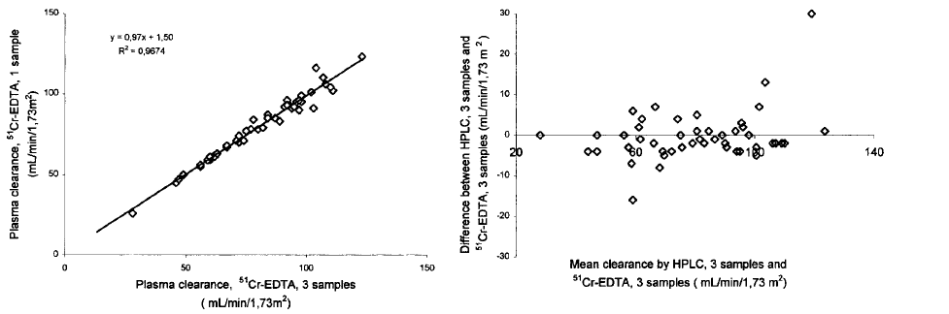
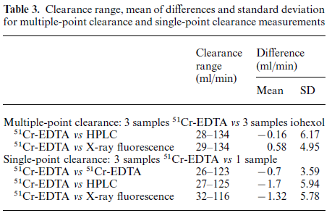
EDTA versus iohexol
N=49
Brandstrom E, NDT, 1998, 13, 1176

Slide 33
Iothalamate versus iohexol
N=102
Accuracy (concordance):
Within 30%: 98%
Within 15%: 80%
Delanaye, AJKD, 2016, 68, 329

Slide 35

Need for Standardization

Slide 36
Standardization for the marker
Only cold methods can easily be implemented worldwide
Iothalamate is difficult to obtain in Europe
Inulin is expensive and only available as urinary clearance
Iohexol is available worldwide
Very stable (central and/or “reference” laboratories)

Slide 37
Standardization for procedure
Urinary versus plasma
Number of samples and timing of samples
Whatever the marker…

Slide 38
Iohexol in CHU of Liège
Iohexol (plasma clearance)
5 hours
Samples at 2, 3, 4 et 5 hours
150 euros

Slide 39
Delanaye P, Clin Kidney J, 2016, 9, 700

Slide 40
Standardization for the measurement
Iothalamate
Iohexol

Slide 41
…versus capillary electrophoresis coupled with ultraviolet detection

Slide 42
Notes:
N=53

Slide 43
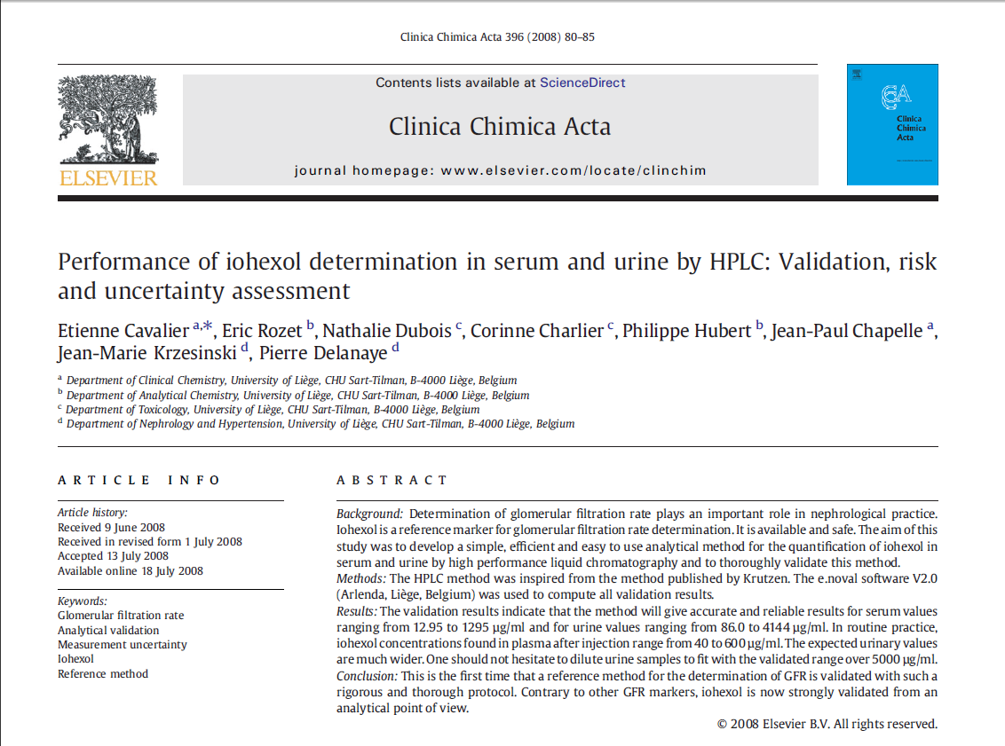

Slide 45
HPLC versus Mass spectrometry
Accuracy (concordance):
Within 30%: 94%
Within 15%: 74%
If 10% correction: 99 and 83%
Delanaye, AJKD, 2016, 68, 329

Slide 46
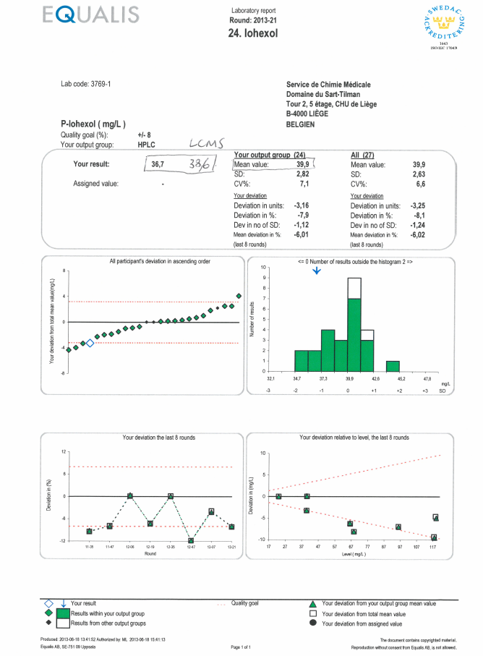

Slide 47
Never forget biological variation…
Delanaye P, Clin Kidney J, 2016, 9, 700

Slide 48
Conclusions
Measuring GFR is useful in clinical practice
Measuring GFR is useful in clinical research
Measuring GFR is useful in epidemiology
Measuring GFR is not so costly (for a reference method)
Measuring GFR is not so cumbersome
Standardization (marker, procedure and measurement) might still be improved
Iohexol is the best balance between physiology and feasibility
Iohexol is safe
Iohexol is the only chance for a worldwide standardized mGFR

Slide 50
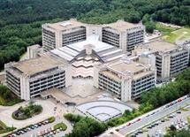
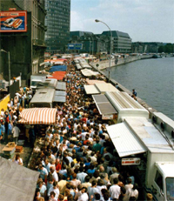
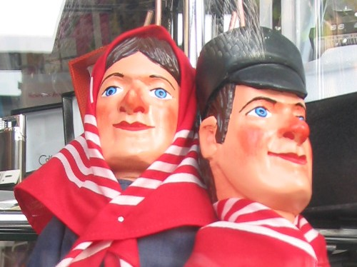

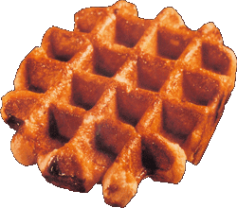
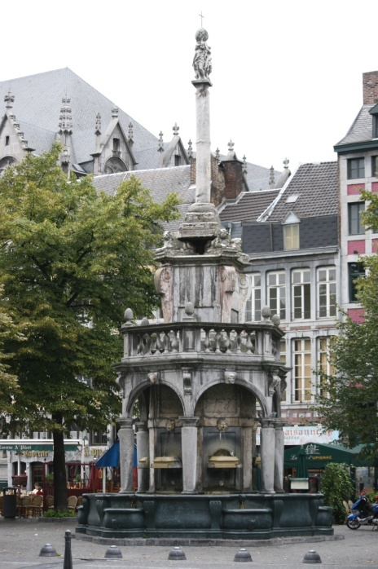
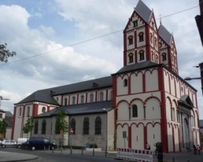
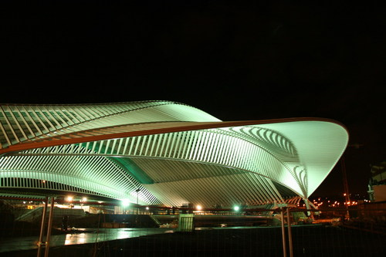
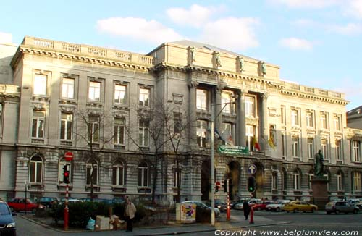
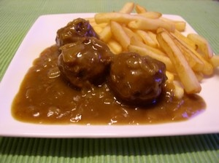
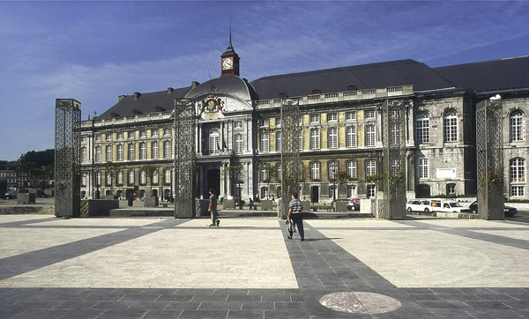
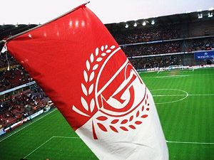
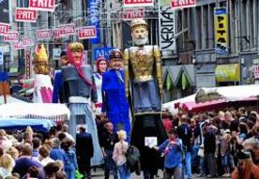
Questions?

