Slide 1
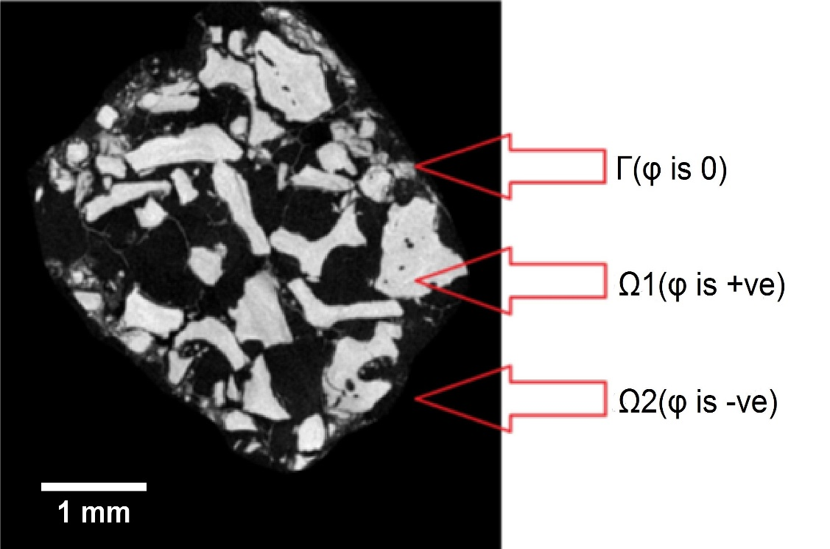
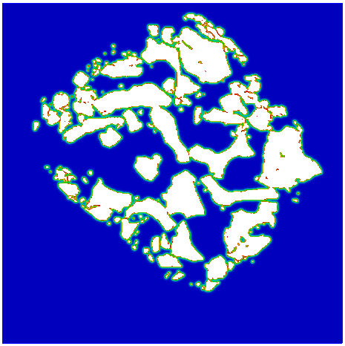
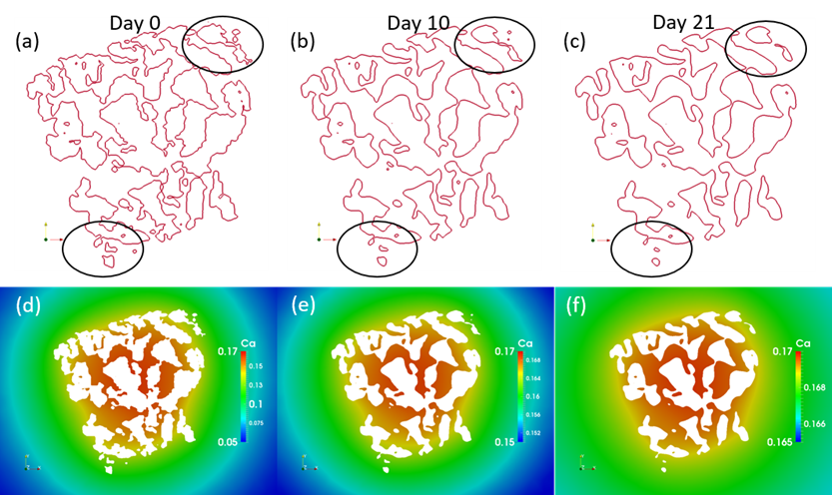
Investigating in vitro calcium dissolution using a mathematical model
V. Manhas^{1,3,4}, Y. Guyot^{1,4}, G. Kerckhofs^{2,4}, Y.C. Chai^{2,4} and L. Geris^{1,3,4}
¹University of Liege, Biomechanics Research Unit, Belgium, ²KU Leuven, Skeletal Biology and Engineering Research Center, Belgium, ³KU Leuven, Department of Mechanical Engineering, Belgium, ⁴KU Leuven, Prometheus Division of Skeletal Tissue Engineering, Belgium
Calcium phosphate (CaP) materials are widely used for dental and orthopaedic applications due to their ability to induce bone formation [1]
Release of calcium and phosphate ions by dissolution affect bone cell chemotaxis, proliferation and differentiation [2]
INTRODUCTION
There is increasing demand to design and develop optimized CaP based bone substitutes [3]
Computational models can help us to understand this complexity, allowing improvement in scaffold design
Aim of this study is to computationally determine local Ca²⁺ concentrations of different clinical grade CaP scaffold types during in vitro dissolution
MATERIALS & METHODS
Nanofocus X-ray computed tomography (nanoCT) images are obtained to extract scaffold geometries (fig.1A)
Scaffold morphology is then defined in finite element (FE) domain (fig.1B)
A
B
Noyes-Whitney equation (dissolution), Fick’s second law (diffusion) and level-set method (degradation) were used to accurately describe evolution of CaP-based scaffolds over time in various environments
Linear/non-linear PDEs were implemented in FreeFEM++, a free C++ based finite element solver
Figure 1: A. NanoCT image of CaP granules in the scaffold and B. Scaffold morphology defined in FE domain (right)
MODEL SETUP
RESULTS
DISCUSSION
In this model, the concentration change of dissolved Ca²⁺ ions with time was described using diffusion-dissolution-reaction equation:
$$\frac{∂C}{∂t}=∇∙\left(D∇C\right)+k_{dc}\frac{S D}{V_{PBS} }\left(C_{sol}−C\right)I_{Ω1}$$
where C is dissolved Ca²⁺ ions concentration (mM), D is diffusion coefficient (m²/s), k_{dc} is dissolution constant (m⁻¹), S is CaP surface area (m²) calculated from input nanoCT image, V_{PBS} is PBS volume (1.5 x 10⁻⁵ m³) and C_{sol} is solubility of Ca²⁺ ions in PBS (mM)
$I_{Ω1}$is indicator function of the scaffold domain:
$I$_{Ω1} := $\left\{\begin{aligned}1 if x ∈ Ω1 (φ>0) \\ 0 if x ∉ Ω1 (φ≤0)\end{aligned}\right.$
The motion of the interface (Γ) in the normal direction was described by the level-set equation with a velocity field v :
$\frac{∂φ}{∂t}=v|∇φ|$
where, $v=k_{sc}k_{dc}D\left(C_{sol}−C\right)$
Initial condition:
C (0, Ω) = 0 for dissolved Ca²⁺ ions
Boundary condition:
No-flux homogenous Neumann boundary condition implemented on ∂Ω as shown below:
$\frac{∂C}{∂n}=0$
Model is shown to yield release characteristics in good agreement with those observed experimentally (fig. 2)
Model was also able to predict dissolution and spatial-temporal degradation of scaffolds (fig. 3)
Day 0
Day 56
A. Ca low
Bone formation
CONCLUSION
Proposed model is an interesting computational tool to investigate in vitro dissolution of CaP based scaffolds
It has potential to facilitate the understanding and the development of complex bone tissue engineering constructs in future
B. Ca medium
Bone formation
Figure 2: Dissolution behaviour of different scaffolds observed experimentally (scatter plot) and predicted mathematically (solid lines)
REFERENCES
[1] Lanao RPF et al., Biomaterials 2011.
[2] Carlier A et al., Acta biomaterialia 2011.
[3] Bohner M et al., Biomaterials 2004.
Bone formation
CONTACT DETAILS
Varun Manhas / Liesbet Geris
Biomechanics Research Unit, University of Liege
liesbet.geris@ulg.ac.be
Figure 3: Dissolution behaviour of Bio-Oss® predicted mathematically in medium change (B_MC) condition
This work is part of Prometheus, the KU Leuven R&D Division of Skeletal Tissue Engineering (http://www.kuleuven.be/prometheus).
The research leading to these results has received funding from the European Research Council under the European Union's Seventh Framework Programme (FP/2007-2013) / ERC Grant Agreements n. 279100; from the Belgian National Fund for Scientific Research (FNRS) Grant FRFC 2.4564.12 and from the special research fund of the KU Leuven (GOA/13/016).

