Slide 1
Engineering education at the heart of the Raw Materials Value Chain
Prof. Eric Pirard (U.Liège)
Prof. Guido Sonnemann (U.Bordeaux, CNRS)

Slide 2
Unsustainable?
25 yrs of Engineering Education

Slide 3
A glimpse into the past
25 yrs of engineering education
Did we aim at unsustainable development ?
Not really, but…
Technology has no limits
Irrigate the moon!
Focus on present and « personal track to a successful career »
Try to make your life even « better » than your (grand)parents
Environmental concern
Limited
No idea where waste is going to…
Social concern
Third world
NGO’s for development cooperation
Sharing resources / sharing knowledge

Slide 4
What has changed?
25 yrs of engineering education
80’s
Better awareness of
Where we are on Earth (globalization)
Where we are in time (future generations)
Brundtlandt, 1987, Our Common Future
90’s
Awareness of our fragile environment
Climate change
Paralysis due to the Gallic syndrom “the sky might fall on our heads”
Growing amounts of waste
Focus on water sanitation, proper landfilling of domestic wastes,…
20…
Positive, Creative, Entrepreneurial mindset
CO₂ ► Enhanced Process Efficiency
Global Limits ► Resource Efficiency
► Circular Economy

Slide 5
A positive mindset
25 yrs of engineering education
Engineers are key players to contribute to sustainable development!
Resources
Energy
Creativity
Entrepreneurial mindset
North-South
Future Generations

Slide 6
Sustainable?
Adressing Changes in Engineering Education

Slide 7
Addressing changes
Modern Engineering Education
Key questions to address in modern programs
Society
Mobility/Travel the world
Social networking
Experience different cultures
Environment
Position « action » in the value chain
Include waste/water management questions
Focus on process optimization
Economy
Entrepreneurship instead of traditional business/law courses
Ideation, Business Model Canvas,…
Erasmus +
International Classrooms
Multicultural team work
Seminars by industrial partners, NGO’s to complement courses
Team projects
Open debate
From student to entrepreneur
FabLabs, StarTech, Venture Lab,…
EIT Label

Slide 8
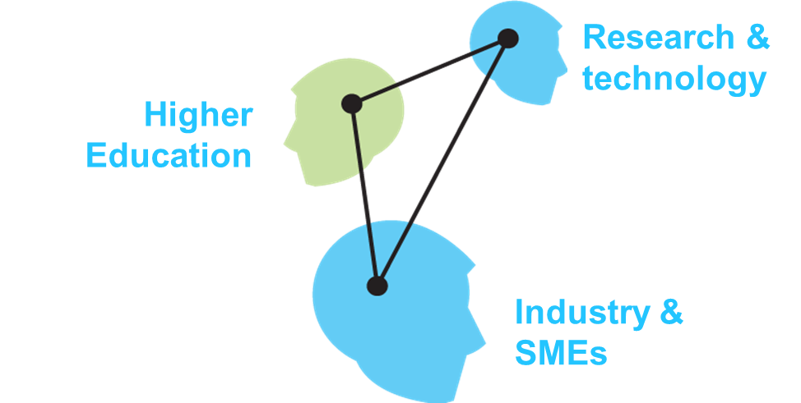
A time for initiatives
Building a Knowledge Innovation Community
EIT European Institute for Innovation and Technology
Enhance Europe’s ability to innovate by nurturing young entrepreneurial talent and supporting new ideas.
Set up a unique European Knowledge Innovation Community (KIC) with a long-term perspective and top level management
Promote education in the knowledge triangle
From student to entrepreneur
From idea to product
From lab to customer

Slide 9
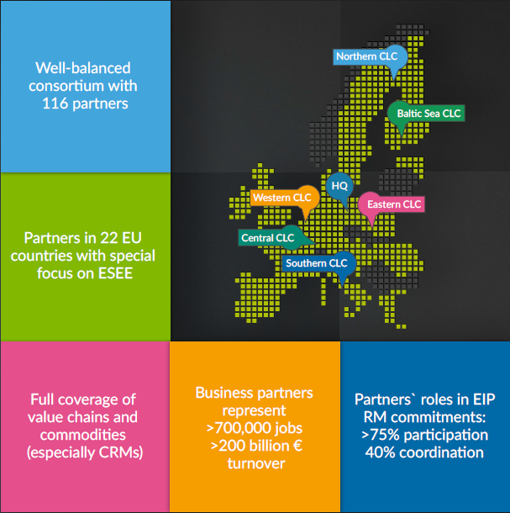
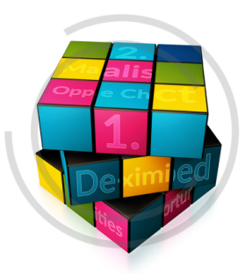
A time for initiatives
Building a Knowledge Innovation Community
EIT Raw Materials (est. Dec 2014)
Boost the competitiveness, growth and attractiveness of the European raw materials sector via radical innovation and entrepreneurship.

Slide 10
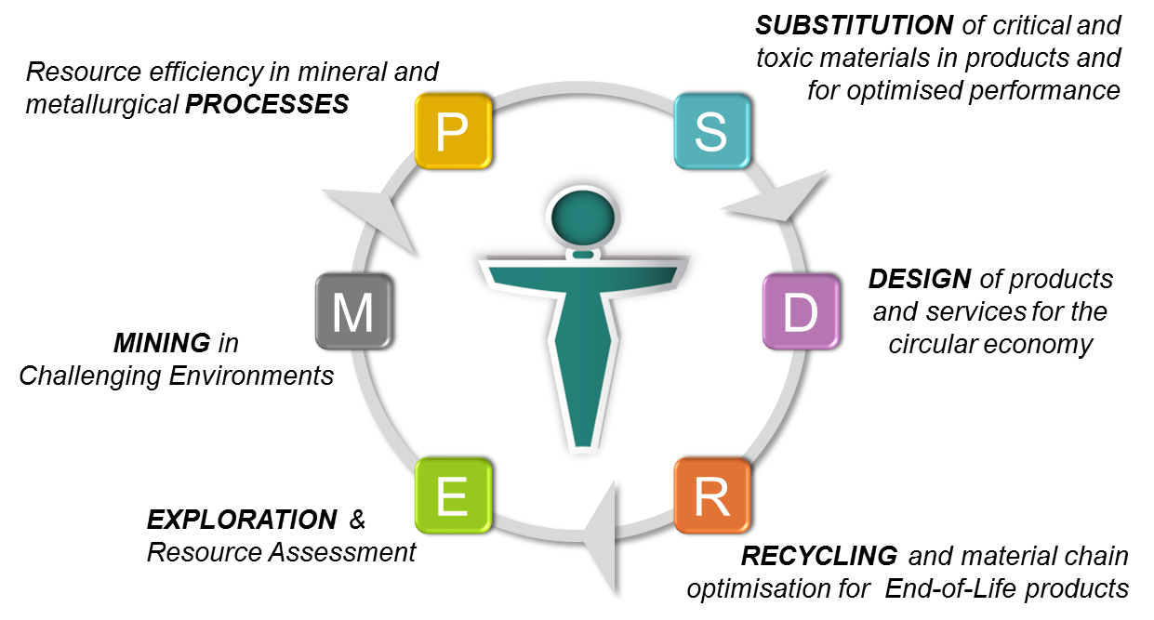
Raw Materials Academy
Educating Actors of the Circular Economy
6 innovation themes

Slide 11
Raw Materials Academy
From T-shaped engineers to T-shaped entrepreneurs
T-shaped professionals are
“broad and holistic lifelong learners who combine an in depth knowledge of their own discipline with a sound understanding of the challenges of the raw materials value chain”
Sustainability & Creativity
Business & Innovation
S
E
P
D
R
Cross-thematic modules
Cross-thematic modules
Thematic MSc/PhD Program

Slide 12
Raw Materials Academy
Missions
Promote a permanent offer of cross-disciplinary programmes.
Actively involve industry in education.
Promote problem-based learning, self organisation and learning by doing.
Offer an open learning environment and a series of online courses.
Facilitate access to experimental platforms for hands-on training.
Promote lifelong learning in the perspective of a resource efficient economy.
Stimulate wider society learning initiatives aiming at raising social awareness.
Foster international cooperation.
Create a lively community of alumni.

Slide 13
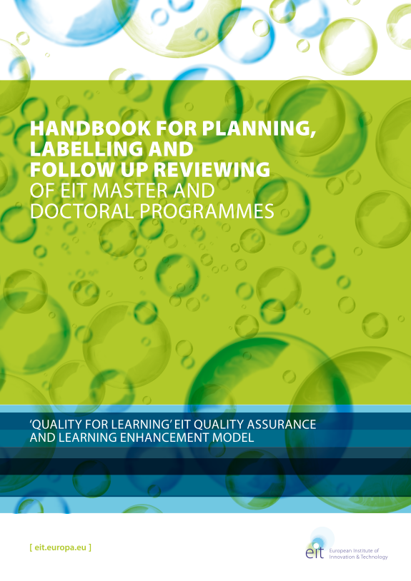
Raw Materials Academy
EIT Labelling
Robust entrepreneurship education
Entrepreneurial skills; Experience of professional life in industry;…
Highly integrated, innovative « learning-by-doing » curriculum
International and cross-organisational mobility
European dimension and openess to the world
English as teaching language
Mutliple degrees
Access policy and joint outreach strategy
Joint admission criteria, joint diploma

Slide 14
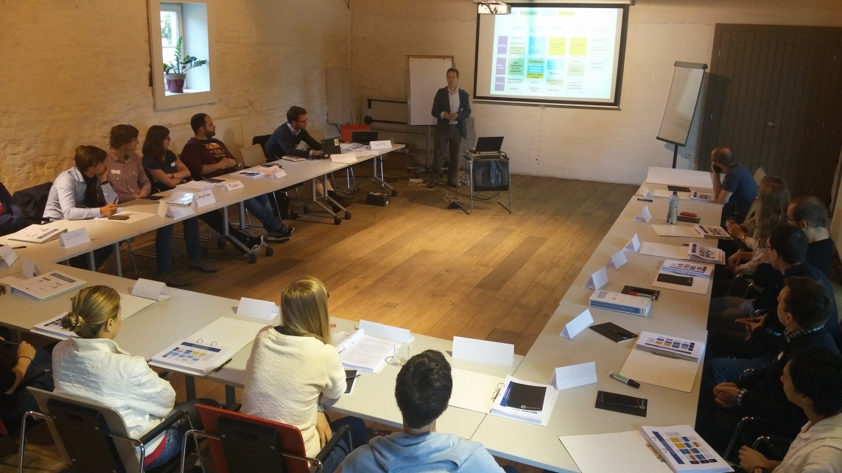
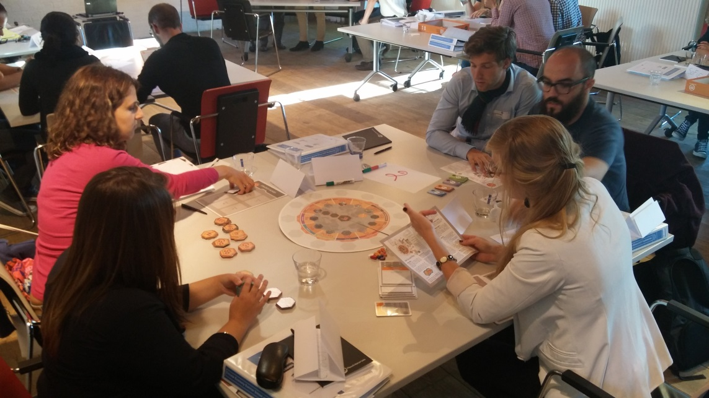
Raw Materials Academy
Activities
DocSumSco
Doctoral School in Circular Economy
Geetbets, 22-26 Aug 2016

