Slide 1
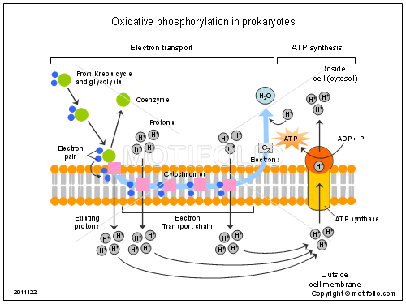
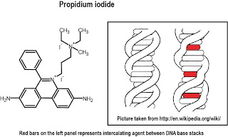
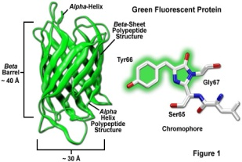
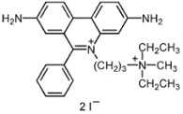
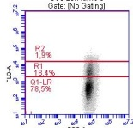
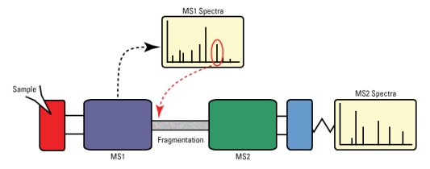
Study of microbial phenotypic heterogeneity under bioprocess conditions using « single-cell » techniques
A. Delepierre¹, A. Brognaux¹, J. Baert¹, C. Tarayre¹, J. Bauwens², F. Francis², F. Delvigne¹
Context
Positive impact : Bet-hedging strategy
Stress
Selection
Negative impact
Microbial phenotypic heterogeneity characterizes the simultanous presence of several phenotypic traits, among an isoclonal cellular population. Noise, defined as stochastic fluctuations in the biochemical reactions, cell age, as well as mutations are at the bottom of the phenomenon and can be reinforced by variations in the microenvironment, mostly under bioprocessing conditions. Indeed, spatial heterogeneity , due to the decrease of mixing efficiency at large scale, leads to gradients of dissolved oxygen, pH and substrate concentration.
« Single –cell » Techniques
Fluorescent labelling
Microbial biosensor
Outer/inner membrane integrity
Propidium iodide staining
Reductase activity< Electron transport chain
Redox Sensor Green Vitality staining
Promoter activity
Green Fluorescent Protein
Promoter
GFP coding sequence
Destabilized GFP
Red
fluorescence
Green fluorescence
Green fluorescence
The Automated Flow Cytometer (FC)
Omic approach
Benchtop Accuri flow cytometer .
Automatable system: Sampling from bioreactor by peristaltic pumps (fluid displacement) and microcontroller
Sample dilution and staining: dyes carried out in line in the tubing between the FC and the bioreactor.
Multiplexable system: T-junctions
FACS Sorted subpopulations
MS/MS spectrometry
Label Free Quantification (MaxQuant)
¹Univ. Liege- Gembloux Agro-Bio Tech. MiPI Unit. Passage des Déportés, 2. B-5030 Gembloux (Belgium)
²Univ. Liege-Gembloux Agro-BioTech. Functional and Evolutive Entomolgy Unit. Passage des Déportés, 2. B-5030 Gembloux (Belgium)

