Slide 1
DYNAMIC MODELING OF WASTE HEAT RECOVERY ORC SYSTEMS IN THE AMESIM PLATFORM
Introduce your company logo here
L. Guillaumeª, B. Ameel^{b}, C. Criens^{c}, I. Siera^{c}, D. Maes^{c}, A. Hernandez^{d}, M. De Paepe^{b,c}, V. Lemortª
ªDepartment of A&M, Thermodynamics laboratory, University of Liege, Belgium
^{b} Department of Flow, heat and combustion mechanics, Ghent University, Belgium
^{c} Flanders Make, Lommel, Belgium
^{d} Department of Electrical energy, Systems and Automation, Ghent University, Belgium

Slide 2
Introduction Project Description
Develop an ORC design methodology
Costs vs. performance
Assist the design engineer with:
Fluid selection
Component sizing
Control design
(Dynamic) performance evaluation
Topology selection
Applicable to automotive waste heat recovery
Partners
Energy conscious design for waste heat recovery
Steady state cost & performance optimization
Conversion to dynamic model
Control design
Fluid preselection
Automotive Use case
ORC design methodology

Slide 3
Introduction Context
Energy conscious design for waste heat recovery
ORC waste heat recovery
Fuel consumption and CO2 emissions
Transient nature of the heat sources
Dynamic simulations :
Essential part of the design process
Components design, control design and transient evaluation of ORC systems.
Library of generic dynamic models
Numerous dynamic models of different candidate ORCs
Work in synergy with a steady-state ORC design tool
Validation
Steady-state models
Dynamic models and experimental data.

Slide 4
Introduction AMESim
Modeling in LMS AMESim simulation platform
Simulation platform for modeling and analysis of 1D multi-domain systems
Graphical User Interface
Numerical solver
Component libraries covering Multi-physics with power exchange (bond graph theory)
Largely used in automotive industry and offers a variety of libraries: Engine, Control, Two-Phase Flow, etc.

Slide 5
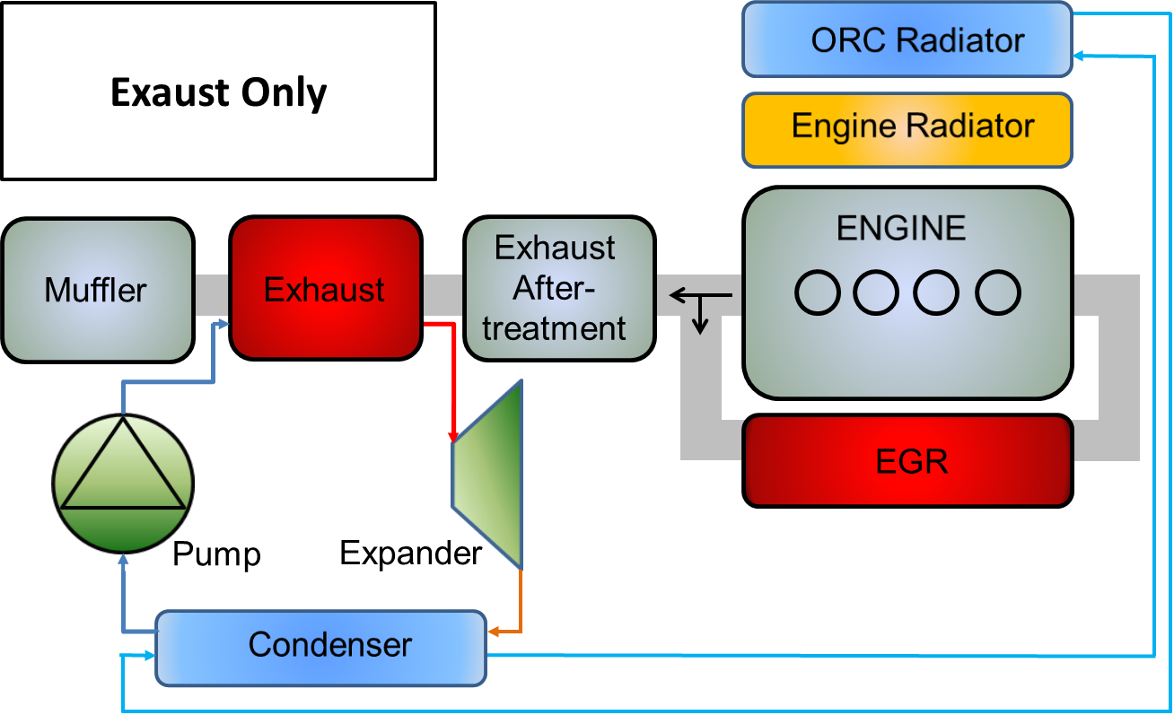
Description of the models Topologies
Library of models
Two heat sources
Exhaust gases and the recirculated gases
6 possible configurations are identified
2x1 heat source,
3x2 heat sources in series,
1x2 heat sources in parallel.
Single heat sink
Engine cooling fluid
Including the use (or not) of a recuperator
12 topologies.
Working fluids
Water, ethanol, R245fa, etc.

Slide 6
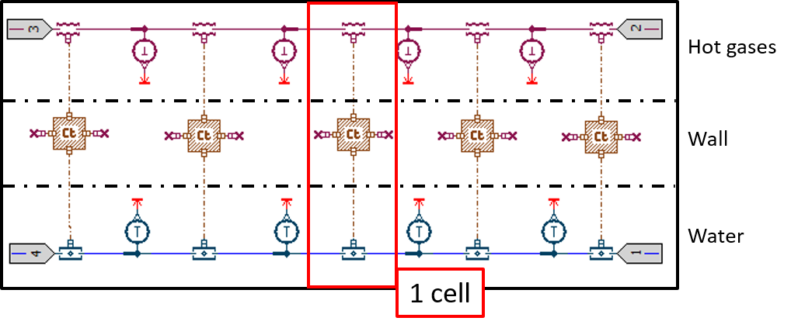
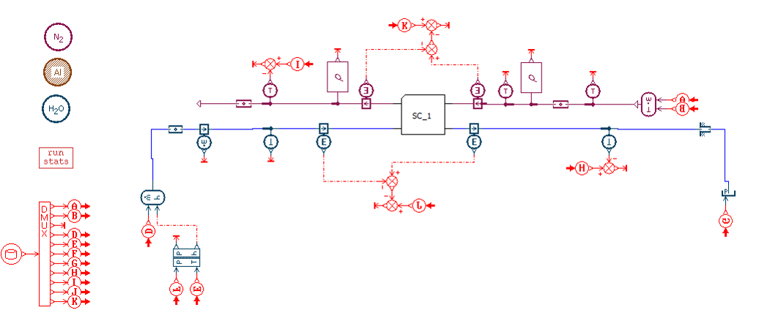
Description of the models Heat exchangers
Finite Volume approach
Mass:
Energy:

Slide 7
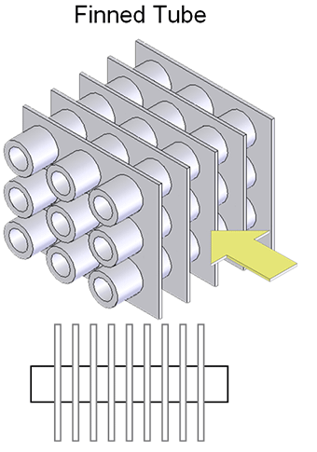
Description of the models Heat exchangers
Evaporator model
Fin and tube HX
Secondary fluid side:
Pneumatic library
User defined Nusselt correlations
$Nu=a Re^{b}{Pr}^{c}$
Primary fluid side
Two phase library
Imposed heat transfer correlations
Single phase: Gnielinski
Two phase: VDIH

Slide 8
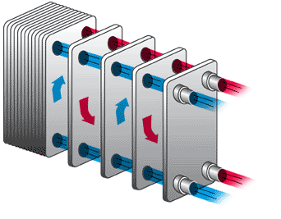
Description of the models Heat exchangers
Condenser model
Plate heat exchanger
Secondary fluid side
Thermal hydraulic library
User defined Nusselt correlations
$Nu=a Re^{b}{Pr}^{c}$
Primary fluid side
Two phase library
Imposed heat transfer correlations
Single phase: Gnielinski
Two phase: Cavallini & Zecchin
Gain factor (plate/tubes)

Slide 9
Description of the models Expansion and pumping devices
Models
Expander
Fixed isentropic and volumetric efficiency
Pump
Fixed isentropic and volumetric efficiency
$$\dot{M}=ε_{v} ρ_{su} N_{rot} V_{s}$$
$ε_{s,pp}=\frac{h_{ex,s }−h_{su}}{h_{ex}−h_{su}}$ $ε_{s,exp}=\frac{h_{su}−h_{ex}}{h_{su}−h_{ex,s}}$

Slide 10
Parameters Definition Interface
Parametrization and steady state comparison
Parametrization process
Geometry of the components
Initial values
Heat transfer correlations for the heat exchangers
To validate the dynamic models against the steady-state model
Input conditions
Dynamic simulation model
Steady state design model
Matlab Interface

Slide 11
Parameters Definition Interface
Geometry and heat transfer correlations
Geometry and initial values: direct
Heat transfer correlations: transformation
Steady-state model detailed geometry-based correlations | Dynamic model simple Dittus-Boelter type Nusselt (secondary fluid side) Gain factor (working fluid side)

Slide 12
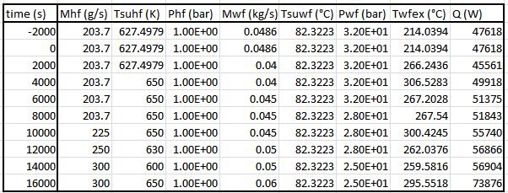
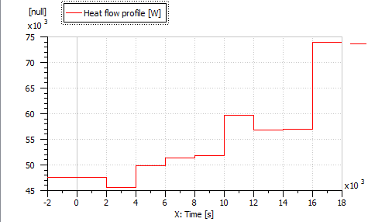
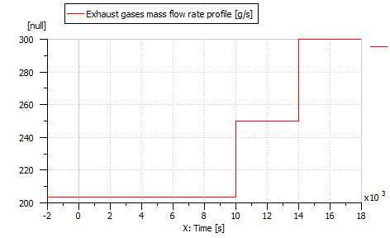
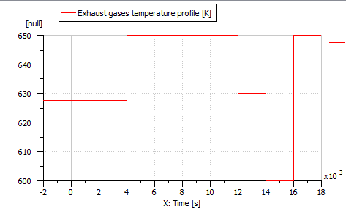
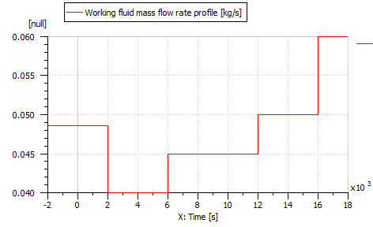
Comparison Against Steady-State Models
Random operating conditions

Slide 13
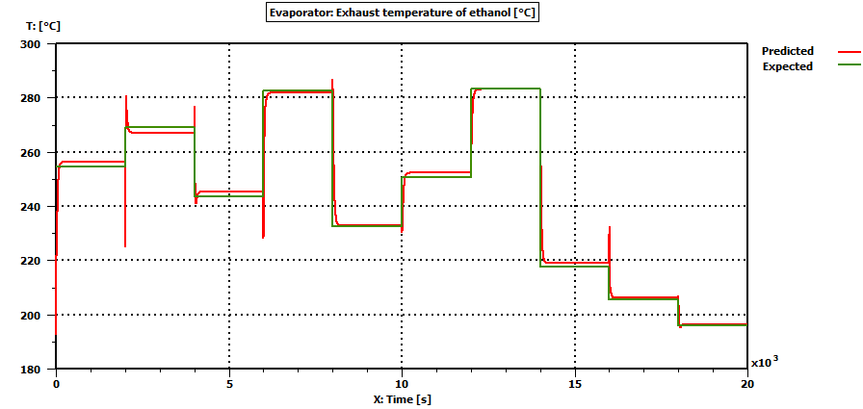
Comparison Against Steady-State Models
Evaporator model
Exhaust temperature on working fluid side [K]
Heat flow rate [W]
Maximum error of 2°C on the exhaust temperature of wf
Maximum error of 1.5 kW on 80 kW total heat flow rate

Slide 14
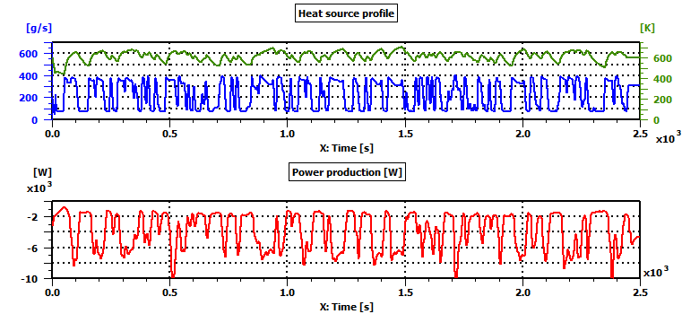
Simulations of driving cycles
Prediction of the performance
Requires a control strategy
Results can be obtained with rudimental control (example with exhaust gases used as a single heat source)
However, to compare objectively the performance of all the topologies, a methodology for controller development has to be defined.

Slide 15
Conclusion and perspectives
Conclusion
Methodology:
Library of generic dynamic models of ORCs
Models for the main ORC components
Interface between Matlab steady-state models and Amesim dynamic models
Parametrization process (geometry, initial conditions, heat transfer correlations)
Inputs generation process
Comparison Against Steady-State Models: Error of 2K
Comparison Against Experimental Data: Error of 1K

Slide 16
Conclusion and perspectives
Perspectives
Dynamic validation
Experimental data with exhaust gases
More detailed expander and pump models
Representative of a technology (scroll, screw, piston, turbine, etc)
Taking into account the losses occurring in the machine
Control strategies
Simulations of driving cycles of the truck
Performance evaluation: Fuel consumption reduction, etc

Slide 17
Questions
Thank you

Slide 18
References
Heat exchanger design handbook, Kuppan Thulukkanam
AMESim documentation
QUOILIN S, BELL I, DESIDERI A, DEWALLEF P AND LEMORT V. Methods to increase the robustness of finite-volume flow models in thermodynamic systems. Energies 2014, 7,1621-1640 ; doi :10.3390/en7031621.
Richter, C. Proposal of New Object-Oriented Equation-Based Model Libraries for Thermodynamic Systems. Ph.D. Thesis, University of Braunschweig, Braunschweig, Germany, 2008
http://fchart.com/ees/heat_transfer_library/compact_hx/hs100.htm

Slide 19
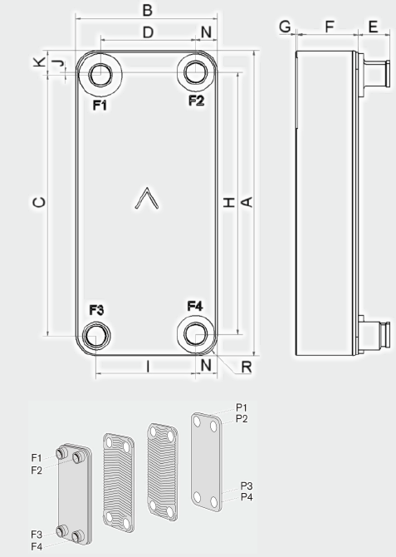
Appendix
Comparison Against Experimental Data
Working fluid : R245fa
Hot fluid: Thermal Oil
ORC test rig
Liege
Characterization of a radial inflow turbine
Geometry is known (data sheet)
A steady state model developed and calibrated (heat transfer correlations)
The AMESim model of the evaporator is parametrized accordingly
Comparison against dynamic data

Slide 20
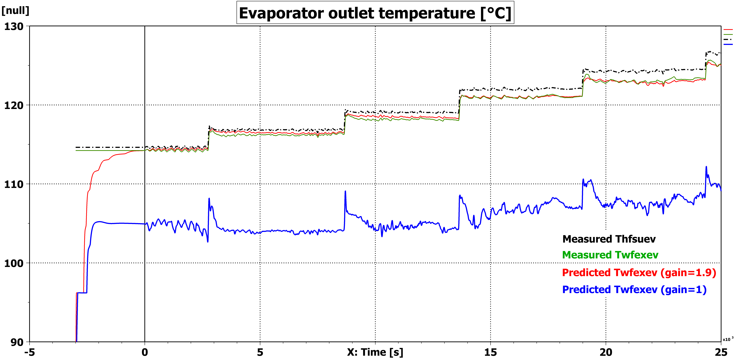
Appendix
Comparison Against Experimental Data: High gain value
To increase the turbine inlet pressure
Increase of the mass flow rate
Increase of the oil temperature to keep a fixed overheating

Slide 21
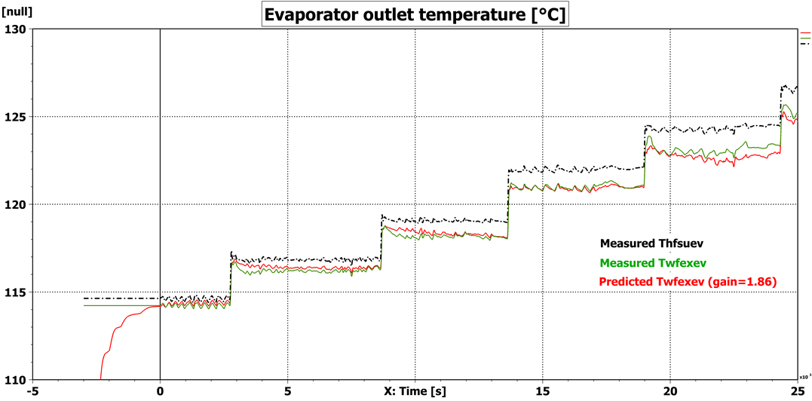
Appendix
Comparison Against Experimental Data: Average gain value
To increase the turbine inlet pressure
Increase of the mass flow rate
Increase of the oil temperature to keep a fixed overheating

Slide 22
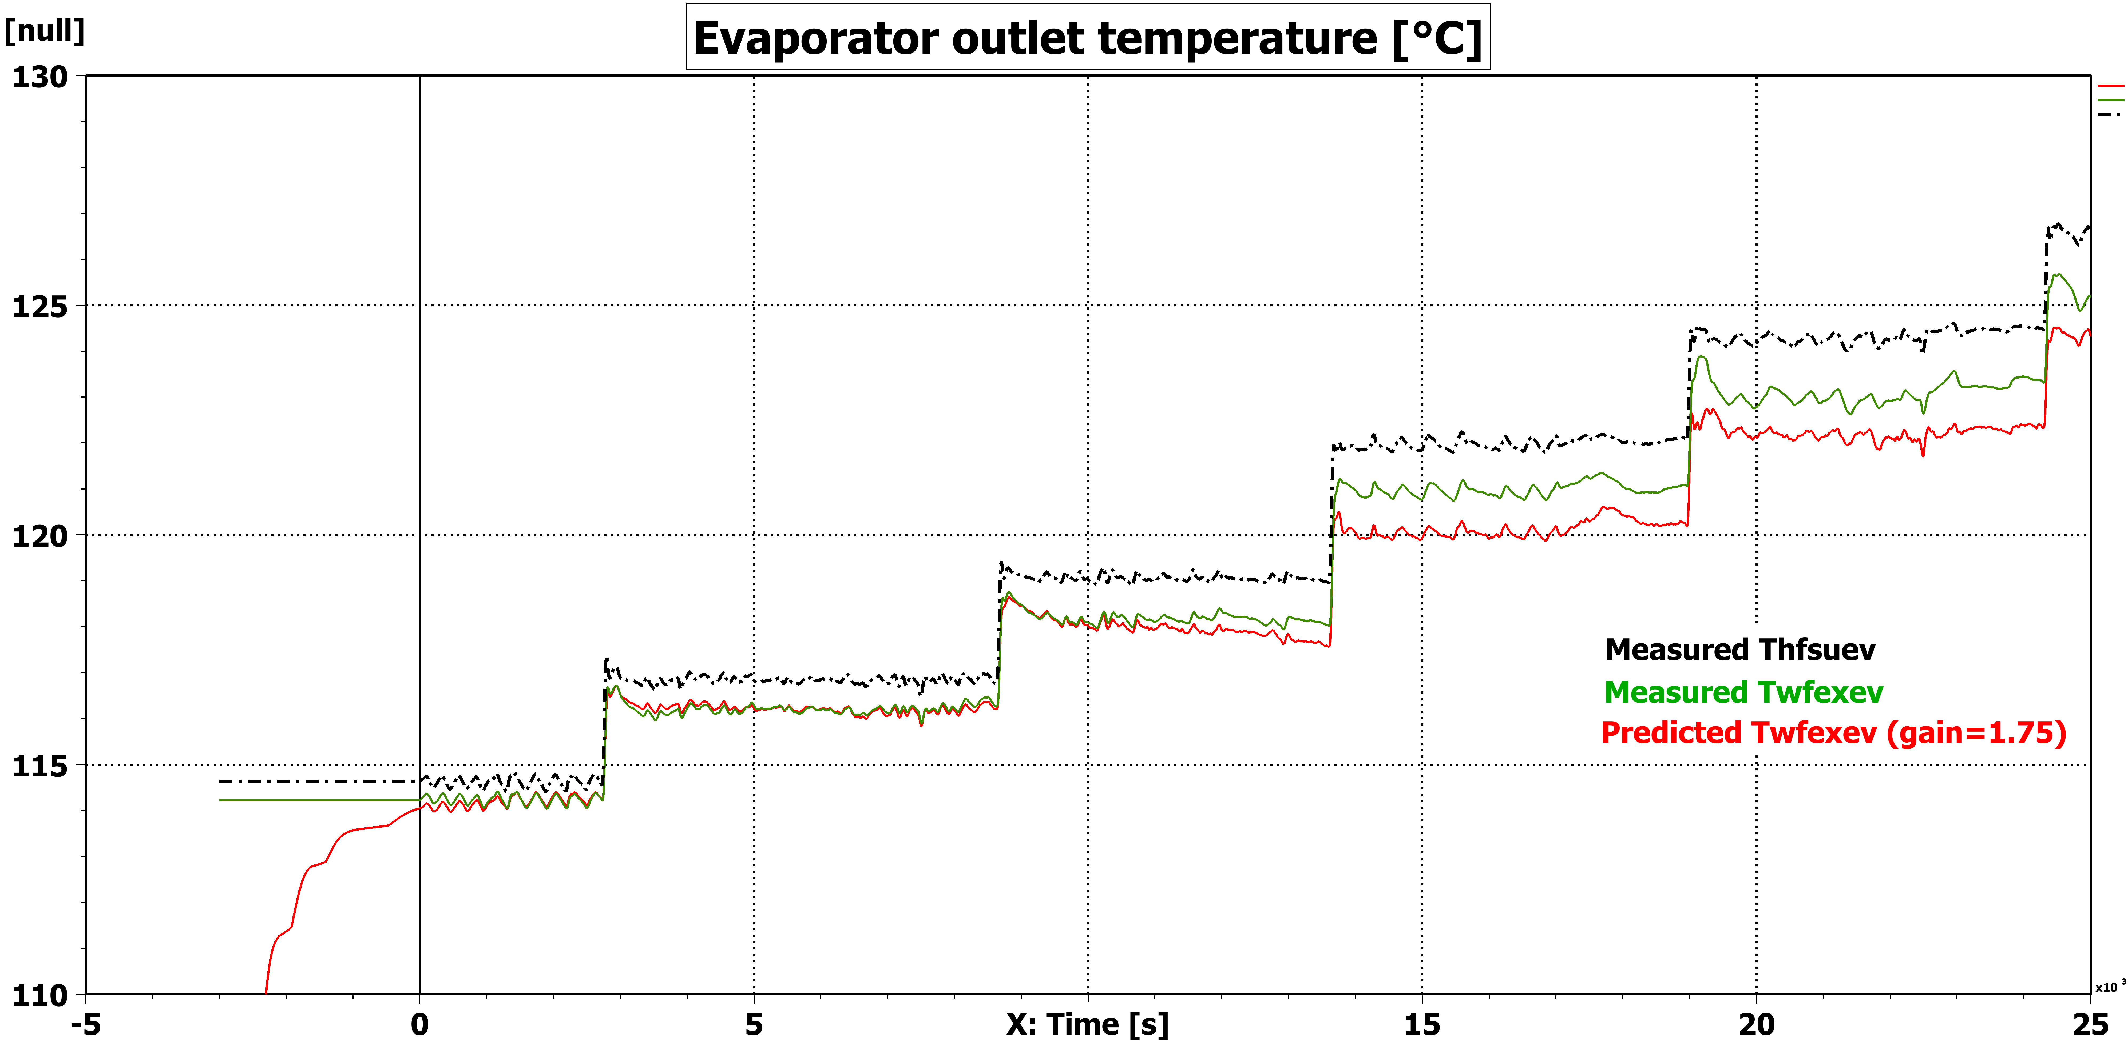
Appendix
Comparison Against Experimental Data: Low gain value
To increase the turbine inlet pressure
Increase of the mass flow rate
Increase of the oil temperature to keep a fixed overheating

Slide 23
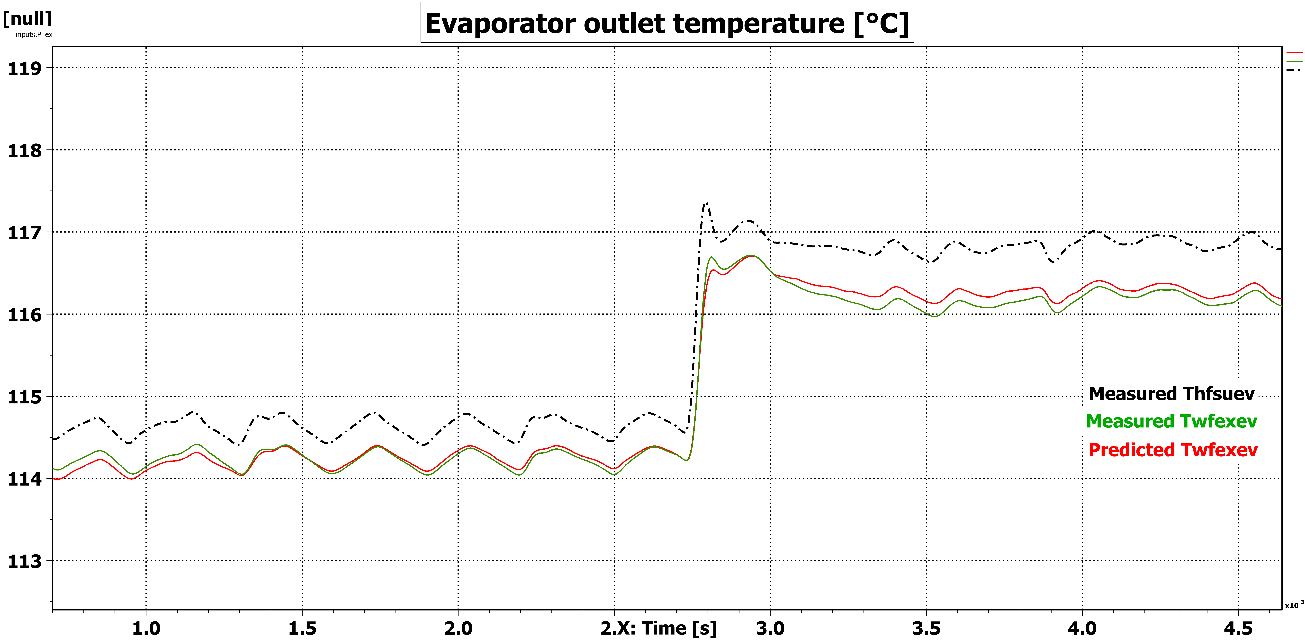
Appendix
Comparison Against Experimental Data: zoom
Maximal error < 1°C on the exhaust temperature of R245fa
Results sensitive to gain value
Low pinch point value

