Slide 1




A mathematical model of respiration under protective ventilation and extracorporeal CO₂ removal therapy
S. Habran, Th. Desaive, Ph. Morimont, B. Lambermont and P.C. Dauby
Notes:
Research = how improve the use of ECCO2RD

Slide 2
Introduction
Notes:
2 concepts: need of - ECCO2RD
- modelisation

Slide 3

Introduction
ARDS
Intensive care unit

Slide 4
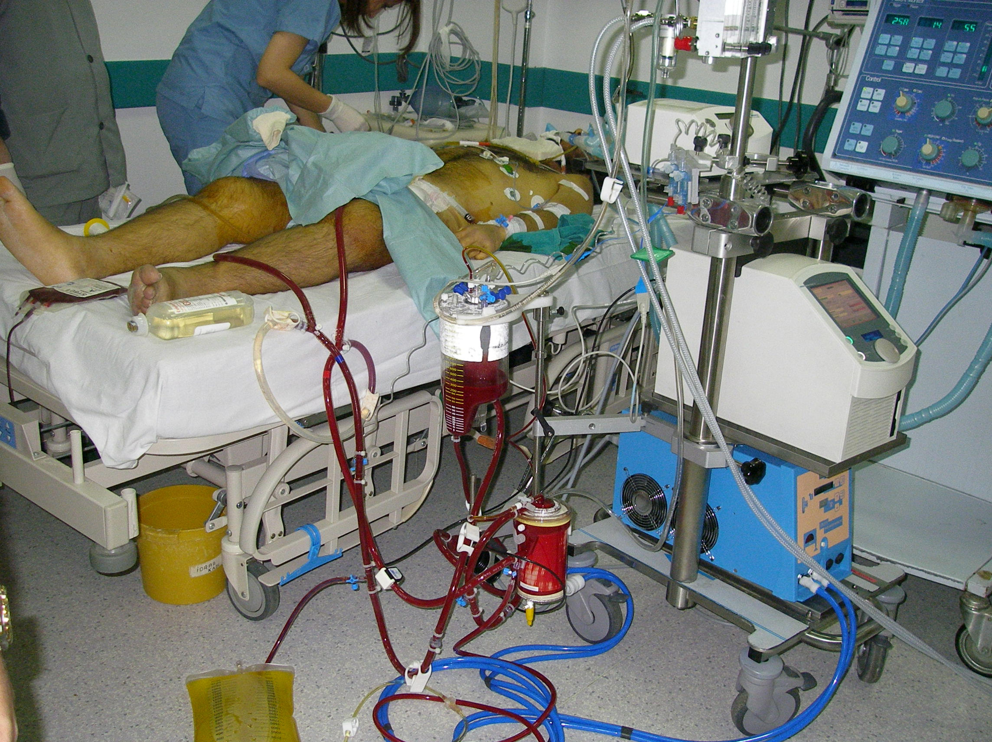
Introduction
ARDS
Intensive care unit

Slide 5
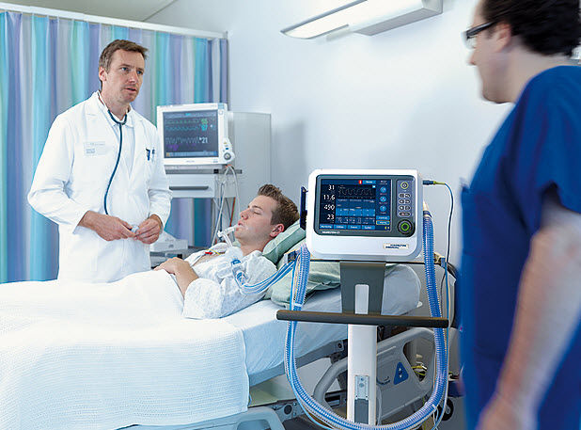
Introduction
ARDS
Intensive care unit
Protective ventilation
Ventilator

Slide 6
Introduction
ARDS
Intensive care unit
Protective ventilation
Ventilator
ECCO₂RT
ECCO₂RD

Slide 7


Introduction
ARDS
Intensive care unit
Recovery

Slide 8
Introduction
Why do clinicians need a mathematical model?
Notes:
For the mathematical concept …
A mathematical model = simulate a well known system.
The goal of the modelisation of the respiration assisted by an ECCO2R

Slide 9
Introduction
Why do clinicians need a mathematical model?
  Better understanding of the complex system
  Prediction of the ECCO₂RT for a specific patient
  Choice of the appropriate blood flow entering the ECCO₂RD before connecting the device to the patient
Notes:
For the mathematical concept …
A mathematical model = simulate a well known system.
The goal of the modelisation of the respiration assisted by an ECCO2R

Slide 10
Methods
Notes:
The model is a lamped parameter model with three compartment: lung, tissues, ECCO2R.
For the lung compartment, a pulmonary shunt is taking into account.

Slide 11
Methods
Lungs
Material balance:
Notes:
In red, we have the material balance
The hypothesis of the O2 and CO2 equilibrium
In orange, it’ is the mixing
In blue, it’s the material balance

Slide 12
Methods
Lungs
Material balance:
Mixing of blood in the arteries:
Notes:
In red, we have the material balance
The hypothesis of the O2 and CO2 equilibrium
In orange, it’ is the mixing
In blue, it’s the material balance

Slide 13
Methods
Lungs
Tissues
Material balance:
Mixing of blood in the arteries:
Material balance:
Notes:
In red, we have the material balance
The hypothesis of the O2 and CO2 equilibrium
In orange, it’ is the mixing
In blue, it’s the material balance

Slide 14
Methods
Lungs
Tissues
Material balance:
Mixing of blood in the arteries:
Material balance:

Slide 15
Methods
Lungs
Tissues
Material balance:
Mixing of blood in the arteries:
Material balance:

Slide 16
Methods
Lungs
Tissues
Material balance:
Mixing of blood in the arteries:
Material balance:

Slide 17
Methods
ECCO₂RD
  Gas side
  Blood side
Material balance:
Material balance:
Notes:
ECCO2R = second lung exepted that diffusion is smaller.
The hypothesis of equilibrium is not taken.

Slide 18
Methods
ECCO₂RD
  Gas side
  Blood side
Material balance:
Material balance:

Slide 19
Methods
ECCO₂RD
  Gas side
  Blood side
Material balance:
Material balance:

Slide 20
Methods
ECCO₂RD
  Gas side
  Blood side
Material balance:
Material balance:

Slide 21
Methods
ECCO₂RD
  Gas side
  Blood side
Material balance:
Material balance:

Slide 22
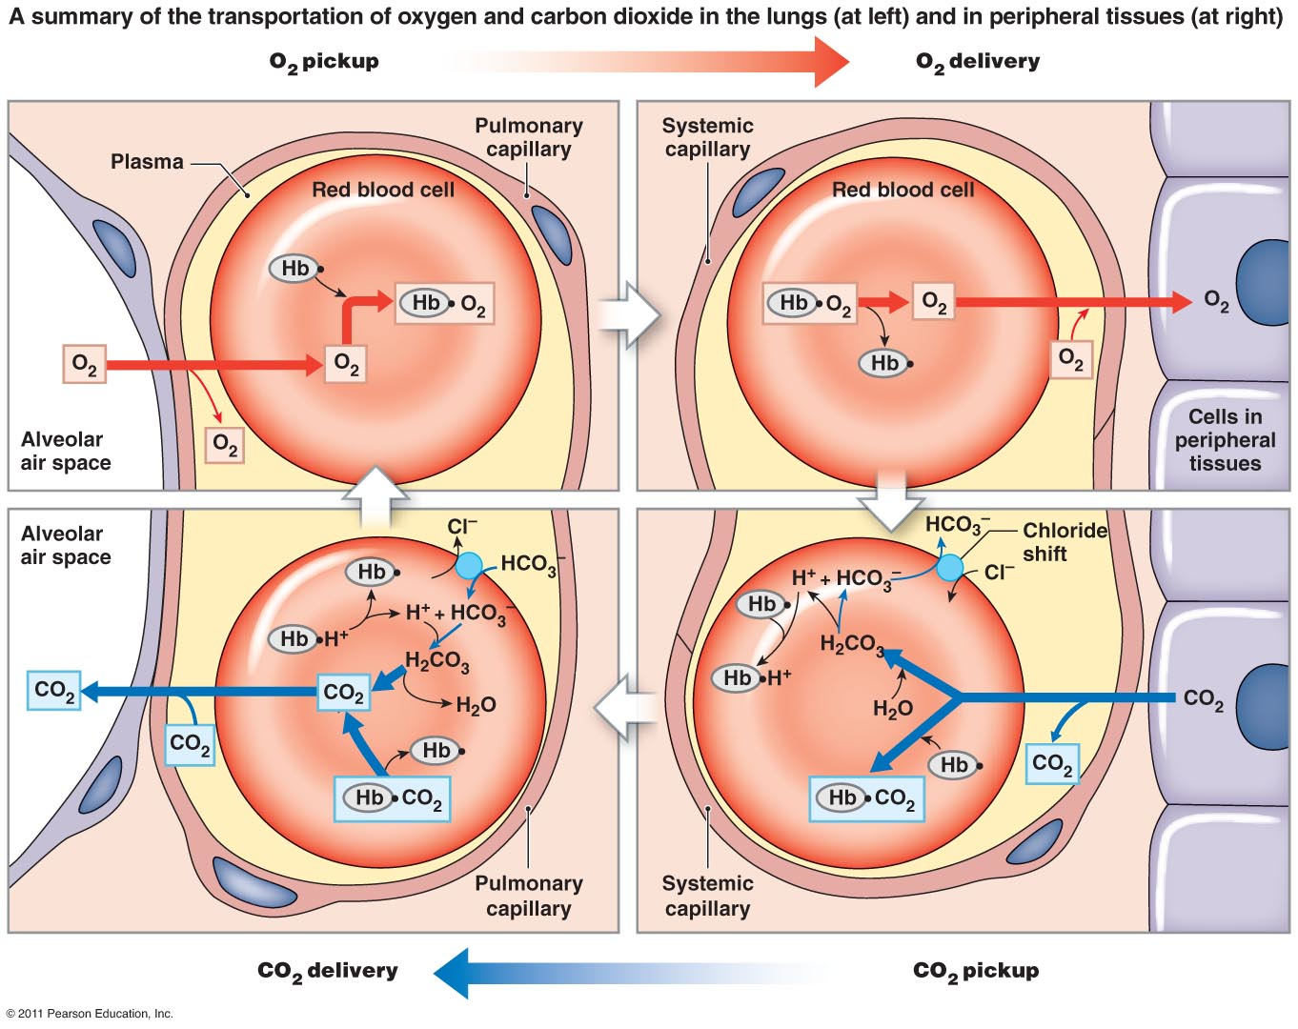
Methods
Notes:
Link pressure and total => blood chemistry model.

Slide 23
Methods
Oxygen
Notes:
So, we can write this equation for O2.

Slide 24
Methods
Oxygen

Slide 25
Methods
CO₂
Notes:
The graphique = empirical formula for ≠ Sat
Straight line in purple = pCO2 diss

Slide 26
Methods
pH
⇌
Notes:
To compute pH, mainly the hydratation reaction of CO2.

Slide 27


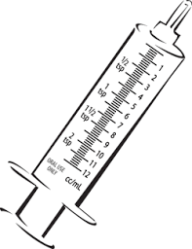
Methods
Validation
Data
  Weight
  Cardiac output
  Tidal volume
  Respiratory frequency
  Arterial and venous blood samples
    pCO2, pO2
    pH
  => Specific to the subject
Notes:
Validation =experimental data => experiments on pig.
We needs …
Thanks to this data, we can …

Slide 28
Results
Validation 1: 4 healthy pigs
  Protective ventilation
  ECCO₂RT
Validation 2: 6 pigs with ARDS
  Protective ventilation and ARDS
  ECCO₂RT

Slide 29
Results
Validation 1:
PV
Q_{D} 200
Q_{D} 400
Q_{D} 200
Q_{D} 400
Q_{D} 600
PV
PV
Q_{D} 200
Q_{D} 400
Q_{D} 600
PV
Q_{D} 200
Q_{D} 400
Q_{D} 600

Slide 30
Results
Validation 2:

Slide 31
Results

Slide 32
Results
V

Slide 33


Application in ICU

Slide 34
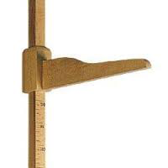
Application in ICU
Data
  Weight
  Cardiac output
    Height and weight
  Tidal volume
  Respiratory frequency
  Arterial and venous blood samples
    pCO₂, pO₂
    pH
No real data => fictional patient

Slide 35
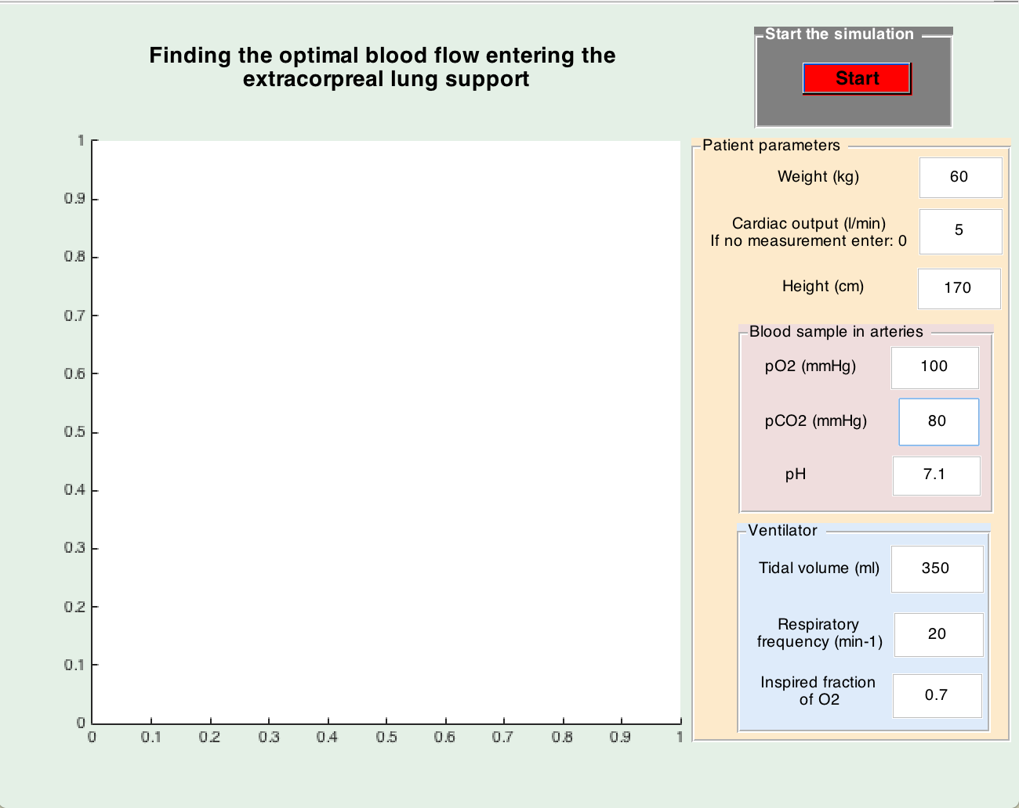
Application in ICU

Slide 36
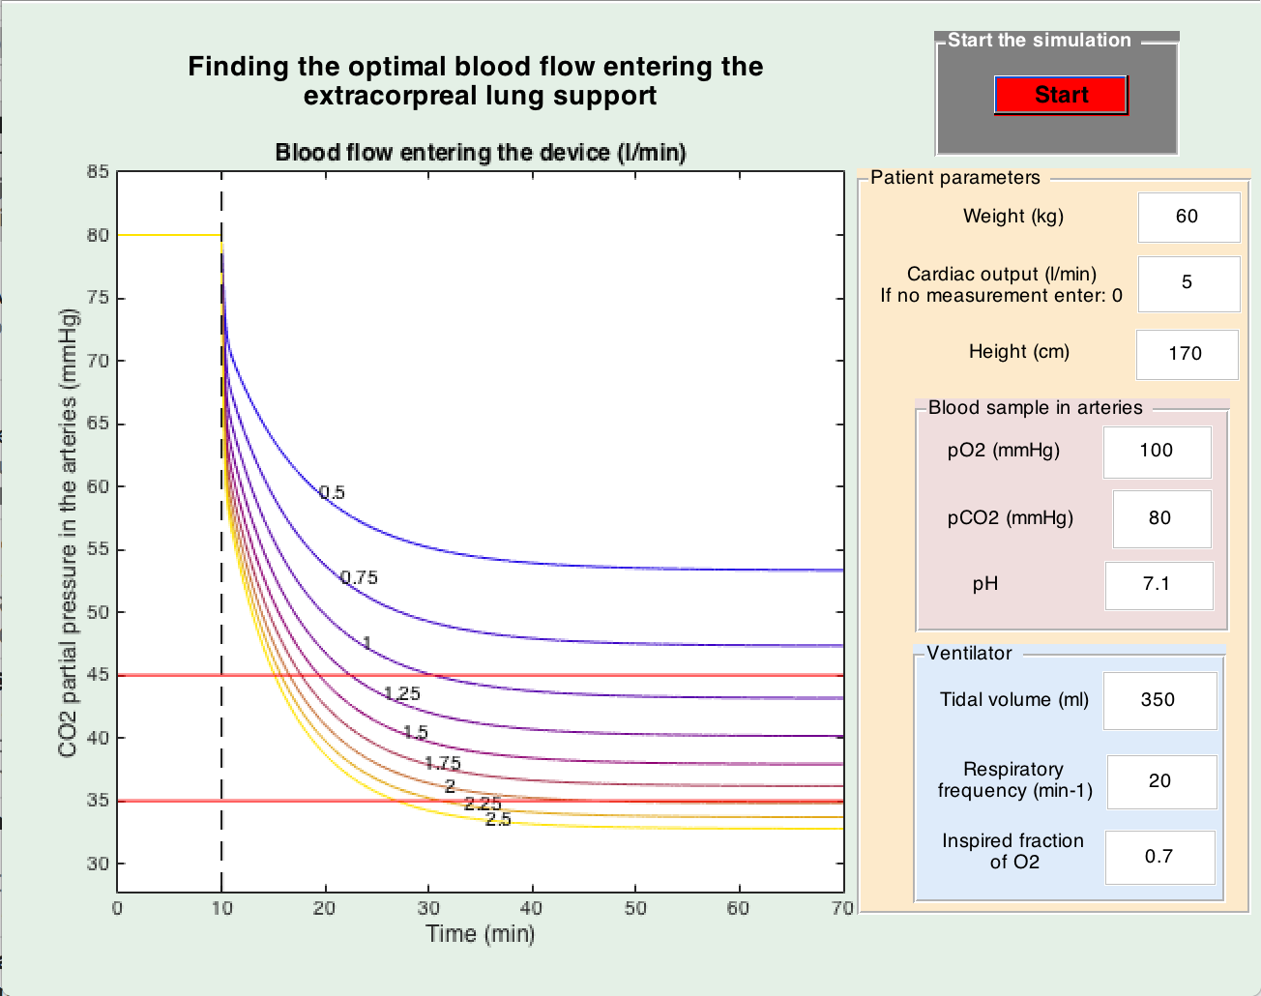
Application in ICU
Q_{d}

Slide 37
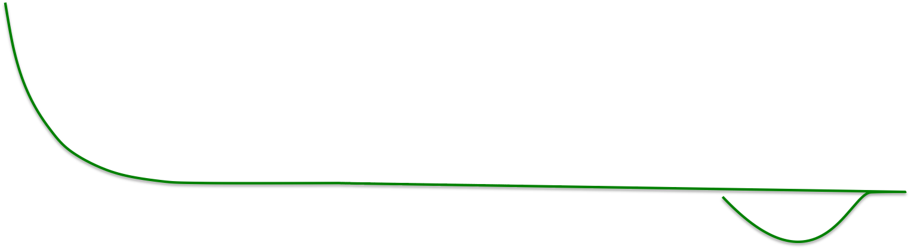
Application in ICU
Q_{d}

Slide 38
Application in ICU
Different ECCO₂RD on the market
Specification | ECCO₂RD 1 | ECCO₂RD 2 | ECCO₂RD 3 | ECCO₂RD 4
Blood flow | Up to 0.8 l/min | Up to 2.4 l/min | 0.5 – 4.5 l/min | 1 – 7 l/min
Surface area | 0.32 m² | 0.65 m² | 1.3 m² | 1.9 m²
function | Partial CO₂ removal | CO₂ removal and partial oxygenation |  | CO₂removal and oxygenation

Slide 39
Application in ICU
Different ECCO₂RD on the market
Specification | ECCO₂RD 1 | ECCO₂RD 2 | ECCO₂RD 3 | ECCO₂RD 4
Blood flow | Up to 0.8 l/min | Up to 2.4 l/min | 0.5 – 4.5 l/min | 1 – 7 l/min
Surface area | 0.32 m² | 0.65 m² | 1.3 m² | 1.9 m²
function | Partial CO₂ removal | CO₂ removal and partial oxygenation |  | CO₂removal and oxygenation

Slide 40
Application in ICU
Size of the cannulae
  Blood pressure has to be:
    > -50 mmHg
    < 300 mmHg
Notes:
To avoid blood damages, 2 blood pressure limits

Slide 41
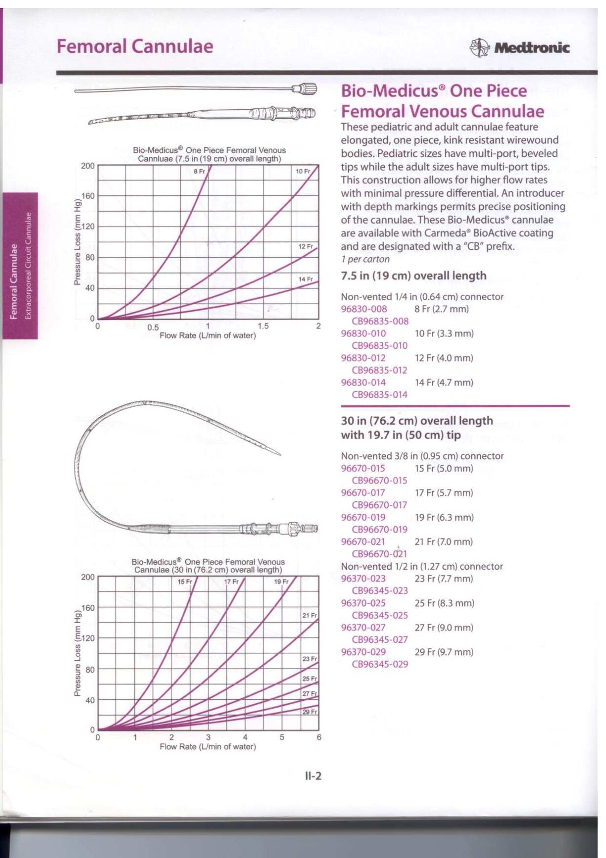
Application in ICU
Size of the cannulae
  Blood pressure has to be:
    > -50 mmHg
    < 300 mmHg
Adult cannulae
Notes:
For the cannula which suck up the blood

Slide 42
Application in ICU
Size of the cannulae
  Blood pressure has to be:
    > -50 mmHg
    < 300 mmHg
Adult cannulae
Notes:
For the cannula which suck up the blood

Slide 43
Application in ICU
Size of the cannulae
  Blood pressure has to be:
    > -50 mmHg
    < 300 mmHg
Adult cannulae
Notes:
For the cannula which suck up the blood

Slide 44

Application in ICU
Size of the cannulae
  Blood pressure has to be:
    > -50 mmHg
    < 300 mmHg
Adult cannulae
not blood
Notes:
For the cannula which suck up the blood

Slide 45
Application in ICU
Size of the cannulae
  Blood pressure has to be:
    > -50 mmHg
    < 300 mmHg
Adult cannulae
300
Notes:
To avoid blood damages, 2 blood pressure limits
Cannula which reinjected the blood
the condition always respect => the smallest

Slide 46
Application in ICU
Size of the cannulae
  Blood pressure has to be:
    > -50 mmHg
    < 300 mmHg
Adult cannulae
300
Notes:
To avoid blood damages, 2 blood pressure limits
Cannula which reinjected the blood
the condition always respect => the smallest

Slide 47
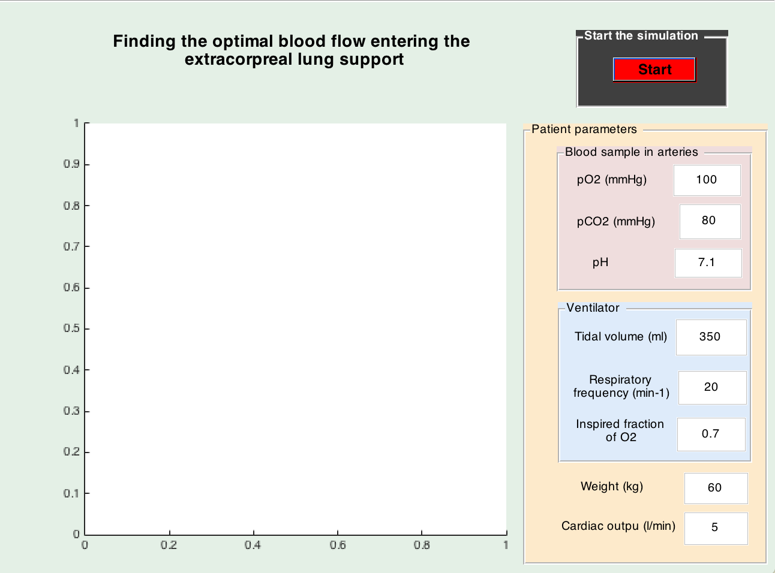
Conclusions
Notes:
Simulation correspond with the measurements.
=> model can be validated.

Slide 48
Conclusions
V
Notes:
Tanks to the model, pCO2 for different blood
=> Optimal blood flow and choose the right cannula.

Slide 49
Conclusions
V
.

Slide 50
Thank you for your attention
E-mail: simon.habran@ulg.ac.be

Slide 51
Application in ICU
Size of the cannulas
  Blood pressure has to be:
    > -50 mmHg
    < 300 mmHg
Pediatric cannulae
≠ of blood
Notes:
To avoid blood damages, 2 blood pressure limits
Cannula which reinjected the blood
the condition always respect => the smallest
For the cannula which suck up the blood
=> dimaeter of the cannule = 10 Fr.
! Curves are under-estimated

Slide 52
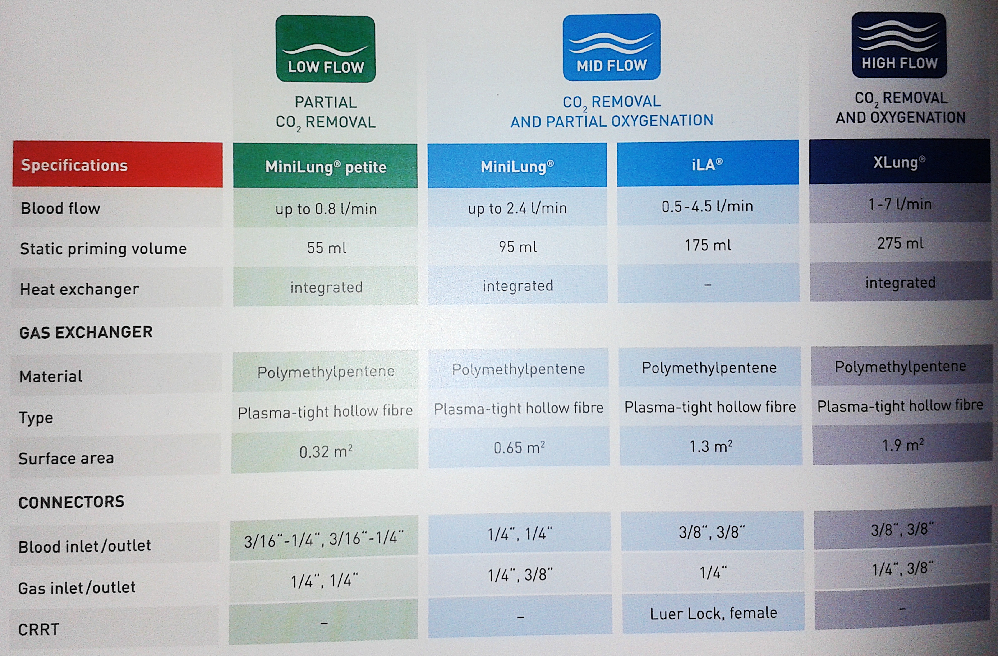
Application in ICU
Different ECCO₂RD on the market

