Slide 1



SIZE OF CANNULAE FOR EXTRACORPOREAL CO2
REMOVAL THERAPIES
S. Habran, Th. Desaive, Ph. Morimont, B. Lambermont and P.C. Dauby

Slide 2
Introduction
Notes:
Introduce two concept:
-The need of of ECCO2R
Modelisation helpfull for this device

Slide 3


Introduction
Pulmonary insufficiency
Intensive care unit
Notes:
For the medical concept

Slide 4
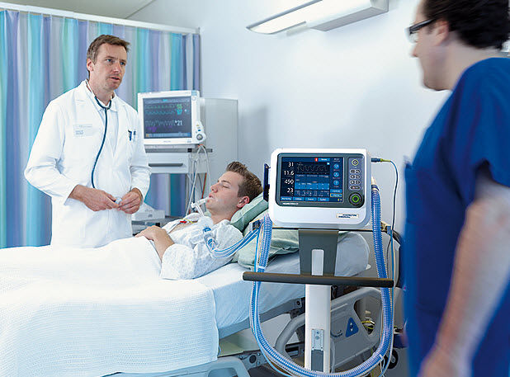
Introduction
Pulmonary insufficiency
Intensive care unit
Protective ventilation
Notes:
A protective ventilation:
Hight FIO2, low tidal volume => hight pCO2 and acidosis

Slide 5
Introduction
Pulmonary insufficiency
Intensive care unit
Protective ventilation
ECCO₂R
Notes:
An ECCO2R is a veno-venous ECLS with small blood flow.
The ECCO2R extract the inferior vena cava and the right atrium.
The aim of the device decrease the pCO2 rapidely but small cannula

Slide 6


Introduction
Pulmonary insufficiency
Intensive care unit
Recovery
Notes:
And of course the aim goal of the device is to reduce the mortality of patient under ECCO2R

Slide 7
Introduction
Notes:
For the mathematical concept …
A mathematical model = simulate a well known system.
The goal of the modelisation of the respiration assisted by an ECCO2R

Slide 8
Methods
Notes:
The model is a lamped parameter model with three compartment: lung, tissues, ECCO2R.
For the lung compartment, a pulmonary shunt is taking into account.

Slide 9
Methods
Lungs
Tissues
Notes:
In red, we have the material balance
The hypothesis of the O2 and CO2 equilibrium
In orange, it’ is the mixing
In blue, it’s the material balance

Slide 10
Methods
ECCO₂R
  Gas side
  Blood side
Notes:
ECCO2R = second lung exepted that diffusion is smaller.
The hypothesis of equilibrium is not taken.
ECCO2R is devided into two compartments
Additional term which express the transfert

Slide 11
Methods
ECCO₂R
  Gaz side
  Blood side

Slide 12
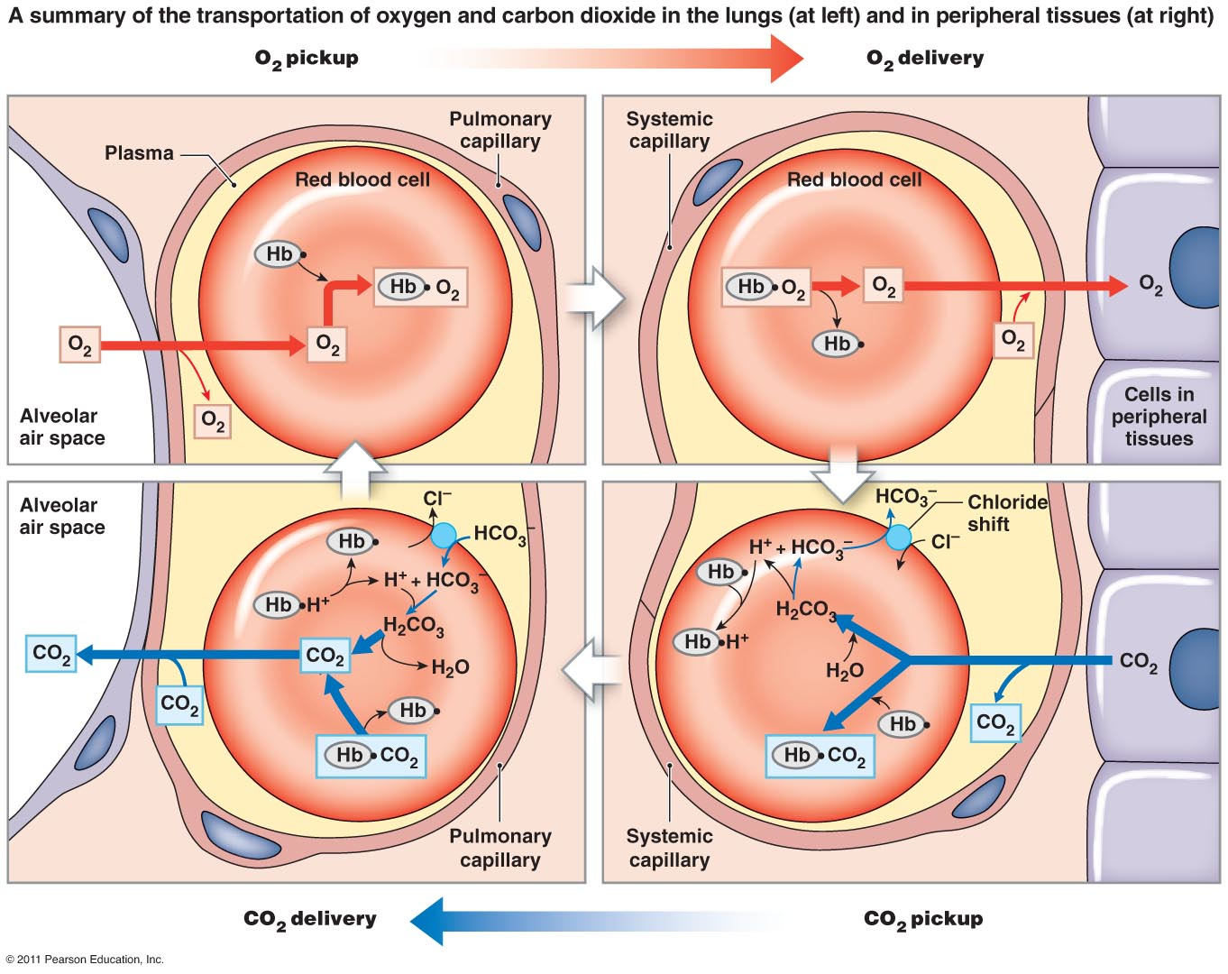
Methods
Notes:
Link pressure and total => blood chemistry model.
O2 goes from… to … thanks 2 kind of transportations
CO2 goes from … to … thanks 3 kind of transportations

Slide 13
Methods
Oxygen
Notes:
So, we can write this equation for O2.
But the saturation of haemoglobine for O2

Slide 14
Methods
Notes:
Different equations exist in the litterature.
pCO2, pH => influence over the saturation
Graph = physiological state
Metabolic acidosis => pH dec.
Hypercapnic acidosis => pCO2 inc.

Slide 15
Methods
CO₂
Notes:
3kind of transport => more complicated.
Here empirical formula of the 3 species.

Slide 16
Methods
CO₂
Notes:
The graphique = empirical formula for ≠ Sat
Straight line in purple = pCO2 diss

Slide 17
Methods
pH
⇌
Notes:
To compute pH, mainly the hydratation reaction of CO2.

Slide 18


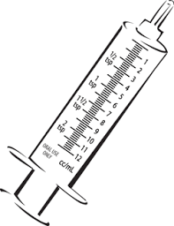
Methods
Validation
Data
  Weight
  Cardiac output
  Tidal volume
  Respiratory frequency
  Arterial and venous blood samples
  => Specific to the subject
Notes:
Validation =experimental data => experiments on pig.
We needs …
Thanks to this data, we can …

Slide 19
Results
Notes:
For example, here you have experimental data.
The crosses correspond to
Vertical lignes correspond

Slide 20
Result
Notes:
The pink curve is …
The simulation of pCO2 in arteries is closed to the experimental data.

Slide 21
Results
Pig 1
Pig 2
Notes:
Validation => other pigs experiments
=> Other measurement => pH in arteries

Slide 22
Results
Pig 2
Notes:
Model is validated => change a parameter and observe the prediction
Decrease the gaz flow in the ECCO2R by a factor 2

Slide 23
Results
Pig 2
Notes:
Increase the gaz flow in the ECCO2R

Slide 24
Results
Pig 2
Notes:
Gas flow has litlle influence over pCO2 decrease in arteries.
On the other hand, blood flow has more influence.

Slide 25
Results
Pig 1
Notes:
Decrease of pCO2 for ≠ blood flow
Physiological values + small blood flow
=> 0.5 l/min

Slide 26

Results
Blood pressure has to be
  > -50 mmHg
  < 300 mmHg
≠ of blood
Notes:
To avoid blood damages, 2 blood pressure limits
Cannula which reinjected the blood
the condition always respect => the smallest
For the cannula which suck up the blood
=> dimaeter of the cannule = 10 Fr.
! Curves are under-estimated

Slide 27

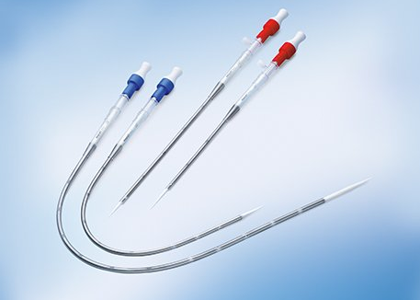
Conclusions
Notes:
Simulation correspond with the measurements.
=> model can be validated.
Tanks to the model, pCO2 for different blood
=> Optimal blood flow and choose the right cannula.
Embellished conclusion

Slide 28
Limitations
?
?
Notes:
Some simulations ≠ to experipmental data.
Parameters constant in my simulation,
To choose the right cannula, Dpdrop tested with blood
DP change very much from an experiment to an other.
Insertion ≠ ways, Blood clots

Slide 29
Thank you for your attention
E-mail: simon.habran@ulg.ac.be

