Slide 1



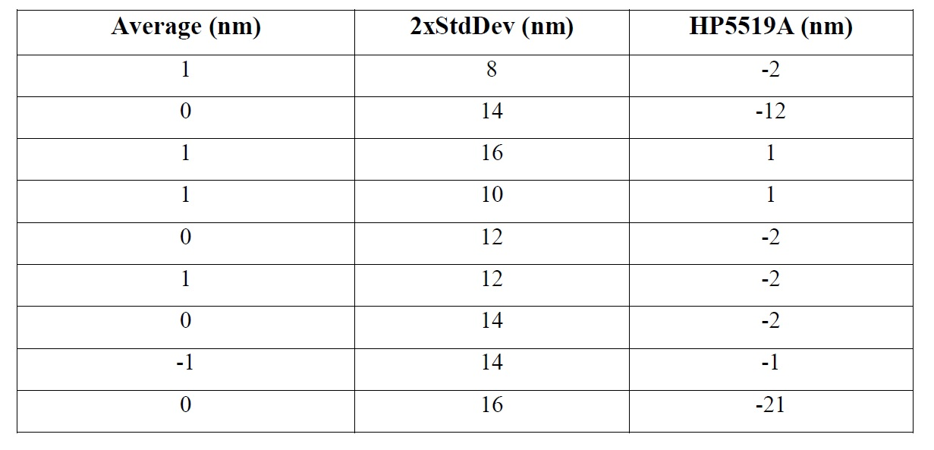
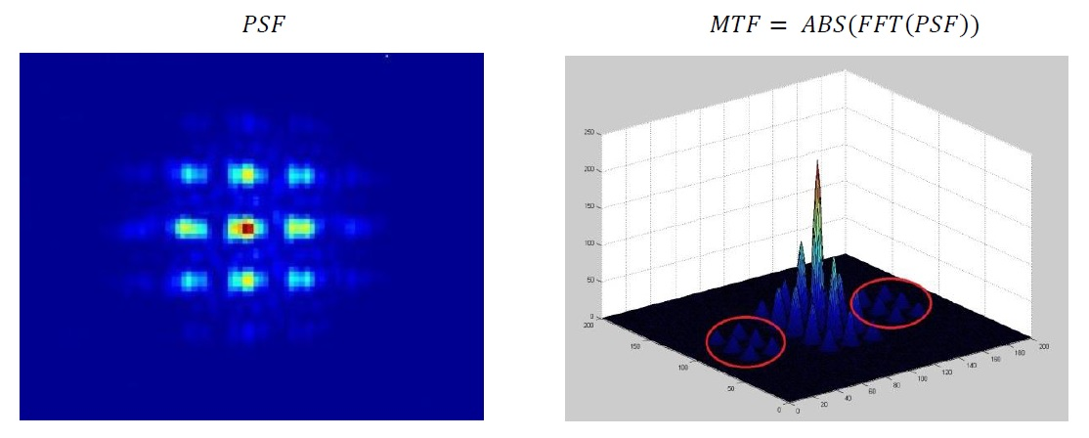
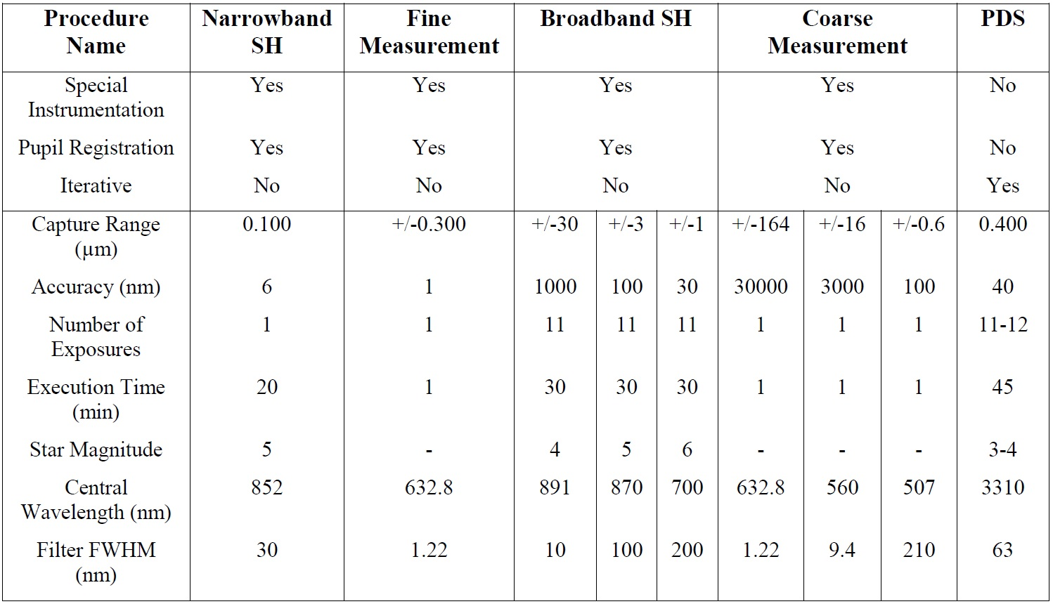
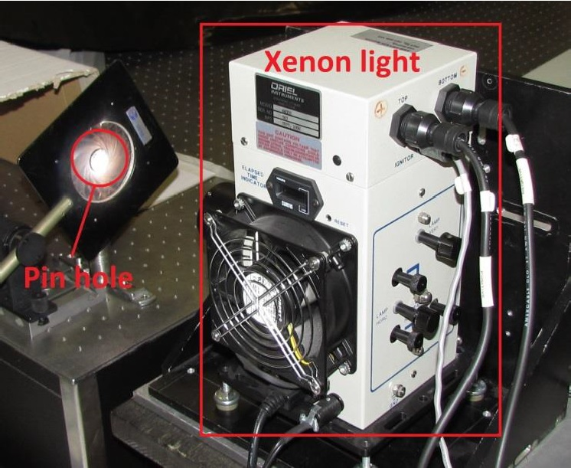
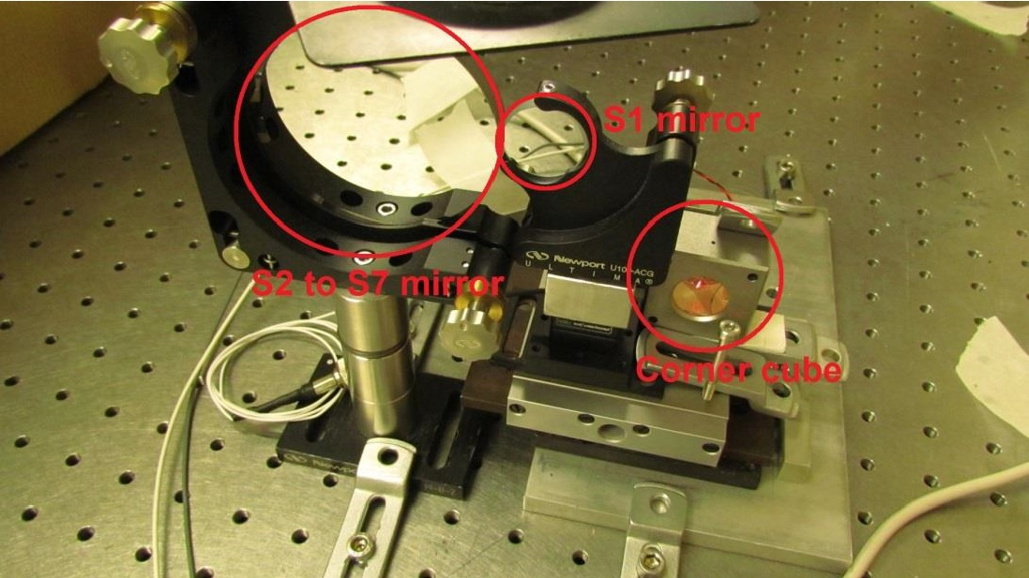
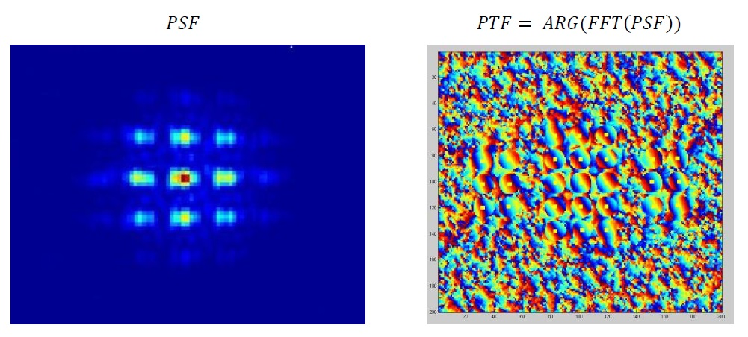
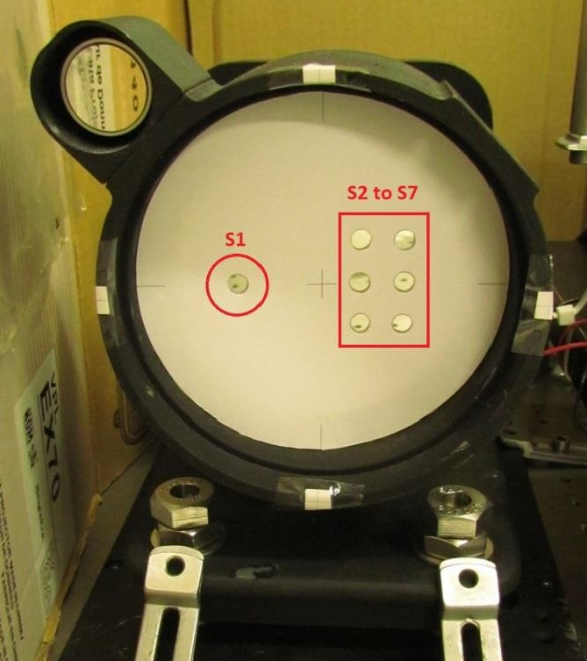
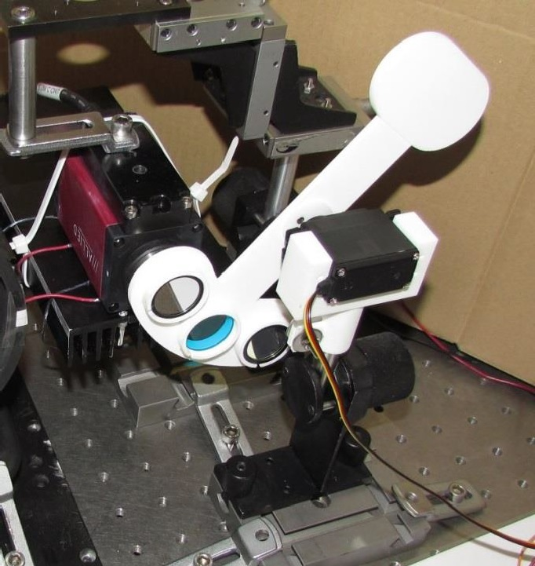

Smart co-phasing system for segmented mirror telescopes
SPIE: 9906-207
Juan F Simar*a, Yvan Stockmana, Jean Surdejb
aCentre Spatial de Liège, LIEGE Science Park, Avenue du Pré-Aily, 4031 Angleur, Belgium;
bInstitut d'Astrophysique et de Géophysique, Université de Liège, Allée du 6 Août 19c, 4000 Liège, Belgium
INTRODUCTION
METHODS
RESULTS
One of the main challenges in space observations is to observe always fainter and more compact objects. This can be achieved by increasing the telescope diameters. So, increasing the primary mirror diameters of the telescopes is the challenge solution but it is technically impossible to manufacture monolithic mirrors larger than 10m in diameter. The use of segmented mirrors thus becomes mandatory. This paper describes the results of a light co-phasing setup mounted in laboratory. This setup is able to correct a piston from 200μm to 15 nm based on coarse (200μm to 300nm) and fine (300nm to 15nm) measurement methods. Both measurements are then chained in a feedback system in order to completely co-phase and keep the segments aligned.
Coarse measurement implementation
Table 1. Results of piston measurements after the co-phasing is finished. Average of 50 measurements (Left column), standard
deviation (Central column), HP55191A measurement (Right column, this measurement leads to a Standard Deviation of 10nm).
The PSF is measured to calculate the MTF (Modulation Transfer Function).
Table 2. Comparison with the Keck telescope system
Fig. 2 PSF (left) and MTF (right) used for the coarse measurement
The peak heights of the MTF are measured so the distance (200µm to 300nm) between segments can be estimated.
Optical Setup
CONCLUSIONS
The following optical setup has been implemented in order to verify the methods.
Fine measurement implementation
With the same PSF, the PTF (Phase Transfer Function) is calculated.
A very compact and light system has been presented. This system can be adapted to any type of space or ground segmented mirror.
The system speed and precision could still be improved using high speed camera and optimized hardware.
Compared with Keck, this system has advantages but additional assessment must be performed to validate it for the case of a real segmented mirror.
Fig. 3 PSF (left) and PTF (right) used for the fine measurement
REFERENCES
Fig. 1 Optical setup implementation
The heights and inclinations of the PTF peaks are measured so the fine piston (300nm to 15nm) and tip/tilt between the segments can be found.
1. Applied Optics, Vol. 54, Issue 5, pp. 1118-1123 (2015), Single wavelength coarse phasing in segmented telescopes
2. SPIE, vol. 7731, p 165 (2010), First steps of the development of a piston sensor for large aperture space telescopes
3. Proc. SPIE 4003, Optical Design, Materials, Fabrication, and
Maintenance, 188 (July 20, 2000), Phasing the primary mirror segments of the Keck telescopes: a comparison of different techniques
It was implemented in a feedback system for automated piston correction.
*jfsimar@ulg.ac.be; phone +32 (0)4 382.46.00; fax +32 (0)4 367.56.13; www.csl.ulg.ac.be

