Slide 1


Vitamin D for the prevention of vascular calcification in normal renal function and CKD patients
Pierre Delanaye, MD, PhD
Department of Nephrology-Dialysis-Transplantation
CHU Sart Tilman, Liège
BELGIUM
Notes:
Prima di tutto vorrei dire grazie a tutti gli organizzatori e particolarmente Maria Fusaro Per l invito a questo congresso

Slide 2

0-2

Slide 3

Vitamin D for the prevention of vascular calcification in normal renal function and CKD patients
Vitamin D for the prevention of vascular calcification in normal renal function and CKD patients
Pierre Delanaye, MD, PhD
Department of Nephrology-Dialysis-Transplantation
CHU Sart Tilman, Liège
BELGIUM

Slide 4

Active Serum Vitamin D Levels Are Inversely Correlated With Coronary Calcification
by Karol E. Watson, Marla L. Abrolat, Lonzetta L. Malone, Jeffrey M. Hoeg, Terry Doherty, Robert Detrano, and Linda L. Demer
Circulation
Volume 96(6):1755-1760
September 16, 1997
Copyright © American Heart Association, Inc. All rights reserved.

Slide 5
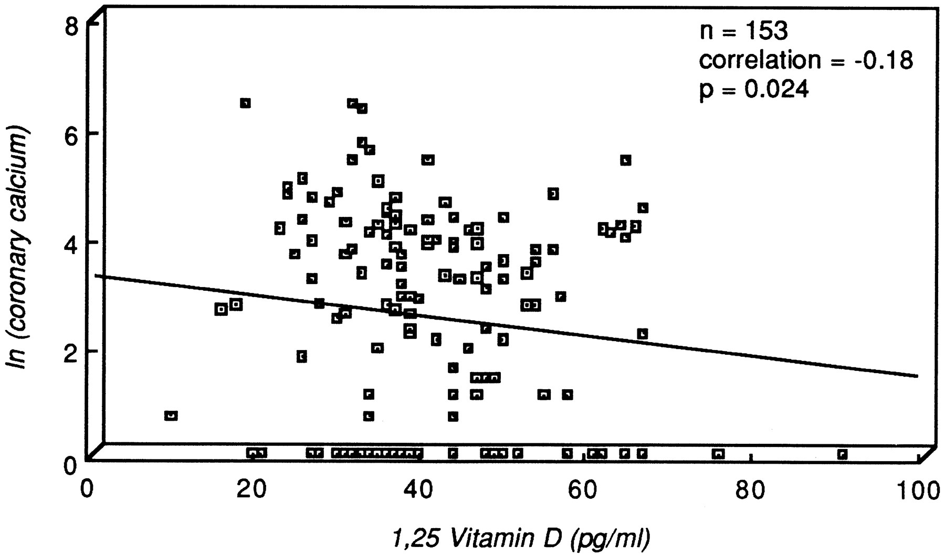
Negative relation between coronary calcification and serum 1,25-vitamin D levels in subjects with a moderate risk of developing coronary heart disease.
Karol E. Watson et al. Circulation. 1997;96:1755-1760
Copyright © American Heart Association, Inc. All rights reserved.
Notes:
asymptomatic patients, CKD excluded, no known CHD
Association not very strong but significant and négative
Negative relation between coronary calcification and serum 1,25-vitamin D levels in subjects with a moderate risk of developing CHD (HW=heartwatch group)>5% 4 years risk for CHD according to Framingham.
Pas de correlation avec PTH et Ostécalcine
En multi varié, âge et 1,25 sortent
Idem negative relationship in 12 patients with familial hypercholesterolemia
Negative association confirmed by Doherty TM Circulation 1997
No association for Arad Y coron artery dis 1998

Slide 6
Notes:
But not only vascular calcifications !! (the authors do not discuss vascular calcification) but inflammation and vascular remodeling
Other data on ventricular hypertrophy and hypertension

Slide 7
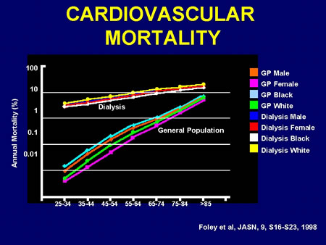
Introduction
Vascular calcifications (VC): CV risk factor in dialysis patients
  High CV mortality not linked to traditional CV risk factors
25=80
Foley RN. Clinical epidemiology of cardiovascular disease in chronic renal disease. Am J Kidney Dis 1998 Nov;32(5 Suppl 3):S112-S119.

Slide 8
Introduction
Coronary calcifications in dialysis patients:
    More prevalent (until 90%) and more severe (calcium score 2.5 to 5-fold higher)
    Early and more rapidly progressive
Goodman WG et al. N Engl J Med 2000;342(20):1478-83
Notes:
8

Slide 9
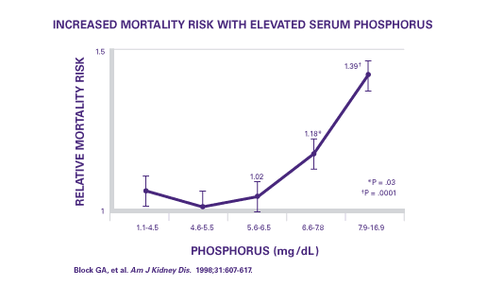
Introduction
  Relationship between
    CV mortality and mineral metabolism markers (P, Ca, and PTH)
Notes:
9

Slide 10
Introduction
  Relationship between
    Several mineral metabolism markers and VC
Goodman WG. N Engl J Med 2000 May 18;342(20):1478-83.
Hruska KA. Pediatr Nephrol 2010 Apr;25(4):769-78.
Mitsnefes MM. J Am Soc Nephrol 2005 Sep;16(9):2796-803.
Shroff RC. J Am Soc Nephrol 2007 Nov;18(11):2996-3003.
Braun J. Am J Kidney Dis 1996 Mar;27(3):394-401.
Goodman WG. Am J Kidney Dis 2004 Mar;43(3):572-9.
Guerin AP. Nephrol Dial Transplant 2000 Jul;15(7):1014-21.
Raggi P. J Am Coll Cardiol 2002 Feb 20;39(4):695-701.
Huting J. Chest 1994 Feb;105(2):383-8.
Oh J. Circulation 2002 Jul 2;106(1):100-5.
London GM. Nephrol Dial Transplant 2003 Sep;18(9):1731-40.
Notes:
10

Slide 11
Introduction
  Relationship between
    VC and CV mortality
London GM. Nephrol Dial Transplant 2003 Sep;18(9):1731-40.
Blacher J. Hypertension 2001 Oct;38(4):938-42.
Matsuoka M. Clin Exp Nephrol 2004 Mar;8(1):54-8.
Block GA. Kidney Int 2007 Mar;71(5):438-41.
Schlieper G. Kidney Int 2008 Dec;74(12):1582-7.
Adragao T. Nephrol Dial Transplant 2004 Jun;19(6):1480-8.
Okuno S. Am J Kidney Dis 2007 Mar;49(3):417-25.
Jean G. Nephrol Dial Transplant 2009 Mar;24(3):948-55.
Adragao T. Nephrol Dial Transplant 2009 Mar;24(3):997-1002.
Notes:
11

Slide 12
CV mortality and VC: no direct proof of causal link
…still a surrogate marker
Notes:
No definitive proof that VC is reversible
No proof that decreasing the VC improve the mortality (plaque stability)

Slide 13
Types and mechanisms of vascular calcifications
VC in CKD: an active and complex process
Figure: Four non-mutually exclusive theories for vascular calcification. (1) Loss of inhibition as a result of deficiency of constitutively expressed tissue-derived and circulating mineralization inhibitors leads to default apatite deposition. (2) Induction of bone formation resulting from altered differentiation of vascular smooth muscle or stem cells. (3) Circulating nucleational complexes released from actively remodelling bone. (4) Cell death leading to release of apoptotic bodies and/or necrotic debris that may serve to nucleate apatite at sites of injury (Giachelli. J Am Soc Nephrol, 2004, 15, 259-2964
Notes:
VC: vascular calcification
CKD: chronic kidney disease
FGF23 -/- => hyperP et CV mais pas si régime pauvre en phosphore

Slide 14
vitamin D (native or active) and Vascular calcifications
We need a RCT in CKD patients (eGFR<30 mL/min/1.73 m²)
Three groups: native vitamin D, active vitamin D and placebo
Maybe different doses, sufficient follow-up
Maybe different population (HTA, diabetes, countries)
Endpoint (surrogacy): incidence of vascular calcifications and/or progression
Hard endpoint: mortality (cardiovascular mortality)
Such a study is not available…
So, we do not really know…

Slide 15
Thank you for your attention!

Slide 16
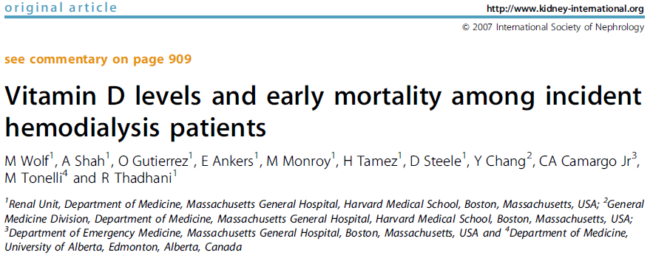
Epidemiology
Incident hemodialysis, prospective cohorte, n= 825 patients
60% are insufficient (10-30 ng/mL)
18% are deficient (<10 ng/mL)

Slide 17
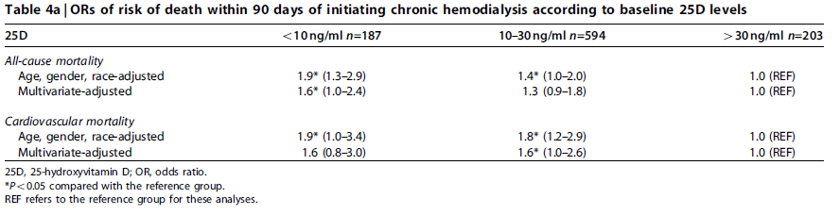
Epidemiology
Notes:
At baseline, none treated by active vitamin D
If treated by vitamin D in the first 90 days => same conclusion
If not treated => mortality higher than treated and no difference according to 25 or 1,25vitamin D level

Slide 18
1370 patients (976 with eGFR<60 mL/min/1.73 m²)
CAC in 53% at baseline
In free CAC patients at baseline, 21% will develop incident CAC during 3 y of follow-up
Low 25-OH vitamin D is associated with incident CAC
Notes:
MESA: Multiethnic study on atherosclerosis (excluded if previous CV events)
12 à17% of diabetic (according to VIT > or < tha 15) and 53 to 59% of hypertension
1,25 there is a trend for association with prevalence but not if adjustement and no assoiation with incident

Slide 19
Notes:
Low 25VIT is associated neother with prevalent CAC not with CAC progression in prevalent
Idem after adjustment for age, diabetes, CRP, LDL, eGFR, BP, season, center, BMI
Especially relevenant in low eGFR
No association for 1,25vitamin D
No data on therapy

Slide 20
Prospective survey in 28 dialysis centers
N=2453 (823 with PTH<150 pg/mL)
Follow-up: 18 months

Slide 21
Notes:
Idem US (Teng) et Japan (Sohji)
No standardization in PTH measurement
No analysis according to vitamin D dosage, very heterogeneous patients and therapies
No data on native vitamin D (no 25OH vitamin D measurement)
Bias of indication
Métananlysis de Palmer = pas assez de donnée
KI 2006Tentori: peu de difference de survie en cacitriol et paricalcitol

Slide 22
Basic research

Slide 23
Expression of 1^{α}-hydroxylase in epigastric artery of donors and recipients
In Vascular Smooth Muscle Cells
5/6 nephrectomized (STN)
Notes:
VDR is also expressed in VSMC (not for all authors => some says it is an artefact)
CKD n=9 non-CKD n=10
1alpha hydroxylase son activité augmente si CKD

Slide 24
Calcitriol: 400 ng/kg
Supraphysiological doses
Induces hyperphosphatemia and hypercalcaemia
Excellent model for inducing vascular calcifications!!!!
Notes:
Especially if diet rich in phosphate

Slide 25
(cholecalciferol, non CKD model)
3x 300 000 UI vitamin D/kg !!
Notes:
Avec vit D et Vitamin K calcificatiosn en 4 jours
Calcification but also hypercalcaemia, no hyperphosphatemia but non CKD model and no measurement of phosphaturia

Slide 27
Notes:
LDLDR -/- = LDL receptor deficient with high fat feeding + CKD => vascular calcification and adynamic bone disease (=model for diabetics with ABD)
CKD after 12 weeks = untreated
How protective? 1) inhibition of osteoblastic gene (CBFA1, osteocalcin) expression in the aorta 2) By stimulating osteoblast function and increase bone turn over in ABD et so promote deposition of Ca and P in bones (c’est pas classique quand même ça chez l’humain)
Nephrectomy of left kidney and electrocautery of right kidney.
Killed ay 28 weeks, vascular calcification = intima in this model
PTH diminue dans tous les groupes traités,
P haut dans les groupes CKD mais étrangement pas plus haut dans le groupe high dose

Slide 29
Notes:
1 microgramme = 100 nannogramme It is still huge doses (even if model are not directly comparable)
Vacular smooth muscle cell
5/6 nephretomized
Same reduction in PTH
Less hyperphosphatemia => not really the case in clinical practice

Slide 30
Observational studies
52 ESRD adults
Naïve of any vitamin D therapy
Notes:
Patient naïve of any vitamin D and cinacalcet (but treated by sevelamer)
Correlation with PWV is independent of age and systolic pressure
Calcification = echo aorte, carotids et axe ilio-femoral + radiography abdominal
Pas de correlation avec calcifications pour 1,25 correlation inverse avec 25OH mais plus après ajustement pour l’âge

Slide 31
Notes:
140 CKD (not only HD, 33% stage 5)
scan

Slide 32
Observational studies
61 children in dialysis (13±4 y)
All treated by 1α-calcidol
Notes:
Dosage calcidol= to maintain PTH>two fold upper lower normal values
Weak correlation between alfacalcidol dosages and 1,25vitamin D dosage au moment de l’étude ou moyenne
Ushape idem for intima media thickness (but not with PWV)
Calcification especially if low 1,25( and high usCRP
PD=48 HD=13
Association does not necessarily indicate a cause-effect relationship
No association with 25OHvitmain but all have low values (8%>30 ng/ml and 50% with <10 ng/mL) (mean 13 ng/mL)

Slide 33
Dialysis patients treated with α-calcidol for hyperPTH
70 with dose < 2 µg/week and 15 with dose ≥ 2µg/week
Pulse wave velocity, mean follow-up of 1.2 year

Slide 34
Notes:
Not clear if adjusted for phosphate (but well for PTH, FGF23 Klotho…)
No association no Ushaped association between PWV et 25-Ohvitamin D

Slide 35
Randomized controlled studies
Notes:
115 cinalcalcet
120 placebo

Slide 36
Cinacalcet = cinacalcet + low doses of vitamin D paricalcitol<2µg/dialysis
Control = vitamin D (PO or IV)
Goal = PTH<300 pg/mL
N (completed the study)=115 in cincalcet and 120 in control
Notes:
Only calcium based for Phsophate chemation => bias because hyperP induced bu active vitamin d is treated by calcium!!!
Baseline mean PTH = 420 pg/mL, median CAC: 600 (695 in cinacalacet and 590 in control)
2microg paricalcitol = 0,5 microgr calcitriol 3X/sem = 0,25 calcitriol and 0,5 alphacalcidol 1X/j
75% use vitamin D at baseline
PTH measured by different assays but the same assay for follow up

Slide 37
Notes:
En temres de calcium de P et de PTH groupe cinalcalcet fait mieux (diminue plus) mais IMPACT (Ketteler NDT) and PARADIGM (WetMore CJASN): pas de différence

Slide 38
Notes:
Post hoc
Protocol adherent
Non protocol adherant

Slide 39
Cinacalcet = cinacalcet + low doses of vitamin D paricalcitol<2µg/dialysis
N=120
N=45
N=70
Notes:
PTH, Ca and P also lower in CPA and NCPA than in controls
No data on comparison between CPA and NCPA
Même dose de cinacalcet dans les CPA et NCPA

Slide 40
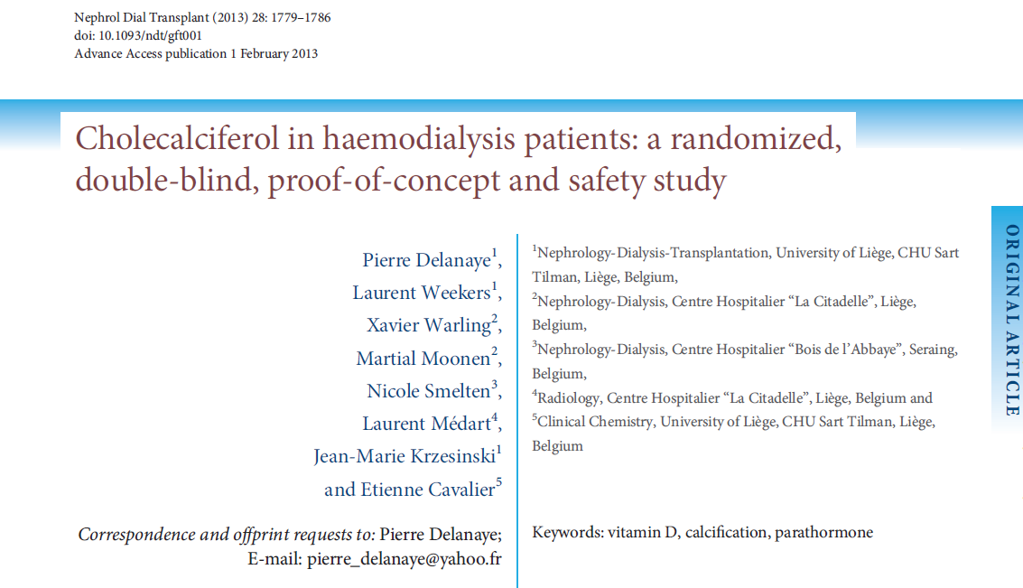

Slide 41
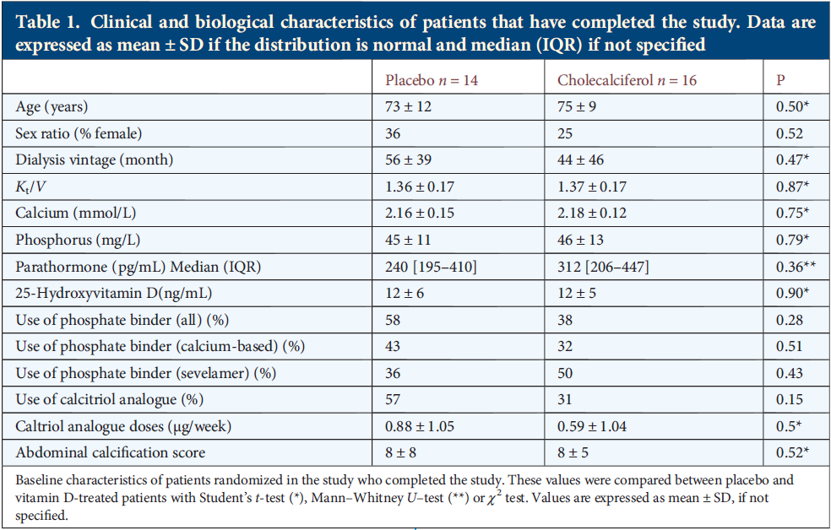

Slide 42
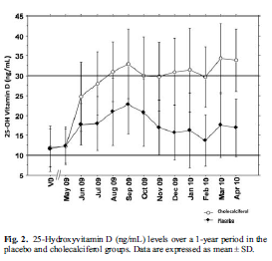
Cholecalciferol:
25.000U/2 weeks
1 year follow
Notes:
Highest 25OH vit D level: 50 pg/mL

Slide 43
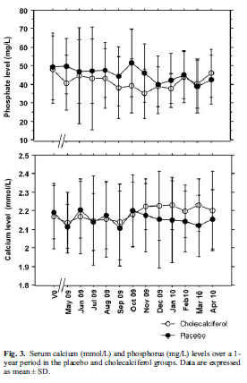

Slide 44
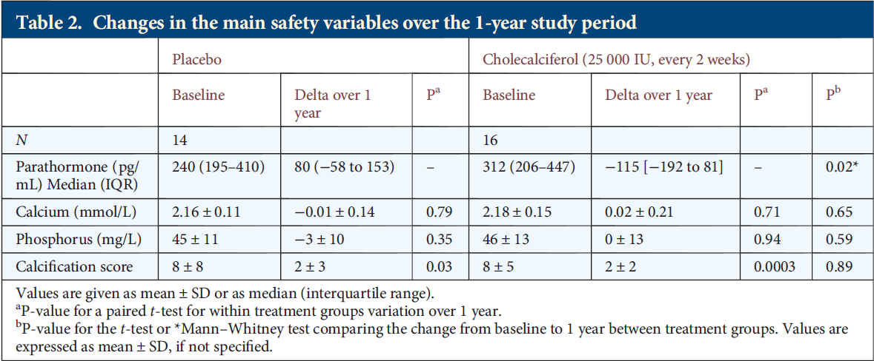
Kauppila: Over 1 year period: + 2 in both arms (idem DCORD)
Notes:
Kauppila n=13 in treated group and 11 in placebo
Two other small studies (Massart in AJKD and Kidir in Ren Failure)

Slide 45
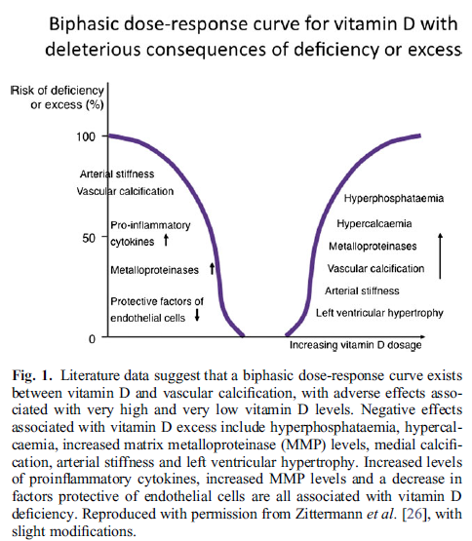
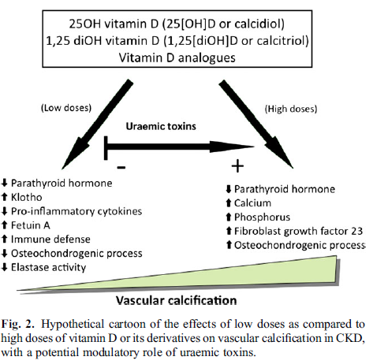
The dose is important

Slide 46
If dose is important, maybe The monitoring is important
Measuring 25-OH vitamin D is routine
Accurate for Vitamin D status
Useful for therapy monitoring (we know “normal values”)
Measuring 1,25 vitamin D is (more) difficult and costly
Useful (monitoring)????
Notes:
In Schroff: no relation between dosage of alfacalcidol and 1,25 vitamin measurements

Slide 47
Vitamin D standardization program traceable liquid chromatography tandem mass spectrometry

Slide 48
Conclusions
The Evidence is low
Native vitamin D does not seem deleterious in terms of vascular calcifications
Active (or new analogs) vitamin D is not deleterious at least if
Nor hypercalcemia neither hyperphosphatemia
  Goal of therapy is PTH in the « normal » levels (2-9x UNV) (no adynamic bone disease)
Strong proofs that the effect is beneficial is however lacking
The dose is probably important
The monitoring could be important

Slide 49

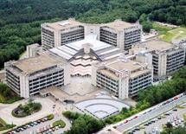
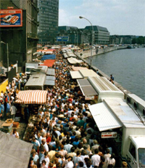


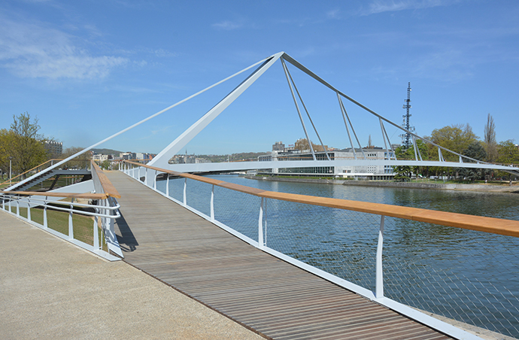
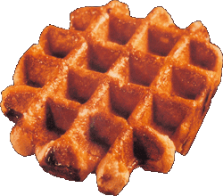
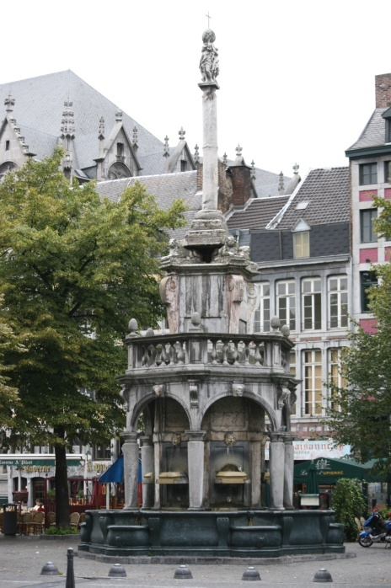

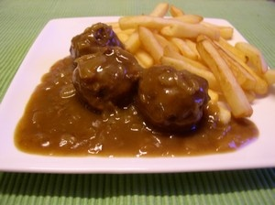

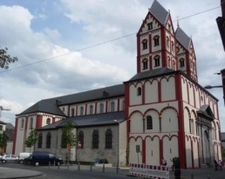

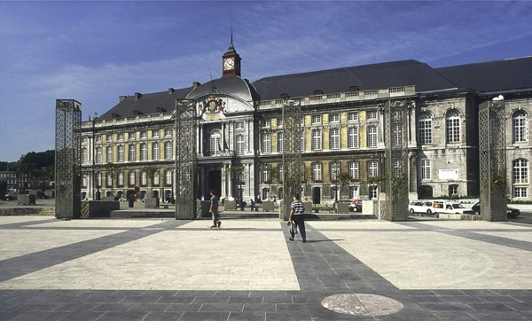

Welcome in Liège !!

