Slide 1
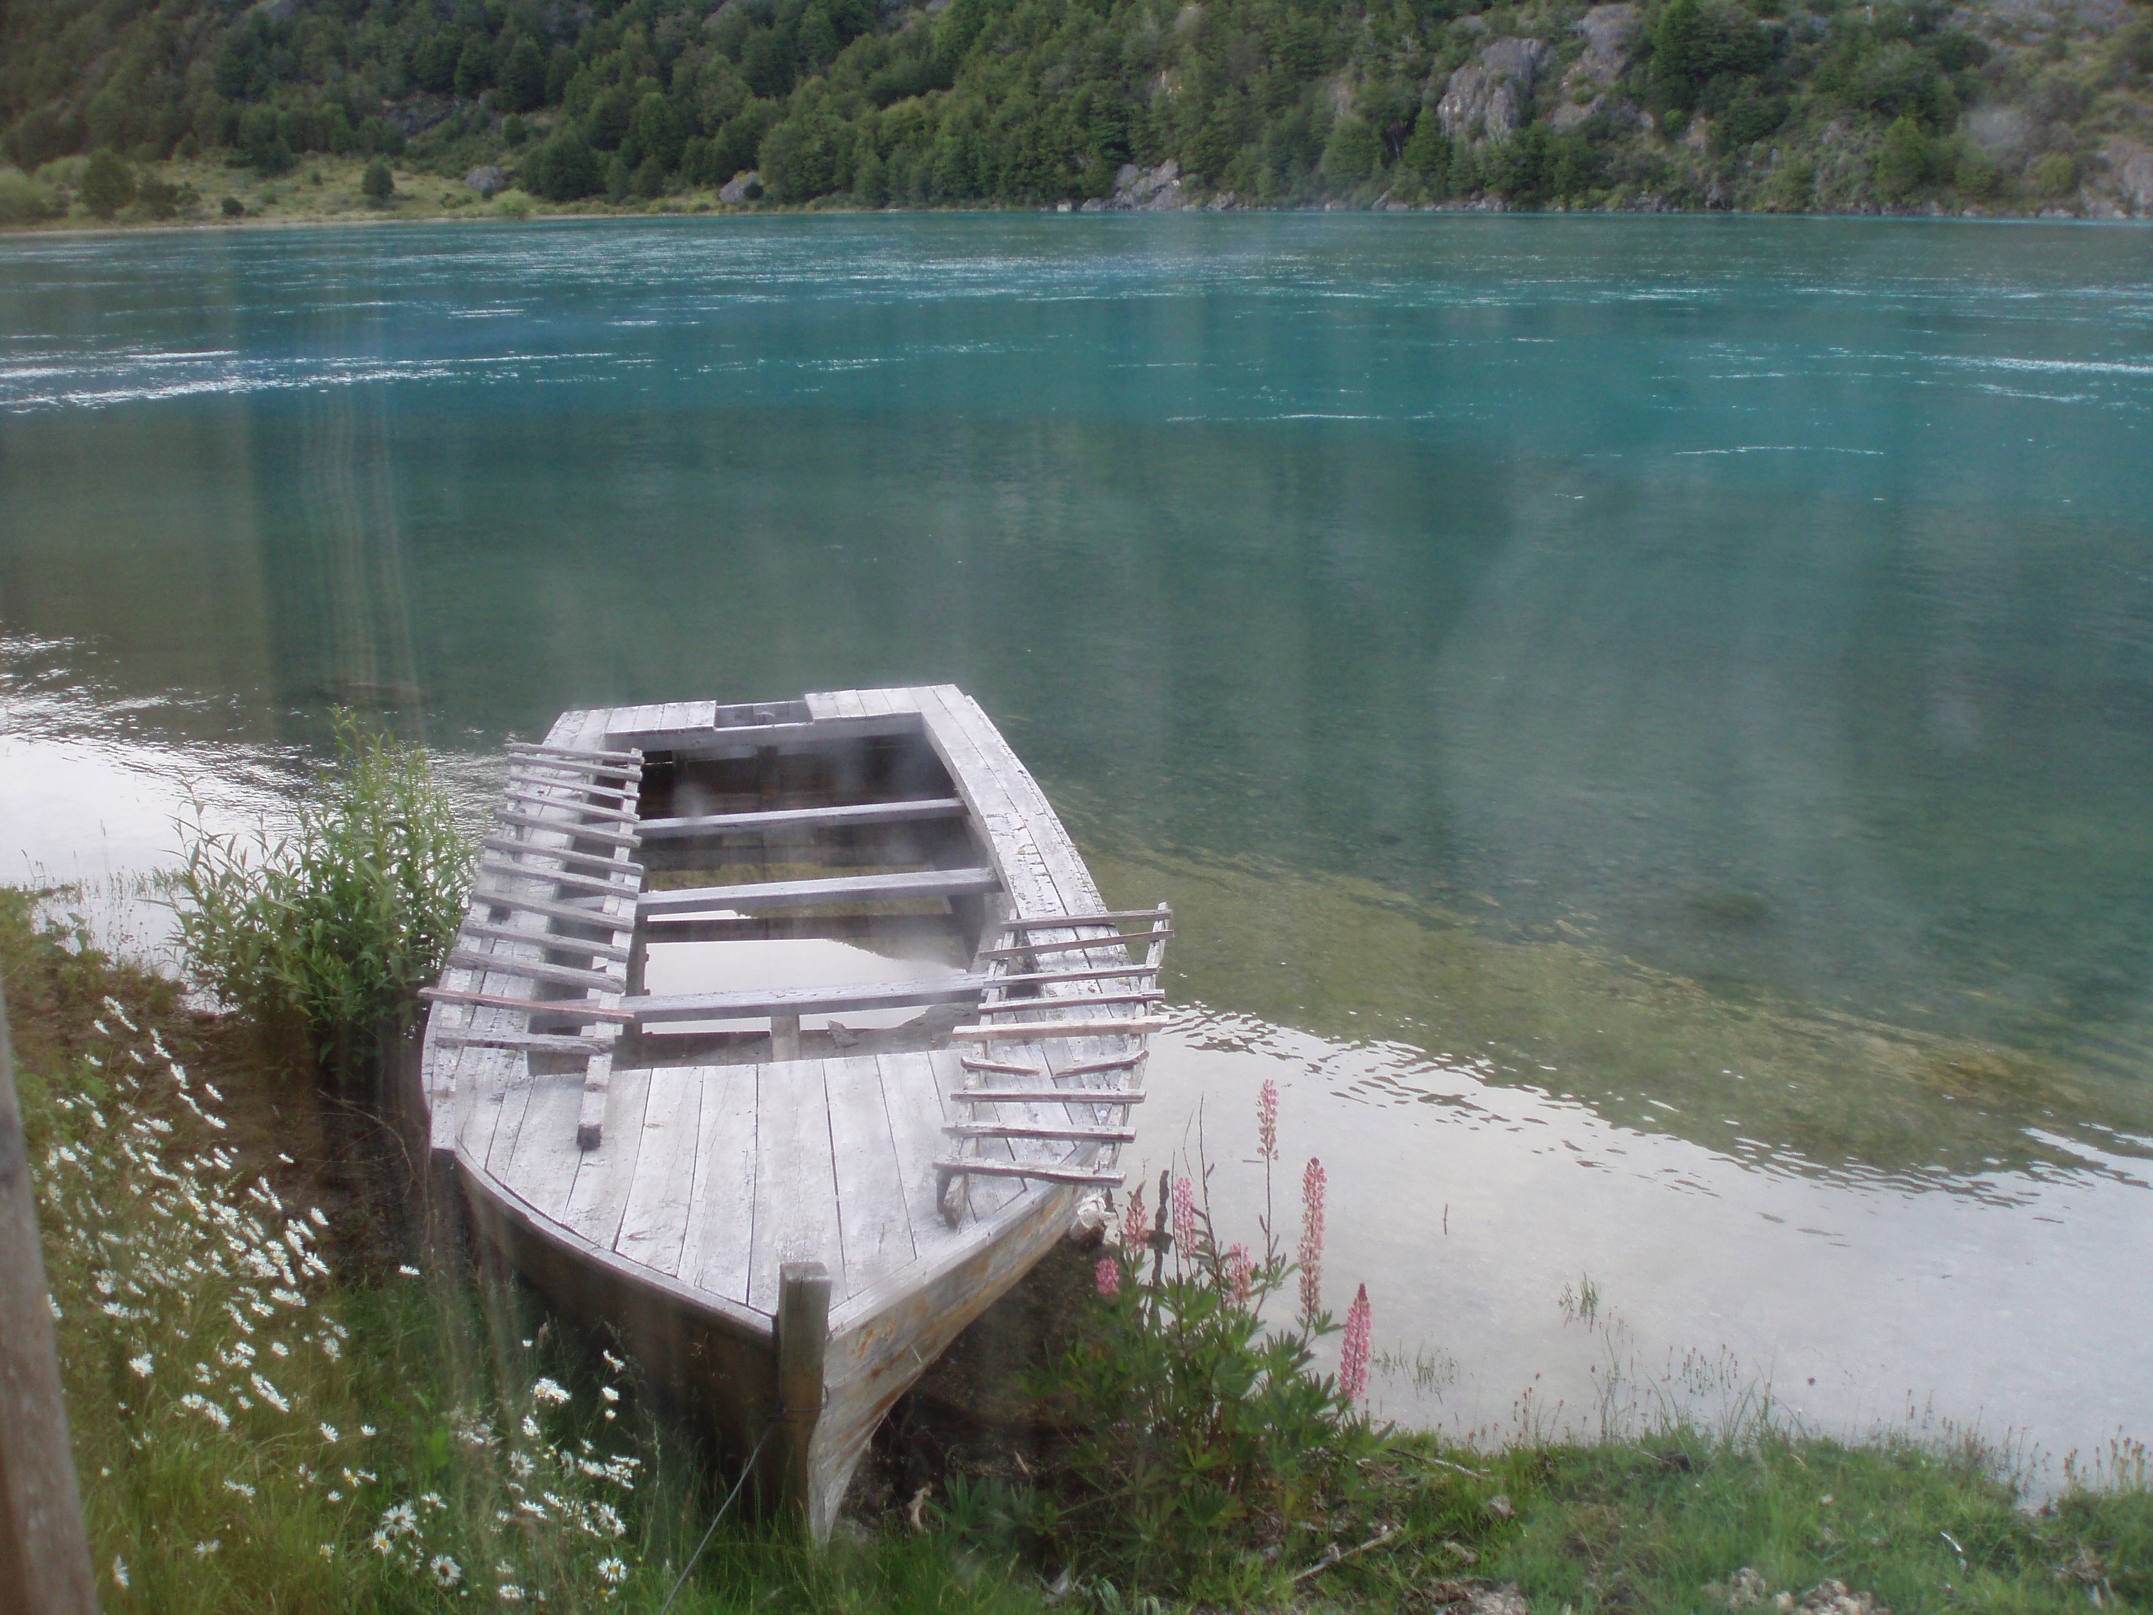




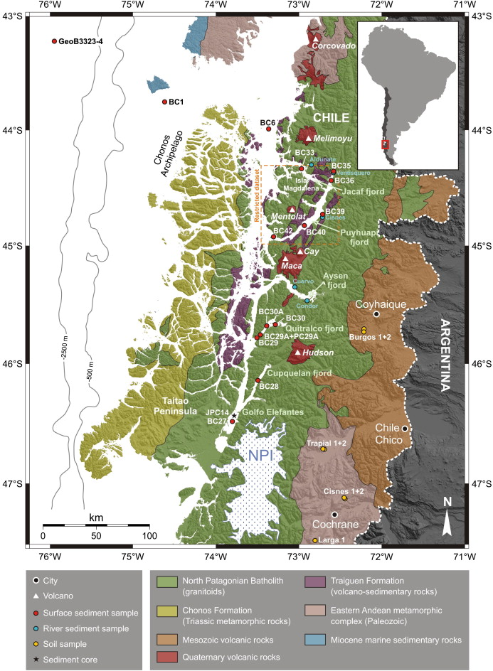
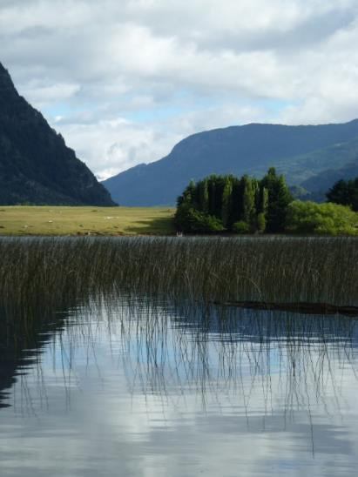
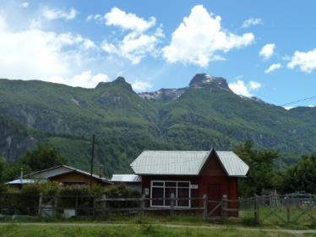
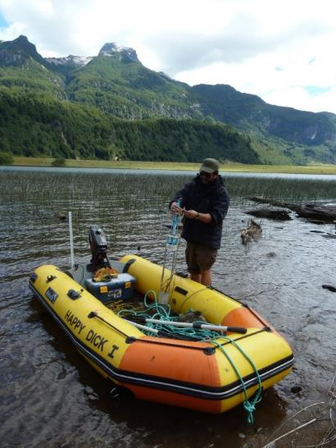

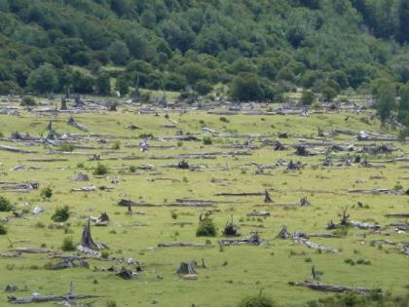
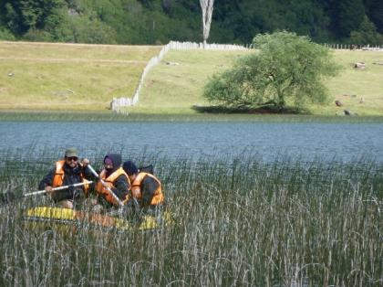
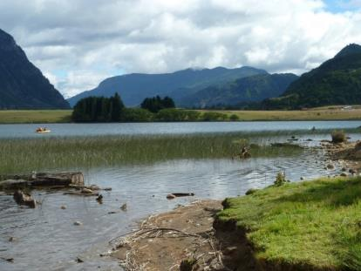
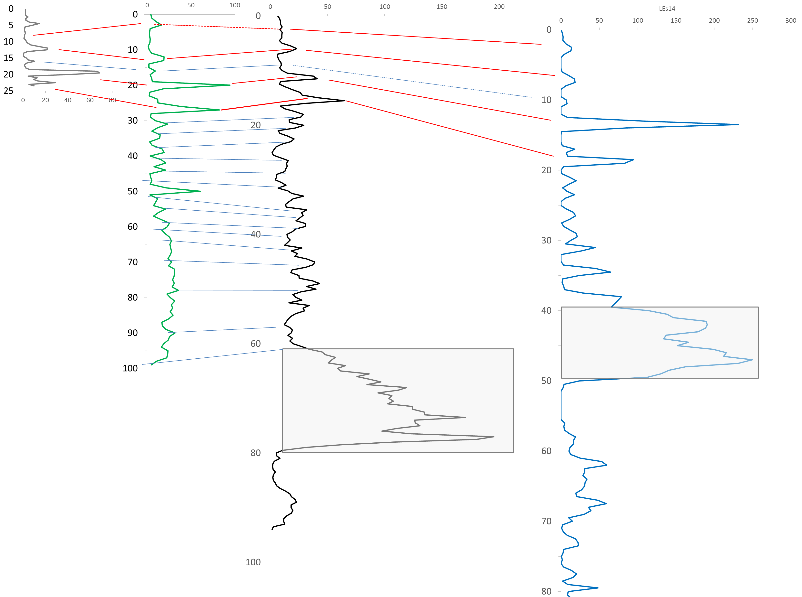
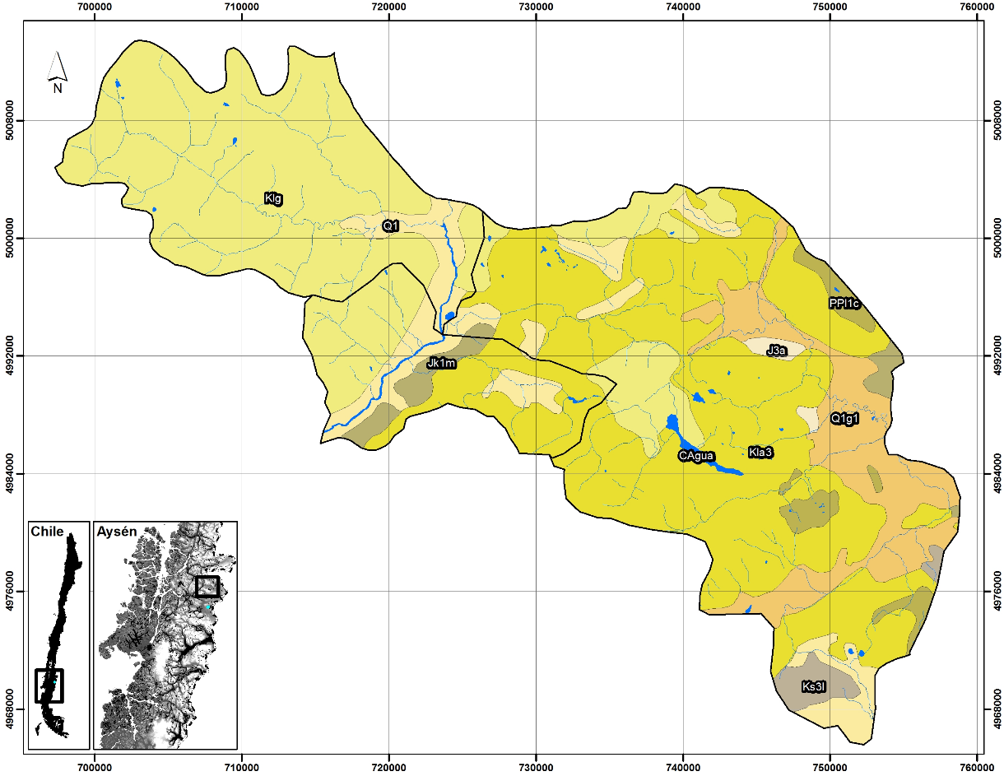
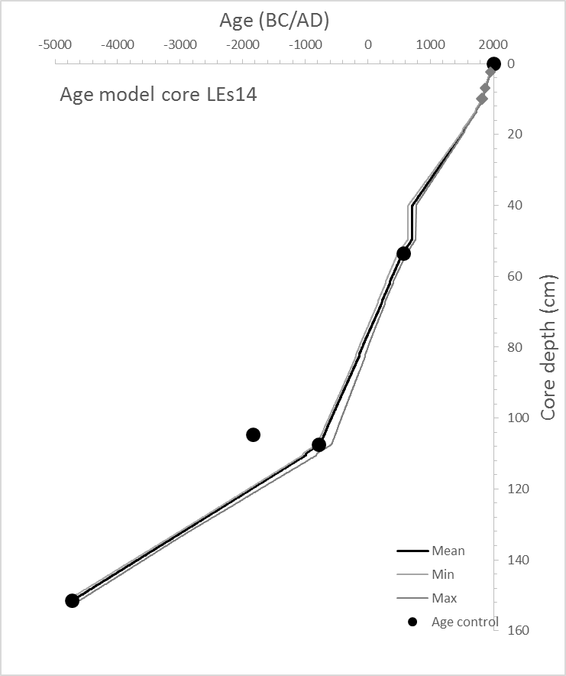
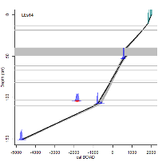
The last millenia sedimentary record of Lago Esponja
from Northern Chilean Patagonia
Fagel N. ¹, Araneda A.^{2,3}, Alvarez D., Perfetti-Bolaño A.², Billy I.⁴, Martinez P.⁴, Schmidt S.⁴ and Urrutia R.^{2.3}
1 AGEs - Clays, Sedimentary environments and Geochemistry, Department of Geology, University of Liege, Allée du 6 aout, B-4000, Liège, Belgique
2 Aquatic Systems Research Unit, EULA – Chile Environmental Sciences Centre, University of Concepcion, Casilla 160-C, Concepcion, Chile
3 Patagonian Ecosystems Research Center (CIEP), Coyhaique, Chile
4 UMR Environnements et Paléoenvironnements Océaniques et Continentaux, Université de Bordeaux, France
AIM & LOCATION
We evaluate the climate and environmental variability of Northern Chilean Patagonia during the Last Millennia, using a multi-proxy analysis of a sediment core from Lago Esponja (45°09’S, 72°08’W).
The lake is located in the region of Aysen del General Carlos Ibanez del Campo, in NW Patagonia (map A).
The study focuses on a multiproxy analysis of sedimentary records. The longest core (150 cm long) was collected in 2014 at 40 m depth (map B)
CORE SEDIMENTOLOGY & AGE MODEL
The sediment is composed of light brown organic-rich clayey silt. It was analyzed for sedimentology (grain size, magnetic susceptibility organic matter and biogenic silica content), mineralogy (X-ray diffraction) and geochemistry (elemental and isotopic analyses of C and N, XRF core-scaner at 1 mm resolution).
A
Core correlation by magnetic susceptibility
Macroscopic descriptions and Scopix radiographies show that the sediment record is finely laminated except a massive decimetric coarser and darker layer corresponding to a tephra (estimated age 700AD±50).
LEs11
LAGO ESPONJA
LEs13
LEs10
B
Tephra
Tephra
LEs10
LEs14
Radiocarbon ages, measured on 3 macro-remains, demonstrate that the core covers the last 6.700 years.
The sedimentation rate ranges between 0.1 mm/yr in the lower section (100-150 cm) and 0.4 mm/yr in the upper meter.
Kig: Granites, granodiorites & hornblende-rich tonalites.
Kia3: Continental volcanic complexes (lavas & basaltic to andesitic breccias). Pyroclastic, andesitic to rhyolithic, rocks with some sedimentary intercalations.
Magnetic susceptibility (confirmed by scopix) evidences 1 tephra and 8 microtephra layers.
LEs11
Lake Esponja
Volcano
City
Map of the Chilean Northern Patagonia showing the location of the studied lake. The colors indicate the simplified geology. Map reprinted from Bertrand et al. (2011).
Geology of the watersheds surrounding the Lake Esponja.
Identification of tephras
& Selection of 14C samples
Age model
MULTYPROXY RESULTS & INTERPRETATION
Environmental significance of sediment variability ?
Organic matter content, grey-scale and magnetic susceptibility present high sediment variability, also marked by changes in the chemical composition.
The biogenic silica content of the sediment is low (mean 5%). Diatom assemblage is dominated by benthic and acidophilous species, with high saprobic values. None marked changes were observed regarding the dynamic of the lake.
The sediment is characterized by a high organic matter content (mean 15%). However its C/N ratio is stable throughout the core (average 12.7), indicating inputs of both allochtonous and terrestrial organic matter.
Synthesis & perspectives
The laminations mainly reflect changes in the allochtonous sedimentary inputs. We suspect high terrestrial inputs during wetter conditions in relation with the Westerlies.
Further studies will investigate the relationships between runoff signal & average regional precipitation in order to confirmed or infermed the climate-driven control in the sediment variability.
More information: nathalie.fagel@ulg.ac.be - www.ages. ulg.ac.be
ACKNOWLEDGEMENT - This research is funded by Chilean Fondecyt project number 1070508 and Belgian projects (FNRS proposal 1360 2007-2010, ULg CFRA 1060 2009-2010)

