Slide 1
Myoferlin is an essential component for VEGF-A production by pancreas
cancer cells
Karim FAHMY
07.11.2014

Slide 2
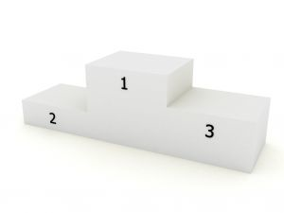
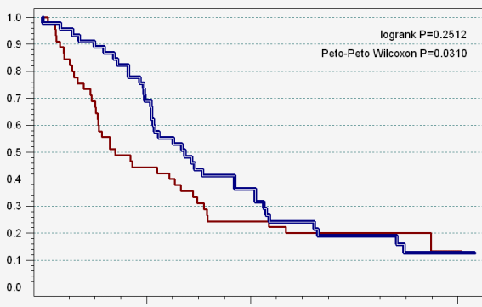
Pancreatic Cancer
2% of cancer cases
4th cause of mortality in cancer
Late diagnosis (50% in stage IV)
Survival rate of 5 years < 5%
Surgical removal combined with chemotherapy

Slide 3
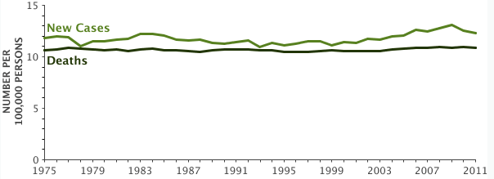
Pancreatic Cancer
National Cancer Institute
World wide 277000 new cases and 266000 deaths !!!!!
International Agency for Research on Cancer
2008

Slide 4
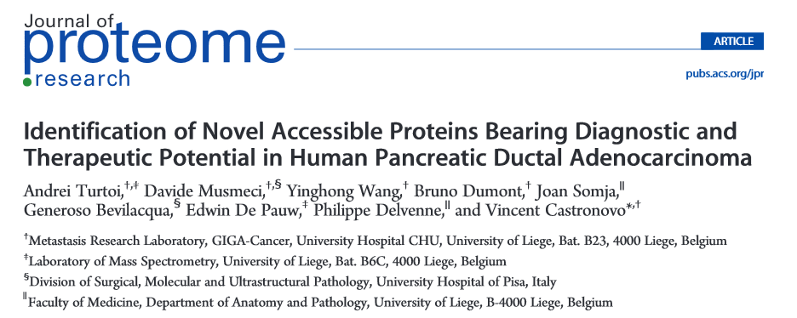
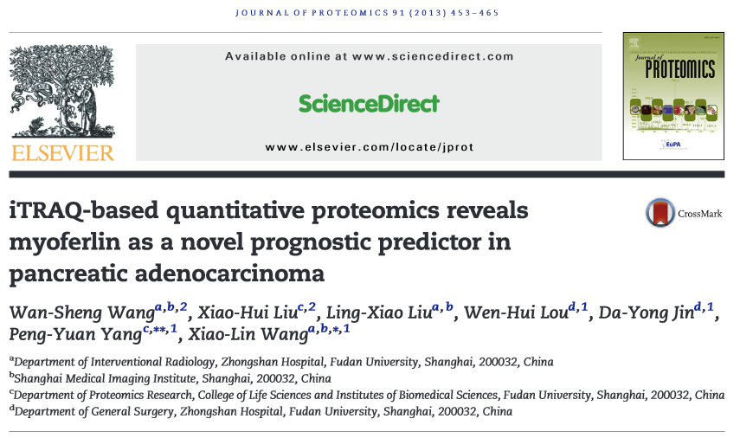
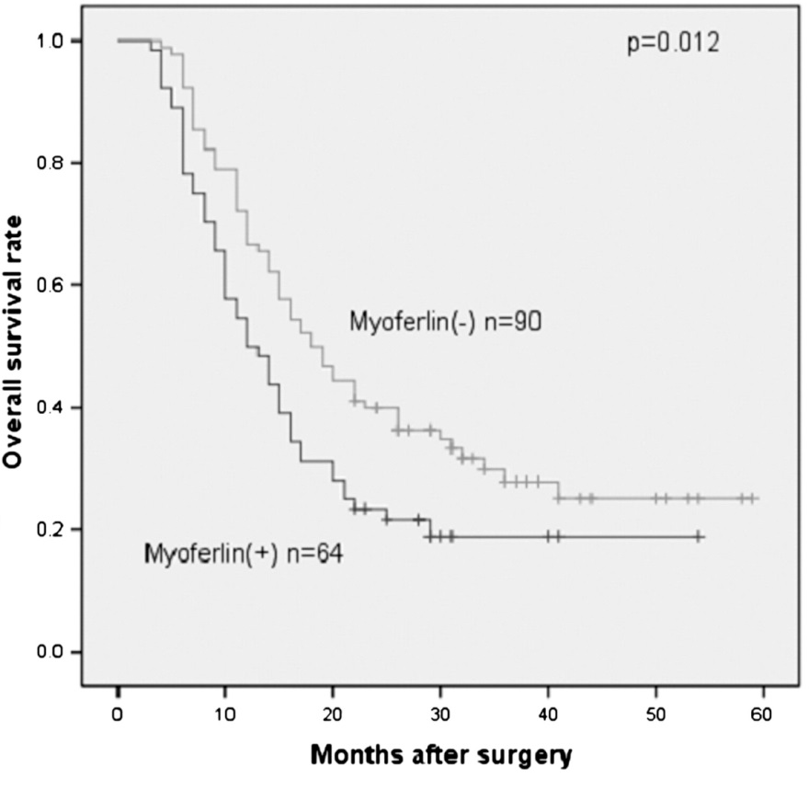
Biomarkers of PDAC

Slide 5
Myoferlin
Myoferlin is described as a calcium/phospholipid-binding protein that plays a role in the plasmalemma repair mechanism that permits rapid resealing of disrupted membranes. It is also involved in endocytic recycling.
Notes:
Caenorhabditis elegans

Slide 6
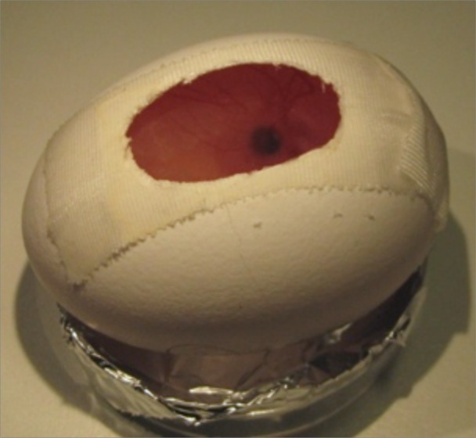
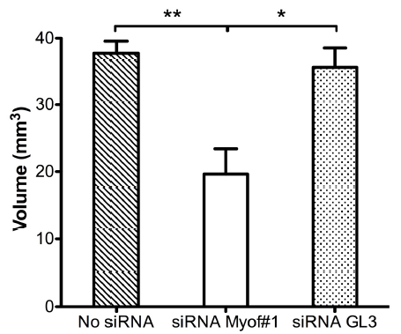
Myoferlin silencing reduces tumor growth in ovo
BxPC-3
D0
D3
D11
D17
D21
Tumoral growth
no siRNA
siRNA Myof#1
siRNA GL3
3 independent biological replicates

Slide 7
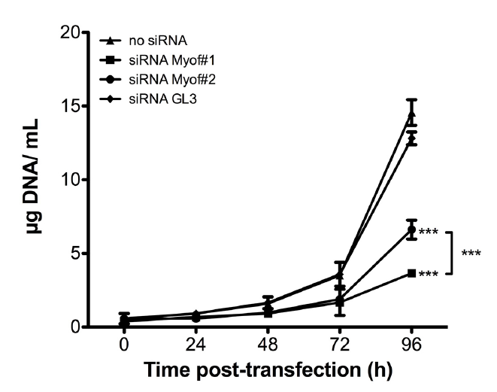
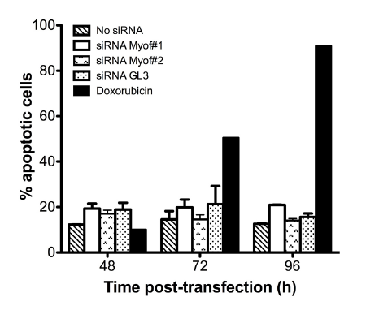
Myoferlin silencing reduces cell growth in vitro
3 independent biological replicates

Slide 8
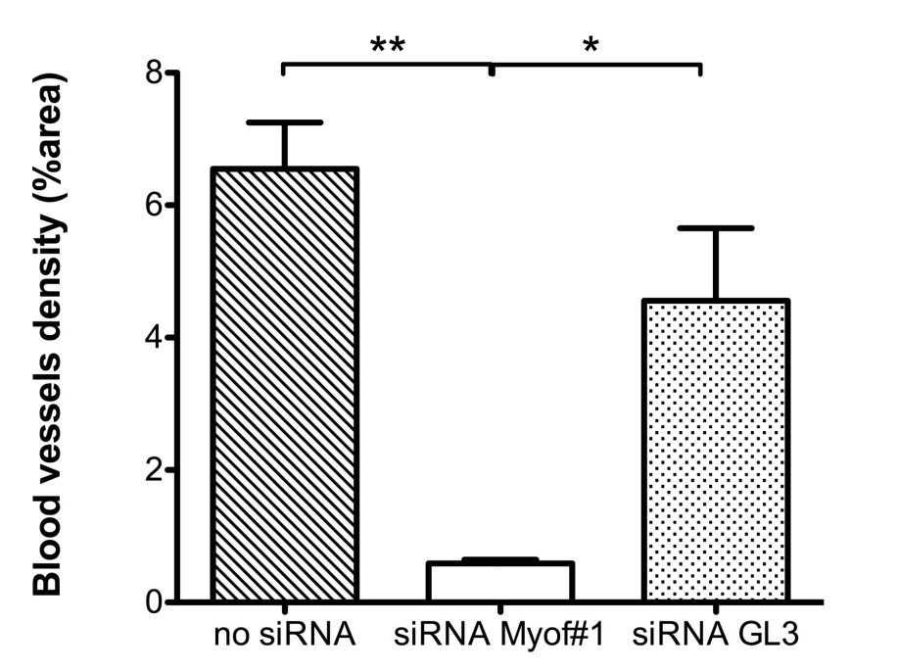
Myoferlin silencing reduces tumor growth in ovo
no siRNA
siRNA Myof#1
siRNA GL3

Slide 9
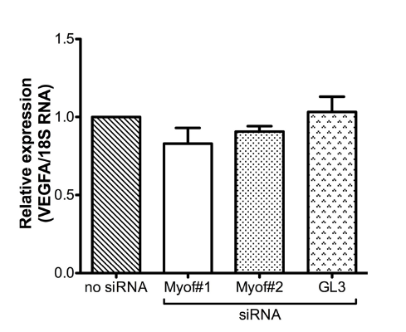
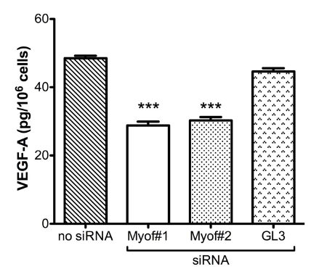
Myoferlin silencing reduces VEGF-A production into
the conditioned medium
siRNA Myof#2
siRNA Myof#1
no siRNA
siRNA GL3
Myoferlin
HSC70
3 independent biological replicates

Slide 10
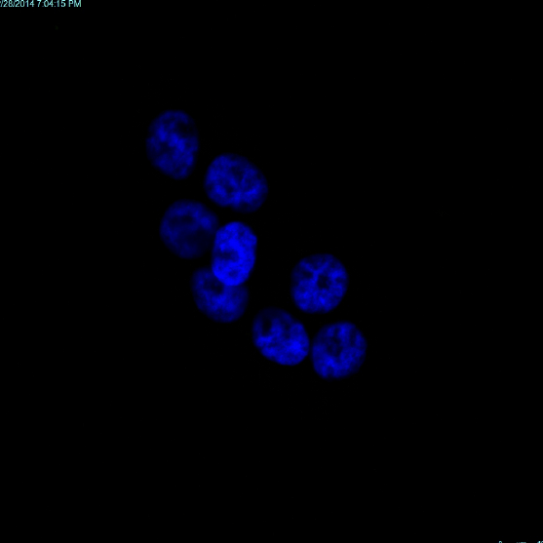
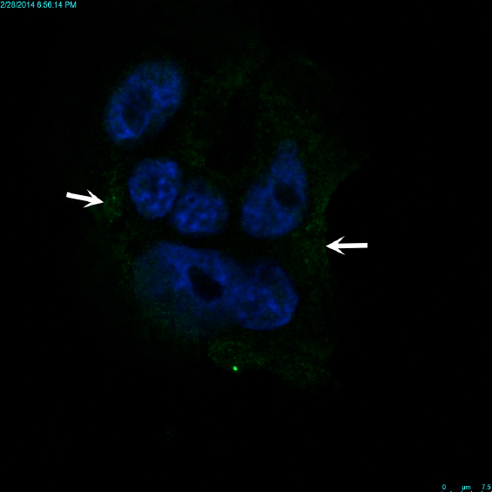
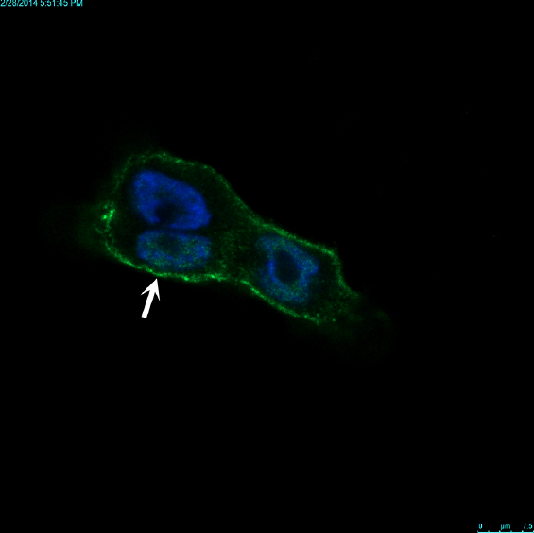
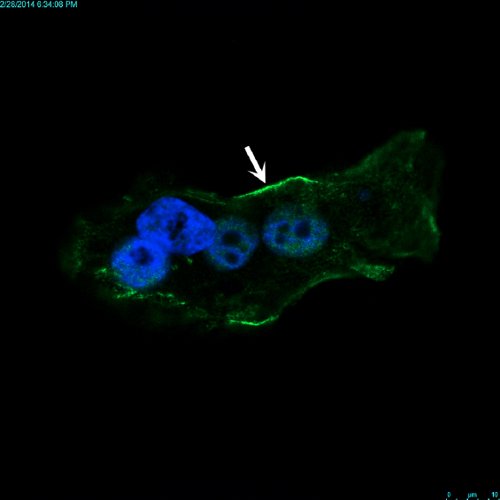
Nucleus
VEGF-A
no siRNA
siRNA GL3
siRNA Myof#1
siRNA Myof#2

Slide 11
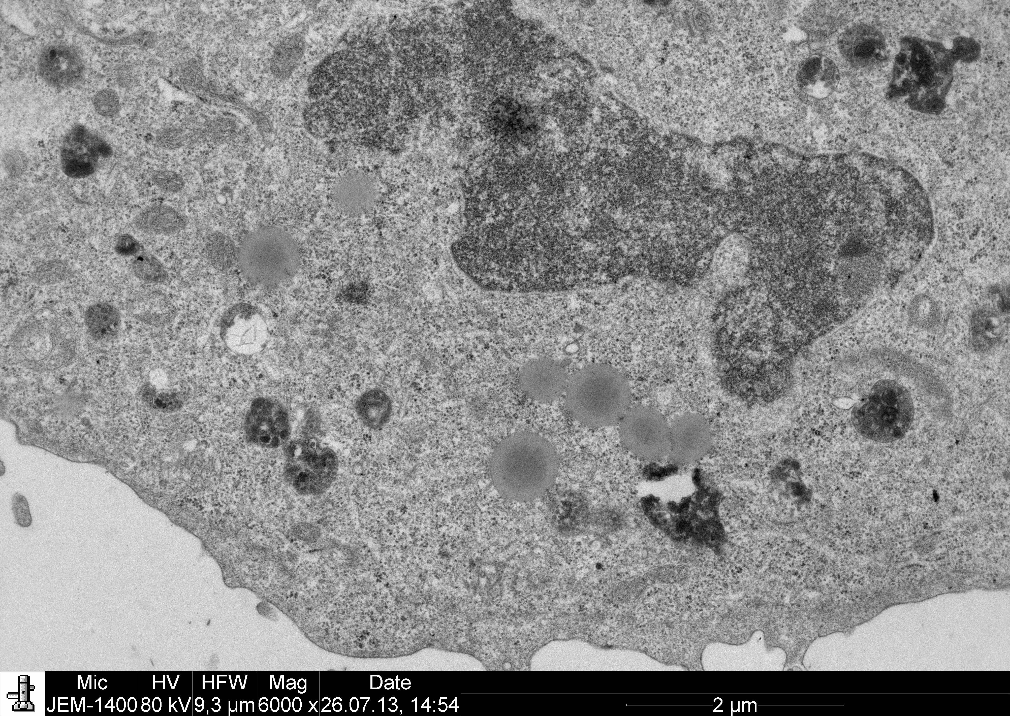
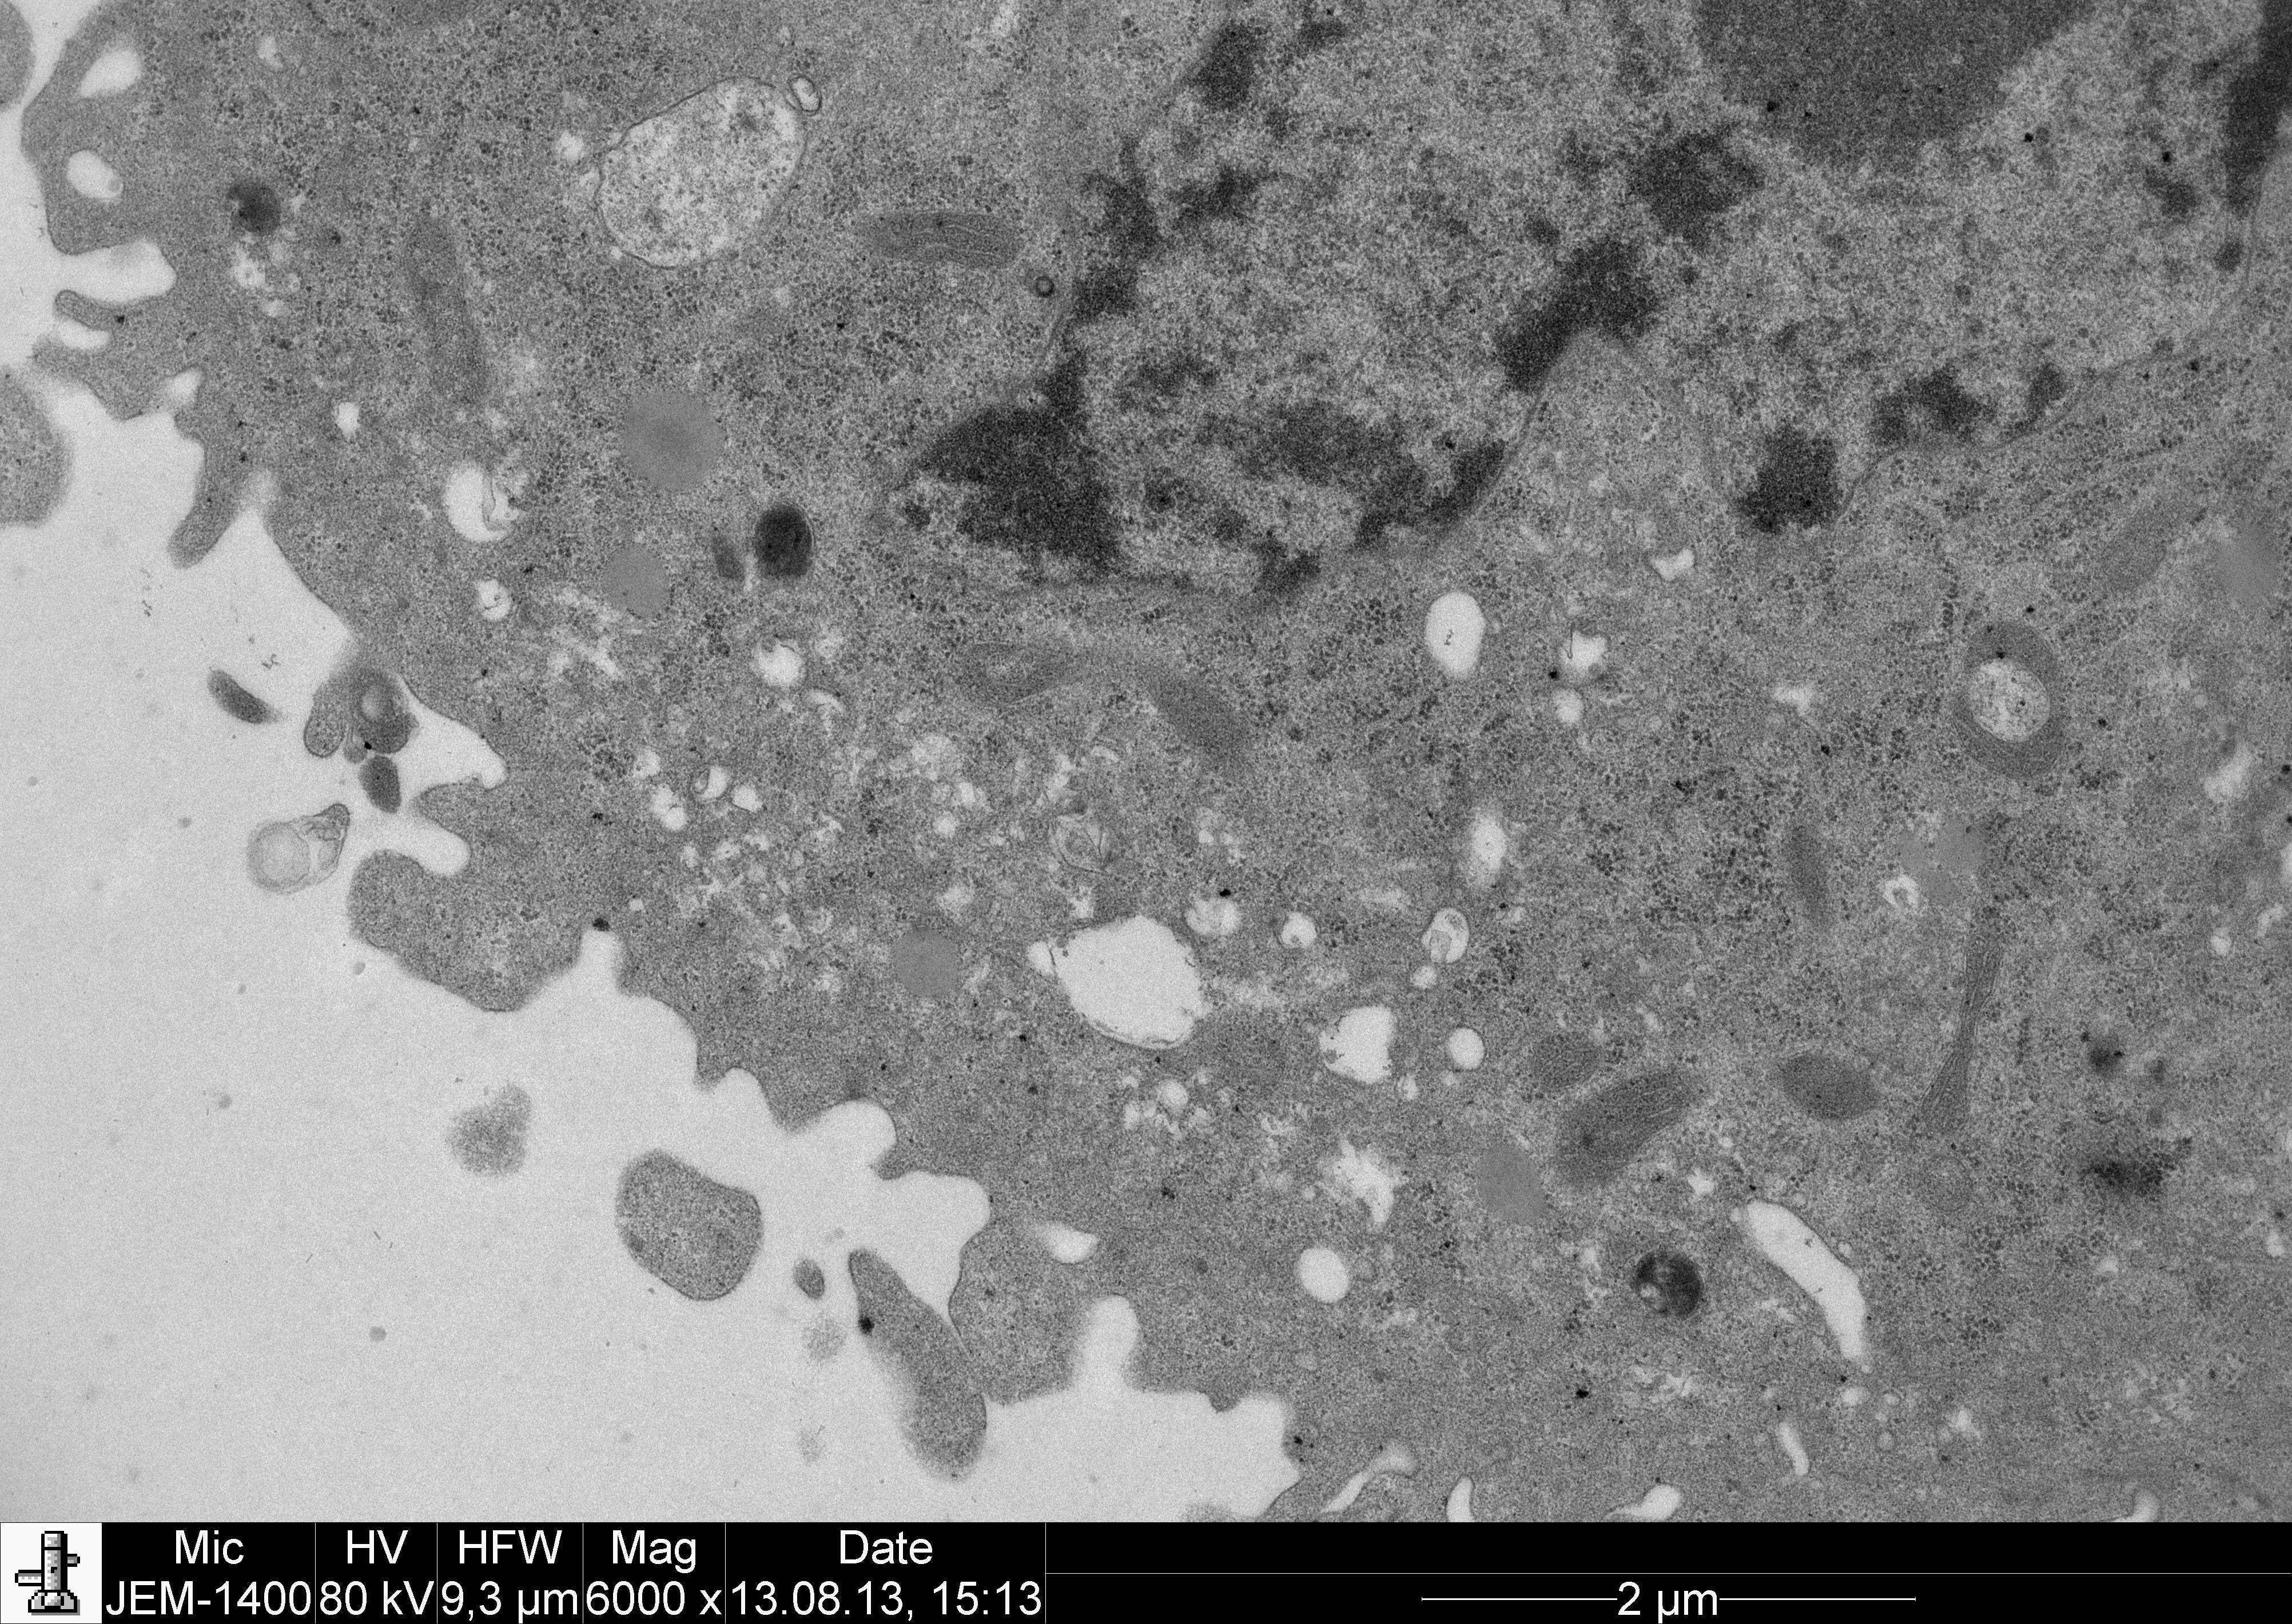
siRNA GL3
siRNA Myof#1

Slide 12
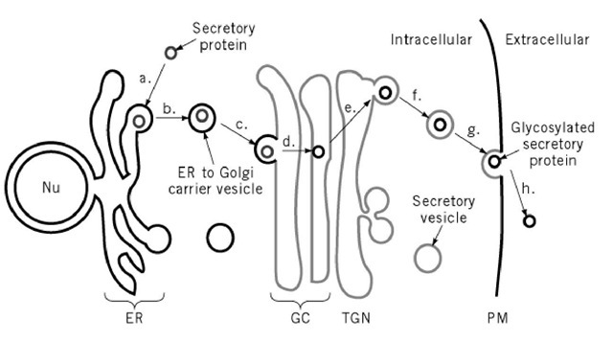
?
Myoferlin
VEGF-A secretion

Slide 13
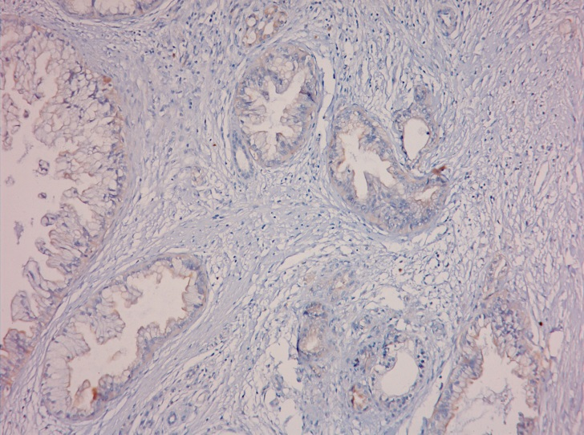
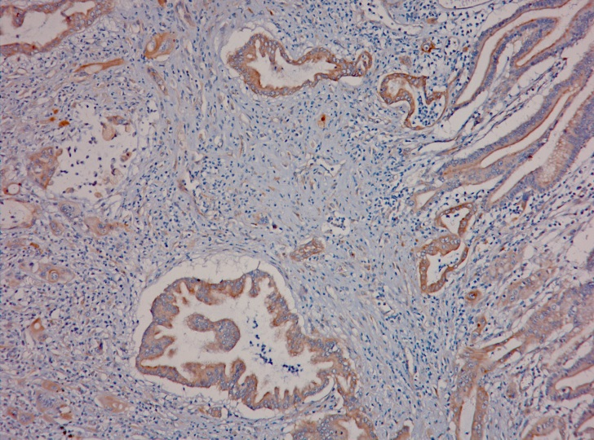
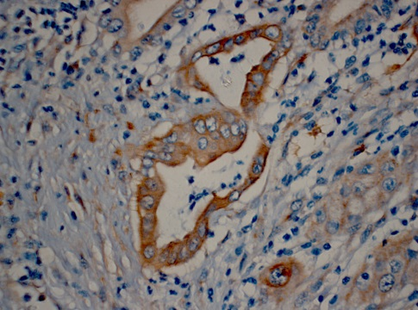
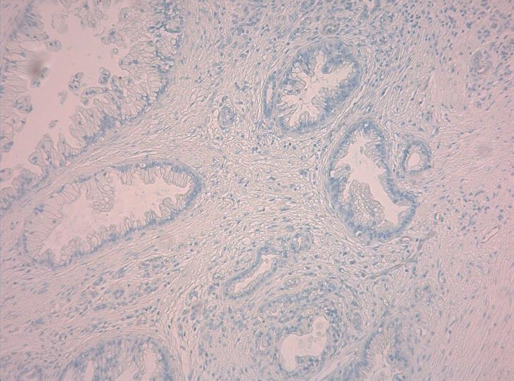
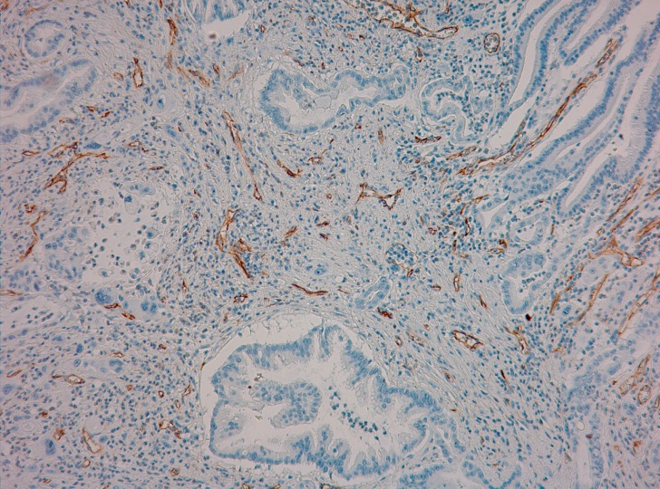
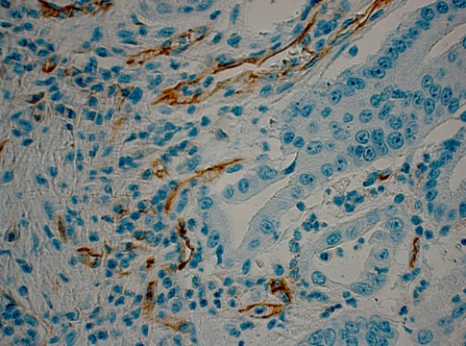
CD31 is associated to Myoferlin in PDAC
MYOF low intensity
MYOF high intensity
26 PDAC
staining of
myoferlin & CD31
CD31 low density
CD31 high density

Slide 14
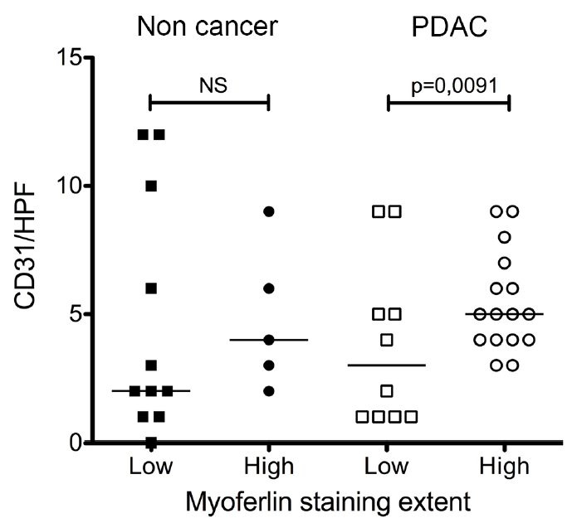
CD31 is associated to Myoferlin in PDAC
Myoferlin intensity

Slide 15
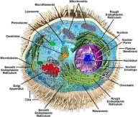
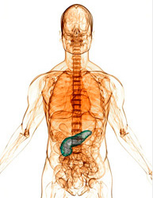
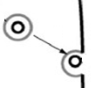
Summary
In ovo: Myoferlin silencing reduces BxPC-3 tumor growth and angiogenesis on CAM
Cellular Biology:
Myoferlin silencing reduces the VEGF-A concentration in the conditioned medium of BxPC-3 cells without altering gene transcription.
Myoferlin silencing seems to inhibit VEGF-A secretion into the conditioned medium. Vesicle-like structures accumulation at the vicinity of the plasma membrane
Clinical data: There is a significant group difference in CD31 density regarding Myoferlin intensity
We think that Myoferlin plays an important role in VEGF-A secretory vesicles fusion in PDAC

Slide 16
Acknowledgments
Prof. V CASTRONOVO
Dr. O PEULEN
Dr. A BELLAHCENE
Dr. A TURTOI
Dr. A GONZALEZ
P HENEAUX
All the PhD students ……
GIGA-R
Cell and Tissue Biology
Prof. M THIRY
S ORMENESE
R STEPHAN
GIGA Imaging :
MD PhD. M ARAFA
Prof. P DELVENNE

Slide 17
Thank you

Slide 18
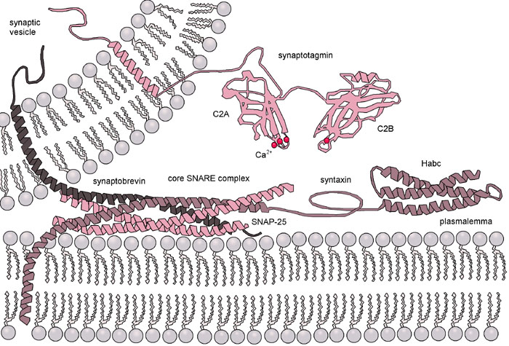
Myoferlin and Synaptotagmin
Calpain

