Slide 1
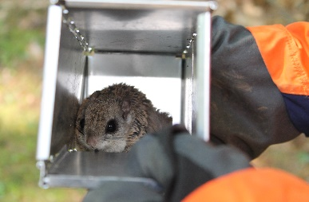
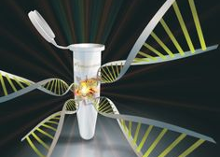
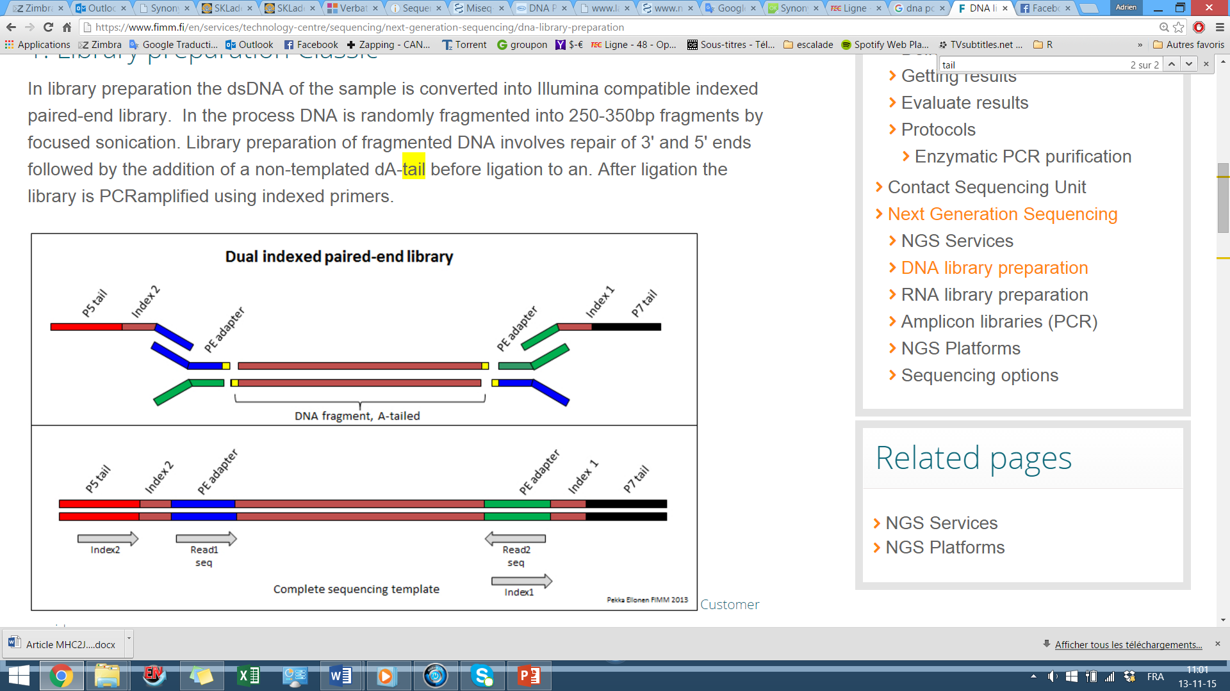
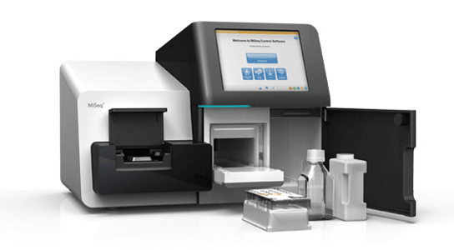
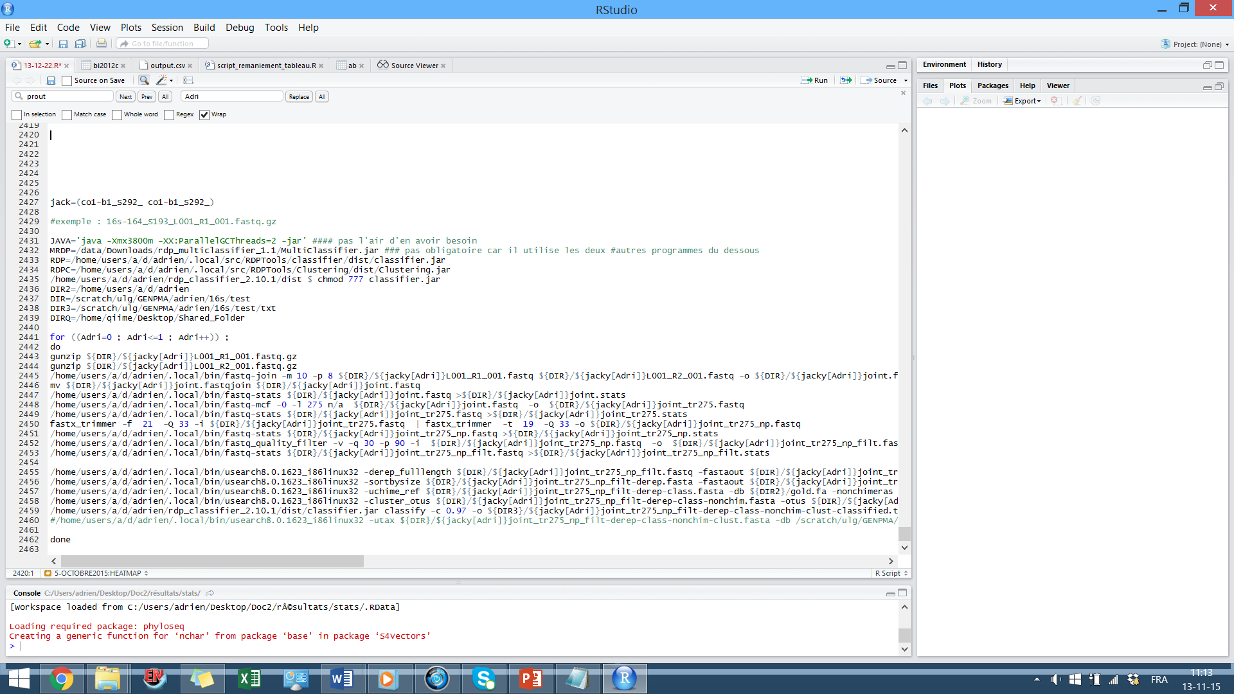
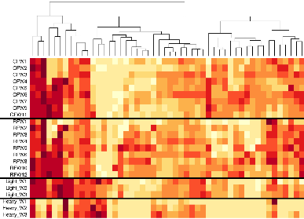






From sample hunt to sequence processing,
the journey of a biologist
A. André^{1;2} , V. Millien² , J. Michaux¹
Bangkok, December 2015
1 : Université de Liège, Belgique
2 : McGill University, Canada
Notes:
As Johan has just shown you, Metabarcoding studies are becoming more and more popular with a field of applications constantly increasing.
For the last three years now , one of my thesis objective consisted in performing a bacterial screening of the internal organs from a Canadian rodent, using next generation sequencing
So for today, I propose you to present the different challenges that biologists working in metabarcoding have to face, starting from the very beginning on the field, and presenting an overview of the following steps.
.

Slide 2
Field work
DNA extraction
Pre-sequencing steps
Sequencing
Raw sequence processing
Data visualization
Notes:
Here are those steps that I am going to detail now.
I will start speaking about field work, DNA extraction.
we will then go through all the pre-sequencing steps and the actual sequencing
Finally , i will show you some bioinformatic bases on how to process raw sequences and finally how to visualize the data.

Slide 3
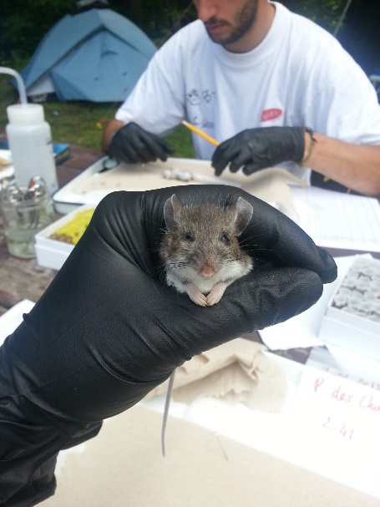
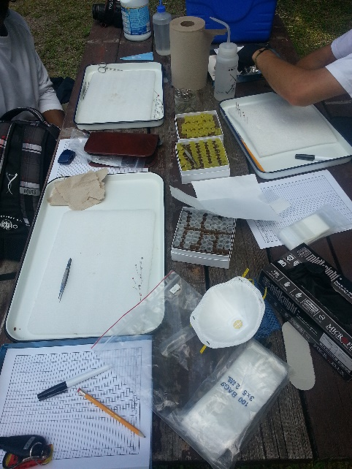
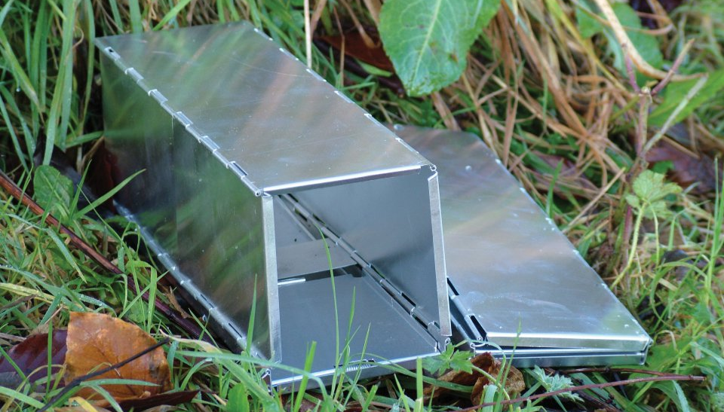
1. Field work
Few questions to ask yourself before starting:
  How many samples ?
  How much time?
  Material required?
  Field assistant?
  Team up with experienced people
  Expensive! ➔ Be efficient
Notes:
Field work!
this is where the journey of real biologist starts! Right?
It is for some of us the most exciting part of our project, but It has to be taken very seriously because the quality of your future papers will be highly dependant on the quality and the number of samples you’ll get on the field.
Field work might be the only steps for which there is no specific directives relative to metabarcoding
Like in every other branch of science, field work must be designed accordingly to your research questions.
You must know in advance how many samples you will need.
How much time is it gonna take to get them?
What kind and how much material will be required?
Whether or not you should engage any field assistant
Whenever it’s possible try to team up with experienced fieldworkers that are already familiar with the methods of trapping or familiar with the environment,
Field work can be very expensive so you have to be efficient in order to collect a maximum of samples in a minimum of time.

Slide 4
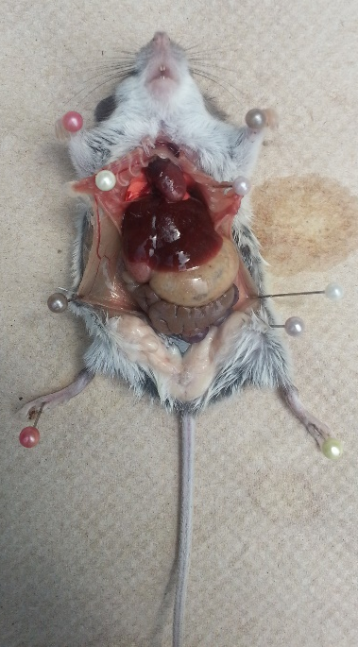
1. Field work
- Minimize the invasiveness
- Maximize the use of your samples:
Hair : Cortisol quantification
Heart : Borrelia PCR screening
Liver-Lungs-Spleen : NGS bacterial screening
Testes : reproductive investment
Guts : Helminth parasite screening
Skull and bones : Morphometrics
Notes:
In my case, I had to capture mice in different part of Canada. I set grids of Sherman traps in different forest during two summers in order to capture 20 mice per sampling site.
Because I was going to screen my samples for bacteria, It was important to work in conditions as clean as possible in order to reduce any external contamination.
Gloves, masks and sterilized dissecting tools were therefore used.
As responsible Biologists, we should always try to minimize the invasiveness of our studies. However, sometimes animals must be sacrified.
In these cases, we should always try to maximize the use from our samples.
For exemple, in my case, In my case, I had to capture mice in different part of Canada
we used the hair to quantify the cortisol levels in order to measure their stress level,
The heart were used for detecting Borrelia by a classical PCR method
I used the liver, lungs and spleen for NGS bacterial screening.
Testes have been weighted to evaluate the reproductive investment
We screened the guts for the presence of any helminth parasites
And finaly the skull and bones have been used for morphometric studies.
And because you never now what could be of any use in the futur, All the remains are kept in a freezer!

Slide 5
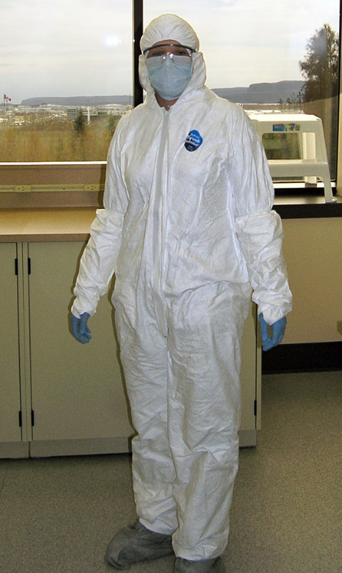
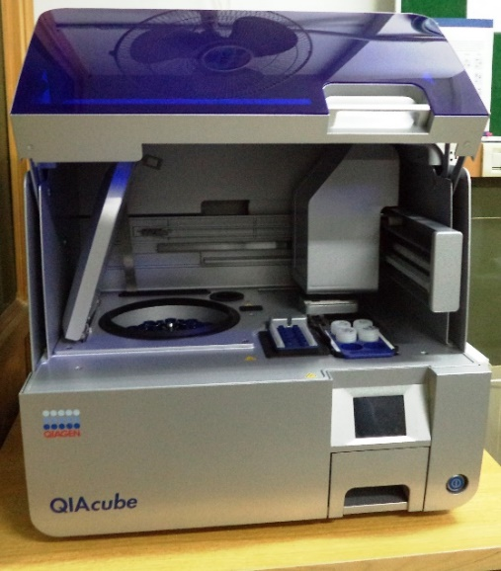
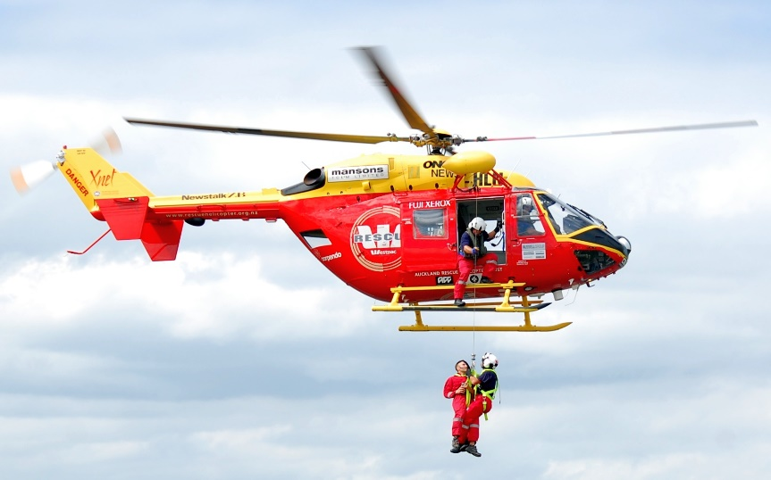
2. DNA extraction
Choose the right kit
Work in a sterile environment
Remove external contamination
Homogenize the sample
Add negative controls
Use of a robot ?
Notes:
Once you’re done with the field work, It’s time to put your labcoat on and start all the lab work!
The first thing to do is generally to start extracting the DNA from your samples.
For this purpose, several lab brands propose kits permitting DNA extraction, each with their own specificity.
Recently, kits focusing on the extraction of bacterial DNA from different media have appeared. They are supposed to yield higher quantity of bacterial DNA than regular kits but of course, they are also much more expensive.
Whatever the extraction method you decide to use, you should awlaus work in a sterile environment to avoid any external contamination.
You should always pay attention to remove any external DNA that could be the result from environmental contamination during field work for exemple.
If you work on ticks for exemple, you should always sterilize the outside surface of the tick by immerging them in a bleach solution.
As I was working on mice internal organs, I only used the internal parts of these organs in order to avoid superficial contamination.
Extraction kits require only few miligrams of tissues, it is therefore important to homogenize each of the sample so that they are representative of the whole organ.
Eventhough the reagents used in the kits are supposed to be sterile, they have been proven to carry many bacterial strains. It is thus crucial to include negative control samples in your study to distinguish which bacteria are actually present in your samples and which one are just contaminations.
A robot can be used to help you performing the extractions. Once again, several models are proposed by different brands. We used the QIACUBE from QIAGEN.
A little tip here. If you plan on buying a robot, pay attention to the after-sale conditions. I’m telling you this because this year we had a minor probleme with our robot and QIAgen asked us 1500€, and it was just to pay the travel expenses for the technician , not even the actual repair… So perhaps they were coming with a Helicopter! We don’t know. At the end, we fixed the robot ourselves and we saved all that money!

Slide 6
3. Pre-sequencing steps
Extracted DNA quantification
PCR1
Purification 1
PCR2
Purification 2
Visual confirmation on gel
DNA Quantification
Notes:
Once you get your DNA, it’s time to go through the presequencing steps ,
There are several of them, andI will not go into details for each of them.
The most important steps are indeed the two PCR

Slide 7
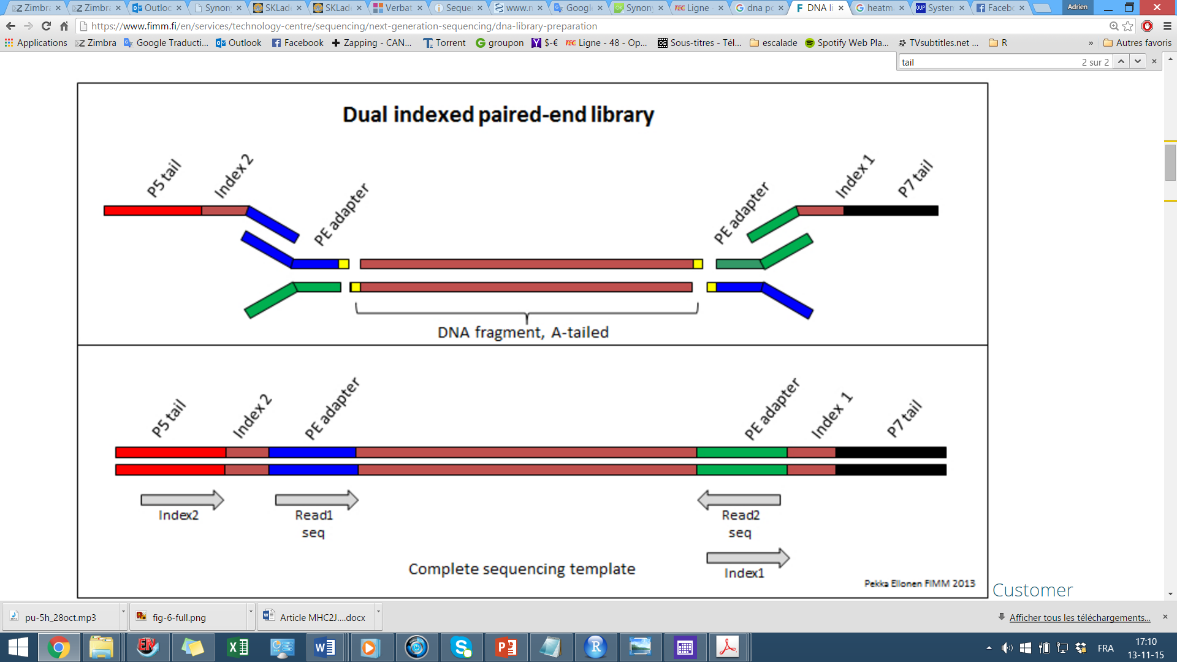
PCR 1 & 2
Adapter for PCR2
Locus specific part
Adapter for sequencing
Adapter for sequencing
Tag forward
Tag reverse
Adapter
Notes:
The first one is a classical PCR. The primer you chose will allow you to amplify the gene of interest.
In my case, I have mainly worked with ribosomal 16S gene for identifying Bacteria. I also had the opportunity to amplify CO1 gene in order to identify ticks species.
The role of the second PCR is to attach the tags that will permit to identifiy each sample individually. This is a key step because at the end of the procedure, all your samples will be pooled together and once the sequencing is done, you must be able to identify every amplified sequences individually.
Let’s say for example that we need to identify 96 samples.

Slide 8
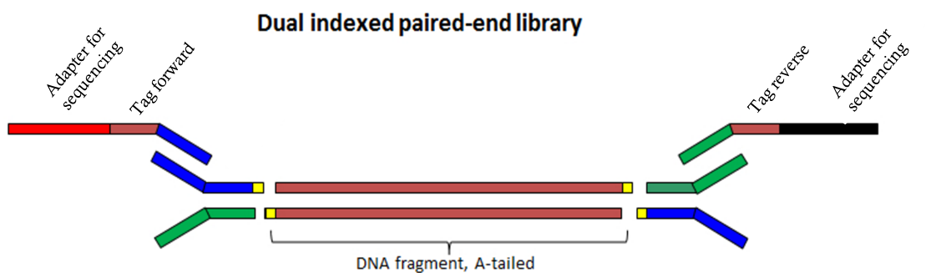
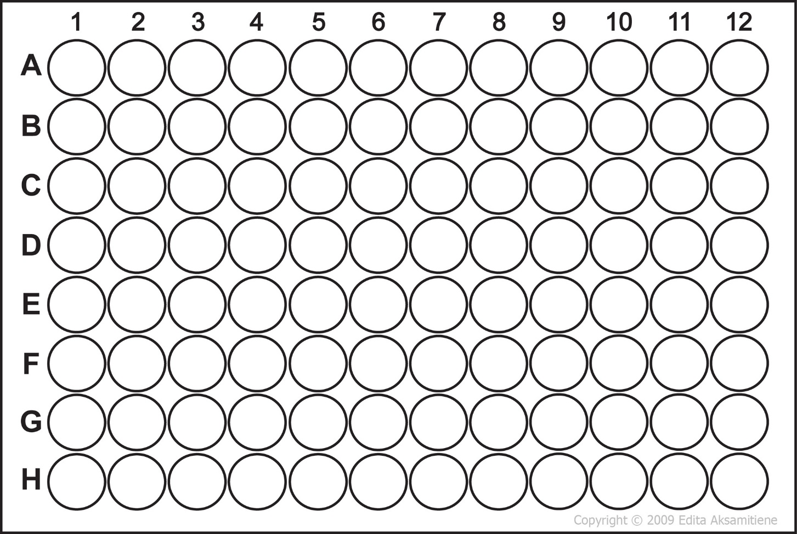
Notes:
How can we do that?
well it’s quite simple.
What you need is 12 forward tags that you will distribute in the plate like this during your pcr mix.

Slide 9
Notes:
And 8 reverse tags, that you distribute like that.
At the end of this procedure, you have 96 unique combination of tags.
And Following this reasoning,
28 tags allow you to identify 192 samples
40 tags allow you to identify 384 samples in one run.

Slide 10
PCRs 1 & 2
Tag attachment
Post-PCR2 samples
Post-PCR1 samples
Notes:
At the end of the two pcr , you can verify on a gel that your first PCR worked and also that you succesfully attached the tags in the second PCR.
On the gel here, we can indeed see that post-pcr2 samples are a bit longer than post pcr1 samples, which means that the tags have succesfully been attached.

Slide 11
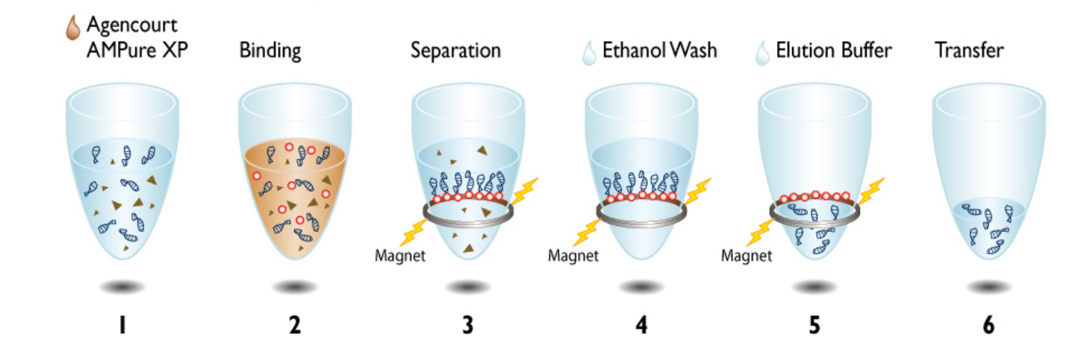
Purification step
Discard any primers and primer dimers
Columns : UltraClean® PCR Clean-Up Kit,
QIAquick PCR Purification columns
Beads: Agencourt AMPure XP beads
Notes:
Next gen sequencing is a very sensitive method that requires clean PCR products. For this reason, purification steps are required after each PCR.
This step allows to discard any primers and primer dimers present in the solution.
The most commonly used method involves magnetic beads that will bind to the amplicons while all the waste, like primers are discarded.
dechets

Slide 12
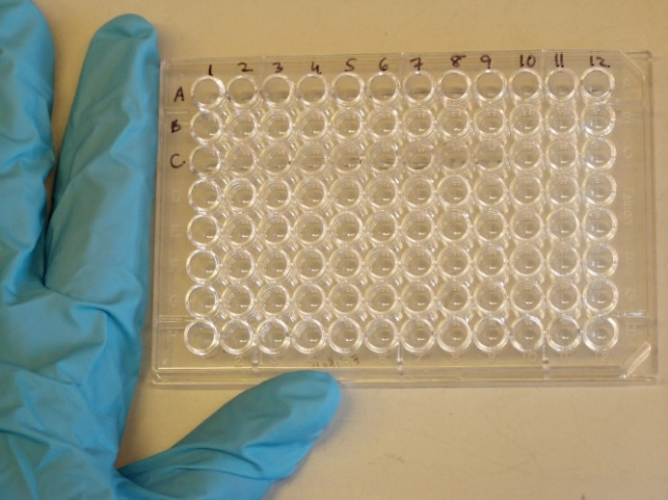
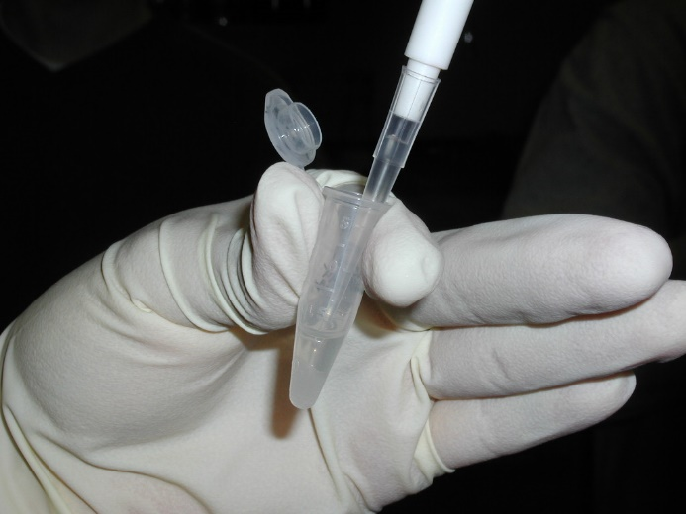
Pre-sequencing steps
Extracted DNA quantification
PCR1
Purification 1
PCR2
Purification 2
Visual confirmation on gel
DNA Quantification
Notes:
After those PCR and their purifications, The last step consists in quantifying the dna from each of the sample and then in normalizing their concentration.
Because each sample is individually tagged, you can now pool all of them in one tube and introduce this pool in the sequencer.

Slide 13
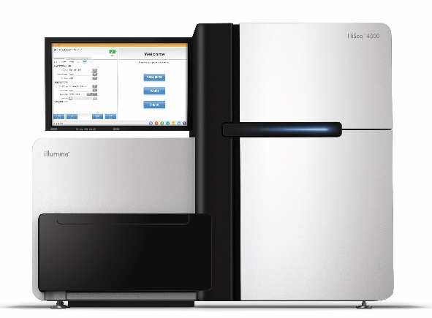
4. Sequencing
Different techniques
  454 pyrosequencing
  Ion torrent
  Illumina
    Hiseq x-ten : 2*150bp, 3 Billion reads
    Miseq : 2*150bp, 25 Million reads. ≈ 60.000 reads/sample if 384 samples
Notes:
Currently, there are different sequencing plateforms available, each of them with their own specificity.
the hiseq from Illumina is currently the most advanced technology in the domain and can yield up to 3 billion reads per run.
For our project, we chose to use the miseq technology. It is also from illumina but much cheaper. It can yield only25 million reads. If you have introduced a pool of 400 samples, it means that you should obtain about 60,000 raw sequences per samples which is arleady a lot

Slide 14
5. Sequence processing
FASTQ format
Sequence ID
Actual sequence
@SEQ_ID GATTTGGGGTTCAAAGCAGTATCGATCAAATAGTAAATCCATTTGTTCAACTCACAGTT
+
!''*((((***+))%%%++)(%%%%).1***-*''))**55CCF>>>>>>CCCCCCC65
Quality scores
Notes:
The output of a sequencing run consists in fastq files.
There are two fastq files per samples, corresponding to the forward and the reverse reads.
Each entry in a fastq file looks like this.
It contains the sequence ID, the actual sequence and the corresponding quality score for each base.
Imagine that this is for just one sequence, but you will have millions of them to treat.
It is a huge amount of data to process

Slide 15
5. Sequence processing
Notes:
It’s now your job to process these raw sequences in order to get clean and workable sequences
For this purpose you need to use a pipeline specially designed for your data. What is a pipeline? Well it is a script that contains different functions that will step by step allow yout o clean your raw sequences.
This script is usually run on ultra fast computer as it may treat huge files.

Slide 16
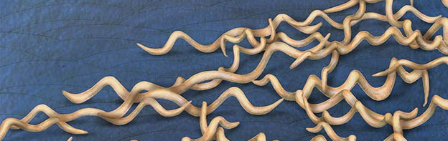
5. Sequence processing
Overview of the steps
  Assemble pair-ended sequences
  Discard too short or too long sequences
  Remove primers on both ends
  Discard sequences with low quality scores
  Discard any chimeric sequences
  Attribute the sequences to their corresponding taxonomy:
GATTTGGGGTTCAAAGCAGTATCGATCAAATAGTAAATCCATTTGTTCA
= borrelia burgdorferi
Notes:
Let’s take a closer look to those scripts :
The fist step of consists in assembling the forward and reverse fastq files.
Next, you have to discard every sequences which does not present the correct length. As they could represent mistakes made by the sequencer.
You then have to cut out the primer sequences on both ends.
The following step consists in discarding any sequence that do not present high enough quality scores.
You can also check your sequences for the presence of chimeric DNA that would have to be discarded too.
The resulting sequences are now supposed to be clean and ready to be attributed to their corresponding taxonomy. The function called RDP classifier is one of the most commonly used in bioinformatics to perform this step.

Slide 17
5. Sequence processing
 | OTU1 | OTU2 | OTU3 | OTU4 | OTU5 | OTU6 | OTU7 | Total reads
Sample1 | 0 | 0 | 3214 | 4555 | 0 | 0 | 0 | 7769
Sample2 | 3 | 0 | 0 | 444 | 560 | 333 | 0 | 1340
Sample3 | 52 | 42 | 0 | 232 | 113 | 540 | 0 | 979
Sample4 | 0 | 670 | 0 | 895 | 0 | 420 | 50 | 2035
Negative control | 0 | 0 | 0 | 1080 | 0 | 0 | 0 | 1080
O.T.U.= Operational taxonomic unit
Notes:
You should now be able build this kind of matrix, where rows correspond to your samples, columns to your OTU, or operational taxonomic units, and cells correspond to the number of sequences.
During the sequencing process, it is possible that some of your samples yield much more sequences than others.
That’s the case here for sample1. it may be due to higher concentration of the sample in the pool despite the normalization or to a higher number of the gene copies.
It is a probleme because these samples will appear richer in term of diversity although this might only be due to an artifact from the method used.
one way to fix the problem is to control the total number of reads per sample by normalizing the total number of reads

Slide 18
5. Sequence processing
 | OTU1 | OTU2 | OTU3 | OTU4 | OTU5 | OTU6 | OTU7 | Total reads
Sample1 | 0 | 0 | 405 | 574 | 0 | 0 | 0 | 979
Sample2 | 2 | 0 | 0 | 236 | 409 | 243 | 0 | 979
Sample3 | 52 | 42 | 0 | 232 | 113 | 540 | 0 | 979
Sample4 | 0 | 322 | 0 | 403 | 0 | 202 | 24 | 979
Negative control | 0 | 0 | 0 | 979 | 0 | 0 | 0 | 979
Notes:
That way, all your samples have an even sampling depth. And they can now be compared with each other

Slide 19
5. Sequence processing
 | OTU1 | OTU2 | OTU3 | OTU4 | OTU5 | OTU6 | OTU7 | Total reads
Sample1 | 0 | 0 | 405 | 574 | 0 | 0 | 0 | 979
Sample2 | 2 | 0 | 0 | 236 | 409 | 243 | 0 | 979
Sample3 | 52 | 42 | 0 | 232 | 113 | 540 | 0 | 979
Sample4 | 0 | 322 | 0 | 403 | 0 | 202 | 24 | 979
Negative control | 0 | 0 | 0 | 979 | 0 | 0 | 0 | 979
Notes:
you also might want to check your negative controls. in order to discard any OTU that would be the result of contamination. In this exemple, the OTU5 is clearly a contamination because it’s present in the negative control and must therfore be discarded.

Slide 20
5. Sequence processing
 | OTU1 | OTU2 | OTU3 | OTU4 | OTU5 | OTU6 | OTU7 | Total reads
Sample1 | 0 | 0 | 405 | 574 | 0 | 0 | 0 | 979
Sample2 | 2 | 0 | 0 | 236 | 409 | 243 | 0 | 979
Sample3 | 52 | 42 | 0 | 232 | 113 | 540 | 0 | 979
Sample4 | 0 | 322 | 0 | 403 | 0 | 202 | 24 | 979
Negative control | 0 | 0 | 0 | 979 | 0 | 0 | 0 | 979
Notes:
You should now have a pretty clean dataset.
But do not shut down your computer now as you are not done yet. The most important part is coming as you now have to treat your data and make it visually understandable.

Slide 21
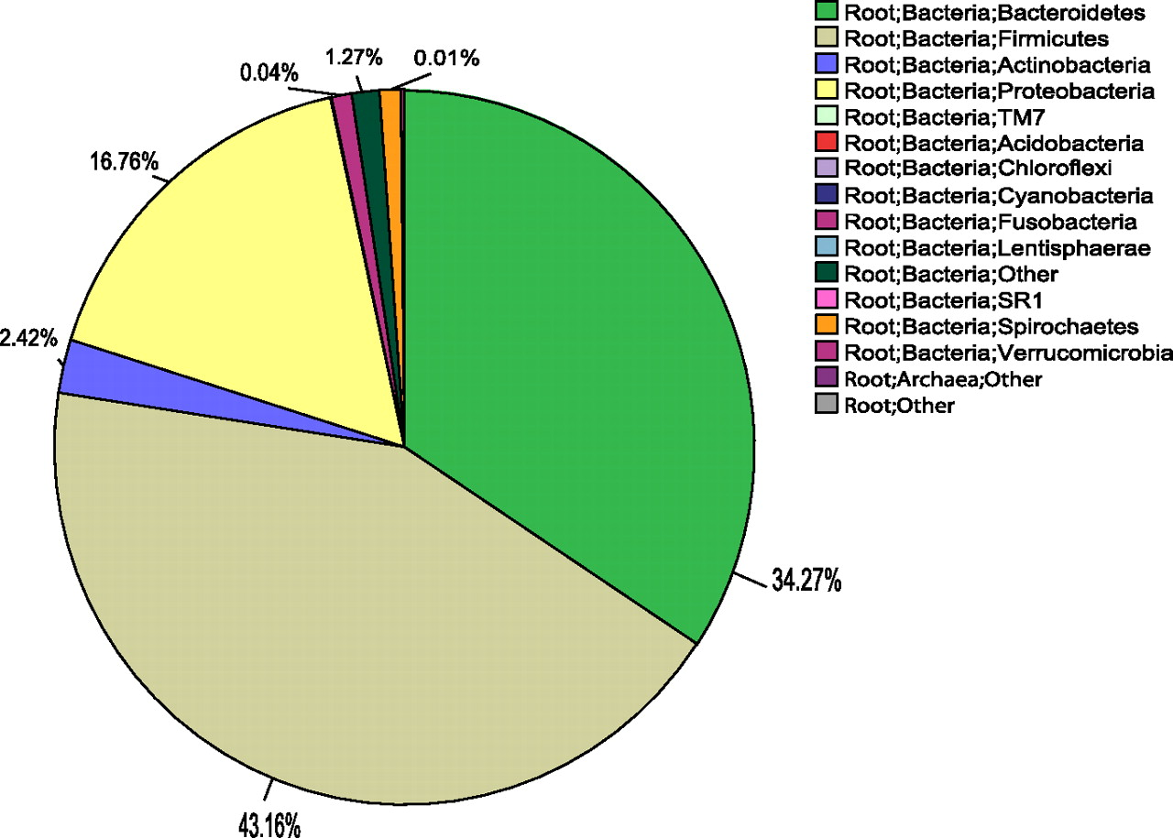
6. Data visualization
Pie chart
Notes:
The easiest way to visualize your data is to build pie charts
It can be drawn whether globaly for all your samples or separately for each of them.
It gives you an idea of the proportion of the different OTU present in your sample

Slide 22
6. Data visualization
Ordination plot
Notes:
Another way to point differences in the OTU assemblage is to draw ordination plots like this one.

Slide 23
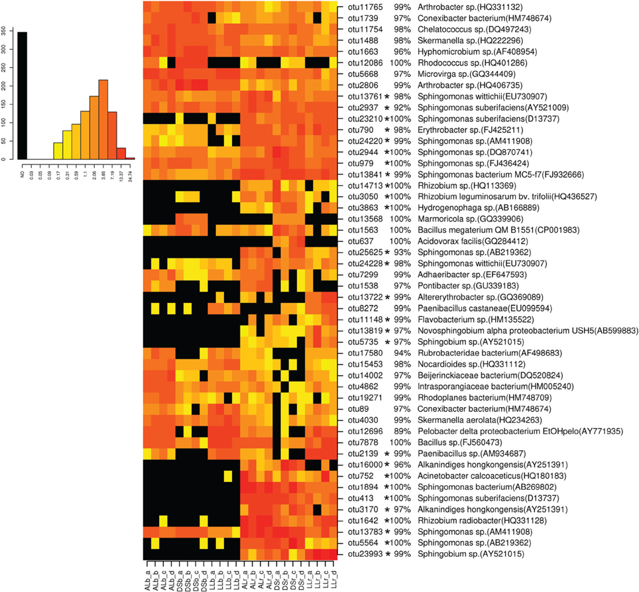
6. Data visualization
Heat map
Notes:
The Heat map is another way to illustrate your data.
It is particularly suitable if you want to have a global view of your samples and OTUs
Here the redder the color is, the higher the abundance should be.

Slide 24
Acknowledgments
Funding :
This work is supported by a Belgian research fellowship from the FRIA (Fonds pour la Formation et la Recherche dans l’Industrie et dans l’Agriculture), financial grants from the Belgian FNRS (crédits bref séjour et crédits aux chercheurs to J.R. Michaux), from the University of Liège (Patrimoine),and from the NSERC fellowship to V. Millien.
Rajouter ici la bourse du Serge.
Special thanks to
  Serge Morand
  Jean-françois Cosson
  Johan Michaux
  all the field and lab collaborators
Notes:
So this is it! I will not go further
I hope that after johan presentation and mine you are now a bit more familiar with metabarcoding studies, their applications, and the way to conduct theses studies,
I first would like to thank Mr Serge Morand for inviting here and Jean-François cosson who made my venue possible.
I’d like to thank Johan Michaux, my director, who is always very supportive
I’ would also like to thank my funding sources and finally to thank all of you for your attention!
If you have any other interrogations or if anything was not clear enough, I’m ready to answer your questions!

