Slide 1
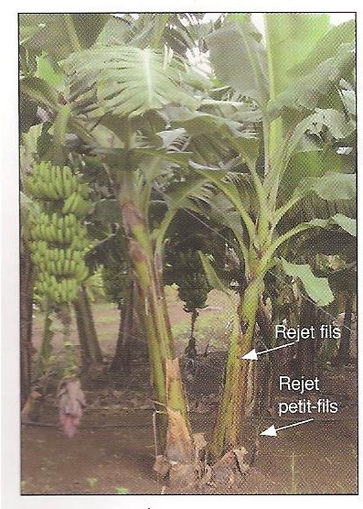
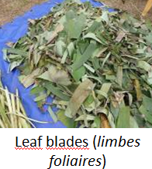
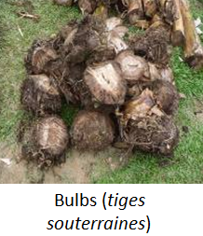
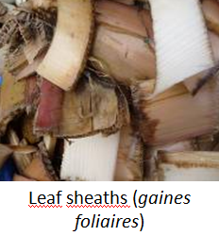
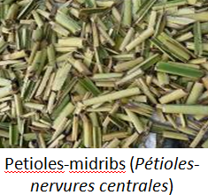
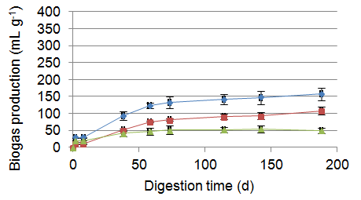
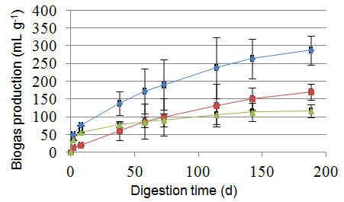
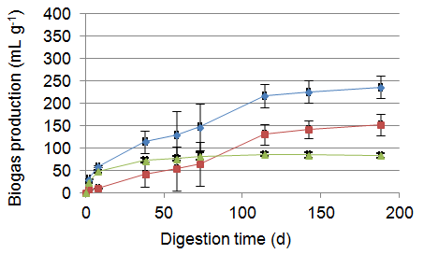
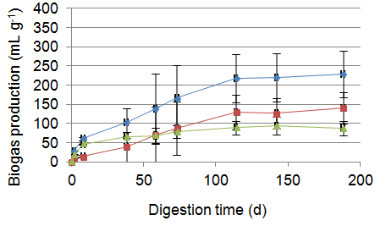
Wastes of banana ‘s lignocellulosic biomass : a sustainable and renewable source of biogas production
Comparative anaerobic digestion of six morphological parts of Williams Cavendish banana (Triploid Musa AAA group) plants
Poster xx
Walloon Centre of Industrial Biology
Irénée KAMDEM
Promotor : Ph. Thonart - S Hiligsmann
Worldwide annual production
Banana fruits : 125 million tons
Discarded annual plant : 250 million tons
= balicebiom = “banana’s lignocellulosic biomass”
➔ high potential for anaerobic digestion
➔ 316 m³ CH₄/ton of balicebiom DW
Annual electricity estimation from an agro-industrial banana plantations (CDC–Del Monte in cameroon)
approximately 10.5×10⁶ kWh worth 0.80–1.58 million euros in the current market
Most important balicebiom parts
% of balicebiom DW:
C/N:
m³ CH₄/ton DW
41
18
98
11
45
150
12
57
140
17
55
130

