Slide 1

Connecting planets to their moons: The auroral satellite footprints
Bertrand Bonfond

Slide 2
The satellite footprints:
A little bit of history
IR: Connerney et al., 1993
UV: Prangé et al., 1996;
Clarke et al. 1996
Visible: Ingersoll et al., 1998

Slide 3
Widespread phenomenon on giant planets
Io, Europa and Ganymede footprints
Saturn: Enceladus footprint
Cf. Clarke et al. 2002, Pryor et al., 2011

Slide 4
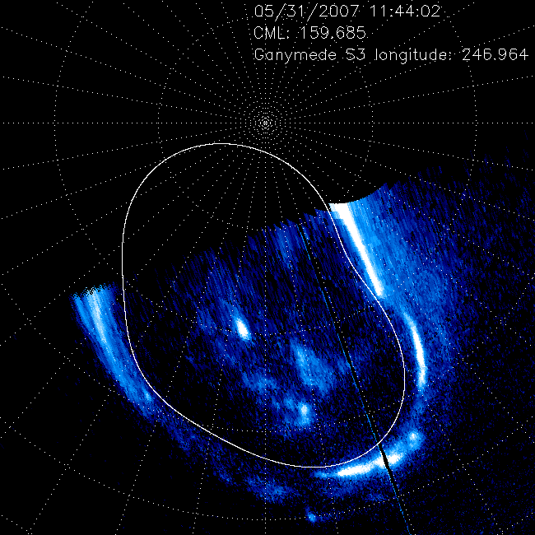
GFP as a landmark in the magnetosphere
Bonfond et al., 2012

Slide 5
Magnetic field models
The projection of the Io footprint location along magnetic field lines should be located along the Io orbit
a constrain on the magnetic field models
VIP4: 4th order multipolar model
Connerney et al., 1998
Grodent et al., 2008
Hess et al., 2011
Notes:
The footprint contour is the locus of the points magnetically connected to Io’s orbit => constraint on the internal magnetic field models

Slide 6
Magnetic field models
Grodent et al., 2008

Slide 7
Flux Equivalence Mapping models
Vogt et al., 2011, 2015

Slide 8
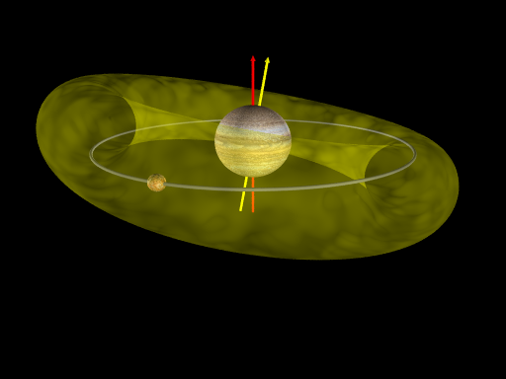
Moons as obstacles for the magnetospheric plasma

Slide 9
Local satellite-magnetosphere interaction
Dougherty et al. 2006
Kivelson et al., 2004
See Jia et al., 2009b and references therein
Jia et al. 2009a
Dols et al., 2012

Slide 10
Best study case for a widespread phenomenon in the universe
Sub-Alfvénic interactions also possible within exoplanetary systems.
.
Shkolnick et al., 2008
Chané et al., 2012
Electro-magnetic interaction between a « Hot-Jupiter » and its star
Solar-wind interaction at Earth can occasionally become sub-Alfvénic
Saur et al., 2013
Notes:
Calcium chromospheric lines enhenced periodically
Proposed to explain the Ha et Hb emission lines for White Dwarf GD356

Slide 11
Interaction model
Flux tube
Alfvén wings
Kivelson et al., 2004
Notes:
2 visions of the problem: a direct current that flows between Io and Jupiter and a perturbations that propagates along the field lines and which is embedded in the plasma stream. The views here are fixed relative to Io.

Slide 12
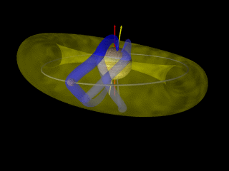
Reflected Alfvén waves

Slide 13
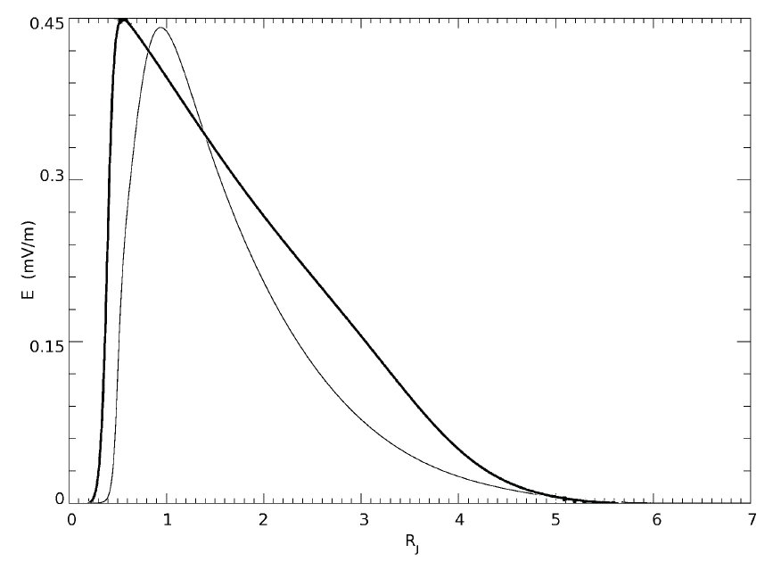
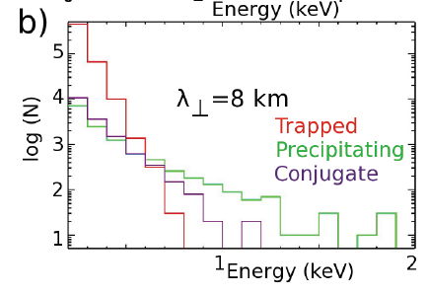
Inertial Alfvén waves + filamentation
Hess et al., 2010
Parallel Electric field
Jones and Su, 2008
Jupiter
Distance
Io
Hess et al., 2010
Bonfond et al., 2013
Notes:
Alfvén waves filamentation is necessary to explain how the energy escapes from the torus
Inertial Alfvén waves can account for the bi-directionnal electron acceleration

Slide 14
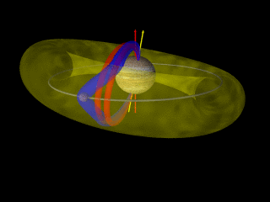
Trans-hemispheric electron beams

Slide 15
What is the Io footprint?
The Io footprint is formed by
  several spots
  a trail
Gérard et al. , 2006

Slide 16
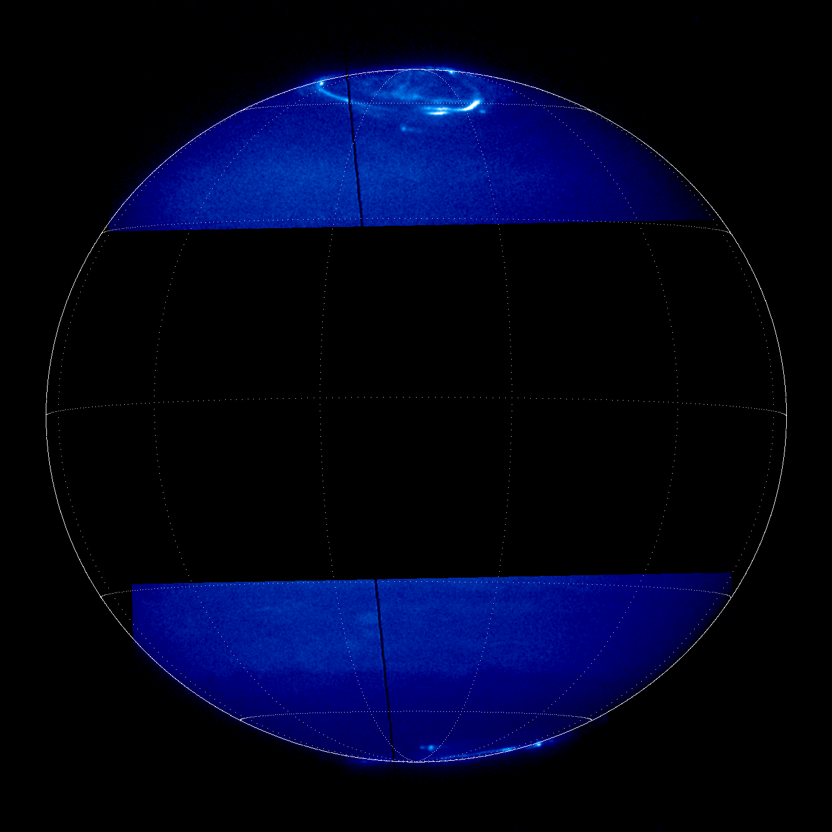
The leading spot
Notes:
We had the opportunity to observe both hemisphere quasi simultaneously.

Slide 17
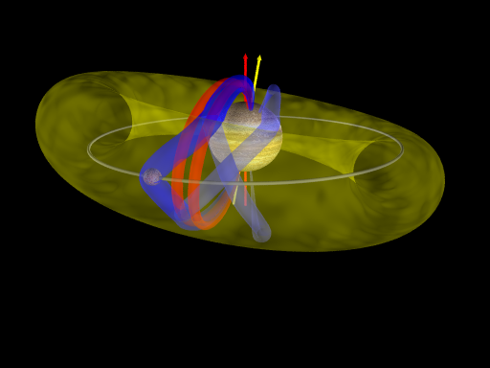
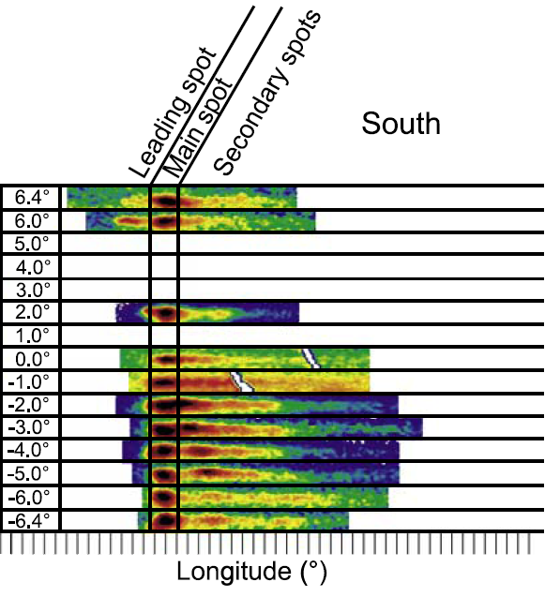
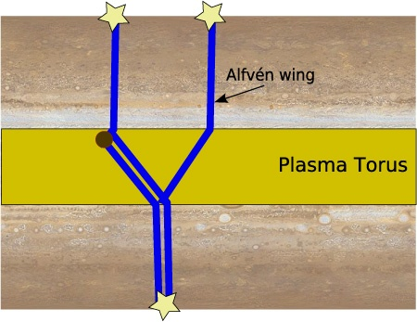
Spots multiplicity evolution
MAW
TEB
RAW
Bonfond et al., 2008

Slide 18
Inter-spot distances
Downstream
Upstream
Bonfond et al., 2009

Slide 19
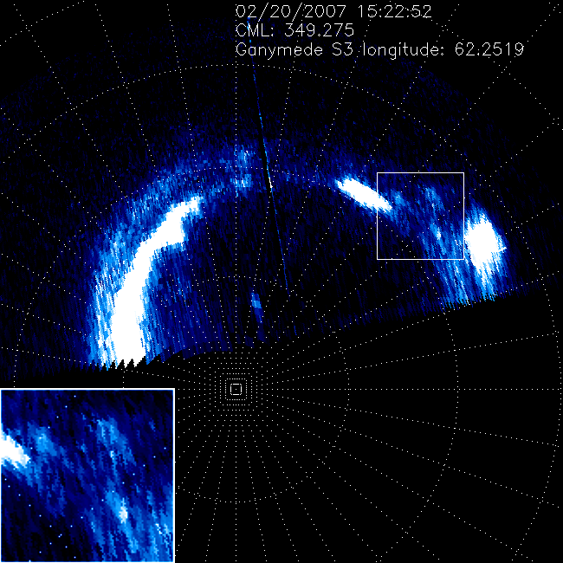
The multiple spots of the Ganymede footprints
Bonfond et al., 2013

Slide 20
Multiple spots of the GFP

Slide 21
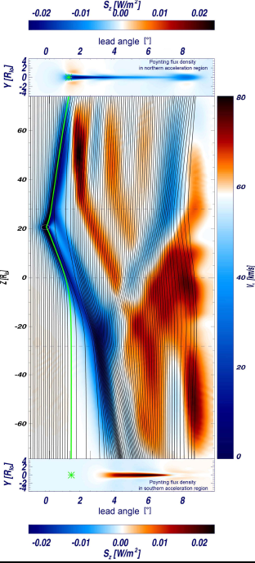
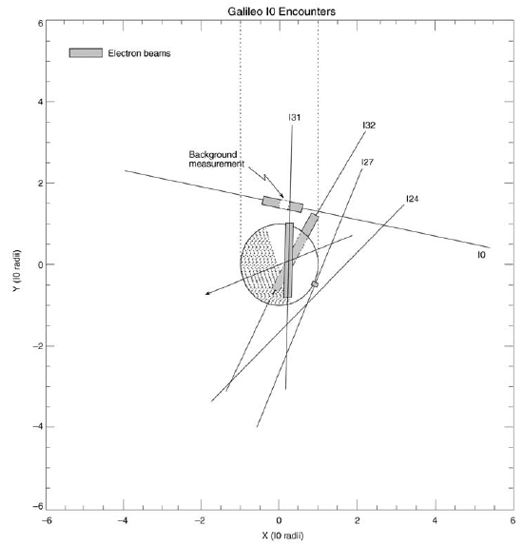
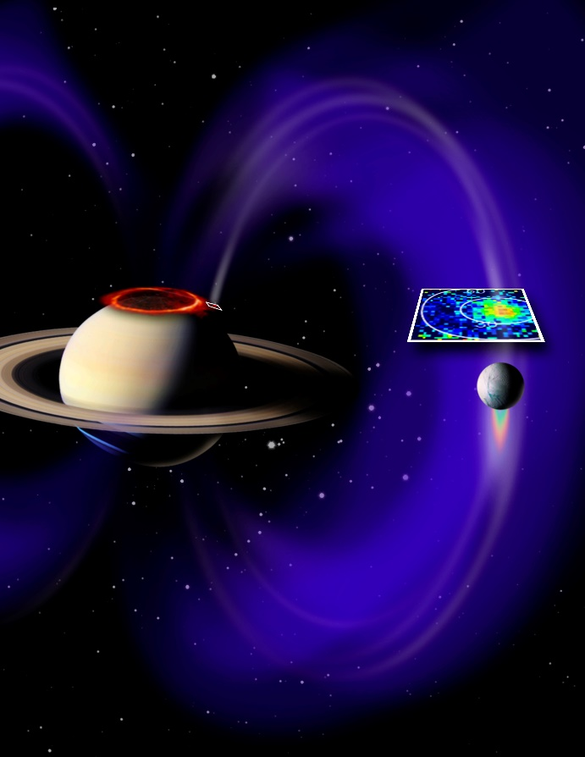
Electron beams
Io
Enceladus
Williams et al., 2003
MHD simulations
  TEB spots location
  electron beams location at Io
Jacobsen et al., 2010
Pryor et al., 2011

Slide 22
Interspot distance variations
For a same S3 longitude, the distance can vary
A proxy for the local density?
Not trivial interpretation if non-linearities are involved
Bonfond et al., 2013a, 2013b

Slide 23
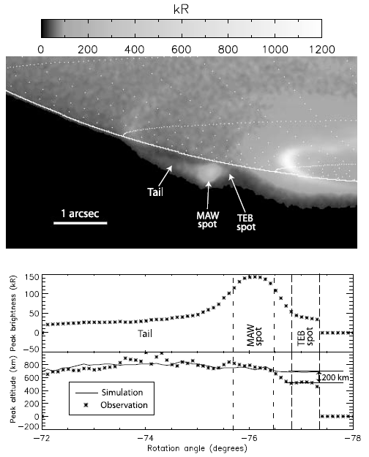
IFP features’ altitude
Peak altitudes:
  Main spot: 900 km
  TEB spot: 700 km
  Tail: 900 km
Bonfond , 2010
Gérard et al. , 2014
Notes:
Approx 66% of the emitted energy comes from electrons below 300eV

Slide 24
Estimate of the electrons energy
Monte-Carlo electron energy degradation model for theoretical distributions
Only the Kappa distribution reproduces the observations
Mean electrons energy: ~1keV (in lieu of 55 keV)
Contradicts models based on quasi-static electric fields
Bonfond et al., 2009

Slide 25
Trailing tail models: steady state vs. Alfvén waves’ multiple reflections
Hill and
Vasyliunas, 2002
Delamere et al., 2003
Jacobsen et al., 2007

Slide 26
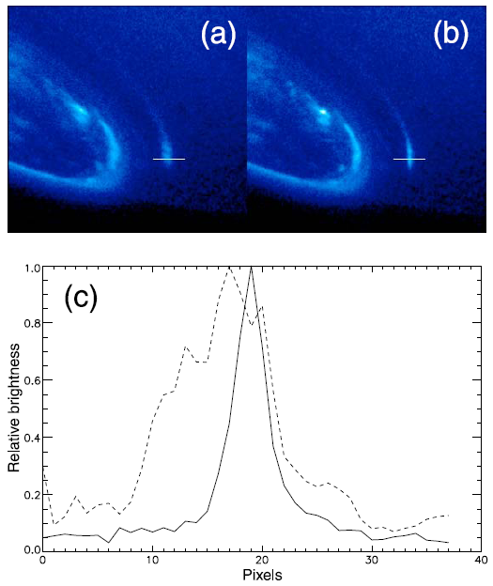
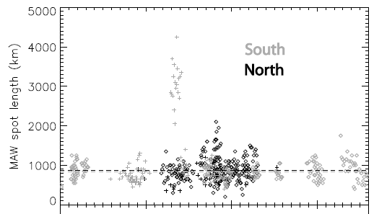
Main spot size
Projection of Io’s diameter along the magnetic field lines: 200-350 km
Measured length: ~850 km except for particular cases
The simulated curtain width should remain below 200 km to match the observations
Bonfond , 2010

Slide 27
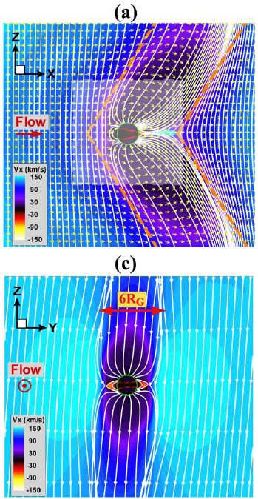
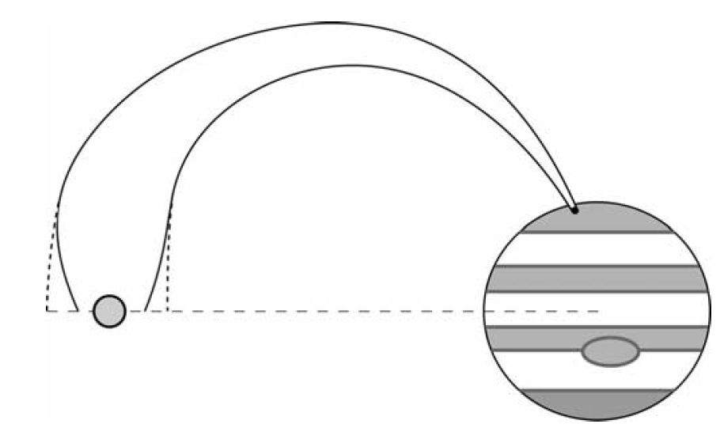
Size of the Ganymede footprint
The Ganymede footprint maps to a characteristic diameter of 8-20RG
Corresponds of the thickness of the Alfvén wing
Interaction region: the whole Ganymede magnetosphere
Grodent et al., 2009
Jia et al., 2009

Slide 28
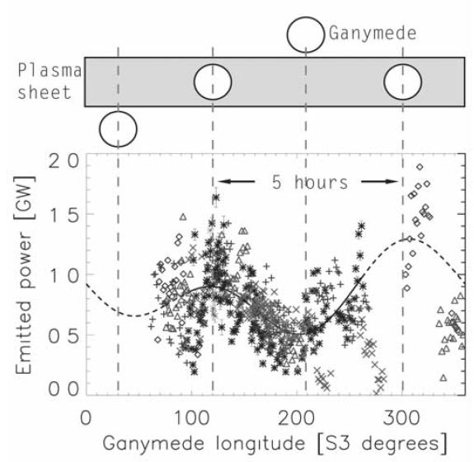
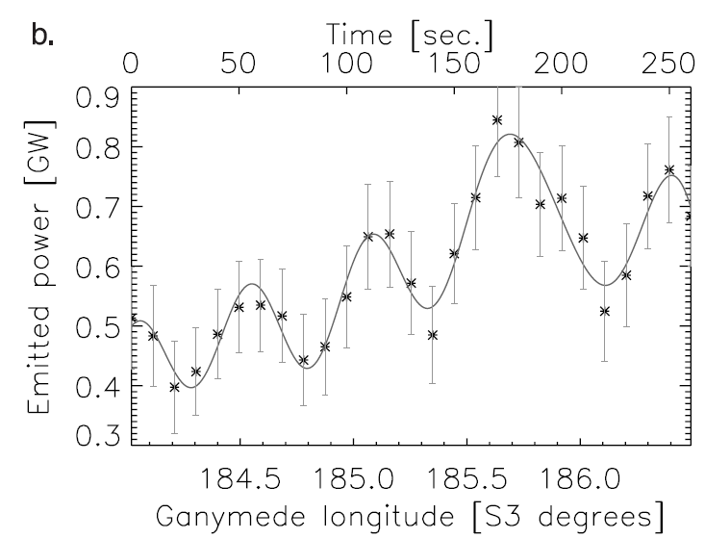
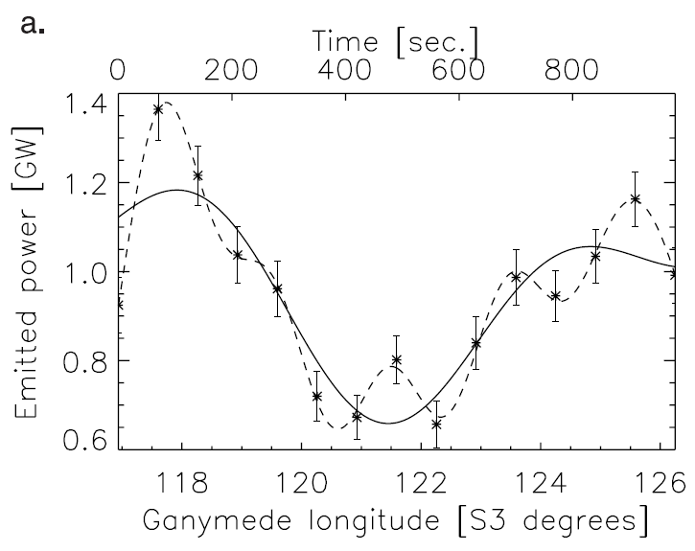
Ganymede footprint brightness variations
5 hours – System III
  Flapping of the current sheet
10-40 minutes
  Related to injections?
100-seconds
  Bursty reconnections at Ganymede?
  Double layer generation
Grodent et al., 2009

Slide 29
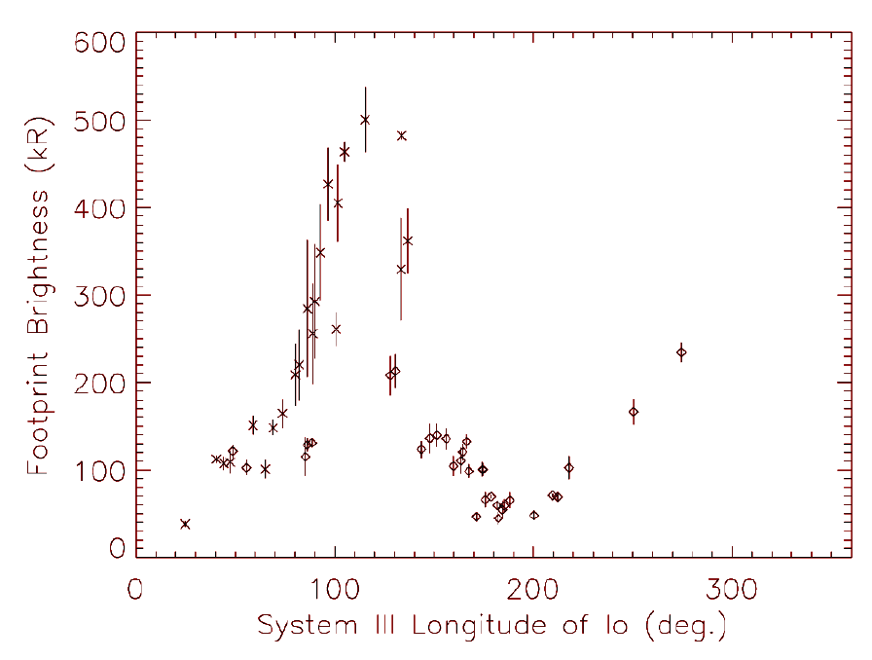
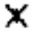
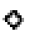
System III spots brightness variations
Serio and Clarke, 2008
: South
: North
Gérard et al., 2006
Bonfond et al., 2013

Slide 30
Local interaction intensity
Wannawichian et al., 2013

Slide 31
Multiple factors
Hess et al. 2013
Radiated power
Alfvén waves reflection
Acceleration efficiency
Magnetic mirroring

Slide 32
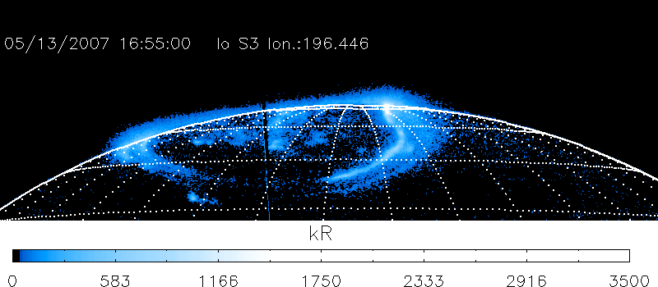
The usual case

Slide 33
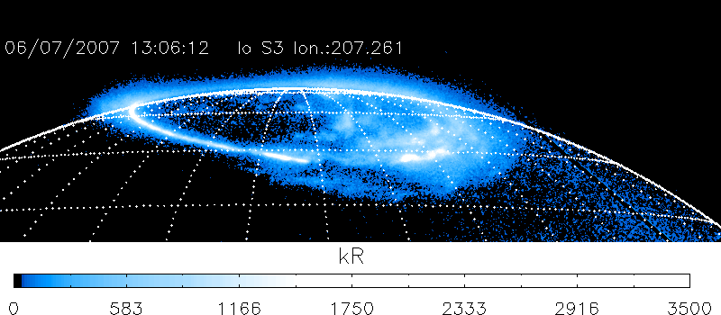
An unusual case

Slide 34
Alvén waves reflection
Payan et al. 2014

Slide 35
Which parameter is the more likely to operate?
Hess et al., 2013
Torus density
Torus scale height
Lobe density
Ionosphere scale height

Slide 36
Conclusions
What is a satellite auroral footprint?
  Several spots and a tail
  Universal process
What can we learn from them?
  About the physics of the interaction
    Wave evolution and propagation
    Electron acceleration process
  About the magnetosphere in general
    Mapping and landmark
    Local plasma properties (?)

