Slide 1

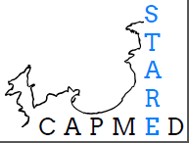


Methodological simplifications for soft-bottom macrofauna study
Applications on soft-bottom macrofauna in Calvi Bay

Slide 2
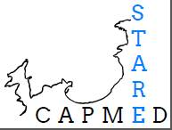
Stare-CapMed Program
Anthropogenic influence on functioning of bay ecosystems
Anthropogenic influences from climatic changes differentiation
More than 10 topics studied
  Plankton, Seagrass meadow, Physico-chimistry, soft-bottom macrobenthos, …
Studied Site: Calvi bay

Slide 3
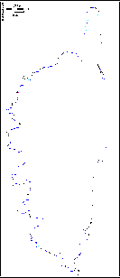
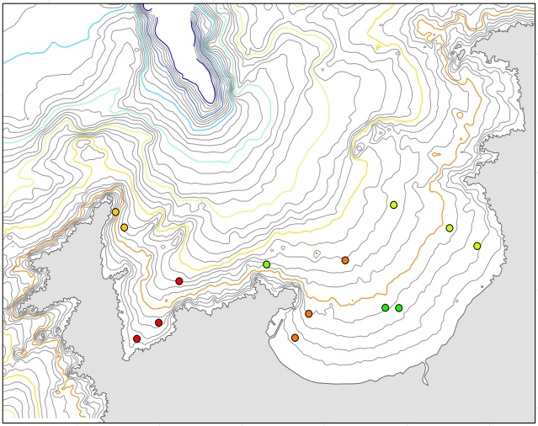
Calvi bay
Mediterannean Sea
North-West of Corsica
Depth: until 100 m followed by a canyon (more than 1000 m)
Presence of anthropogenic influences
  River mouth
  Fish farm
  Organized and free anchoring
  Sewage outfall

Slide 4
Study of Soft-bottom macrofauna
Time consuming
Finding facilitations for sorting and identification
Adapted staining method
Taxonomic sufficiancy
Habitat types
Reference conditions

Slide 5
Analyses simplifications
Working by habitats types
  Why?
  Corsica = preserved area with weak human influences
  needed of high precision scale of habitats
  and high sensibility scale
Identifiing bad and high reference conditions
Evolving taxonomic sufficiency

Slide 6
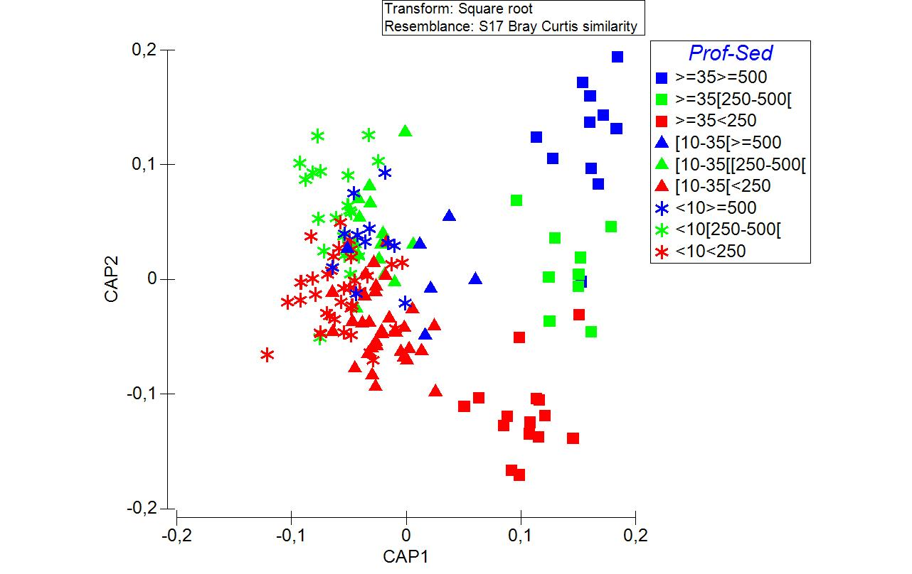
Habitat types identification
Source | P(perm)
Pr | 0,001
Se | 0,001
He | 0,001
PrxSe | 0,017
PrxHe** | 0,223
SexHe | 0,108
PrxSexHe** | 0,594
198 sampled stations around the Corsica
Identification based on Permanova and CAP
8 habitats identified
Depth range | [0-35[m | [0-10[m | [10-35[m | [35-m
X<250µm | Sandy clearing | SF; [0-35[ | SF; [0-35[ | SF; [35-
250µm≤X<500µm | Sandy clearing | SM; [0-10[ | SMG; [10-35[ | SM; [35-
X≥500µm | Sandy clearing | SG; [0-10[ | SMG; [10-35[ | SG; [35-
Median

Slide 7
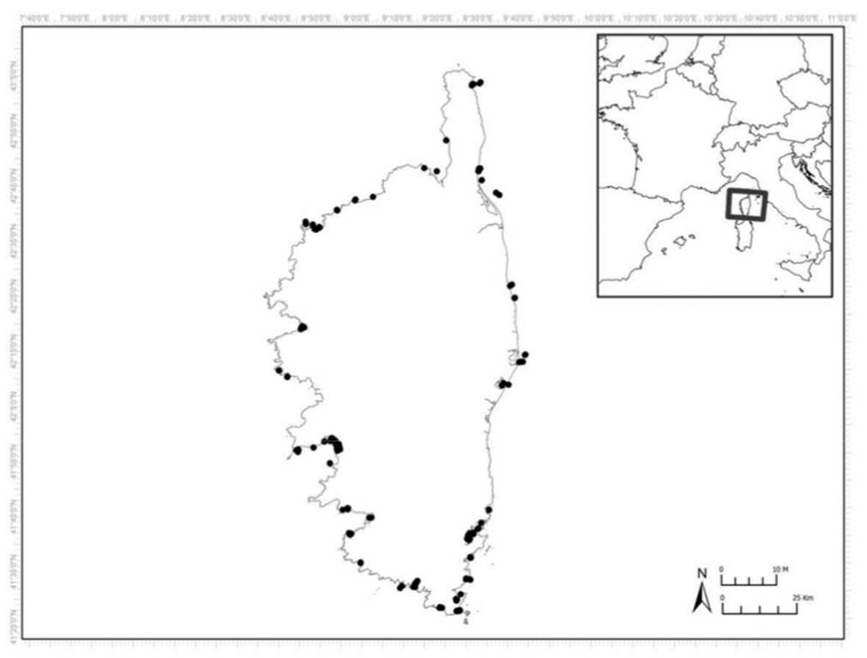
Benthic referential
Based on 90 stations around Corsica (3 or 5 replicats)
Bad and high reference values identification for M-AMBI calculation by habitat types
 | Stations | AMBI | Diversity | Richness
SF; [0-35[ | Bad | 6 | 0 | 0
 | High | 0,82 | 5,04 | 74
SM; [0-10[ | Bad | 6 | 4,65 | 55
 | High | 1,41 | 2,52 | 16
SG; [0-10[ | Bad | 6 | 4,7 | 73
 | High | 1,98 | 3,97 | 31
SMG; [10-35[ | Bad | 6 | 0 | 0
 | High | 0,93 | 5,39 | 80
Sandy clearing | Bad | 6 | 5,73 | 124
 | High | 1,51 | 3,19 | 41
SF; [35- | Bad | 6 | 0 | 0
 | High | 1,28 | 6,27 | 140
SM; [35- | Bad | 6 | 0 | 0
 | High | 1,38 | 5,96 | 134
SG; [35- | Bad | 6 | 0 | 0
 | High | 0,98 | 6,12 | 144

Slide 8
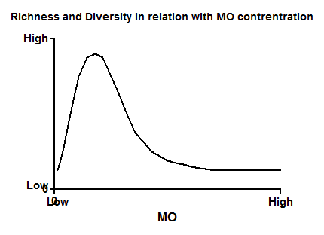
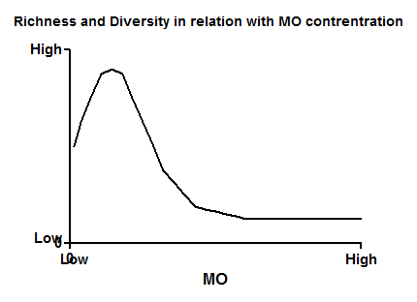
Weighting of the M-AMBI value by Piélou index class
J’MAMBI
Why?
Naturally poor assemblages:
Naturally rich assemblages:
High J’
Low J’
High J’
Low J’
Fine distinction between sites
How to know?

Slide 9
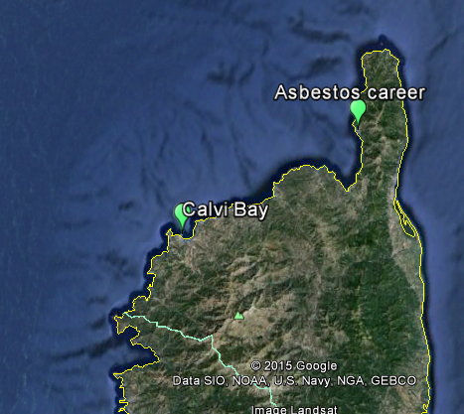

Distinction between area at proximity of an old asbestos career and area with weak anthropogenic influences.
    Two with good M-AMBI ecological status
    J’ value different
    Distinction between the two ecological status due to weighting
 | Habitat type | AMBI | Diversity | Richness | M-AMBI | M-AMBI Status | Pielou (J') | J' Eval | J'MAMBI | J'MAMBI Status
Asbestos career | SF>=35m | 1,467 | 4,35 | 75 | 0,73 | Good | 0,70 | 0,8 | 0,59 | Moderate
Calvi Bay | SF>=35m | 1,351 | 5,62 | 93 | 0,86 | Good | 0,86 | 1 | 0,86 | Good

Slide 10
Taxonomic sufficiency
Reference conditions calculated for Genus and Family levels by habitat types
    Bad and high values identified as for species level
Utilities of J’ weighting classes
    Good Correlation values
Comparison with results of Species level
    Good Kappa values (0,85 for genus or 0,65 for family)
    Good Correlation values (R² = 0,95 for genus or 0,76 for family)
Mean view: Family level sufficient
Precise view: Species level necessary
    Examples via Study case

Slide 11
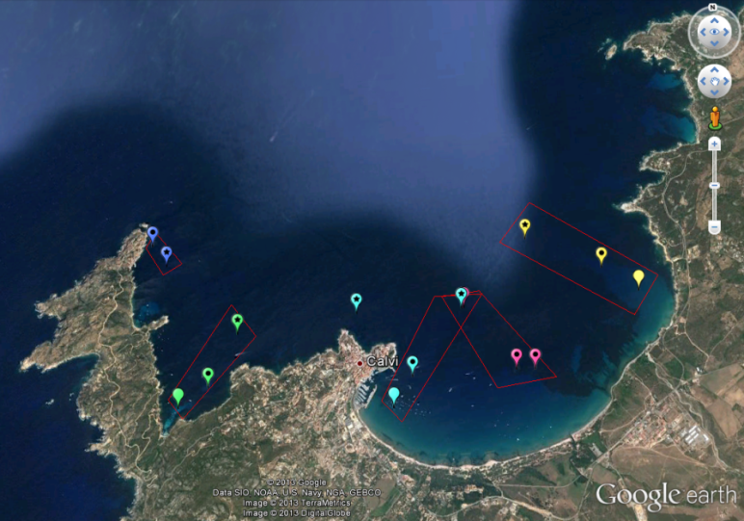
Study case
Application of results of J’MAMBI calculation and TS on sampled stations in Calvi Bay
5 anthropogenic sources
Gradient in sampling stations
2 stations outoff influences
River Mouth area
Fish Farm area
Organised anchoring area
Sewage outfall area
Open boat anchoring area
Unimpacted area

Slide 12
EQR by level for each station

Slide 13
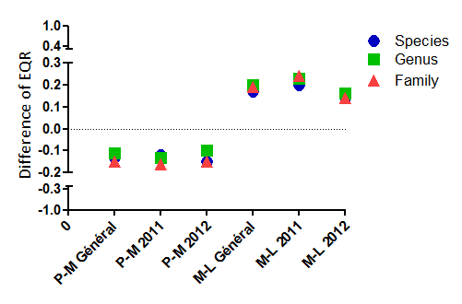
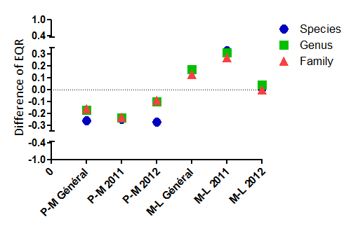
Distance from the source
Mean Value
By source:
Anchoring
River Mouth

Slide 14
Conclusions
Difference of result between mean status at bay level and at influence levels
  General view: family level sufficient
  More precise situation: species level
Good perception of status in relation with the knowledge

Slide 15
Perspectives
More analysis on Calvi Bay and around Corsica
Analysis of others sites around the Mediterannean Sea

Slide 16
All suggestions and remarks are welcome as well as data sets
Thank you for your attention.

