Slide 1

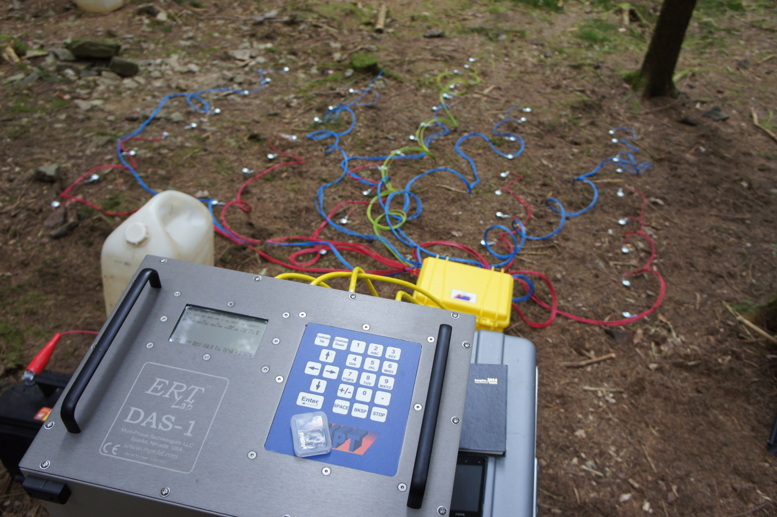
Contact resistance problems applying ERT on low bulk density forested stony soils
Is there a solution?
Deborah Deraedt¹, Camille Touzé¹, Tanguy Robert², Gilles Colinet¹, Aurore Degré¹, and Sarah Garré¹
University of Liège, Gembloux Agro Bio-Tech, BIOSE, EESP, Gembloux, Belgium
AQUALE, Noville-les-Bois, Belgium

Slide 2
Aims
We use ERT (Electrical Resistivity Tomography) for 2 purposes:
1. To determine soil depth
2. To quantify water fluxes heterogeneity
Both along a forested slope with high stone content

Slide 3

Where do we come from?
ERT Study
Forest
Terrameter LS
Pasture
DAS-1
Tracing test
Site
Equipment
No
DAS-1
No
Saline tracer
Saline tracer
ERT Study
Forest
Terrameter LS
Pasture
DAS-1
Tracing test
Site
Equipment
No
DAS-1
No
Saline tracer
Saline tracer
ERT Study
Forest
Terrameter LS
Pasture
DAS-1
Tracing test
Site
Equipment
No
DAS-1
No
Saline tracer
Saline tracer
Terrameter LS
Forest
DAS-1

Slide 4
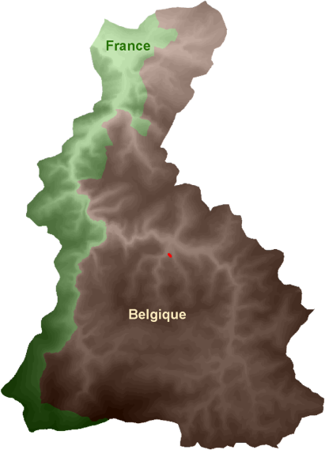
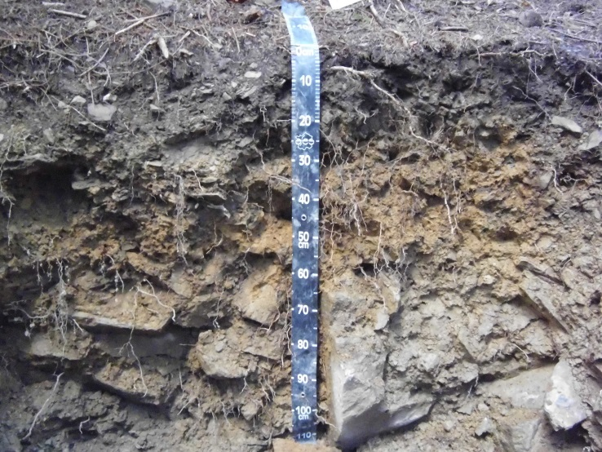
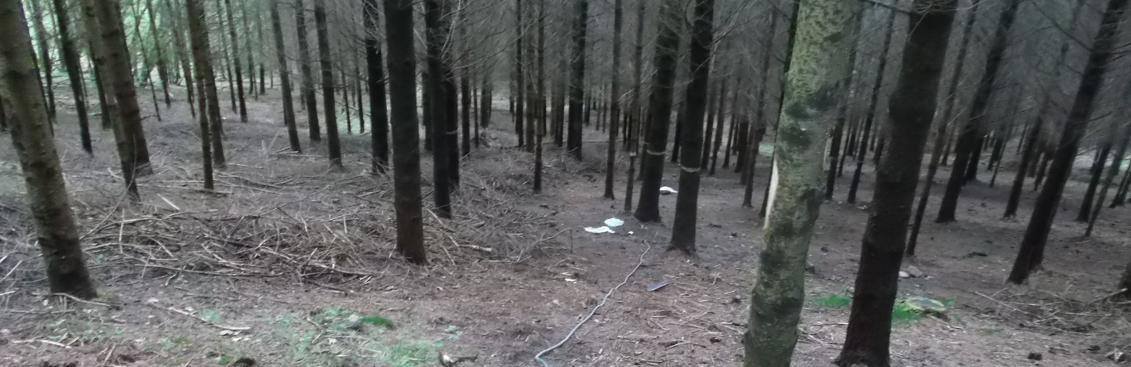
Material & Methods
Forest
  Belgian Ardennes
  Spruce and douglas mix
  30 years old
  Silty soil with high stone content (surface average : 45%)
  Low bulk density (surface average : 1.25g/cm³)
  Rather dry soil all the year long

Slide 5
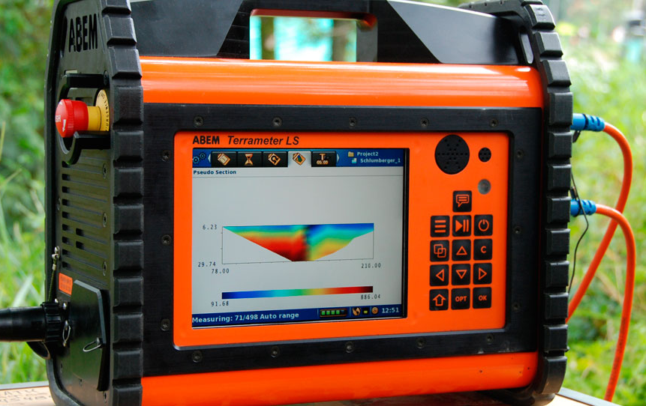
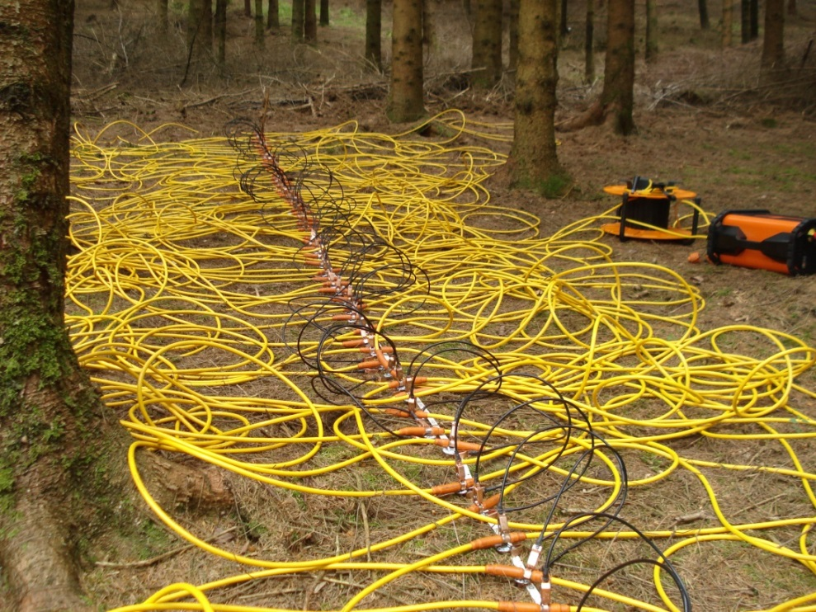
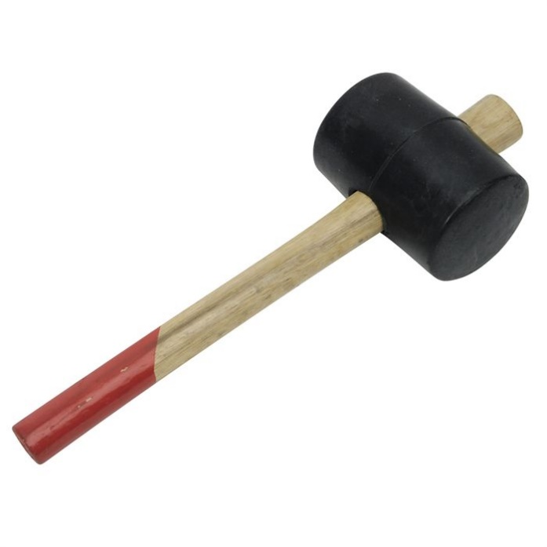
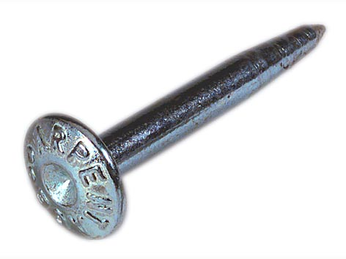
Material & Methods
Forest
  Terrameter LS
Electrodes layout :
Two types of configurations tested:
Single array
Dipole-dipole
Wenner-Schlumberger
10 cm
63 electrodes
6.3 m

Slide 6

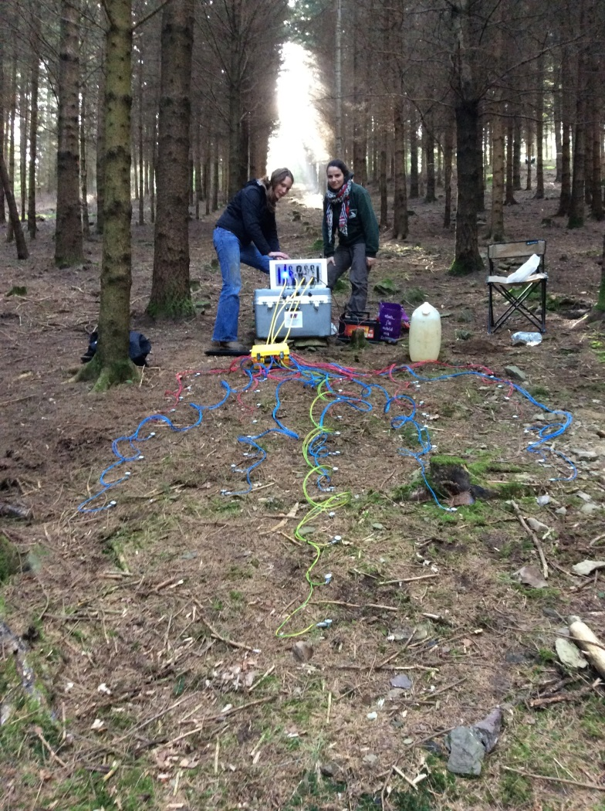
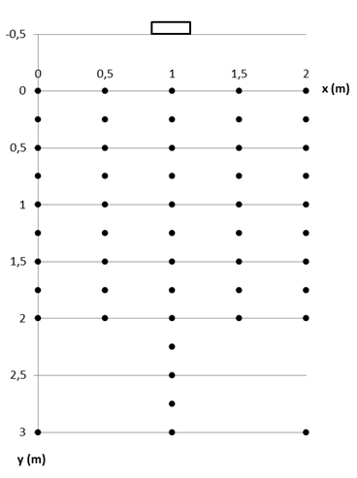

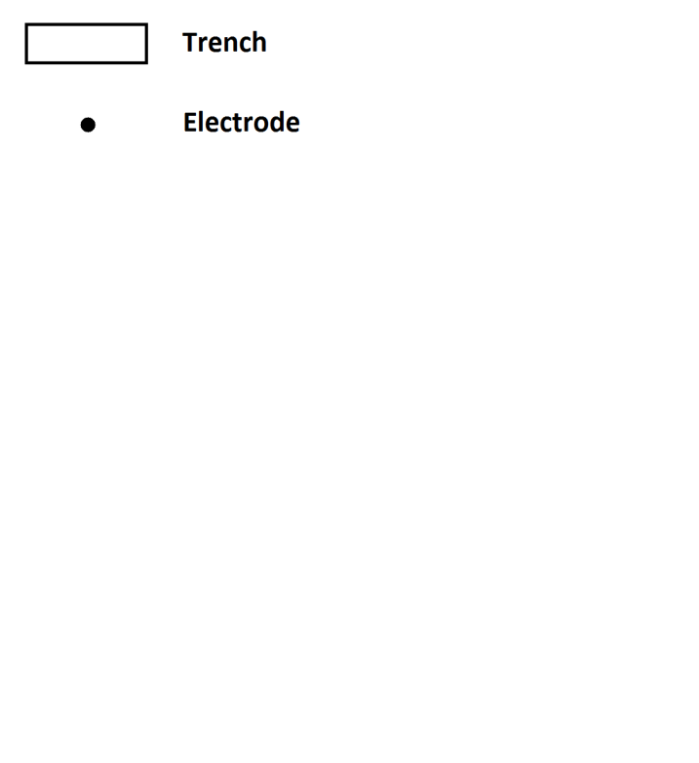
Material & Methods
Forest
  DAS-1
Electrodes layout :
Configurations tested :
5 arrays (2*2m, 1*3m, 2*2m)
Dipole – Dipole
Wenner-Schlumberger
Wenner Alpha
49 electrodes

Slide 7
Material & Methods
ERT Study
Forest
Terrameter LS
Pasture
DAS-1
Tracing test
Site
Equipment
No
DAS-1
No
Saline tracer
Saline tracer
Pasture
DAS-1

Slide 8
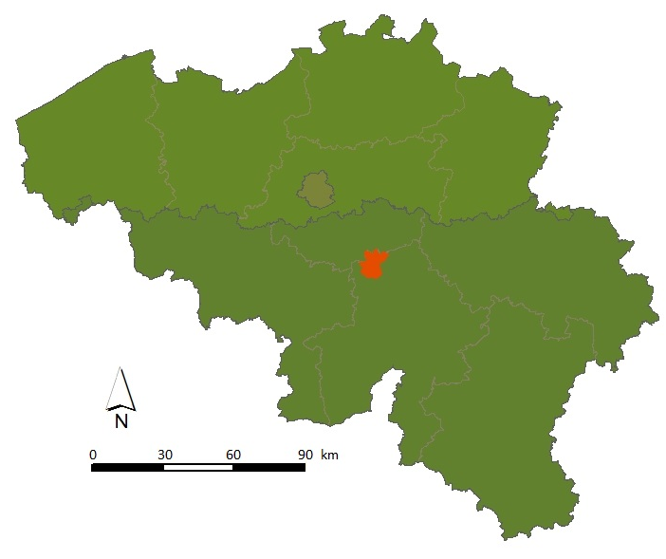
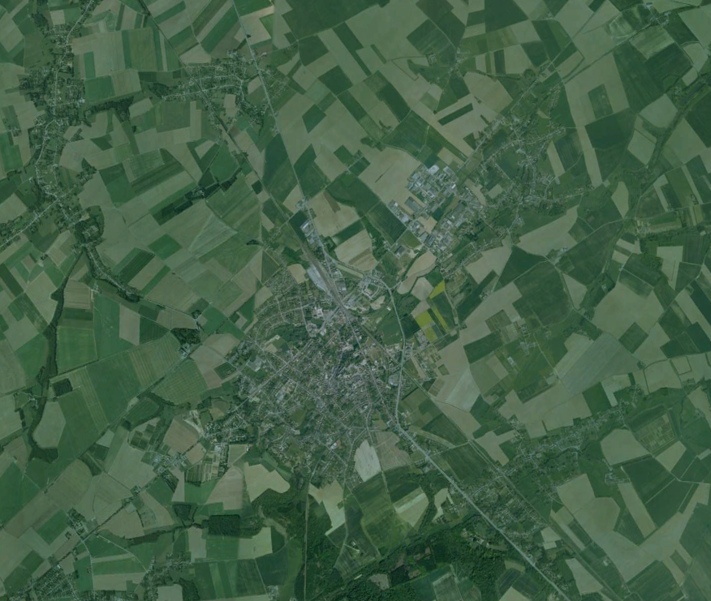
Material & Methods
Pasture
  Central Belgium
  Silty soil
  Low stone content
  (<2%)
  Bulk density (1.4g/cm³)
0 1 2 km

Slide 9
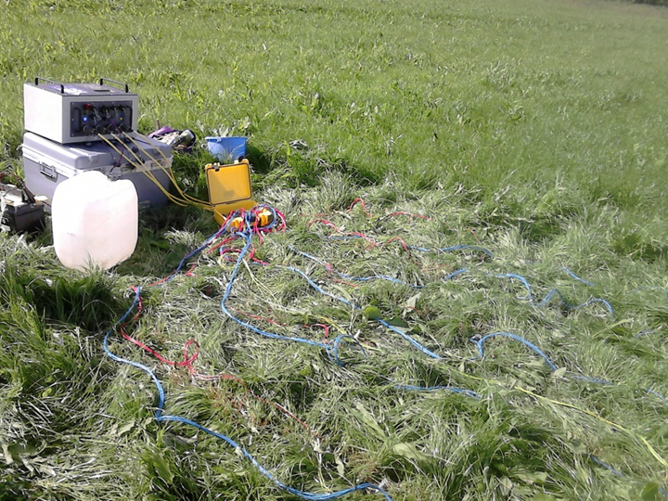
Material & Methods
Pasture
  DAS-1
Electrodes layout :
Configurations :
5 arrays
(2*2m, 1*3m, 2*2m)
Dipole – Dipole
Wenner-Schlumb.
Wenner Alpha

Slide 10
Material & Methods
ERT Study
Forest
Terrameter LS
Pasture
DAS-1
Tracing test
Site
Equipment
No
DAS-1
No
Saline tracer
Saline tracer
Tracing test
Saline tracer

Slide 11

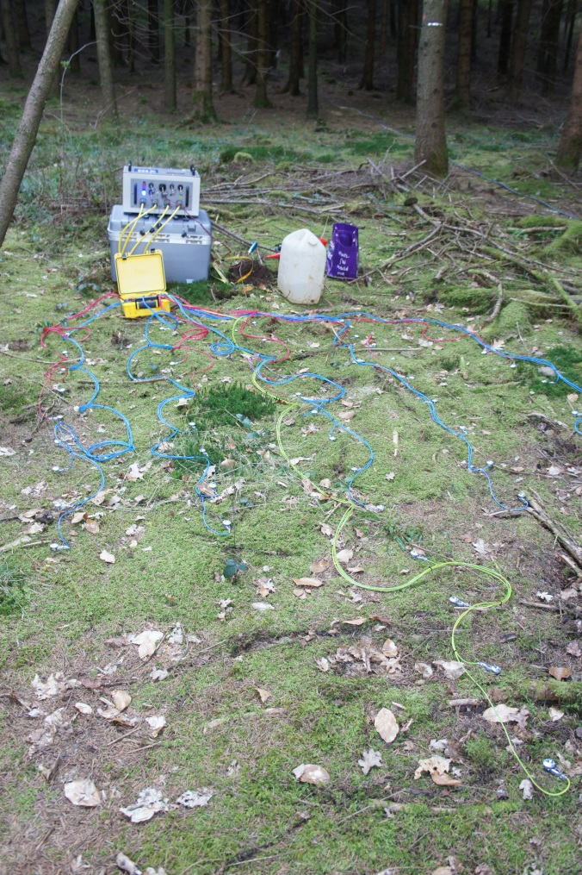
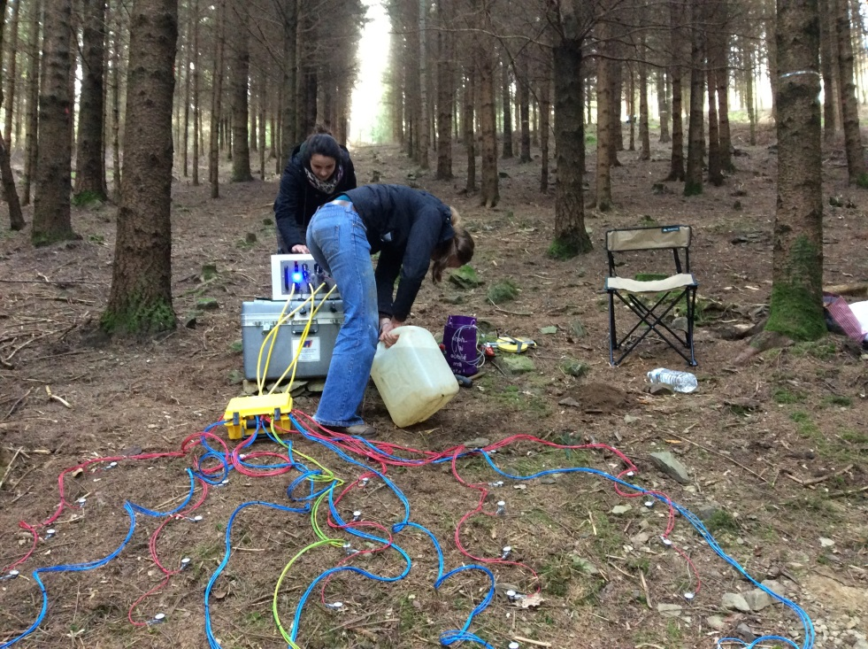
Material & Methods
Tracing test
40 to 65l of saline tracer

Slide 12
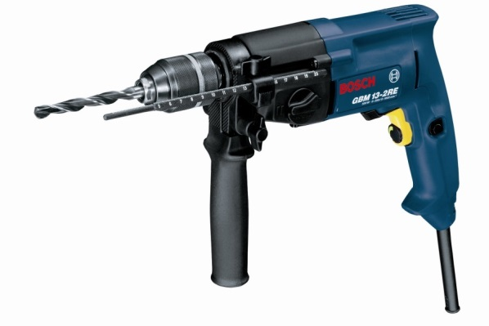

Results
 | Equipment | Tracing | Site | Contact Resistance (Ω) Should be < 3000 Ω
 | Terrameter LS | No | 1 x Forest
 | Equipment | Tracing | Site | Contact Resistance (Ω) Should be < 3000 Ω
 | Terrameter LS | No | 1 x Forest
New ERT device | DAS-1 | No Yes | 1 x Pasture 2 x Forest | 750 – 1700 13100 – 51000
 | Equipment | Tracing | Site | Contact Resistance (Ω) Should be < 3000 Ω
 | Terrameter LS | No | 1 x Forest
New ERT device | DAS-1 | No Yes | 1 x Pasture 2 x Forest | 750 – 1700 13100 – 51000
Drilled holes + Water | DAS-1 | No | 1 x Pasture 1 x Forest | 670 – 1600 9800 – 32800
 | Equipment | Tracing | Site | Contact Resistance (Ω) Should be < 3000 Ω
 | Terrameter LS | No | 1 x Forest
New ERT device | DAS-1 | No Yes | 1 x Pasture 2 x Forest | 750 – 1700 13100 – 51000
Drilled holes + Water | DAS-1 | No | 1 x Pasture 1 x Forest | 670 – 1600 9800 – 32800
Drilled holes + Mud | DAS-1 | No Yes | 1 x Forest 3 x Pasture | 11700 – 32500 1600 – 2700

Slide 13
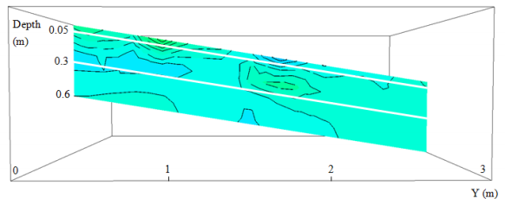
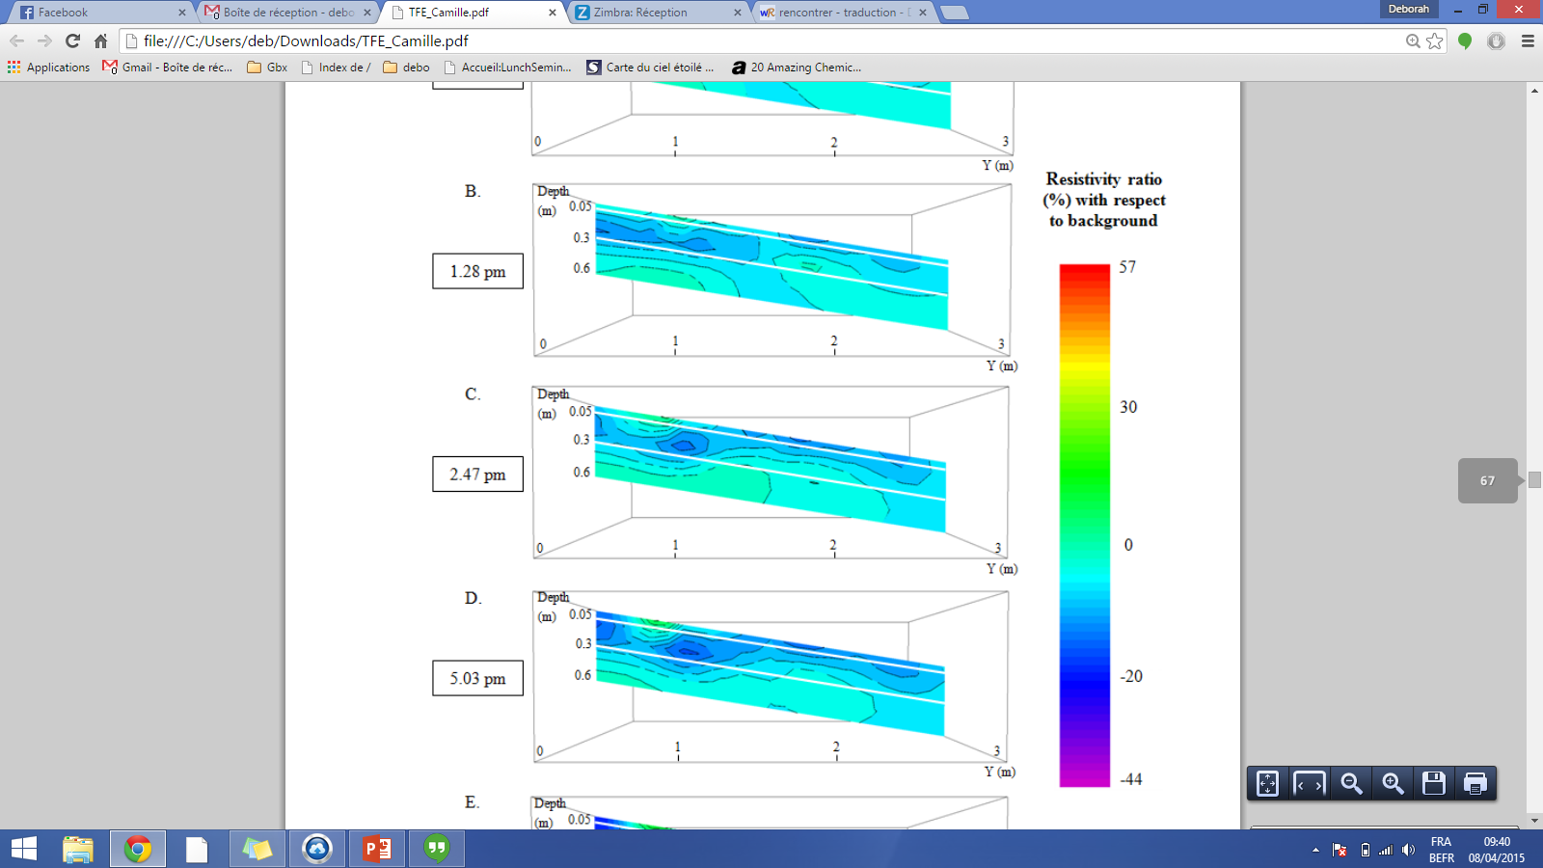
Results on the pasture
Wenner Alpha
&
Wenner Sclumberger data

Slide 14

Results
 | Equipment | Tracing | Site | Contact Resistance (Ω) Should be < 3000 Ω
 | Terrameter LS | No | 1 x Forest
New ERT device | DAS-1 | No Yes | 1 x Pasture 2 x Forest | 750 – 1700 13100 – 51000
Drilled holes + Water | DAS-1 | No | 1 x Pasture 1 x Forest | 670 – 1600 9800 – 32800
Drilled holes + Mud | DAS-1 | No Yes | 1 x Forest 3 x Pasture | 11700 – 32500 1600 – 2700
 | Equipment | Tracing | Site | Contact Resistance (Ω) Should be < 3000 Ω
 | Terrameter LS | No | 1 x Forest
New ERT device | DAS-1 | No Yes | 1 x Pasture 2 x Forest | 750 – 1700 13100 – 51000
Drilled holes + Water | DAS-1 | No | 1 x Pasture 1 x Forest | 670 – 1600 9800 – 32800
Drilled holes + Mud | DAS-1 | No Yes | 1 x Forest 3 x Pasture | 11700 – 32500 1600 – 2700
Drilled holes + Mud + CaCl₂ | DAS-1 | No | 1 x Forest | 5200 – 15600
 | Equipment | Tracing | Site | Contact Resistance (Ω) Should be < 3000 Ω
 | Terrameter LS | No | 1 x Forest
New ERT device | DAS-1 | No Yes | 1 x Pasture 2 x Forest | 750 – 1700 13100 – 51000
Drilled holes + Water | DAS-1 | No | 1 x Pasture 1 x Forest | 670 – 1600 9800 – 32800
Drilled holes + Mud | DAS-1 | No Yes | 1 x Forest 3 x Pasture | 11700 – 32500 1600 – 2700
Drilled holes + Mud + CaCl₂ | DAS-1 | No | 1 x Forest | 5200 – 15600

Slide 15
Problem
How to fix the contact resistance problem in the forested soil??
As a reminder :
  High stone content in the top soil (45% in average)
  Low bulk density (surface average : 1.25g/cm³)
  Rather dry soil all year round

Slide 16


Thank you for your attention
Any question or suggestion?
deborah.deraedt@ulg.ac.be

