Slide 1
Conference Presentation AMSE-ORC 2013 Rotterdam – October 8th 2013
Non-constant wall thickness scroll expander investigation for a micro solar ORC power plant
by
Ir. Rémi DICKES (MIT/ULg) Dr. Matt OROSZ (MIT)
Pr. Harry HEMOND (MIT)
Notes:
Good morning ladies and gentlemen
welcome to this presentenation about
Scroll expanders designed for a micro-solar ORC power plant
More precisely about variable wall thickness scroll expander
Rémi DICKES – PhD Student from Ulg
Work ➔ partnership between the university of Liège and MIT

Slide 2
PRESENTATION STRUCTURE
Context and Issues
Optimal scroll geometries selection
CAD modeling of a single stage prototype
Prototype fabrication and assembly
Conclusion and perspectives
Notes:
About the presentation structure
First, start by describing C&I leading us to this work
Then, talk about different step performed in order to select optimal scroll geometries for a particular MicroCSP application
Geometries chosen ➔ present a first single stage prototype ⬄ designed, frabricated and assembled
To conclude, give a word about the future of this project and work remains be done

Slide 3
PART 1
CONTEXT
AND
ISSUES
Notes:
So about C&I

Slide 4
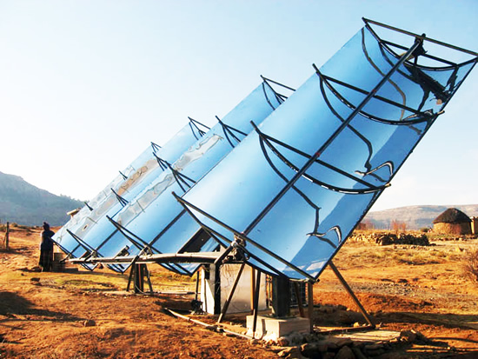
1. Context and Issues
Electricity access in developing countries
Environmental concerns
Favorable insolation conditions
MicroCSP
Photovoltaic
MicroCSP = Micro “Concentrated Solar Power” plant |||| ORC = Organic Rankine Cycle
Notes:
Work < more general project WHOSE goal is
provide electricity in remote areas of developing countries
presenting favorable insolation conditions
Two main technologies exist to meet this challenge : MicroCSP (explain) and PV

Slide 5
1. Context and Issues
Electricity access in developing countries
Environmental concerns
Favorable insolation conditions
MicroCSP
Photovoltaic
Thermal storage ⬄ Batteries
Cogeneration available
Hybridization with a back up generator
MicroCSP = Micro “Concentrated Solar Power” plant |||| ORC = Organic Rankine Cycle
Notes:
However, 3 important advantages over PV:
First : To extend daily-time production or damp irradiation fluctuation
Thermal storage in µCSP mucher&easier than batteries required in PV
Secondly, cogeneration available with µCSP ➔ both electricity/hot water
Finally, …

Slide 6
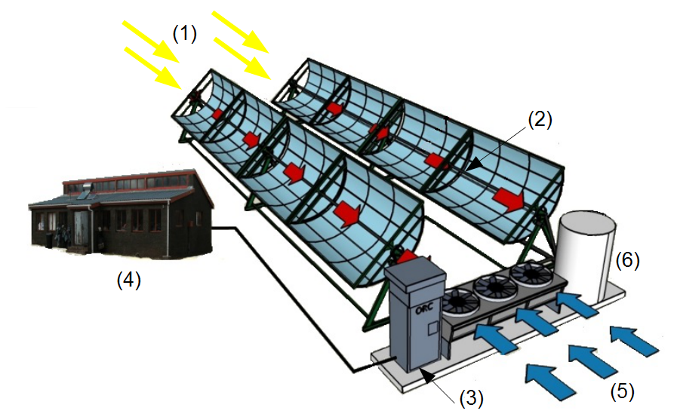
1. Context and Issues
MicroCSP description:
Sun rays
Parabolic trough collectors
ORC unit
Off-grid electric load
Ambient air
Thermal storage
MicroCSP = micro ‘Solar Power Power’ plant
Notes:
General architecture as illustrated…
Solar rays fall on PTC ➔ concentrate them on a pipe
Pipe flows HTF ➔ hot fluid = heat source for an ORC unit
ORC unit supply demand & thermal storage used to provide stable heat source

Slide 7
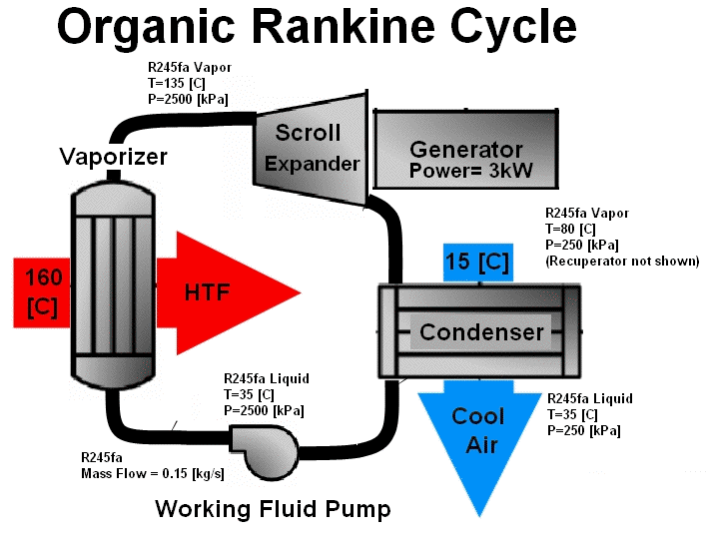
1. Context and Issues
MicroCSP description:
Operating conditions (T_{ev}/T_{cond})
Low Carnot efficiency
Improve expansion device
MicroCSP = micro ‘Solar Power Power’ plant
Notes:
Major drawback ➔ low Tev and high Tcond RESULTING in a low Carnot efficiency
Thus important: optimize each component ➔ insure µCSP performance as good as possible
Among different components ⬄ expansion device = major enhancement parameter to be optimized

Slide 8
1. Context and Issues
MicroCSP description:
MicroCSP = micro ‘Solar Power Power’ plant
Notes:
Frame of this work
Scroll expander = positive displacement volumetric machine
Made of a fixed&orbiting scroll
As shown on this video, relative motion ➔series of expansion pockets (center➔outise)

Slide 9
1. Context and Issues
Motivations for a new design of scroll expander
Optimized internal volumetric ratios
Two-stage/single-shaft architecture
Single signal frequency f and output voltage V
Half of the power electronic required ➔cheaper and more simple
Variable wall thickness profile
More compact expansion device
Heat and mechanical losses reduced
Notes:
Why new design? explore 3 ways of improving performance
First: design expansion device + optimized internal rv for a MicroCSP application

Slide 10
1. Context and Issues
Motivations for a new design of scroll expander:
Optimized internal volumetric ratios
Two-stage/single-shaft architecture
Single signal frequency f and output voltage V
Half of the power electronic required ➔cheaper and more simple
Variable wall thickness profile
More compact expansion device
Heat and mechanical losses reduced
Notes:
Secondly, IN PRACTICE, generally 2 expanders in series
Create architecture + 2 expansion stages on a single shaft
Only one generator ➔ single electric output + divide by 2 power electronics (-$)

Slide 11
1. Context and Issues
Motivations for a new design of scroll expander:
Optimized internal volumetric ratios
Two-stage/single-shaft architecture
Single signal frequency f and output voltage V
Half of the power electronic required ➔cheaper and more simple
Variable wall thickness profile
More compact expansion device
Heat and mechanical losses reduced
➔ prop. to η_{is}
Notes:
Third reason: investigate variable wall thickness scroll geometries
Unlike commercialized scroll machine with constant wall thickness profile
Increase expansion device compactness ➔ reduce h/m losses inherent to the machine
Measure compactness ➔ geometrical factor = CF + definition
Use geometrical parameter as a performance indicator
Assume CF proportional to eta_is

Slide 12
PART 2
Optimal scroll geometries selection
Notes:
Let’s now talk about
process leading us to select optimal scroll geometries
for a particular µCSP application

Slide 13
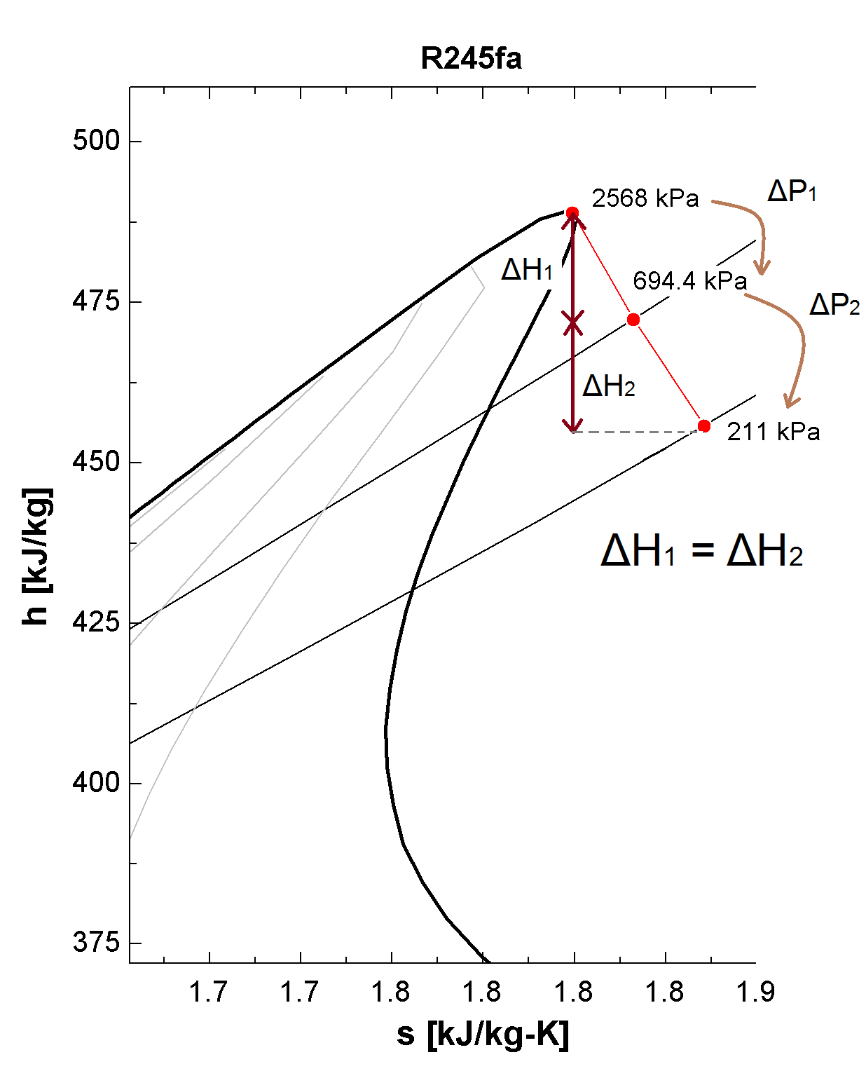
2. Optimal scroll geometries selection
Operating requirements given by a steady-state model (EES)
135°C ➔ 35°C
5kW
R245fa
3000 rpm
=
r_{v,1st} = 4.9
r_{v,2nd} = 3.36
=0.15 kg/s
Notes:
First step = define all expansion requirement ➔ fulfill production expectation
Realize by steady-state model ➔ specify nominale operating conditions
Temperature
Total output power
Working fluid
Etc
Provide rv, m_dot, V_in for both expansion stages

Slide 14
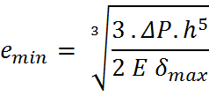
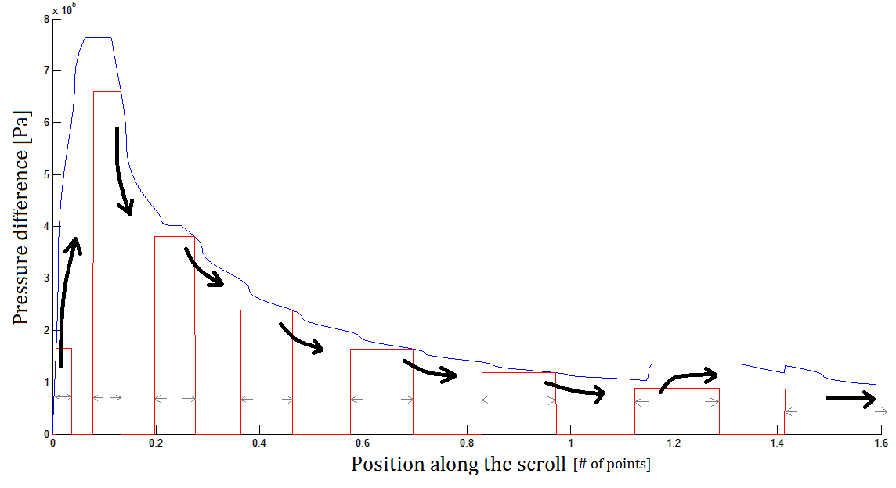
2. Optimal scroll geometries selection
Minimum wall thickness requirement
Cantilever beam theory :
Notes:
Second step:
Define minimum wall thikness requirement in order of our scroll geometry ⬄ withstand pressure difference and avoid excessiv leakage

Slide 15
2. Optimal scroll geometries selection
26.000 scrolls database
r_{v} criteria
Deterministic modeling
2 geometries selected
26 candidates
CF ranking
Danfoss frame
s_{x} = c₁ + c₂ φ + c₃ φ² + c₄ φ³ +c₅ φ⁴
1 geometry ⬄ 8 parameters
R, d and N
Notes:
Knowing these data
Use 8 dimentionnal planar-curve frame
generate 26.000 scroll database

Slide 16
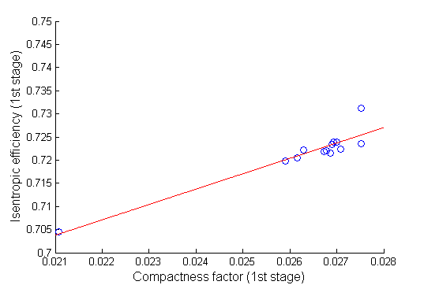
2. Optimal scroll geometries selection
26.000 scrolls database
r_{v} criteria
Deterministic modeling
2 geometries selected
26 candidates
CF ranking
prop. to η_{is}
Notes:
From database ➔ select geometries having correct rv
Rank selected candidates by decreasing CF
Use CF = performance indicator (CF prop eta)

Slide 17
2. Optimal scroll geometries selection
26.000 scrolls database
r_{v} criteria
Deterministic modeling
2 geometries selected
26 candidates
CF ranking
Decreasing wall thickness
Increasing wall thickness
Constant wall thickness
Notes:
For example:
Increasing wall thickness geometries ➔ smallest compacity ➔ smallest isentr eff
Decreasing/constant wall thickness ➔ higher compactness thus higher isentro eff

Slide 18
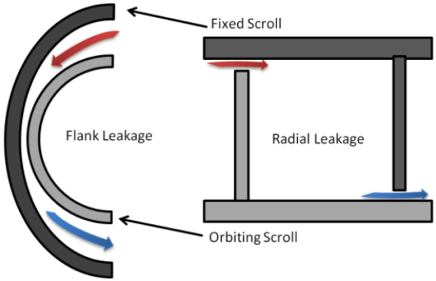
2. Optimal scroll geometries selection
26.000 scrolls database
r_{v} criteria
Deterministic modeling
2 geometries selected
26 candidates
CF ranking
Deterministic model of a scroll expander taking into account
Radial and flank leakages
Intake and exhaust throttling losses
Friction losses between the scrolls
Mechanical losses into the bearings
η_{is} , , FF
Notes:
Only for 26 best candidates
Use deterministic model ➔ simulate performance
Takes into account all major phenomena occurring during the expansion i.e.
radial/Flank leakages
Throttling losses at the intake and exhaust
Friction losses between scrolls
Mechanical losses into bearings

Slide 19
2. Optimal scroll geometries selection
26.000 scrolls database
r_{v} criteria
Deterministic modeling
2 geometries selected
26 candidates
CF ranking
η_{1st,is} = 73.12%
highest CF among candidates
= 3.03 kW
1st stage:
2nd stage:
Full expansion: η_{is,tot} = 68.6 %
η_{2nd,is} = 66.14 %
highest CF among candidates
= 2.5 kW
Notes:
From these results
select 2 best geometry for both stage illustrated
Characterized respectively by eta_is of 73.12 – 66.14%
Combining the two stage, overall expansion = isentropic efficiency 68.6%

Slide 20
2. Optimal scroll geometries selection
26.000 scrolls database
r_{v} criteria
Deterministic modeling
2 geometries selected
26 candidates
CF ranking
η_{1st,is} = 73.12%
highest CF among candidates
= 3.03 kW
1st stage:
2nd stage:
Full expansion: η_{is,tot} = 68.6 %
η_{2nd,is} = 66.14 %
highest CF among candidates
= 2.5 kW

Slide 21
2. Optimal scroll geometries selection
Losses study
Losses modeled | First stage |  | Second stage
---- | η (%) | Δη (%) | η (%) | Δη (%)
Inlet/Outlet Throttling losses | 97.19 | - | 88.7 | -
Same as the previous + Mechanical losses | 82.77 | 14.43 | 68.75 | 19.95
Same as the previous + Flank leakages | 77.26 | 5.51 | 68.02 | 0.73
Same as the previous + Radial leakages | 73.67 | 3.59 | 66.68 | 1.34
Same as the previous + Heat losses | 73.12 | 0.55 | 66.14 | 0.54
Notes:
Deterministic model = powerful tool ➔ many analyses possible
One of them = losses study
investigate contribution of each losses source on the efficiency drop
Find: mechanical losses = main source of losses

Slide 22
2. Optimal scroll geometries selection
Losses study
Losses modeled | First stage |  | Second stage
---- | η (%) | Δη (%) | η (%) | Δη (%)
Inlet/Outlet Throttling losses | 97.19 | - | 88.7 | -
Same as the previous + Mechanical losses | 82.77 | 14.43 | 68.75 | 19.95
Same as the previous + Flank leakages | 77.26 | 5.51 | 68.02 | 0.73
Same as the previous + Radial leakages | 73.67 | 3.59 | 66.68 | 1.34
Same as the previous + Heat losses | 73.12 | 0.55 | 66.14 | 0.54
Main source : mechanical losses

Slide 23
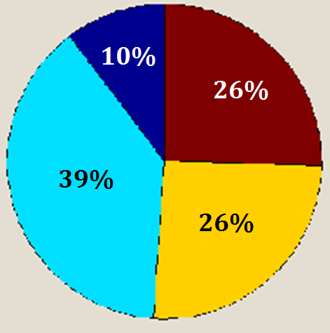
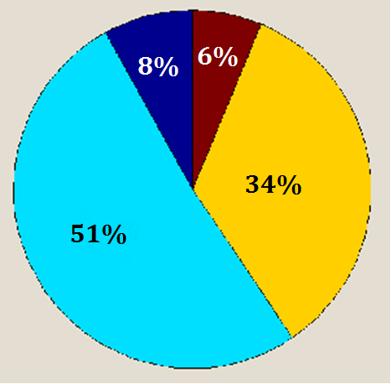
2. Optimal scroll geometries selection
Losses study : mechanical source analysis
Losses source | First stage | Second stage
Thrust bearing | 42.1 W | 74.06 W
Journal bearing (top) | 269.8 W | 276.3 W
Journal bearing (low) | 179.9 W | 184.2 W
Scroll friction | 33.07 W | 181.6 W
TOTAL | ≈530 W | ≈ 720 W
Notes:
Particularly, one can analyze the fraction of each mechanical source
As can be seen: bearing losses roughly the same both stage
But scroll friction much higher in the second stage because of smaller v_spec
Indeed, expansion ➔ bigger v_spec ➔ bigger expansion device required for a same mass flow ➔ greater friction

Slide 24
2. Optimal scroll geometries selection
Performance enhancement?
Design | A | B | C
Wall thickness profile | Constant | Constant | Decreasing
Volumetric ratio | 2,8 (both stages) | Optimized | Optimized
 | 5.04 kW | 5.45 kW | 5.5 kW
η_{is,tot} | 62.4 % | 67.43 % | 68.6 %
Δ η_{is,tot} = 5.03%
Δ η_{is,tot} = 1.17 %
Δ η_{is,tot} = + 6.2%
Notes:
Another interesting study= evaluate performance enhancement our design
To do so, compare 3 cases
design A ➔ what is done is common practise : constant wall thickness scroll geometry with non optimized internal volumetric ratio

Slide 25
2. Optimal scroll geometries selection
Performance enhancement?
Design | A | B | C
Wall thickness profile | Constant | Constant | Decreasing
Volumetric ratio | 2,8 (both stages) | Optimized | Optimized
 | 5.04 kW | 5.45 kW | 5.5 kW
η_{is,tot} | 62.4 % | 67.43 % | 68.6 %
Δ η_{is,tot} = 5.03%
Δ η_{is,tot} = 1.17 %
Δ η_{is,tot} = + 6.2%
Notes:
Design B ➔ still constant wall thickness but optimized rv
Effect optimized rv results in a 5.03% increase eta_is

Slide 26
2. Optimal scroll geometries selection
Performance enhancement?
Design | A | B | C
Wall thickness profile | Constant | Constant | Decreasing
Volumetric ratio | 2,8 (both stages) | Optimized | Optimized
 | 5.04 kW | 5.45 kW | 5.5 kW
η_{is,tot} | 62.4 % | 67.43 % | 68.6 %
Δ η_{is,tot} = 5.03%
Δ η_{is,tot} = 1.17 %
Δ η_{is,tot} = + 6.2%
Notes:
Design C ➔ our design: Decreasing wall thickness geometry
effect decreasing wall thickness geometry smaller
only performance improvement by 1.17% efficiency

Slide 27
2. Optimal scroll geometries selection
Performance enhancement?
Design | A | B | C
Wall thickness profile | Constant | Constant | Decreasing
Volumetric ratio | 2,8 (both stages) | Optimized | Optimized
 | 5.04 kW | 5.45 kW | 5.5 kW
η_{is,tot} | 62.4 % | 67.43 % | 68.6 %
Δ η_{is,tot} = 5.03%
Δ η_{is,tot} = 1.17 %
Δ η_{is,tot} = + 6.2%
Notes:
Combination both effects result increase 6.2%
Effect overall µCSP performance in nominal condition – around 0.75 %

Slide 28
PART 3
CAD modeling
of a single-stage prototype
CAD = ‘Computer-Aided Design’
Notes:
validate deterministic code ➔ first build single stage prototype

Slide 29
3. CAD modeling of a single-stage prototype
CAD modeling
SolidWorks 2012
Architecture derived from Copeland compressors (ZR series)
Expander: 30 assembled pieces
CAD = ‘Computer-Aided Design’
Notes:
First step, realize CAD modeling
To do so: CAD software SW
Main architectural features derived form
As illustrated on this short video, expander = assembly of 30 pieces

Slide 30
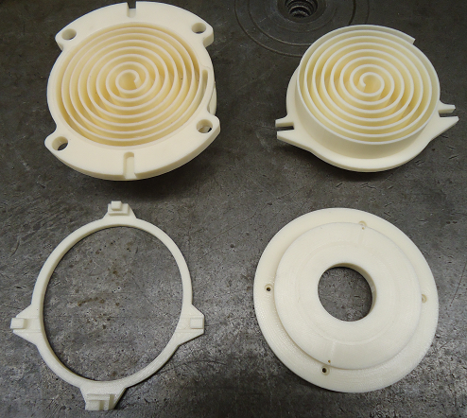
3. CAD modeling of a single-stage prototype
Mechanical viability checked by a 60% scale 3D-printed model (FDM printer)
Oil delivery circuit/BPC control
system
CAM with HSMXpress
Notes:
Mechanical viability …

Slide 31
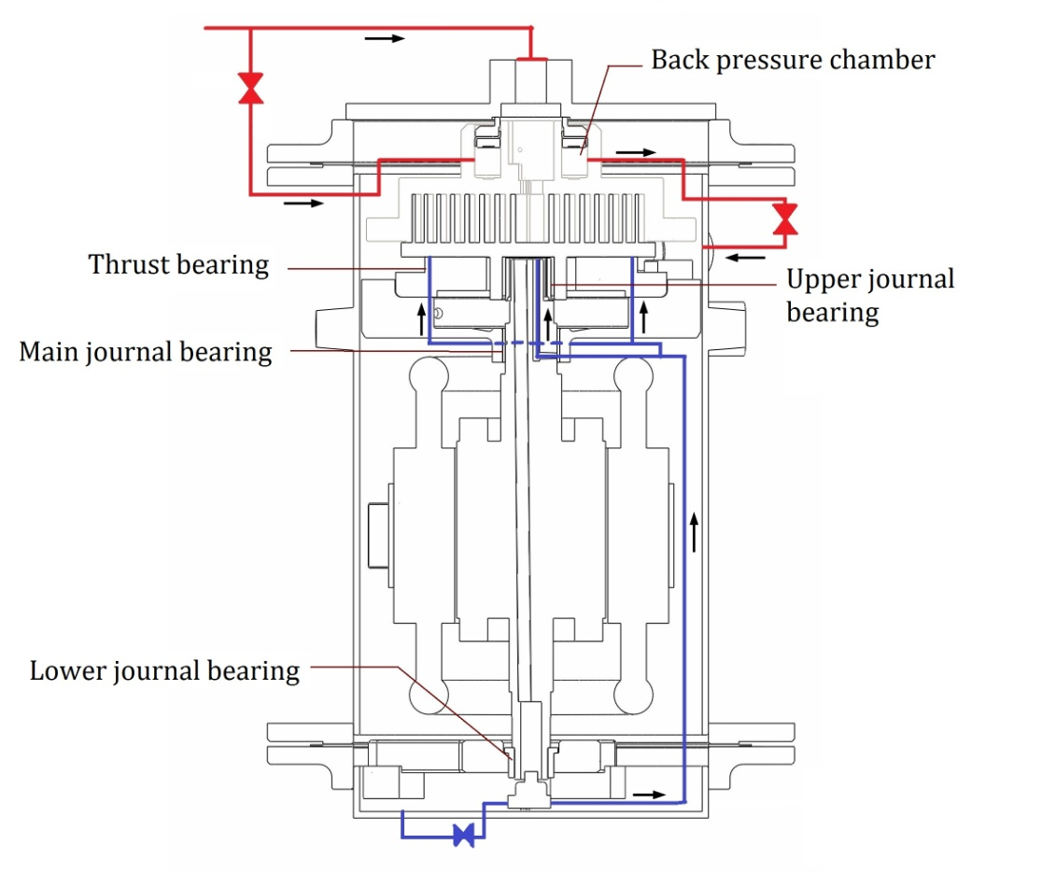
3. CAD modeling of a single-stage prototype
Mechanical viability checked by a 60% scale 3D-printed model (FDM printer)
Oil delivery circuit and
BPC control system
CAM with HSMXpress
Notes:
Besides pieces shown you
two additional circuits required ➔ensure the proper functioning expander
first : lubrication circuit, represented blue, oil delivery through expander
BPC control system, depicted red, control relative axial compliance between scrolls

Slide 32
3. CAD modeling of a single-stage prototype
Mechanical viability checked by a 60% scale 3D-printed model (FDM printer)
Oil delivery circuit and BPC control
system
CAM with HSMXpress
CAM = ‘Computer-Aided Manufacturing’
Notes:
Finally, SW +CAM software (HSMXpress) ➔ generate instruction code ➔ control CNC machine during the fabrication

Slide 33
PART 4
Prototype Fabrication
and
Assembly
Notes:
Speaking about the fabrication of this first prototype

Slide 34
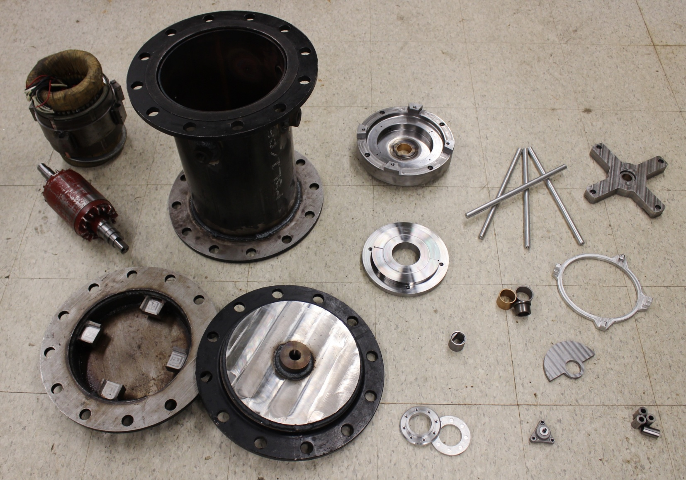
4. Prototype fabrication and assembly
Notes:
two month work machine shop
Machine different pieces shown previous animation

Slide 35
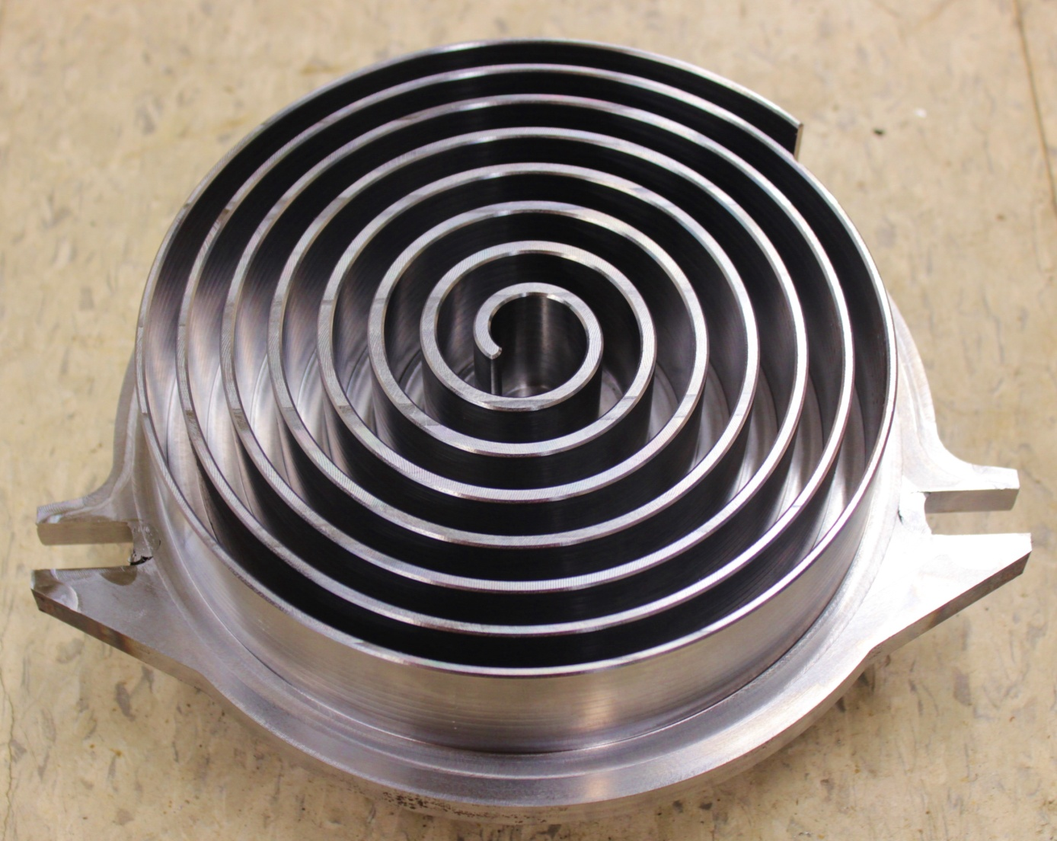
4. Prototype fabrication and assembly
Notes:
One can see a zoom in picture of the orbiting scroll

Slide 36
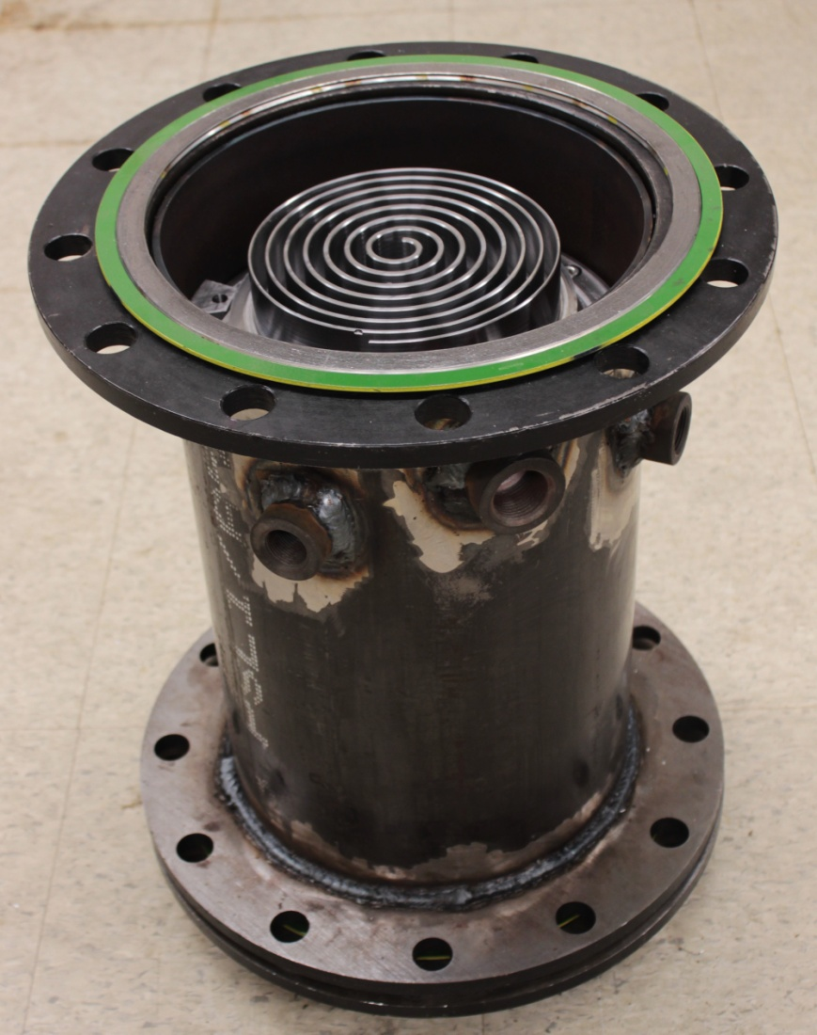
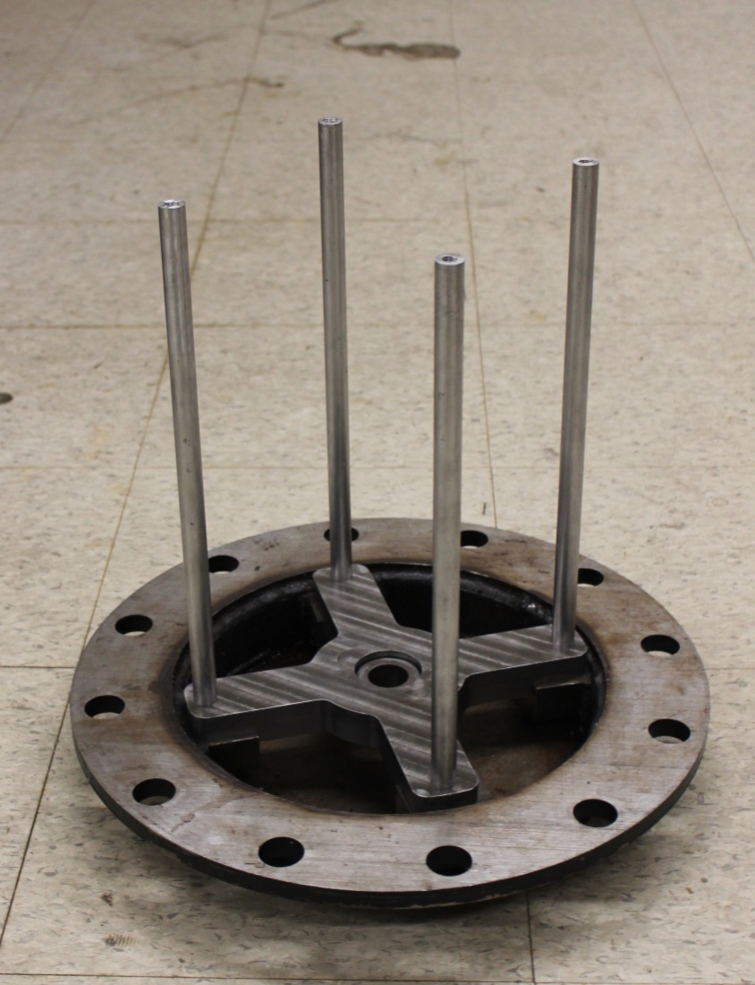
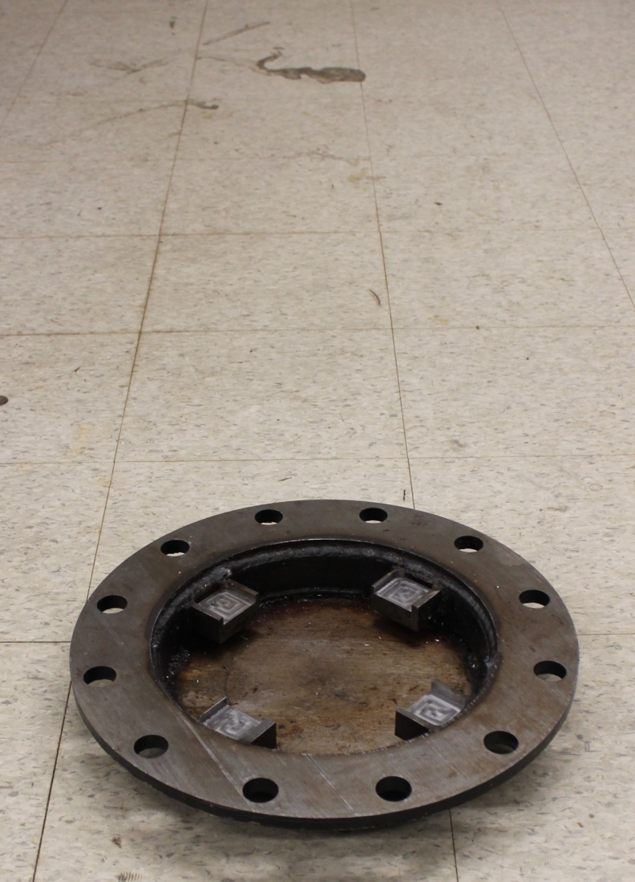
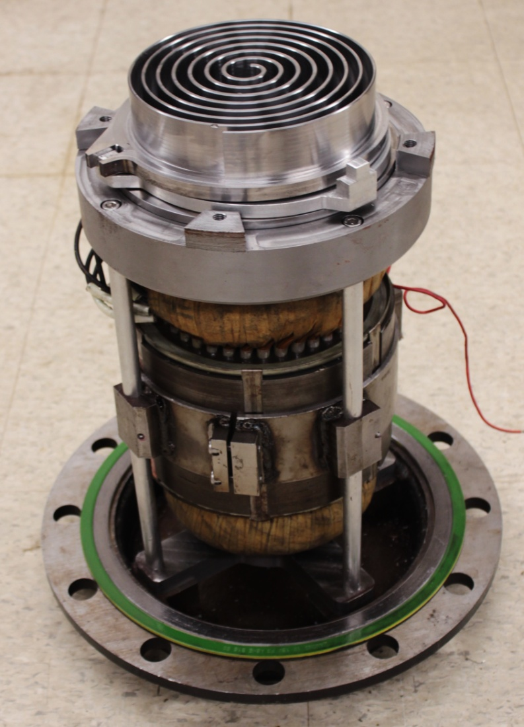
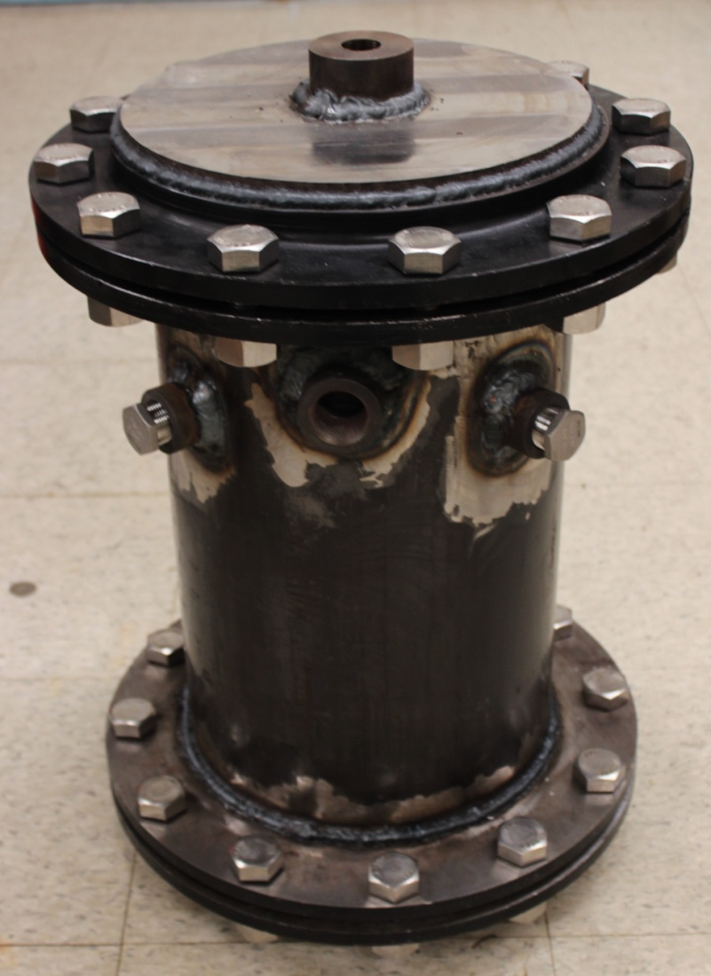
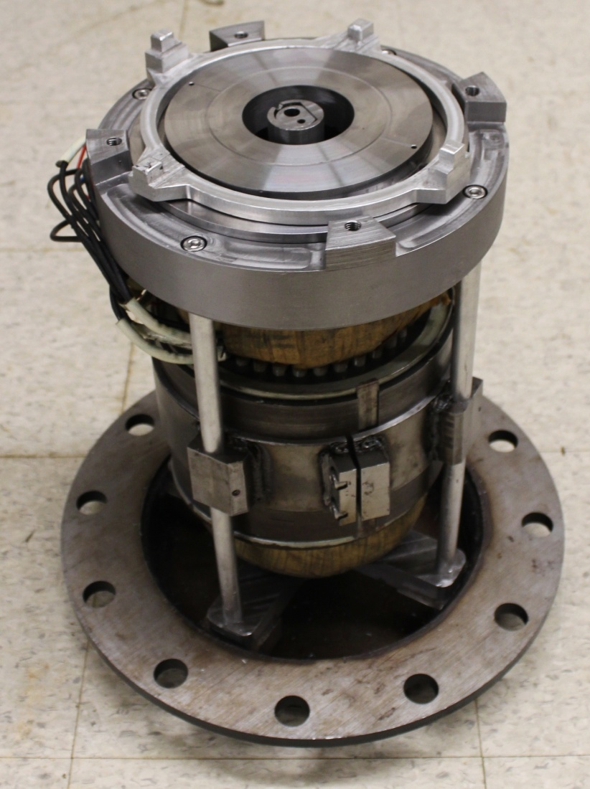
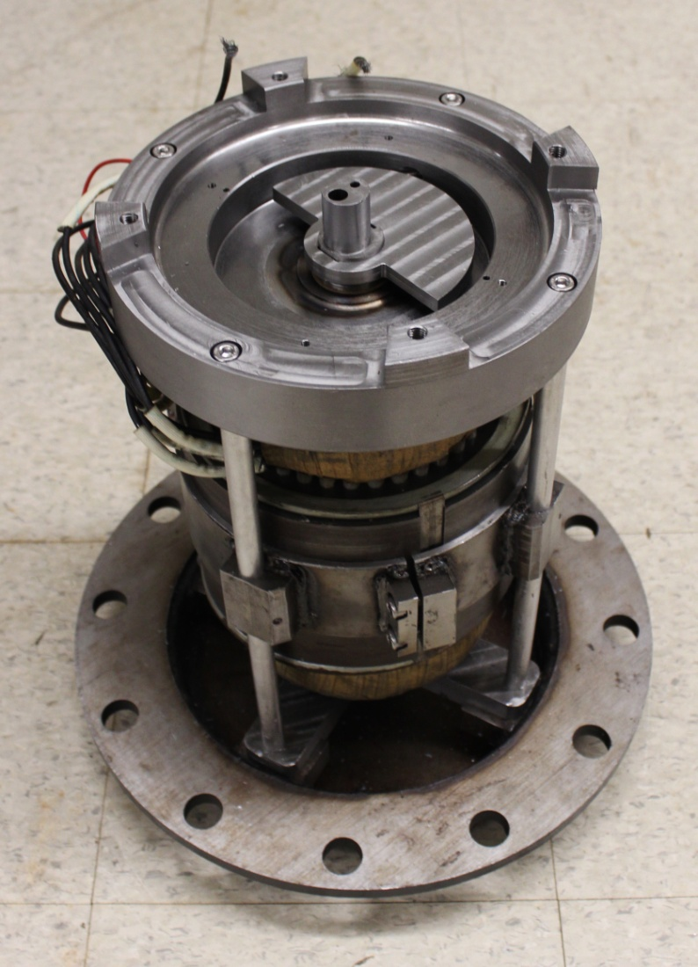
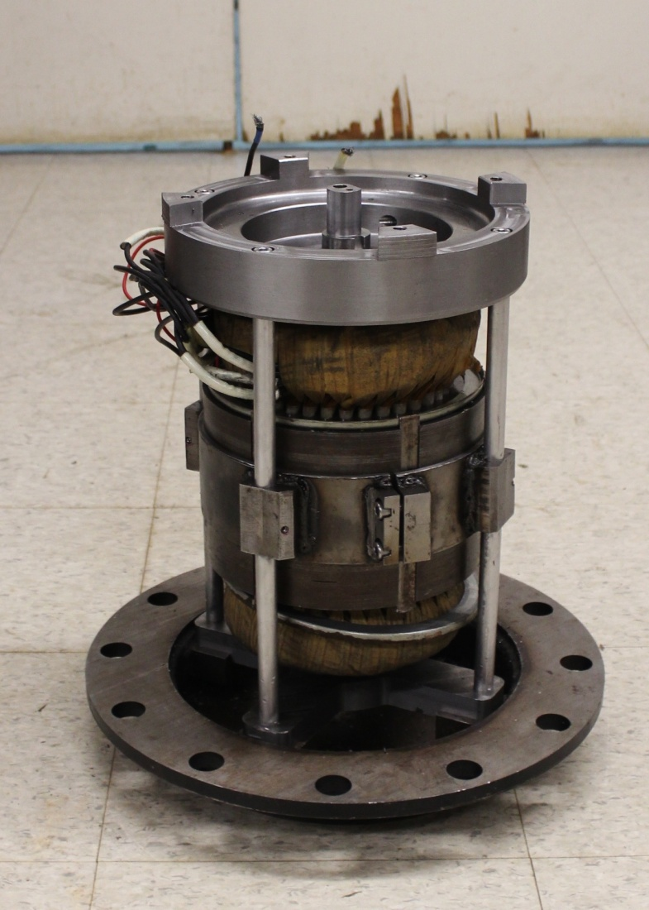
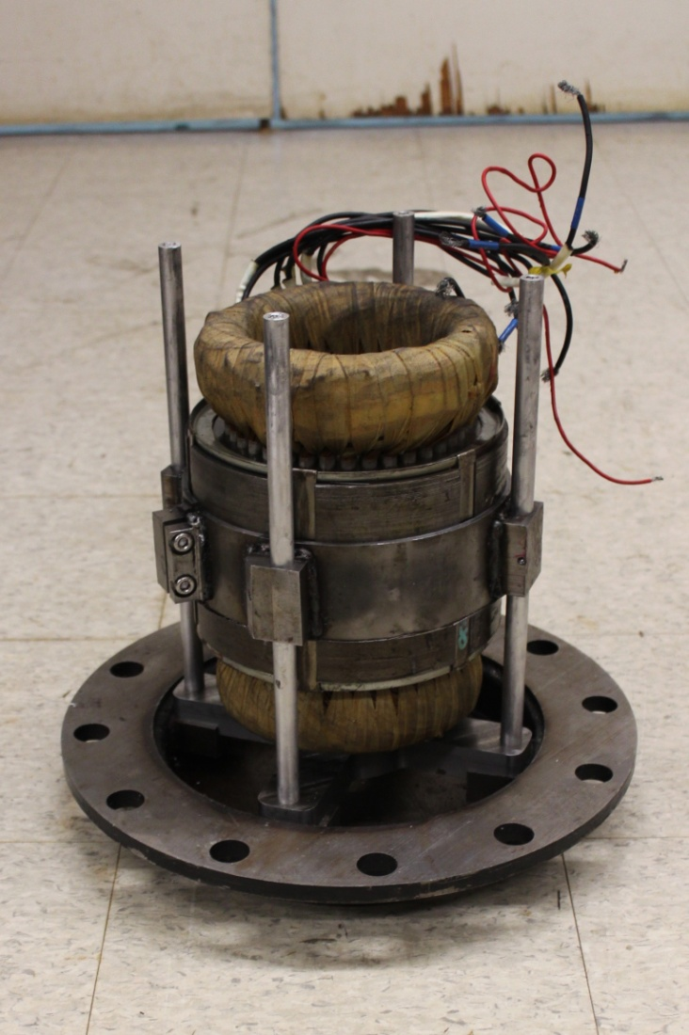
4. Prototype fabrication and assembly

Slide 37
PART 5
Conclusion
And
Perspectives
Notes:
To conclude
let me give you a word ➔remains to be done

Slide 38
5. Conclusion & Perspectives
Finish the single-stage prototype
Check the envelope sealing
Instrumentation
Oil delivery circuit & BPC circuit piping
Experimental test and validation
Test rig at Eckerd College (FL)
Validate the deterministic model
(Update the second stage geometry)
Design and fabrication of the two-stage prototype
Notes:
First target ➔ finish single-stage prototype
Different remaining tasks includes
Check envelop sealing ➔ ensure no leakages anymore
Instrumentation
Realize oil delivery/BPC circuits

Slide 39
5. Conclusion & Perspectives
Finish the single-stage prototype
Check the envelope sealing
Instrumentation
Oil delivery circuit & BPC circuit piping
Experimental test and validation
Test rig at Eckerd College (FL)
Validate the deterministic model
(Update the second stage geometry)
Design and fabrication of the two-stage prototype
Notes:
Once done
use prototype in a microCSP test rig at Eckerd College
In order ➔ get experimental result ➔ validate deterministic model
if necessary ➔ redo selection process for second stage

Slide 40
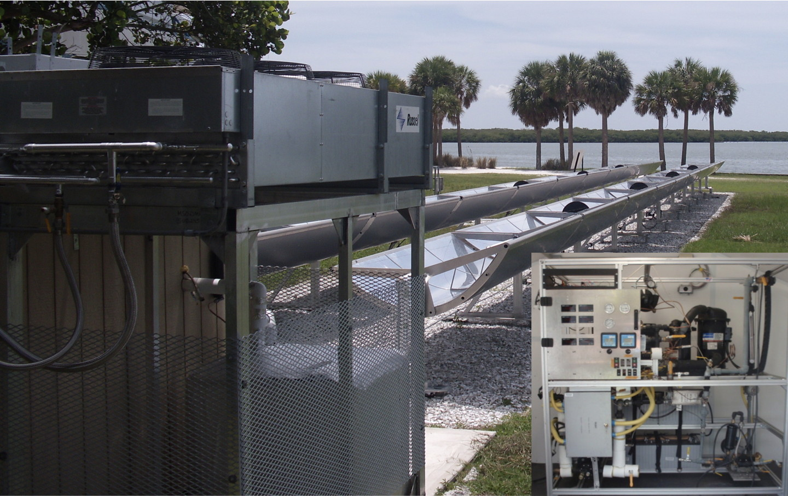
Test rig (Eckerd College – FL)
Collectors
Condenser
ORC unit
HTF tank
Notes:
*

Slide 41
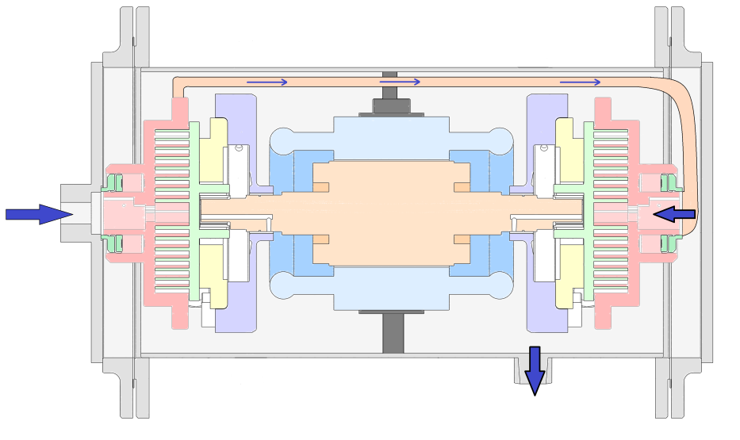
5. Conclusion & Perspectives
Finish the single-stage prototype
Check the envelope sealing
Instrumentation
Oil delivery circuit & BPC circuit piping
Experimental test and validation
Test rig at Eckerd College (FL)
Validate the deterministic model
(Update the second stage geometry)
Design and fabrication of the two-stage prototype
Notes:
Finally ➔ design& fabricate twto stage scroll expander prototype

Slide 42
Thank you for your attention
QUESTIONS ?
More information : Design and fabrication of a variable wall thickness two-stage scroll expander to be integrated in micro-solar power plant - Master thesis – Rémi DICKES

Slide 43
APPENDIX
Variable wall thickness geometries ➔ Danfoss frame
1 geometry ⬄ 8 parameters
Warning : non reversible process! ➔ random generation
Select the best candidates among a database
s_{x} = c₁ + c₂ φ + c₃ φ² + c₄ φ³ +c₅ φ⁴
R, d and N
Only exploring viable parameter domains
All parameter combinations are not viable
Using a hierarchical parameter selection strategy

Slide 44
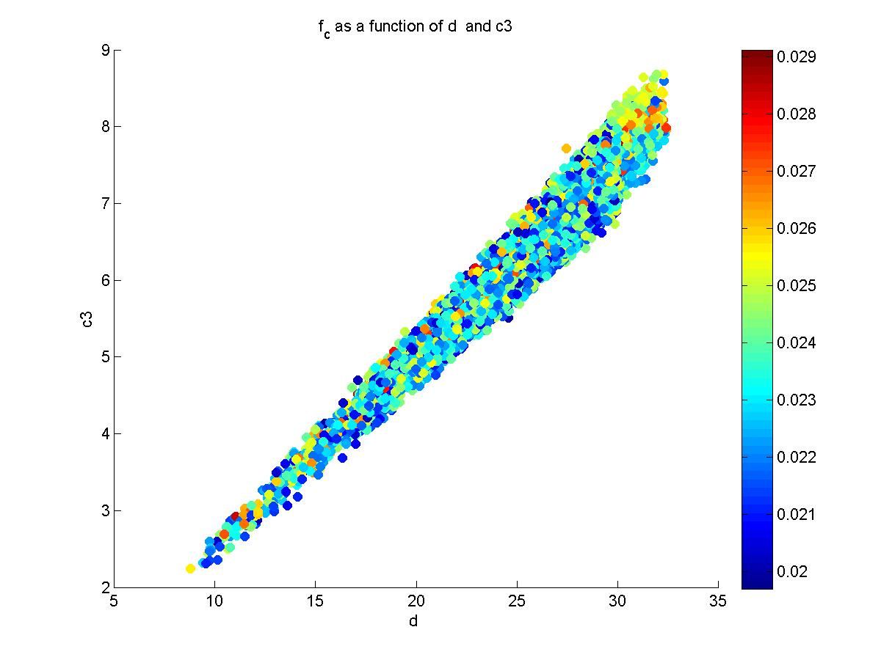
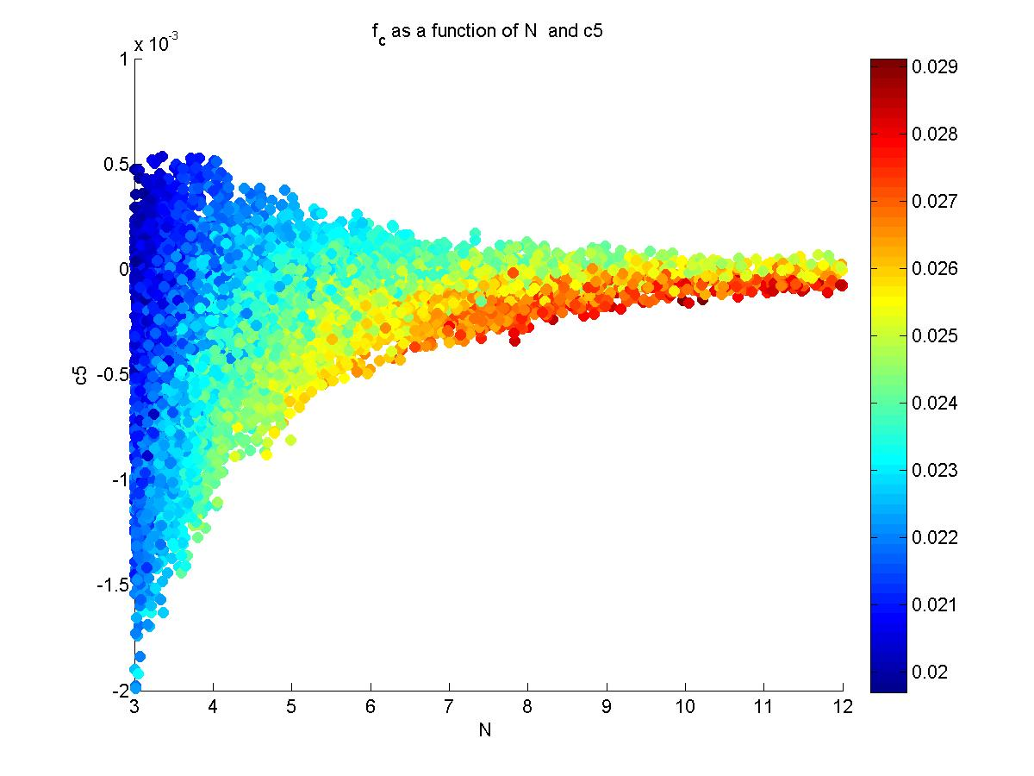
APPENDIX

Slide 45
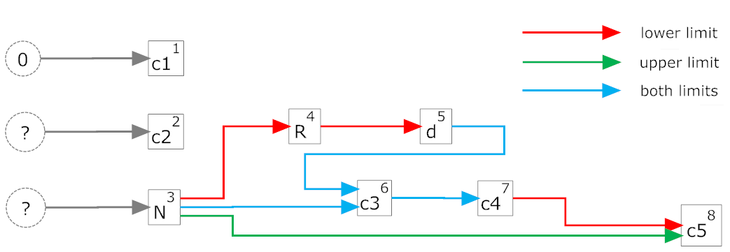
APPENDIX

Slide 46
APPENDIX

