Slide 1


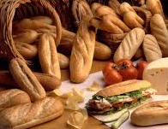
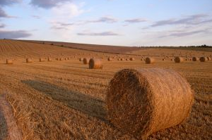
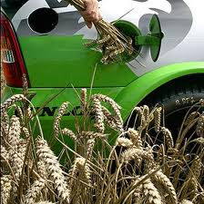
Social Life Cycle Assessment: a methodology to evaluate sustainability
of cereal uses in Wallonia

Slide 2
Cereals food and non-food uses: « 4F »

Slide 3
ALT-4-CER: which « F’s » of the « 4F » for Wallonia?
Key steps:
To draw the portrait of the Walloon cereals, and their current and future/potential uses
To define several scenarios 2030 acc. to current trends (B-a-U) and contrasting breaks
To develop environmental and socio-economic LCA methodologies fed with local data
To integrate environmental and socio-economic aspects through multi-criteria analysis with stakeholders
To provide clues for most sustainable and pertinent uses of the cereal resources in Wallonia

Slide 4
Walloon cereals: 2010

Slide 5
Scenarios 2030
→ 4 contrasted scenarios for potential future uses:
  Defined with stakeholders’ support;
  Based on current trends and contrasting breaks;
  Key hypotheses: climate change, political choices, population growth, animal products consumption, etc.
Business-as-Usual: current trends extrapolated from past 15 years
Strategic: environmental, economic and social optimization of current system
Localisation: development of new cereal conversion units in Wallonia + increased autonomy
Globalisation: massive export + focus on high added-value products (biorefinery, bio-based chemistry)

Slide 6
Scenarios 2030: Grains + straw + forage maize

Slide 7
Scenarios analysis with E-LCA & S-LCA
  Cover the 3 pillars of sustainable development
Common objective: evaluate environmental and socio-economic consequences of potential changes in the uses of Walloon cereals by 2030, in comparison with current situation (2010)

Slide 8
Scenarios analysis with E-LCA
Environmental LCA → identify regional differencies regarding the cultivation step:
  (New) cropping practices;
  Machinery characteristics & fuel consumption;
  Direct field emissions assessment;
  Inputs management;
  Animal feeding & husbandry;
  etc…
+ Conversion processes based on existing facilities

Slide 9
Scenarios analysis with S-LCA
Stakeholders categories
  Workers
  Companies
  Farmers
Impact subcategories
  Workings hours
  Health and safety at work
  Local employment
  Added value creation
Impact categories
Working conditions
Socio-economic
repercussions
9

Slide 10
Data inventory in S-LCA
Working conditions: interviews:
  Using methodology Bilan Travail (production step):
    Developed by INRA in order to assess work types and share for animal rearing systems
    To be adapted for crop systems
Use farms’ accounting data collected at the Walloon Region level (FADN-like) (production step)
Conversion step: data collection from existing facilities
10
La filière rizicole au Sud Viêt-nam : un modèle méthodologique (2000)
Philippe Lebailly, Thomas Dogot, Pham Van Bien, Tran Tien Khai
Notes:
Partie prenante : groupes qui partagent des intérêts communs et des relations similaires avec le système étudié

Slide 11
Multi-criteria Analysis
Integrate environmental and socio-economic impacts (E-LCA & S-LCA results)
Involve stakeholders (producers, policy makers, consumers):
  Identify most relevant impact categories, group/prioritize
  (Weight into a global performance indicator?)
11

Slide 12
Human & eco-toxicity
Ozone layer depletion
Human health
Climate change
Ecosystem quality
Acidification
LCI data
Eutrophication
Resources
Abiotic resources use
Integration
Working hours
Working conditions
Health & Safety at work
Local employment
Socio-economic repercussions
E-LCA
Added value creation
S-LCA
Subcategories
Impact categories
12

Slide 13
ALT-4-CER: Expected results
Key features of the project:
  To involve local stakeholders in all steps (scenario building, data collection, impact weighting)
  To use local data → for local issues
Answer key questions raised today in human Societies:
“What type of agriculture do we want for tomorrow?
Is it ethically, environmentally and economically sustainable to dedicate cereals resources to other uses than human food?”

Slide 14
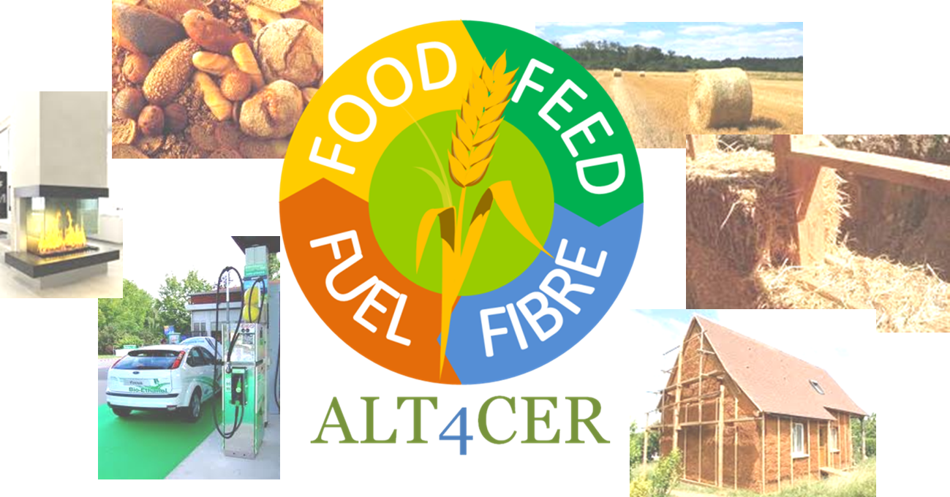
Thank you for your attention!
Contact:
Alice DELCOUR, Florence VAN STAPPEN
Walloon Agricultural Research Centre
a.delcour@cra.wallonie.be, vanstappen@cra.wallonie.be

