Slide 1
MUCOADHESIVE HYDROXYETHYL-CELLULOSE SPONGES AS DELIVERY SYSTEM FOR VAGINAL APPLICATION
Tania Furst- PhD student
December 12th 2014
Biopharmacy Day
Vlaardingen - NL
Notes:
Good afternoon everybody.
Thank you to give me the opportunity to present my work

Slide 2
INTRODUCTION
Notes:
First, the introduction.

Slide 3
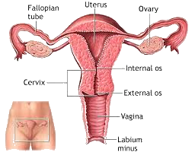
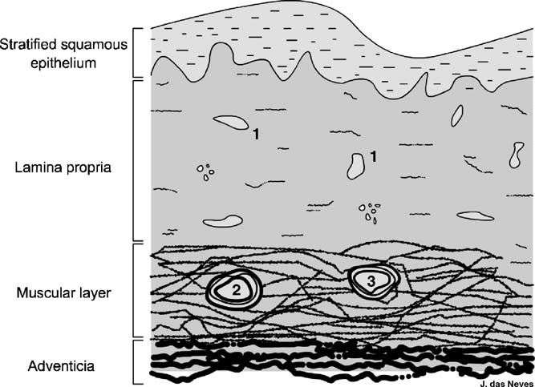
VAGINAL ROUTE
Excellent way for mucosal drug delivery for systemic and local applications
Avoidance of the hepatic first-pass effect
Homogeneous and dense vascularization
High mucosal permeability
Subject to physiological and non physiological factors
Natur al clearance process of vaginal secretions (mucus)
Constant flux
Bioavailability of drugs local effect?
Notes:
First of all, I will start with a brief introduction on the vaginal route, its advantages and inconvenients and after that, I will explain you the objective of my research
It is well known that the vagina is an excellent route for mucosal drug delivery for both systemic and local applications.
The avoidance of the hepatic first-pass metabolism, the presence of homogeneous and dense vascularization and the high mucosal permeability have made this route widely used for the administration of many drugs (sexual hormones, peptides, antimicrobials, antimycosics, …)
However, despite these advantages, vaginal conditions are subject to changes because of numerous physiological and non-physiological factors, like the menstrual cycle of women or menopause, but also after sexual intercourses or depending on personal hygiene.
Another important parameter which can interfere with the performance of a delivery system is the natural clearance process of vaginal secretions, commonly called mucus
Although considered as a mucosal tissue, the vagina does not have secretory glands. Vaginal secretions are formed by a mixture of fluids
The continuous production and elimination of the mucus can be considered as a relatively constant flux.
The mucus plays an important role and can significantly impact drug absorption or action.
These particularities could lead to variations in the bioavailability of drugs.
with the purpose to achieve a sustained local effect and to retain a dosage form in the vagina, it is necessary to consider and overcome all these variations.

Slide 4
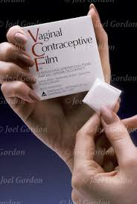
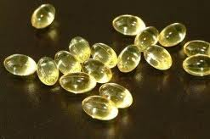
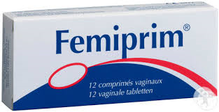
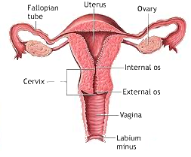
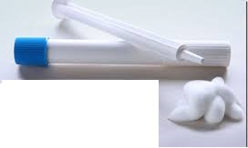
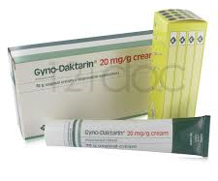
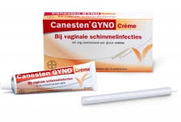
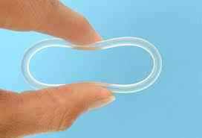
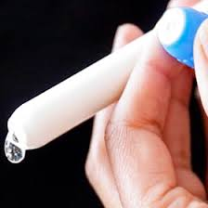
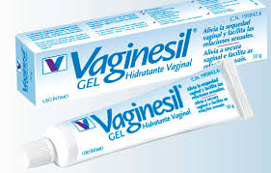
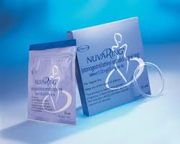
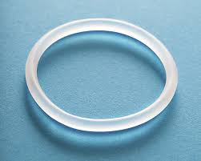
COMMERCIALIZED VAGINAL FORMS
Ovules and Tablets
Films
Foams
Creams
Gels
Rings
Notes:
A large variety of vaginal forms have been developed and commercialized (tablets, gels, creams, rings, foams, films, …)
And, in order to have a prolonged contact between drug and mucosal surface and to enable a sustained drug release, solid or semi-solid systems are generally preferred.
Among these systems, we particularly focus on hydrogels in this project.

Slide 5
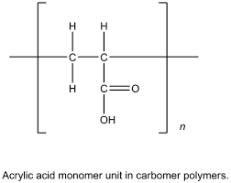
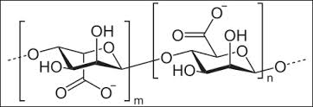
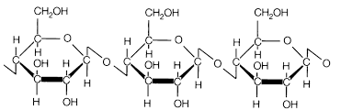
HYDROGELS
3D polymeric matrices: gelling excipient + liquid
Residence time
Mucoadhesive polymer
Polyacrylates
Alginates
Chitosan
Cellulosic derivatives
Hydroxyethyl-cellulose (HEC 250M)
Notes:
Hydrogels are like a three-dimensional polymeric matrices, made of small quantities of gelling excipient in relatively large amounts of liquid. They are easy to prepare and to use.
But, for a vaginal application, the choice of the polymer is crucial !!
In fact, depending on this polymer, hydrogels could be rapidly eliminated with the flux of vaginal fluids.
To increase the residence time, a bioadhesive and particularly mucoadhesive excipient is required
The most commonly used mucoadhesive polymers are polyacrylates (carbomer), alginates, chitosan and cellulosic derivatives
And based on previous results obtained in our laboratory [ in the framework of the development of vaginal HEC sponges containing cidofovir as active ingredient (17)(COLVIR Patent)] we focused on cellulosic derivatives hydrogels and particularly on HEC

Slide 6
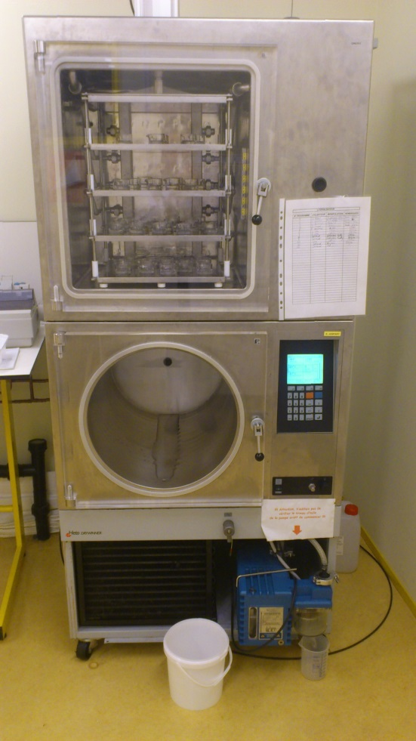
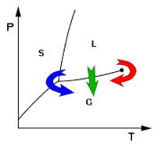
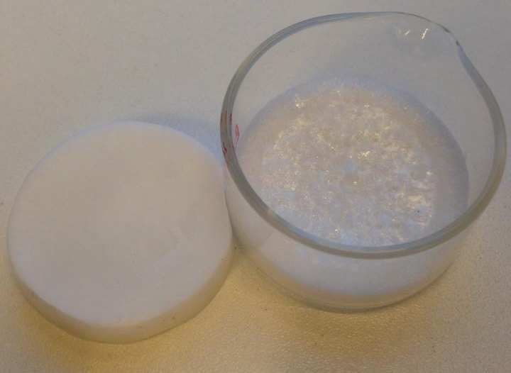
SPONGES
Lyophilization of hydrogels
solid delivery systems: sponges
Preservation of sensitive molecules
Ease of handling and application
Allowing a prolonged drug delivery
Notes:
These cellulosic hydrogels will be then lyophilized to obtain a solid delivery system with a spongy texture. And these systems are called sponges
On this picture, we can see the freeze-drier used for the lyophilization of the hydrogels
This graph represent the different phases of the lyophilization process.
In fact, there are 3 phases : the freezing phase, which is the critical phase and which consists to cool down the temperature to form water ice crystals
The second phase is the primary drying, where the pressure is lowered and enough heat is supplied to the material for the water to sublime
The last phase is the secondary drying : and it aims to remove the unfrozen water molecules
I will explain you later the different conditions of lyophilisation that I have used to prepare sponges
Why lyophilization and Why choose a solid from?
It was chosen to enable the preservation of sensitive molecules such as oligonucleotides and for its ease of handling and application and also to allow a prolonged drug delivery

Slide 7
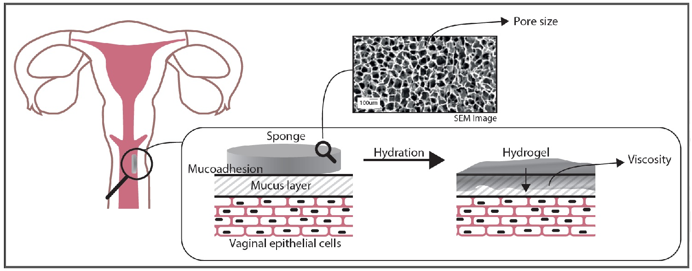
OBJECTIVE
Sponges must meet different criteria:
Formulation of cellulosic derivatives lyophilized sponges
Characterization of their microstructure, mucoadhesion, rehydration ability and stability
Adhere to the vaginal cavity
Be rehydrated with the little amount of mucus
Reform an hydrogel
Appropriated viscosity
1
3
2
4
Notes:
So, I have explain you how to produce sponges and why we have choosen this system.
and now, what are the criteria that sponges must meet ?
adhesion to the vaginal mucosa and rehydration with the little amount of available vaginal fluids to return to hydrogel with an appropriated viscosity
The final aim of this study was thus to formulate cellulosic derivatives lyophilized sponges and to characterize them in terms of mucoadhesion, rehydration ability and stability.

Slide 8
RESULTS
Notes:
Now I will present you the results.

Slide 9
1. PREPARATION
Hydrogels
Homogeneous aqueous dispersion of HEC 250M and PEG 400
Sponges
3 different freezing conditions
 | HEC 250M (mg) | PEG 400 (mg)
A | 100 | 25
B | 200 | 25
C | 200 | 50
 | Freezing step
 | Cycle 1 | Cycle 2 | Cycle 3 | Duration
 | -15°C | -25°C | -35°C | 3h30
 | Primary drying step
 | Temperature |  | Pressure | Duration
 | -15°C |  | 0.8 bar | 3h00
 | -10°C |  | 0.1 bar | 12h00
 | Secondary drying step
 | Temperature |  | Pressure | Duration
 | 10°C |  | 0.1 bar | 5h00
 | Total |  |  | 23h30
Notes:
The hydrogels (6 g) are prepared by a homogenous aqueous dispersion of HEC 250M polymer and PEG 400. Different compositions have been tested , with different amount of polymer and PEG .
PEG is used as a plasiticizer
In brief, the polymer is gradually dispersed in water, PEG 400 is added and water is added to obtain 6g of hydrogel. The homogeneization is performed for 3h at room temperature
All the hydrogels are prepared into 4 cm diameter glass containers
Once homogenous, these hydrogels are lyophilized.
For that, 3 different conditions of freezing temperatures have been tested
For cycle 1, the freezing temperature was -15°C, For the cycle 2 it was -25°C and -35°C for the las one. The rest of the lyophization process was the same for the 3 cycles and the total duration ime was 23h and 30min

Slide 10
2. GENERAL ASPECT
 | HEC 250M (mg) | PEG 400 (mg)
A | 100 | 25
B | 200 | 25
C | 200 | 50
Dried spongy texture
Flexibility and elasticity depend on the concentrations of HEC and PEG
No influence of the freezing conditions
3. WATER LOSS
(%)= (W_{H} – W_{S}) / W_{H} x 100 (W_{H}=weight of the hydrogel and W_{S}=weight of the sponge)
 | Water loss (%)
Sponge | cycle 1 | cycle 2 | cycle 3 | Mean (%) | sd
A | 97,55 | 97,47 | 97,28 | 97,43 | 0,14
B | 95,65 | 95,67 | 95,93 | 95,75 | 0,16
C | 95,17 | 95,08 | 95,55 | 95,27 | 0,25
only 3 to 5% of water
low moisture content, stability
Notes:
Once freeze-dried, all the formulations have a dried spongy texture. Sponges B and C were flexible and elastic properties were observed, unlike sponges A which contain a lower polymer concentration.
The freezing conditions did not have any influence on the formation of soft sponges
The water loss was calculated by weight difference before and after lyophilization for each sponge and was evaluated for the three different conditions of lyophilization.
It was the same for all the tested freezing conditions and All of the resulting sponges contained between 3 to 5 % of water.
This is interesting because,
It is well known that the content of water may be a critical parameter for the stability of drugs incorporated in these kind of drug delivery system.
The presence of water can be a reason of chemical degradation for many drugs and of bacterial proliferation.
Low moisture content of the sponges could reduce the risk of degradation of the incorporated drugs and of the sponge itself.

Slide 11
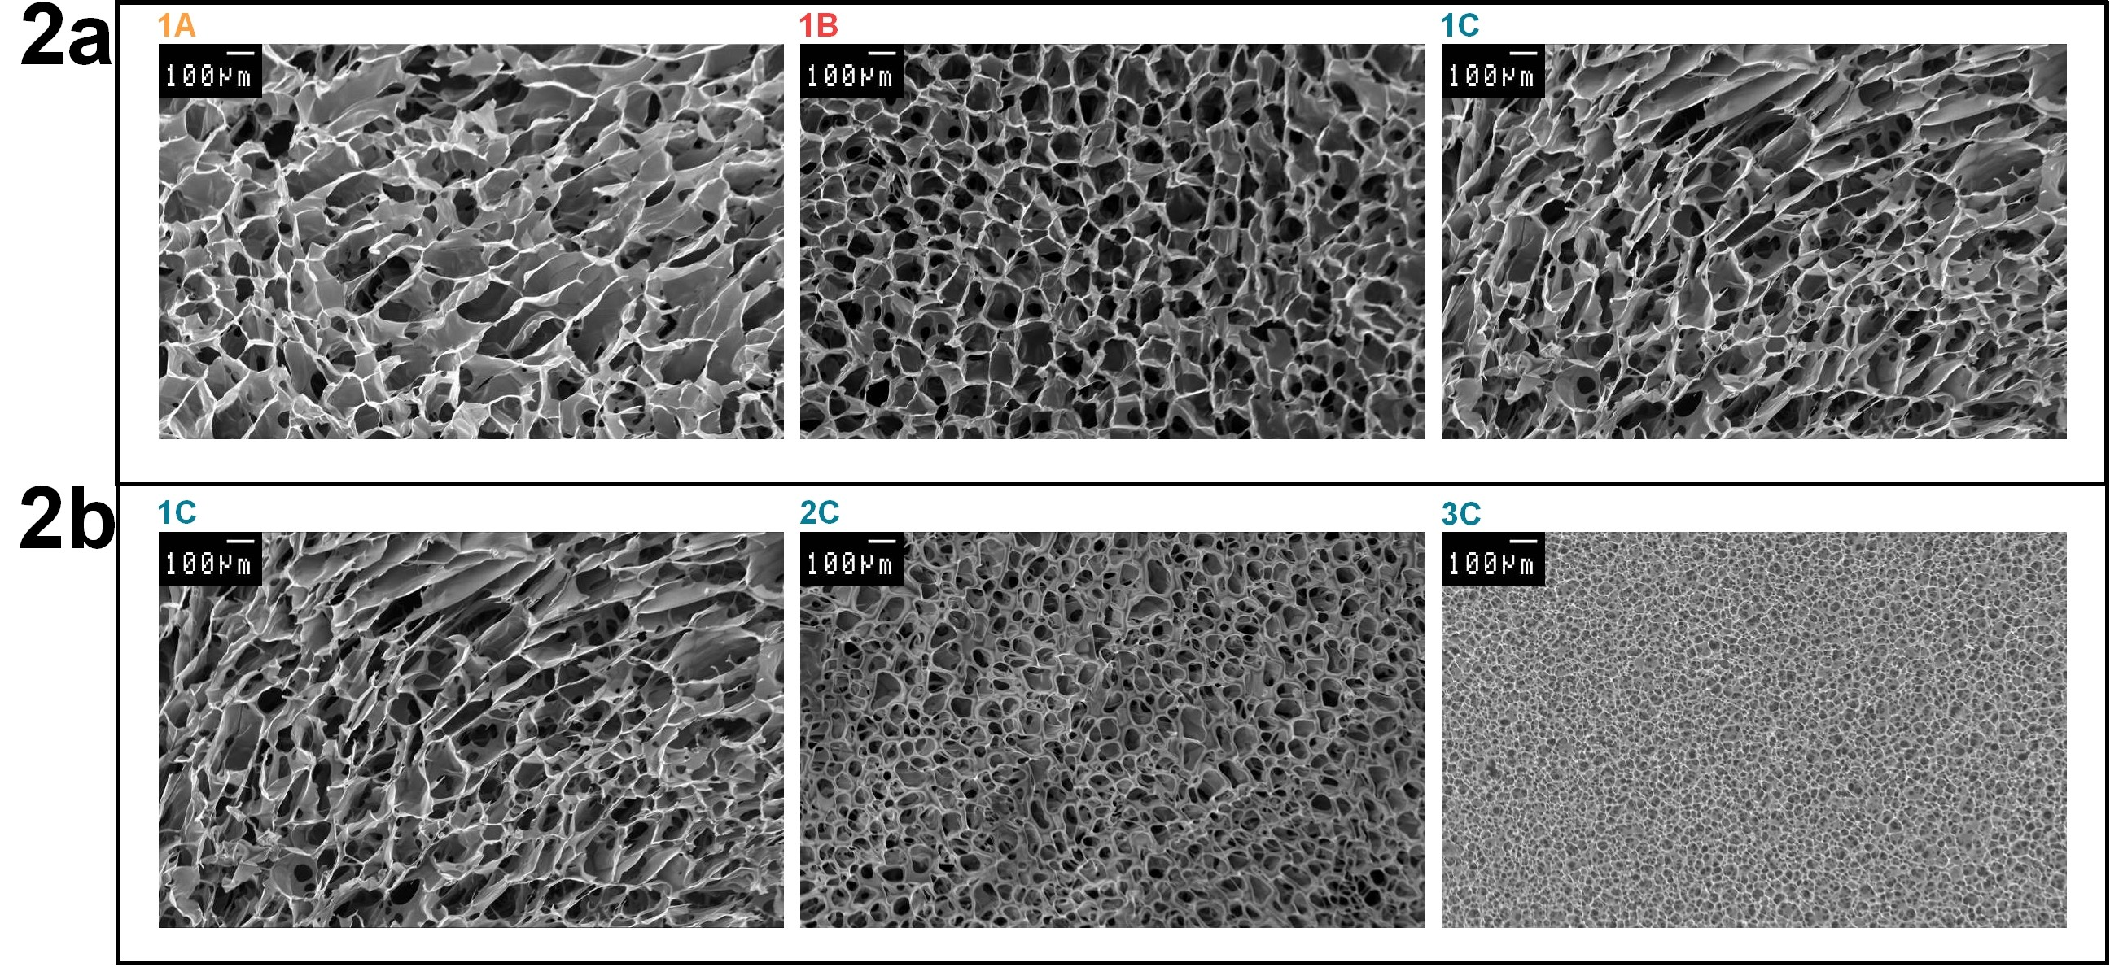
4. MICROSTRUCTURE
 | HEC 250M (mg) | PEG 400 (mg)
A | 100 | 25
B | 200 | 25
C | 200 | 50
Cycle 1 | Cycle 2 | Cycle 3
-15°C | -25°C | -35°C
Scanning electron microscopy (SEM)
freezing temperature pore sizes
Notes:
To check if the preparation method affects the porosity and the microsctructure, the sponges were imaged by SEM microscopy.
As shown in this figure, all sponges are formed by a dense network of interconnected pores.
Many studies have demonstrated that microstructure depend on the freezing process and that a fast freezing process prevents the formation of large ice crystals and consequently, generates small pores
In one hand, we can observe that at the same freezing temperature, -15°C, the pore size depends on HEC 250M and PEG 400 concentrations. Sponges 1B that contains twice as much HEC 250M as 1A (200 mg vs 100 mg), while PEG 400 concentration was unchanged (25 mg), show smaller pores. The higher concentration of HEC 250M produced sponges with smaller pores.
Sponge 1C which contains twice as much plasticizer as sponge 1B, for an equivalent amount of HEC 250M, shows less homogeneous pores, with both larger and smaller pores. This difference could be explained by the fact that the plasticizer, PEG 400, made the sponge softer, with a lesser-condensed structure. Same conclusions were observed for the two other freezing temperatures
On the other hand, if we compare the effect of the freezing temperature on the microstructure of sponges C.
It clearly appears that the sizes of the pores depend on the freezing temperature (1C at -15°C, 2C at -25°C and 3C at -35°C). Freezing at -15°C has created big ice crystals that have disrupted the hydrogel and made large pores in the sponge. Conversely, freezing at -35°C has generated a fast freezing rate which has prevented the formation of big ice crystals and thus small pores.
When the freezing temperature decreased, the pore sizes decreased too. This was more pronounced for sponges C than for sponges B and A, respectively.
The surface areas of the pores have been calculated in each sponge

Slide 12
4. MICROSTRUCTURE
Surface area (µm²) calculated using ImageJ® software
Notes:
And These observations were confirmed comparing the surface areas of the pores (µm²).
it was obvious that when the freezing temperature decreased, the median sizes of the pores also decreased significantly.
In addition, we also observed that an increasing in polymer and plasticizer concentrations (3A → 3B → 3C) induced a higher frequency (%) of small pores in the sponges

Slide 13
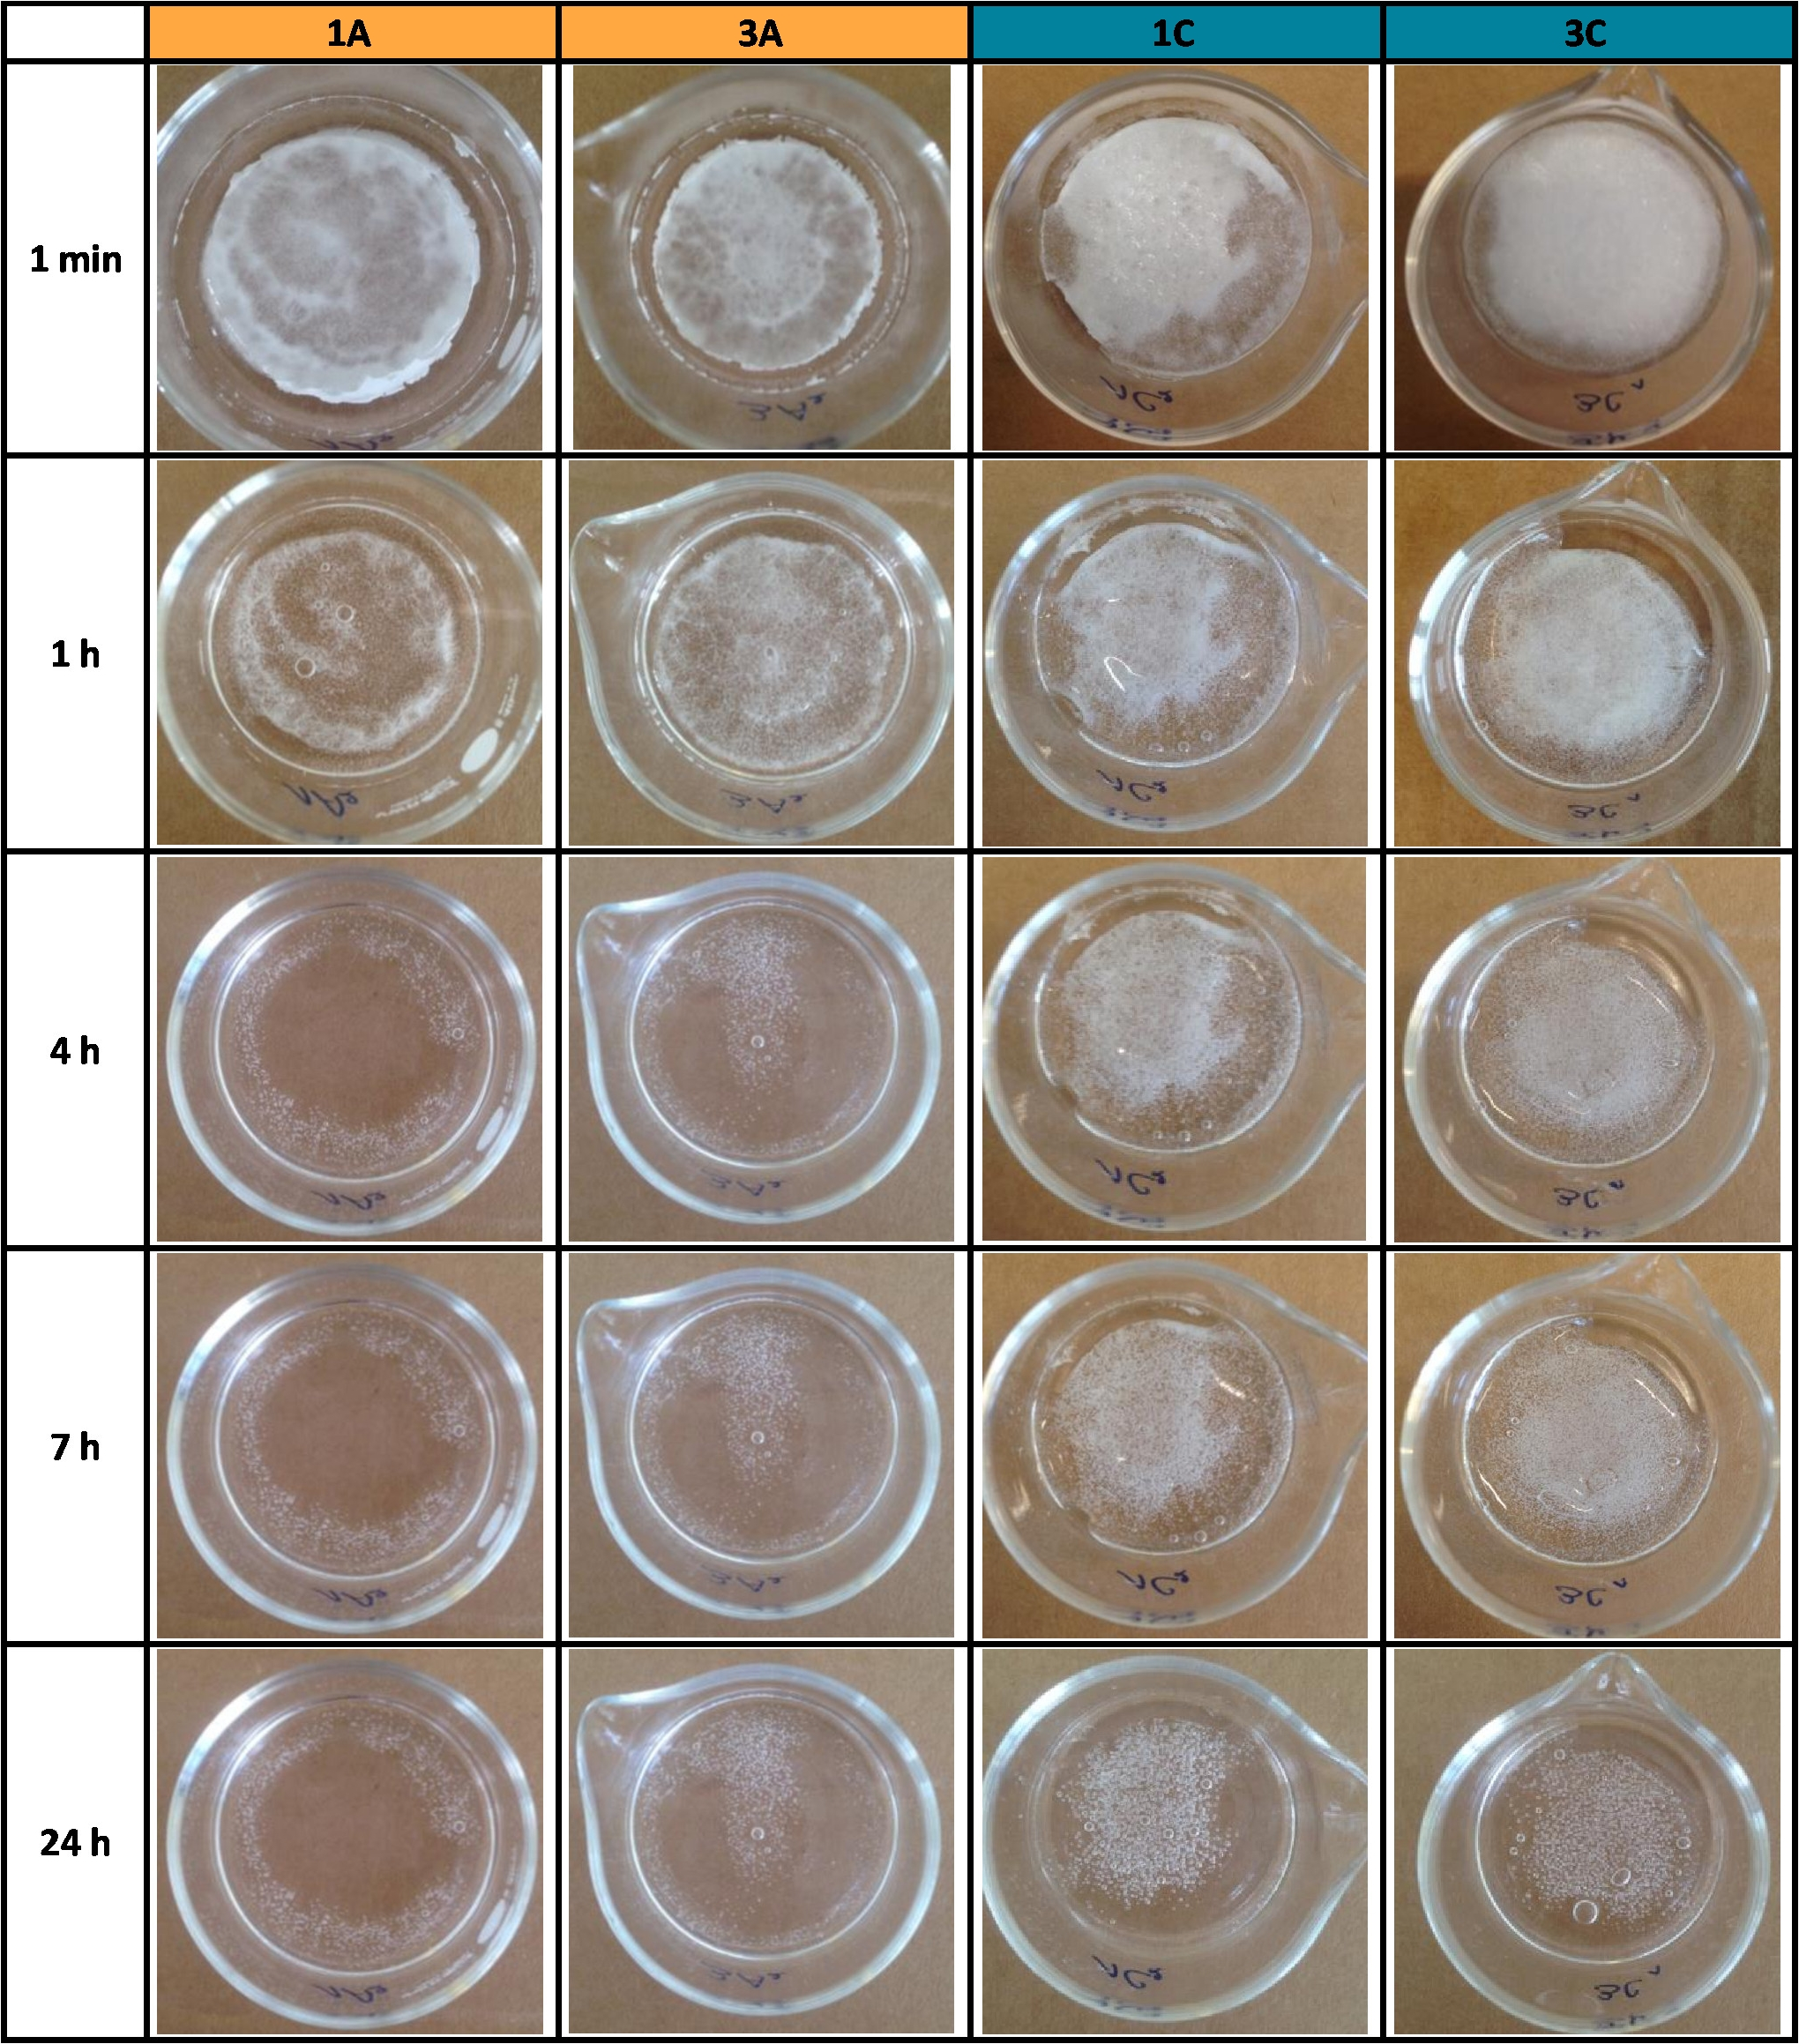
5. REHYDRATION STUDY
Influence of the pore sizes ?
Local vaginal effect : - mucus flux - low volume fluids
+ 2 mL of synthetic cervicovaginal mucus
Cycle 1 | Cycle 2 | Cycle 3
-15°C | -25°C | -35°C
Quick and uniform rehydration
Avoid a fast elimination
polymer concentration rehydration speed
Notes:
After that, we have measured the rehydration ability of the sponges and their ability to reform hydrogels .
The aim was to evaluate if the freezing temperature and consequently the pore sizes of sponges had an influence on the rehydration speed.
In order to have a local vaginal effect, two critical physiological parameters have to be taken into account, constant mucus flux and low volume of vaginal fluids. Considering these two parameters, the sponges have to be quickly and uniformly rehydrated in the vaginal cavity, in order to rapidly adhere to the mucosa and avoid a too fast elimination.
For mimicking the vaginal conditions, 2 mL of CVM were added on the top of each sponge and pictures have been taken at different time to asses the rehydration speed.
There was no difference in terms of rehydration speed when the freezing temperature was -15°C or -35°C. Despite their larger pore size, sponge 1A, freeze dried at -15°C, was not rehydrated faster than 3A, freeze dried at -35°C. Observations were similar for sponges 1C and 3C and for sponges 1B and 3B (results not shown).
All the sponges A were totally rehydrated after 4 hours, while sponges B and C were totally rehydrated after 24 hours, independently of the freezing temperature.
This difference was due to the HEC 250M concentration. And thus, the pore sizes do not affect the rehydration speed

Slide 14
6. VISCOSITY
Hydrogels and rehydrated sponges (+ 2 mL of CVM)
Suitable to increase the residence time BUT no reference values
Comparison with Gynodaktarin® and Lubrilan®
Intermediate viscosity : not too liquid and not too viscous ??
Notes:
The viscosity of hydrogels was measured
To increase the residence time in the vagina, the viscosity of the rehydrated sponges has to be suitable
Actually, there are no references and no target values of an optimal viscosity for vaginal delivery systems. It is hard to define an optimum of viscosity due to the physiological changes in the vagina
In order to have a range of vaginal adapted viscosity, we have compared the viscosities to that of two commercialized pharmaceutical products; a vaginal cream (Gynodaktarin®) and a lubricant (Lubrilan®).
This demonstrates that before lyophilization, the viscosities of hydrogels B and C were similar and were between the viscosities of Gynodaktarin® and Lubrilan®, while the viscosity of hydrogel A was lower. The viscosity was influenced by the HEC 250M concentration.
After lyophilization and rehydration of the sponges with CVM, the viscosities increased significantly.
The viscosities of B and C were still similar but higher compared to the commercial products. The viscosity of rehydrated sponge A increased and was comparable to that of Gynodaktarin®.
The increase of viscosity was due to the small amount of CVM added. CVM viscosity is nearly as high as the hydrogel A before lyophilization.
Ideally, the viscosity of the rehydrated sponges has to be intermediate;
not too liquid to be retained for a reasonable time in the vaginal cavity but not too viscous to allow the diffusion of the active drug through the hydrogel.
Among the three sponges tested, sponge A seems to be the more suitable. Rehydrated sponges B and C are likely to be too thick and too viscous to enable a good diffusion of the encapsulated drug.
This diffusion will be tested in further experiments and will allow us to refine our conclusions.

Slide 15
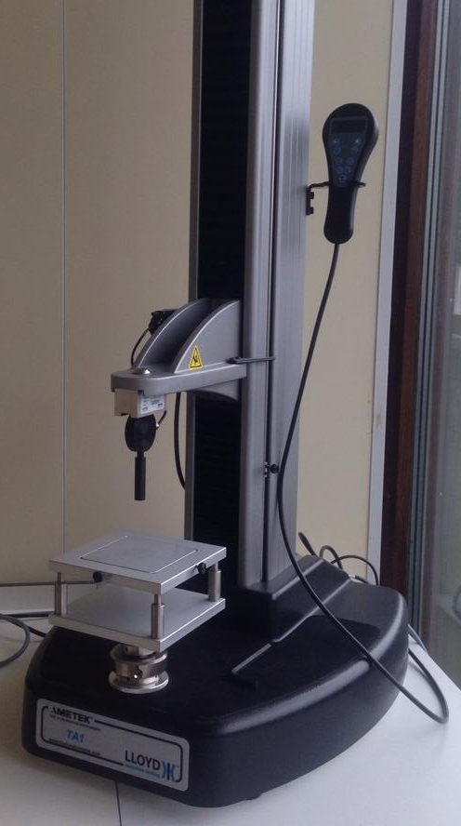
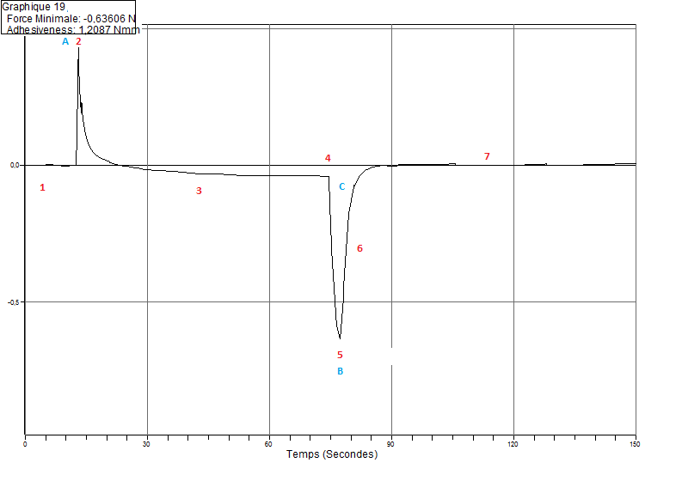
7. MUCOADHESION
Essential property to ensure prolonged vaginal retention
Mucoadhesive strenghts (N) of hydrogels
Mucoadhesive strengths (N) of sponges
Texture Analyzer
Mucin discs + CVM (37°)
C
-25 mm = step 3
0 = step 1
+1 mm, 60 sec = step 2
Notes:
After, we have measured the mucoadhesion, which is an essential property to ensure a prolonged vaginal retention and thereby clinical performance
The mucoadhesive strenghts of the hydrogels and of the sponges was determined using a TA
For that, we have prepared mucin disc, with thirteen mm of diameter and we have attached it on the upper probe of the TA , with both side adhesive tape.
The disc was hydrated with CVM. After that, the probe was brought into contact with the hydrogel or the sponge and was maintained fixed for 60 seconds (steps 1 and 2). Finally, the probe was elevated (step 3). The mucoadhesive strength was determined from the force of detachment between de disc and the hydrogel/sponge

Slide 16
7. MUCOADHESION
 | HEC 250M (mg) | PEG 400 (mg)
A | 100 | 25
B | 200 | 25
C | 200 | 50
Depend on the HEC concentration
Sponges >> hydrogels
Strength from 0,9N to 1,5N
Notes:
First, we have measured the mucoadhesiveness of hydrogels with increased HEC concentrations . It appears that the mucoadhesive strengths were low (10⁻² N) and increased with the concentration of the polymer.
After, we have measured the mucoadhesiveness of our hydrogels and sponges, also in comparison with the 2 commercialized pharma products.
It was obvious that sponges had higher mucoadhesive strength than the pharmaceutical products, and were 100 times more adhesive compared to their corresponding hydrogels.
Obviously, the two selected pharmaceutical products are not intended to be adhesive. As I said before, they have been chosen to give a range of viscosity. And thus, they were used to have an idea of their mucoadhesion capacity, as no reference product is available.
The strength necessary to separate the hydrated mucin disc from the surface of the sponge was almost 1N. This force could be sufficient to obtain an appropriate adhesion during the therapeutic period.
Among the three sponges, C was the most mucoadhesive. But the mucoadhesive strengths of the three sponges were not significantly different (from 0.9 N to 1.5 N).
Based on these results, the three different sponges were found to be satisfactory.

Slide 17
8. PRELIMINARY STABILITY STUDY
21 days
3 different conditions of storage
RT, open glass container
25°, incubator with 60% relative humidity
RT, desiccator
Texture modification, rehydration by moisture absorption
special packaging
C
Interesting role of PEG 400
 | HEC 250M (mg) | PEG 400 (mg)
A | 100 | 25
B | 200 | 25
C | 200 | 50
Conservation and stability
Notes:
Finally,
A preliminary stability study was carried out during 21 days. The sponges have been stored in three different conditions; (a) at room temperature in an open glass container, (b) at room temperature in a desiccator and (c) in an incubator at 25°C with 60% of controlled relative humidity.
It was observed that storing sponges in the 2 first conditions have modified their texture. They rehydrated by moisture absorption, became sticky and loosed their spongy conformation.
Sponges should be kept away from moisture, in low relative humidity conditions. Special packaging should be developped or adapted
It should also be noted that the plasticizer (PEG 400) plays an important role for the conservation.
It was observed that only sponges A and C retain their soft texture while sponges B became breakable after 21 days even in the low moisture conditions of the desiccator.
Conservation and stability of sponges are two important parameters to be considered.
They have to keep their initial texture and their mucoadhesive capacity.
This preliminary study shows that only sponges A and C, kept in low relative humidity, retain their soft texture for 21 days.
This study will be continued over a long period of time.

Slide 18
CONCLUSIONS AND PERSPECTIVES
Notes:
I will finish with conclusions and perspectives

Slide 19
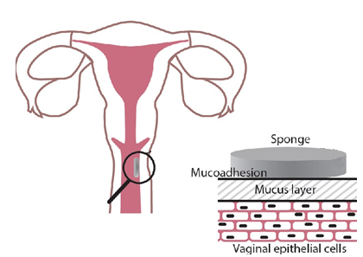
CONCLUSIONS
Influence of the freezing conditions
Influence of the polymer concentration on the rehydration speed, on the viscosity and on the mucoadhesion
Importance of conservation
dry solid form
easy to handle
able to protect incorporated drug
low rehydration speed
optimal viscosity
mudoadhesive
100mg HEC 25mg PEG at -35°C
Notes:
In conclusion,
We have demonstrated that the freezing temperature had an influence on the pore sizes into the sponges, that the polymer concentration directly influenced the rehydration speed and the mucoadhesion and finally that the conditions of storage have to be considered.
In conclusion, to obtain a dry solid form, easy to handle, able to protect the incorporated drug, with a low rehydration speed in cervicovaginal mucus, an optimal viscosity and good mucoadhesive strength, sponges containing 100mg of HEC 250M, 25 mg of PEG400 and freeze dried at -35°C should be preferred.

Slide 20
PERSPECTIVES
Continue the stability study
Adapted packaging
Incorporation of drug : oligonucleotides and liposomes
Evaluation of the diffusion through the rehydrated sponge
Evaluation of the toxicity

Slide 21
ACKNOWLEDGEMENTS
Promotors : Géraldine Piel (LTPB) and Brigitte Evrard (LTPB)
Marie Piette
Anna Lechanteur
Antoine Frère
Maria-Luz Alvarez
Claudio Palazzo
Reatul Karim
Fabrice Krier Aude Pestieau
Justine Thiry
Gilles Dufour
Charline Defourny
Laurence Collard Françoise Léonard
Contact: tania.furst@ulg.ac.be
Notes:
I would like to thanks specially my promotors, Gerladine Piel and Brigitte Evrard, and thank you all for your attention.

