Slide 1
Development and optimization of pegylated lipoplexes for vaginal application
Lechanteur Anna
SF Nano Workshop - Porto - 03rd October 2014

Slide 2
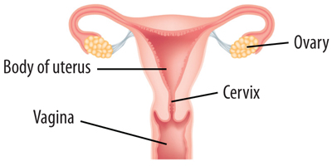
Human PapillomaVirus: HPV
CERVICAL CANCER:
World Health Organization (WHO)
Fourth cause of cancer death among women
266000 deaths in 2012
Surgery
Chemotherapy
Radiation
Normal cervix
LSIL
HSIL
Invasive cancer
15 years

Slide 3
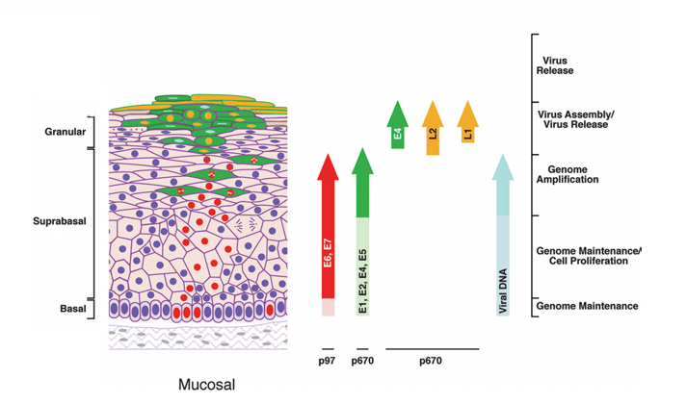
E6 and E7 oncoproteins
→ E6 and E7 oncoproteins
Doorbar, J. Molecular biology of human papillomavirus infection and cervical cancer. Clinical Science. 2006. 110, 525–541

Slide 4
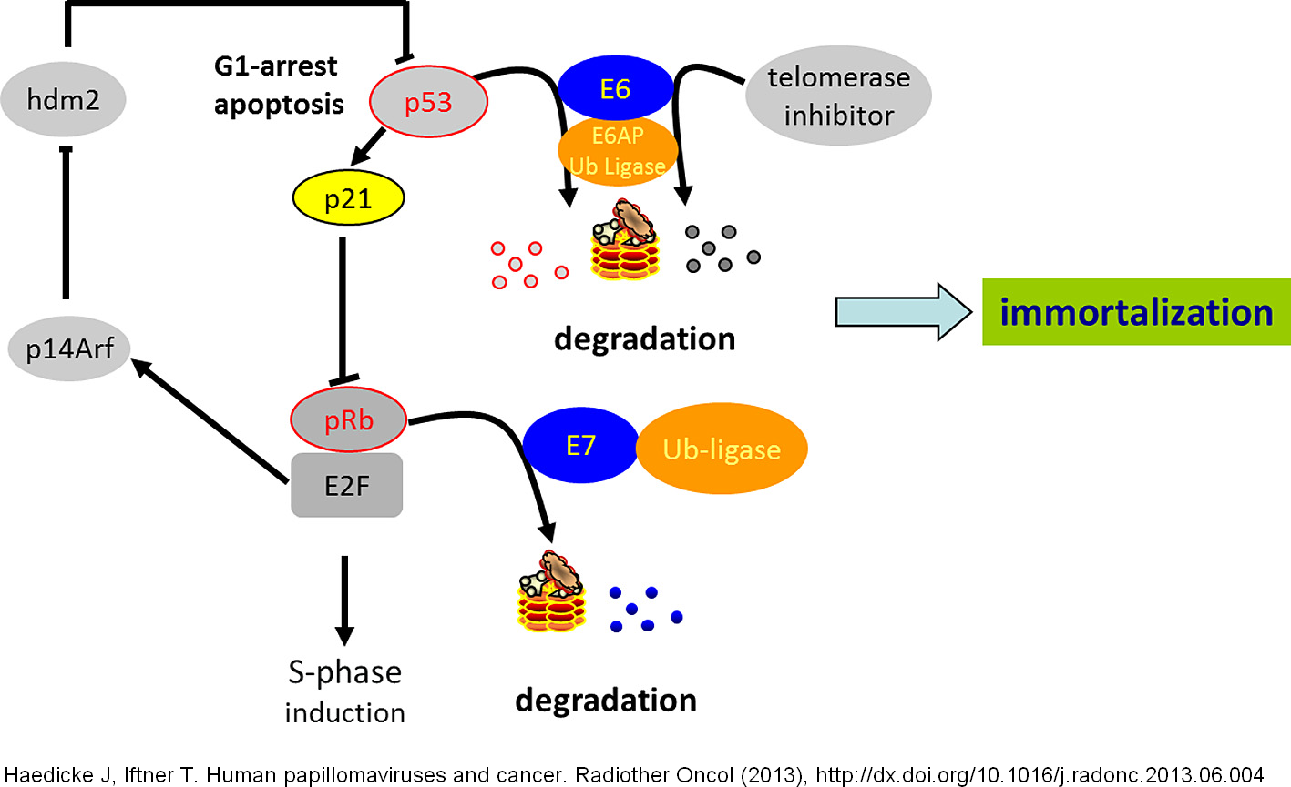
E6 and E7 oncoproteins
→ E6 and E7 oncoproteins
E6 and E7 oncoproteins :
→ interesting targets
→ appropriate for siRNA therapy

Slide 5
Strategy
→ siRNA anti-E6
→ siRNA anti-E7
→ siRNA anti-E6 + siRNA anti-E7
siRNA

Slide 6
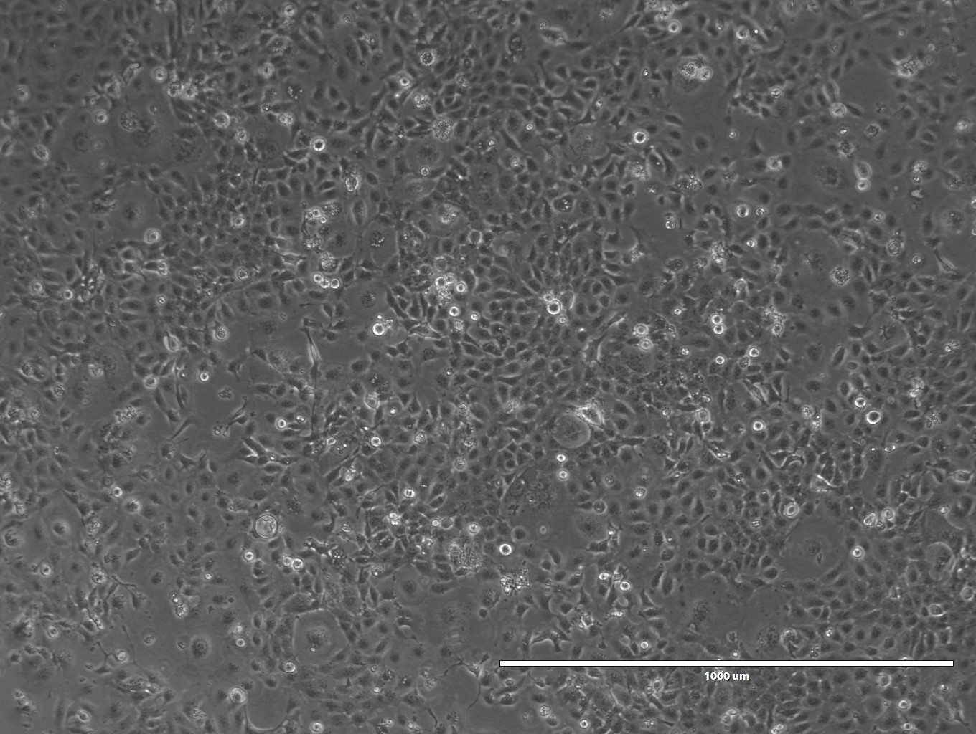
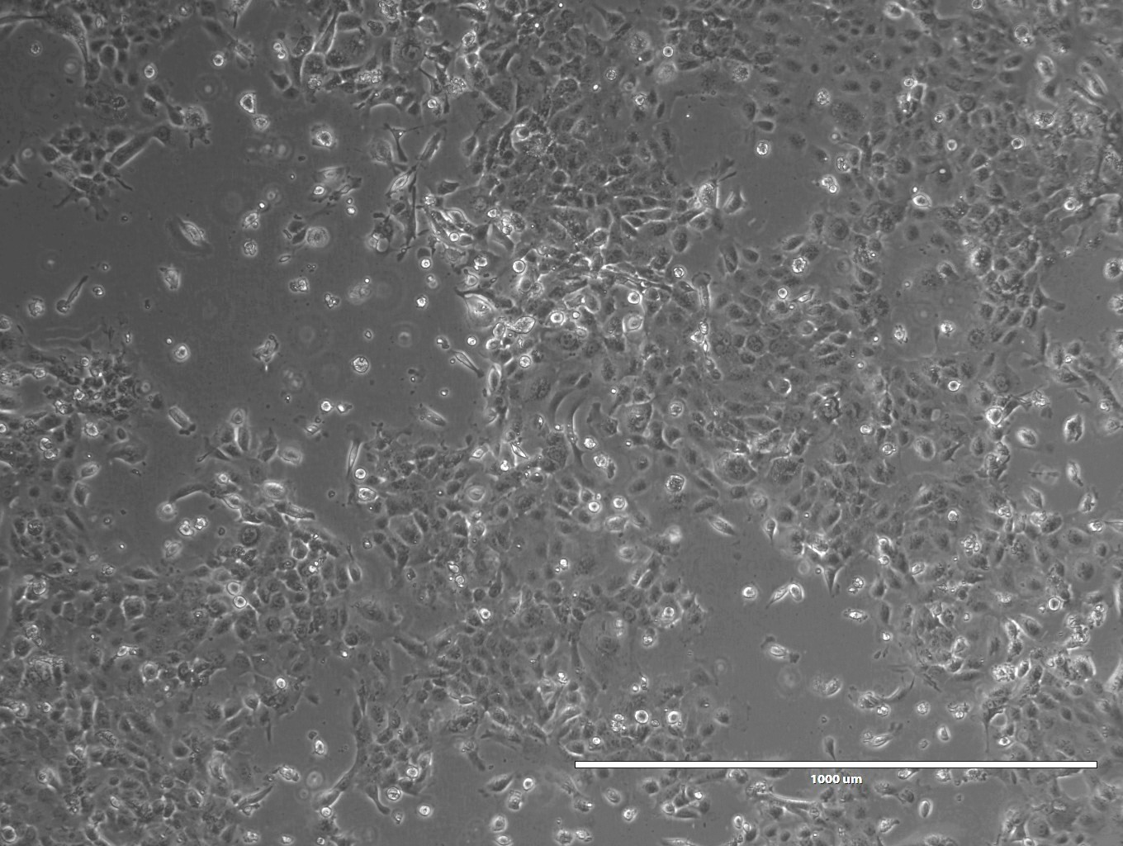
Validation of siRNA anti-E6/E7 efficiency
→ Evaluate different siRNA combinations with Oligofectamine® in order to induce apoptosis on CaSki cells (HPV16 + cells)
Transfection time: 3 days
SCR
E7

Slide 7
Objectives
Cationic lipid: DOTAP
Cholesterol
Fusogenic lipid: DOPE
DOTAP/Chol/DOPE
1/0,75/0,5
+ siRNA E6 100nM
N/P ratio = 2,5

Slide 8
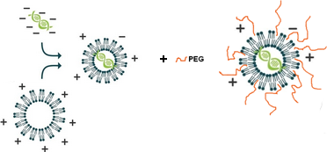
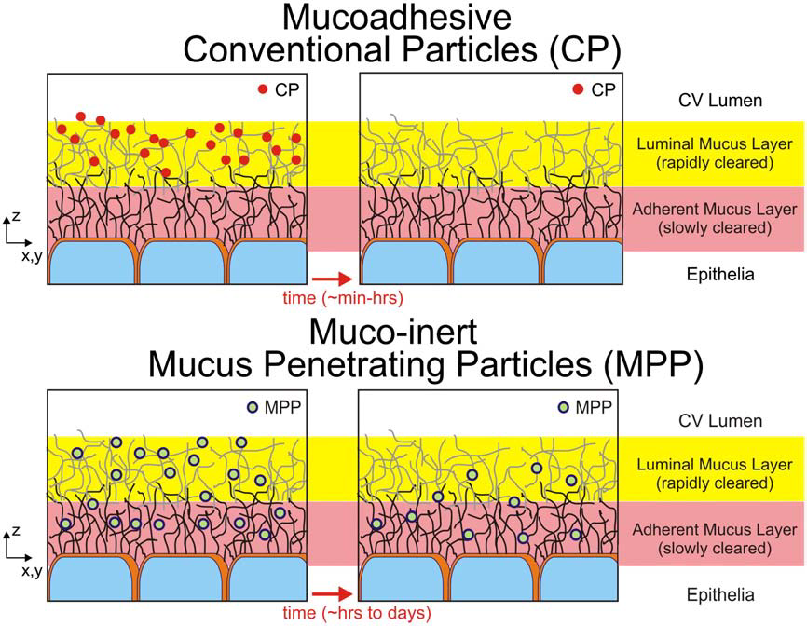
Objectives
Vaginal route
Low drug doses
Site specific delivery
Low systemic side effects
Circumvention of first-pass hepatic clearance
MPP
Avoid electrostatic adhesive interaction
Avoid hydrophobic entrapment
Uncharged hydrophilic polymer
DSPE-PEG 750 and DSPE-PEG 2000
S.K. Lai et al. / Advanced Drug Delivery Reviews 61 (2009) 158–171

Slide 9
Objectives
Physicochemical assays
- Z-average size - PdI
- Zeta potential
- Percentage of encapsulation
- Flow cytometry
- Confocal microscopy
3) qRT-PCR
4) Western Blot

Slide 10
General methods
Lipoplexes formulation
DSPE-PEG 750
+
10%
30%
50%
or
+
→
Lipoplexes (N/P 2,5)
Liposome
siRNA (100nM)
DSPE-PEG 2000
In vitro assays
Flow cytometry / Confocal microscopy
qRT-PCR /
Western Blot
Transfection
Seeded CaSki cells in 6-wells plate
D-1
D 0
D 1
D 2

Slide 11
Physicochemical properties
Size and Zeta potential measurements (Malvern NanoZS)
Encapsulation of siRNA onto liposomes
(Ribogreen®)

Slide 12
In vitro efficiency
Evaluation of transfection potential by flow cytometry assay (FACS Canto II)
CaSki cells (HPV16 +)
[siRNA-scramble FITC] = 100nM
Oligofectamine® 6µL
Lipoplexes N/P 2,5
n=3
Notes:
Mettre si seul

Slide 13
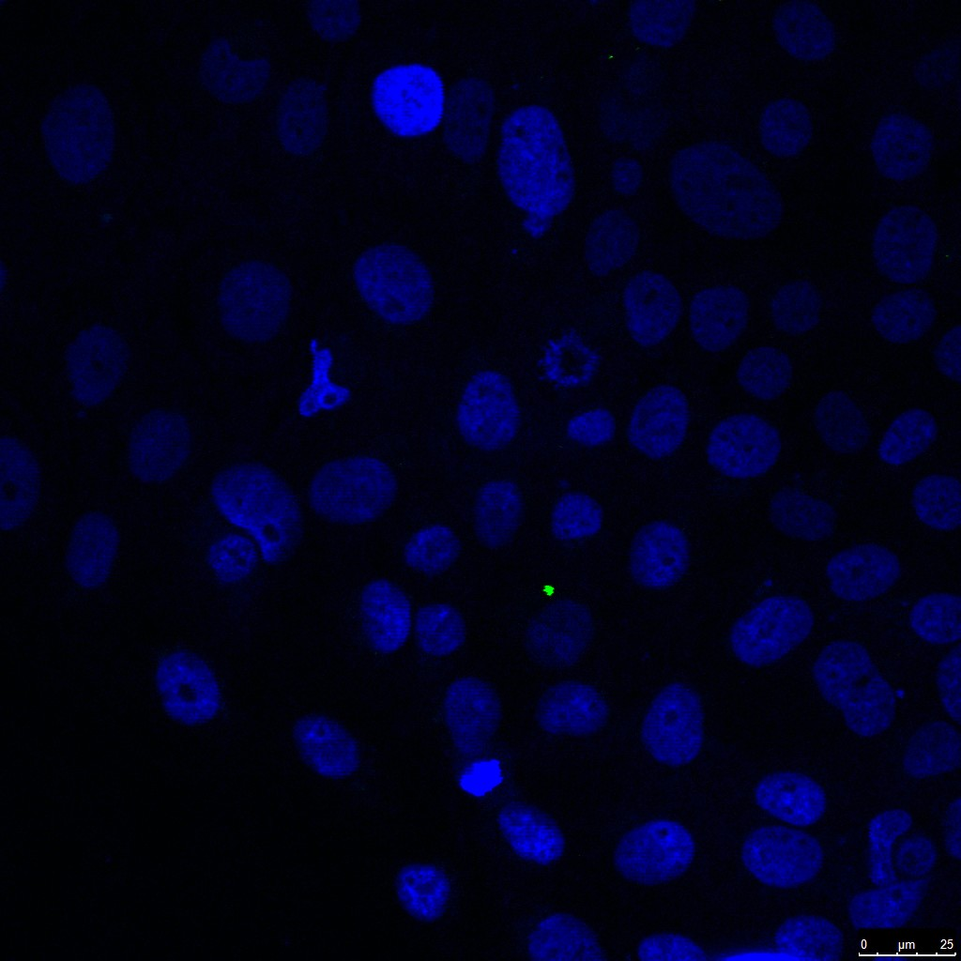
In vitro efficiency
Evaluation of transfection potential by confocal microscopy (Leica SP5)
Blue: Nucleus staining with DAPI
Green: siRNA FITC
Objective: 63x
Pinhole: 309,95
siRNA FITC 100nM
Empty liposome
Lipoplexe- siRNA FITC 100nM
Lipoplexe PEG2000 50%- siRNA FITC
Notes:
Mettre si seul

Slide 14
In vitro efficiency
Evaluation of releasing potential of siRNA E6 into the cytoplasm by qRT-PCR
CaSki cells (HPV16 +)
[siRNA-scramble and E6] = 100nM
Oligofectamine® 6µL
Lipoplexes N/P 2,5
Normalization: GAPDH primers
n=3

Slide 15
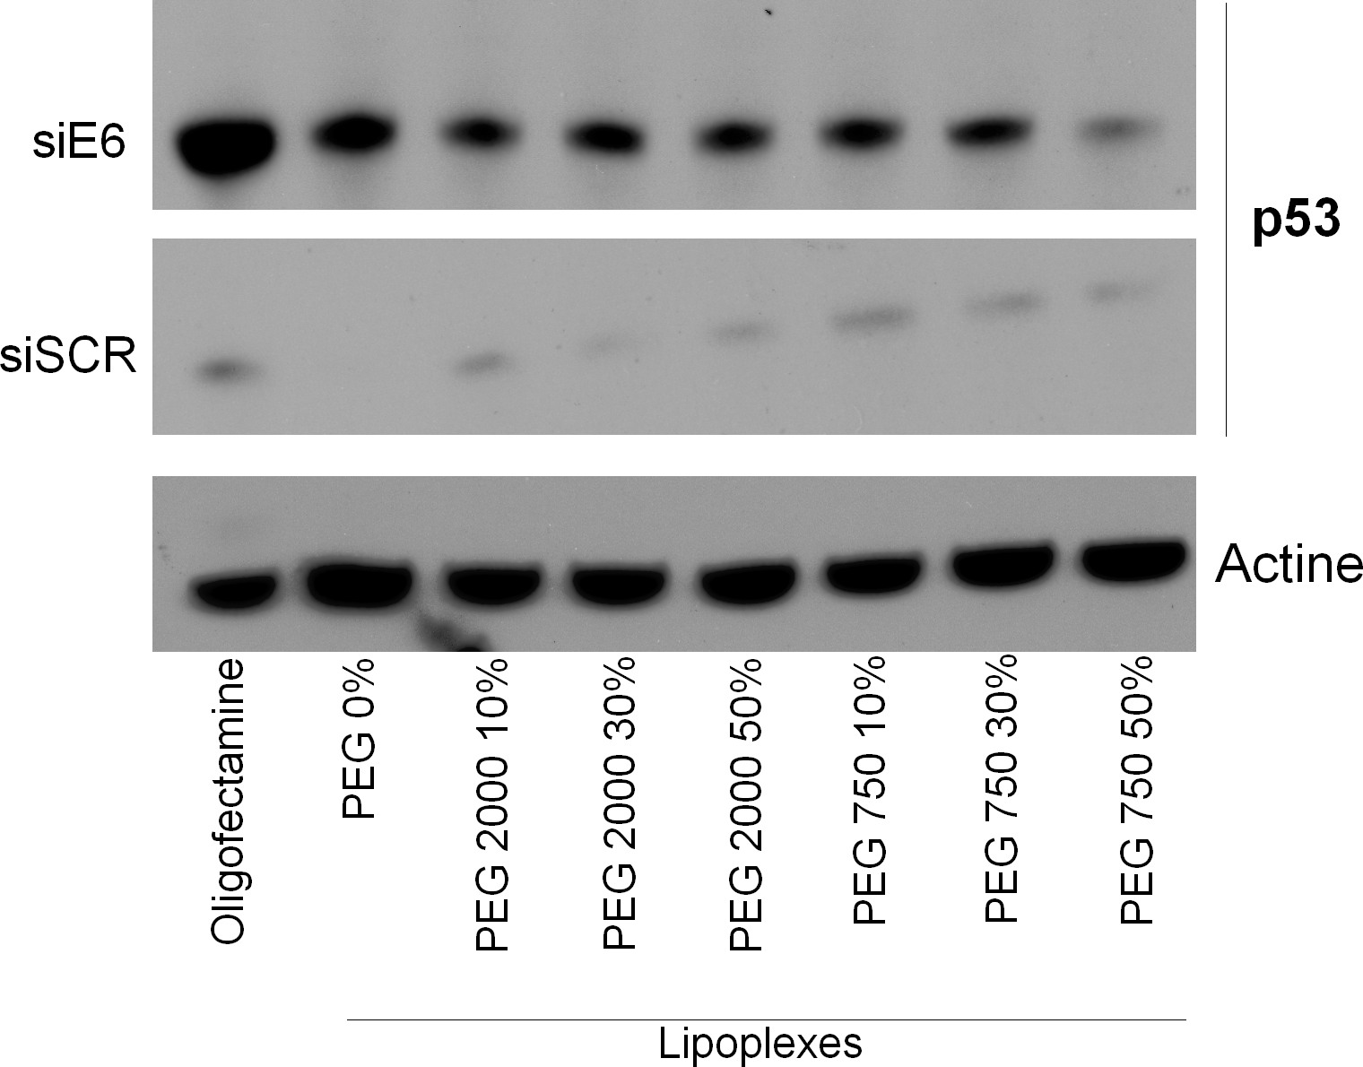
In vitro efficiency
Evaluation of p53 re-expression by Western Blot
CaSki cells (HPV16 +)
[siRNA-scramble and E6] = 100nM
Oligofectamine® 6µL
Lipoplexes N/P 2,5

Slide 16
In vitro efficiency
Cytotoxicity assay (WST-1)
CaSki cells (HPV16 +)
[siRNA-scramble] = 100nM
Oligofectamine® 6µL
Lipoplexes N/P 2,5
n=4

Slide 17
Conclusion
Appropriate physicochemical properties
High transfection and MFI
mRNA E6 extinction
p53 re-expression
Lechanteur A, Furst T et al, siRNA encapsulation into liposomes for a topical treatment of cervical preneoplastic lesions: promising gene delivery system, 2014, Submitted

Slide 18
Prospects
→ Perform apoptosis and proliferation assay
→ Confirm the hypothesis: siRNA are blocked in the endosome by co localization of Alexa546-siRNA and NDB-cholesterol (confocal microscopy) and LysoTracker® probe
→ Increase proportion of fusogenic lipid = DOPE
Lechanteur A, Furst T et al, siRNA encapsulation into liposomes for a topical treatment of cervical preneoplastic lesions: promising gene delivery system, 2014, Submitted

Slide 19
Acknowledgements
Promotors: Géraldine PIEL (LTPB) and Pascale HUBERT (LEP)
Laboratory of Experimental Pathology
DELVENNE Philippe
HUBERT Pascale
HERFS Michael
DEMOULIN Stéphanie
RONCARATI Patrick
GIGA-Imagerie et Cytométrie de flux
ORMENESE Sandra
STEPHAN Rafaat
EVRARD Brigitte
PIEL Géraldine
FURST Tania
FRERE Antoine
PALAZZO Claudio
ALVAREZ Maria-Luz
University of Angers
KANBER Erdem

