Slide 1
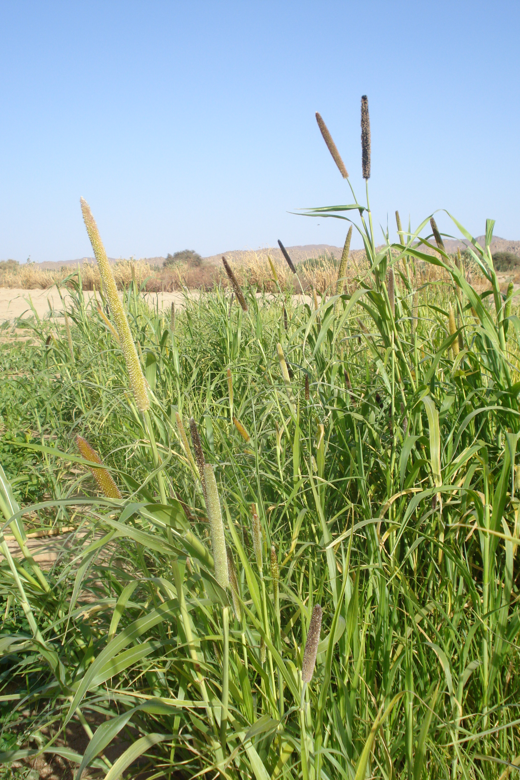
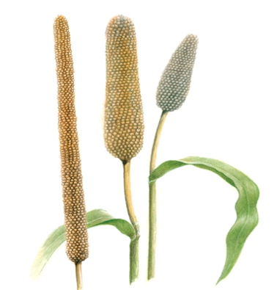
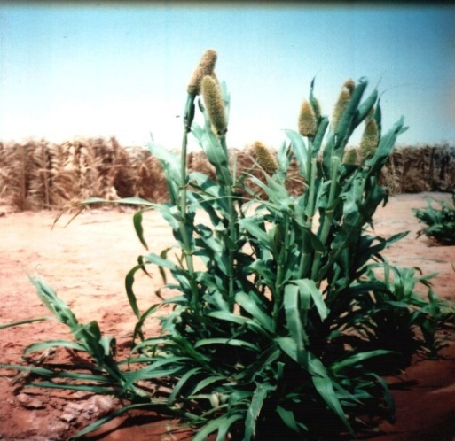
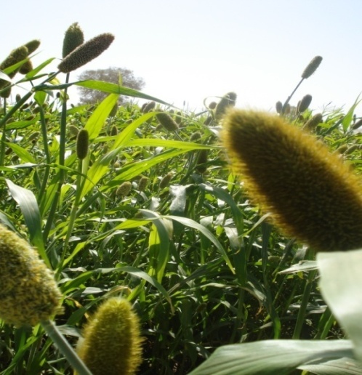
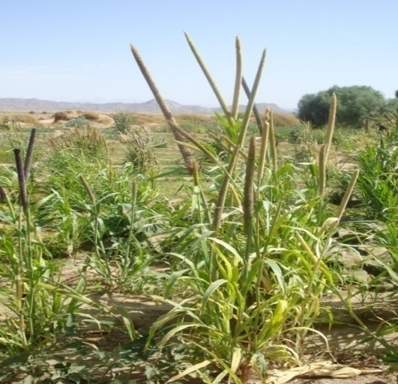
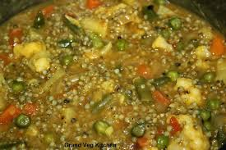
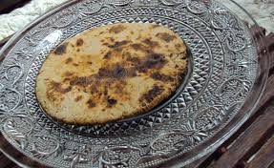
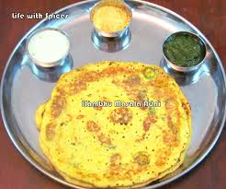
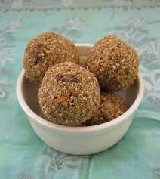
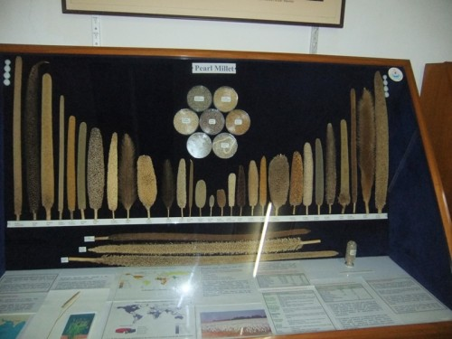
2th International Congress on vegetal biodiversity - Marrakech 2014
27-30 April Marrakech, MARROCO
BIODIVERSITY AND UTILISATION OF PEARL MILLET CULTIVARS IN HYPER ARID REGIONS OF ALGERIA
Nadia Boudries^{1. 2}. Marianne Sindic^{1 ,} Naima Belhaneche-Bensemra^{3 ,} Boubekeur Nadjemi²
¹University of Liege. Gembloux AGRO-BIO TECH. 02 Passage des déportés. Belgium
²Laboratory of Research on Bioactive Products and Biomass Valorization, High School Teacher training, BP 92 Kouba, Algiers, 16050 Algeria.
³Department of Environmental engineering. National Polytechnic School of Algiers. 10 Hassen Badi. El Harrach . Algiers. Algeria
Abstract
Pearl millet (Pennisetum glaucum) is the most widely grown type of millet. It has been grown in Africa and the India since prehistoric times. The center of diversity, and suggested area of domestication is in the Sahel zone of West Africa. In Sahara of Algeria many cultivars are cultivated and used in food. It’s known to be well adapted to growing in areas characterized by drought, low soil fertility, and high temperature. It performs well in soils with high salinity or low pH.
Keywords: Pearl millet, biodiversity, uses, Sahara of Algeria.
1. Introduction
Pearl millet is an important food across the Sahel. It is a main staple in a large region of northern Nigeria, Niger, Mali and Burkina Faso. India is the largest producer of pearl millet
Pearl millet goes by several common names, including Bulrush millet, Babala, Ddukn (in the Sudan), Bajra (in India) and Bachna (in Algeria). It appears to have emerged and first been domesticated in the Sahel, which is known to be the crop’s main center of diversity.
The Sahara of Algeria which is a hyper arid region bordering the Sahel countries include many cultivars of Pennisetum glaucum (L.). Data on Algerian pearl millet cultivars were nonexistent so the aims of this study were to inventory the landraces cultivated. Many prospection campaigns were done in 2002 to 2006. Many samples of pearl millet harvests were collected and morphological properties were studied for their phenotypic biodiversity and looking for their competitive potential to satisfy specific technological and nutritional needs for target market. Conservation and use of genetic diversity of millet in Sahelian farming systems are at the heart of important issues, including food self-sufficiency.
Table 1: Morphological characteristics of the pearl millet of Tidikelt and Ahaggar
2. Pearl millet importance:
a dependable and nutritious source of food for millions in marginal agricultural areas
More than 90 million poor people depend on pearl millet for food and income in Africa and Asia. Pearl millet is not just source of energy, but also a good source micronutrients (FAO 1995)
Pearl millet covers an estimated 31 million hectares worldwide and is grown in more than 30 countries.
Charactéristic | Tidikelt |  |  | Ahaggar |  | References
 | millet landrace small seteae | millet landrace long seteae | Domesticated millet (from Essoudane) | millet landrace | Domesticated millet (from Tidikelt) | ^{d (}Cerighelli, 1955) ^{e} (Pernes, 1984)
Length of the stem(m) | 1,50 - 1,95 | 1,50 - 1,95 | 2,30 - 2,50 | 1,00 - 1,20 | 1,75 | 3 m^{d}
Foliage | medium | medium | Abundant | less abundant | -
Length of leave (cm) | 50 - 70 | 40 - 50 | 50 - 60 | - | 70 - 75 | ˃100e
Wide of leave (cm) | - | - | - | - | 3,4 - 4,0 | max. 7e
Nodes distance | 6 - 12 | 6 - 12 | 12 - 18 | - | 24
Size of ear (cm) | 8 - 23 | 8 - 23 | 15 - 88 | 6 - 10 | 35 - 110 | 5 cm to 2m^{d}
Color of seed | yellow-gray | yellow-gray | yellow | gray | yellow | Yellow to gray^{e}
Length of roots (cm) | 20 | 20 | 25 - 35 | 10 - 15 | -
Pearl millet health benefits
  provides protection against breast cancer
  reduction in the occurrence of wheezing and asthma in children.
  minimizing the risk of type 2 diabetes
  gluten free cereal for people suffering from celiac disease .
  highly nutritious cereal with high starch and protein content (11-12%, with a better amino acid profile than other cereals
  provides anemia thanks to its high grain iron contents (60-65 ppm iron).
  more easily digestible than the ones found in wheat
A
B
C
Figure 1: photos of pearl millet landraces domesticated cultivars
A domesticated in Tidikelt fromEssoudane. B: domisticated in Ahaggar from Tidikeltl (long seteae).
C : domesticated in Ahaggar from Essoudane(long ear)
4. Uses of pearl millet
In western India 46% of production of pearl millet grain goes for food use, 37.5% for cattle feed, 7.7% for poultry feed, 8.8% for alcohol industry production and only a small fraction, 0.4%, is used for seed purpose. The relative share of different uses of grain by 2020 indicated that the share of cattle feed will increase to 38.6%, share of poultry feed will increase to 9.4%, alcohol industry and other non-food uses will be increased to 11.7%, while food uses will decrease to 40%.
In Algeria pearl millet main utilizations are animal feed and human food as 3sida, bread and cakes.
3. Pearl millet Biodiversity
Pearl millet were cultivated in In Salah and Tamanrasset (Sahara of Algeria) known to have high temperatures (11-47°C) and low rainfall rate (2-29 mm/year).
A prospection, survey, interviews with farmers and campaigns of sampling were done from the 2002 to 2012 and many landraces and domesticated cultivars were cultivated and locally classified as:
Tidikelt (In Saleh)
2 landraces: Bechna El baldia local millet small setae
      local millet long setae
Domesticated cultivars Millet introduced (bechnet essoudane)
Ahaggar (Tamanrasset)
2 landraces: eneli Local millet bechnet Ahaggar
(stems and ears short and bitter grains gray where its low use in food)
Local millet El bechna essafra
2 domesticated cultivars Millet with ears without setae (bechna saffra n’tidikelt)
Millet introduced from Tidikelt
(with ears covered with setae, El bechna Assafra mchaara n’Tidikelt)
Millet introduced from the Sahel
(with long ears, Bechnat essoudane Touila)
Figure 2: Some culanary preparations using pearl millet seeds
5. Conclusion
Due to its superior adaptation (compared to all other tropical cereals) to drought, soil salinity,, and high temperatures, not to mention its food, feed and fodder values, opportunities exist for pearl millet to make inroads in new niches in Central Asia, the Middle-East, Australia and the Americas where preliminary trials have yielded encouraging results. It has traditionally been cultivated in sprite of its nutritional and forage value.
significant researches must be done for the conservation of pearl millet in situ and the development of strategies of selection in order to improve the traditional varieties (stability and outputs)
- to characterize the agrobiodiversity maintained in the hyperarid agrosystems to chart genetic diversity
to understand its evolution according to the effect of the social and environmental changes.
Preservation of pearl millet biodiversity = food security
6. References
FAO. 1995. Le sorgho et le mil dans l’alimentation humaine. http://www.fao.org/documents/show_cdr.asp?url_file=/docrep/T0818F/T0818F03.htm consulté en Juin 2005
Cerighelli, R. 1955. Cultures tropicales. I- Plantes vivrières. Edition librairie J.-B. Baillière et fils, paris, 635 p
Pernes, J. 1984. Gestion des ressources génétiques des plantes. Technique et documentation, Lavoisier, Tome 1. Paris, 211p.

