Slide 1
Is Geometallurgy Teachable? A challenge for EMerald
Eric Pirard

Slide 2
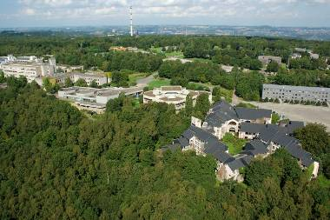
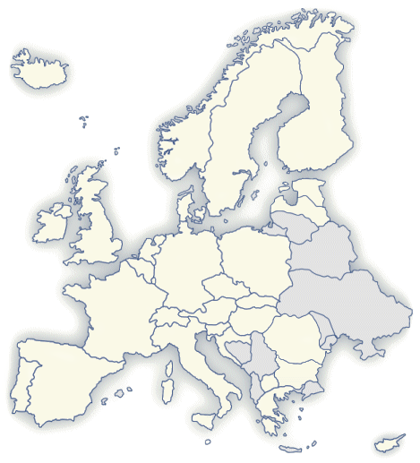
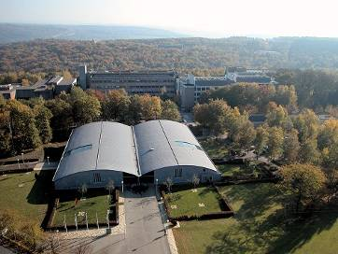
University of Liège
A heart beating for Europe
Liège - A millenary city
Less than 300km from:
London, Frankfurt, Paris, Amsterdam,...
Cradle of mining & metallurgy in Europe
21000 students 2000 PhD students
500 professors
The largest network of spin-off companies in Belgium
Notes:
Superimpose Australia

Slide 3
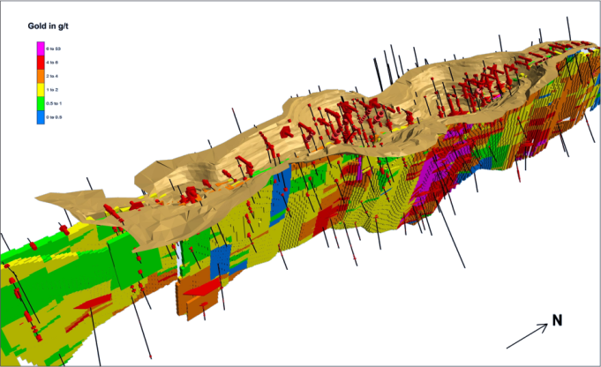
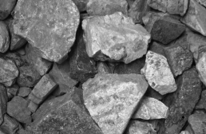
Geometallurgy
Science and dialogue
A PROGNOSTIC perspective
Deposit
Regional Variability,…
Zonation, stratification,…
Faults, Geomechanical testing,…
Rock/Ore
Local Variability,…
Grade and Mineralogy
Pores, Fractures, Grain size, shape, arrangements, …
Mineralurgical testing,…
Particulate system
Interparticle variability (Liberation)
Microchemical probing,…
A geometallurgist gathers quantitative data as input to models for predicting behaviour in several industrial processes (blasting; grinding; leaching; flotation;…)
He considers both valuable, deleterious and gangue-forming minerals
Sampling, Geostatistics and Stereology:
3D from cores
3D from sections
3D from tomography

Slide 4
Geometallurgy
Science and dialogue
Bridging the gap between geology and engineering
CHEMICAL
METALLURGICAL
MINING
GEOLOGY
ENGINEERING
Geology | Engineering
Inductive reasoning | Deductive reasoning
Diagnostic / Observation | Prognostic / Modelling
Understanding Nature | Serving societal needs
Using technologies | Developing technologies
Qualitative | Quantitative
Familiar with variability, heterogeneity, large time and space scales | Accuracy, precision, statistics,
No limits | Economic constraints

Slide 5
Geometallurgy
Science and dialogue
Liège 1900
Improve (create ?) dialogue between geologists and mining engineers
New degree in Engineering
Followed by Nancy 1908,…
Liège, Nancy 2000
“He is not an engineer nor a geologist…”
Trend to focus solely on environment / hydrogeology
Mineral resources is among the less popular orientations
Liège, Nancy, Lulea, Freiberg 2012
Master in Georesources Engineering
Triple Diploma BE, FR, SE
INGENIEUR GEOLOGUE
GEOTECHNICS
ENVIRONMENT HYDROGEOLOGY
OIL & GAS
NUMERICAL GEOLOGY
MINERAL RESOURCES
GEORESOURCES ENGINEER

Slide 6
Georesources Engineering
The right timing
Europe’s sudden awareness
Lulea declaration 2009
Raw materials initiative 2010
EIP Raw Materials 2012
EIT Knowledge Innovation Community on Raw Materials 2014
Challenges for the future
Identify resources for strategic elements
Optimize resource recovery (minimum waste, energy-water efficiency)
Develop geometallurgical estimation
Advanced modelling and 3D mapping of reserves
Consider urban resources (recycling)
EU support
Erasmus Mundus EMerald 2012
Master & PhD in Raw Materials + “entrepreneurship modules” EIT KIC Label 2015
Research & technology
Higher Education
Industry & SMEs

Slide 7
Georesources Engineering
The right curriculum?
A 2 years master program (120 ECTS)
THEORY
PROJECT
GEOresource Characterization
15 ECTS
15 ECTS
GEOresource Processing
20 ECTS
10 ECTS
GEOresource Modelling
10 ECTS
10 ECTS
GEOresource Management
10 ECTS
Specialized seminars
10 ECTS
Master Thesis
20 ECTS

Slide 8
Georesources Engineering
The right curriculum ?
Admission
M Sc or B Sc in Engineering
M Sc (or B Sc) in Geology
Min 22 ECTS Maths
ex. of a GEO-characterization course
Process Mineralogy
Sampling (Gy)
Particle Size & Shape Distributions
Optical Microscopy I & II
Image Analysis
SEM, EDX, QEM-Scan
XRD
Mineralogical balance
IN
S1
LIEGE
Levelling course (5 ECTS)
for non-geologists :
Geology and mineral resources for geologists :
Numerical data analysis
Geostatistics (5)
Process Mineralogy (5)
Mineral Processing I (5)
Waste and by-products processing (5)
Specialized Seminars (5)
Legal – Economic aspects of raw and secondary materials
Associate

Slide 9
Georesources Engineering
The right curriculum ?
S2
S3
NANCY
LULEA
Geomodelling (5)
Pilot Plant Project (5)
Advanced Characterization (5)
Mineral Processing II (5)
Recycling (5)
Mine Geology (7.5)
Geometallurgical Project (7.5)
Mineral Processing II (7.5)
Modelling in Mineral Proc. (7.5)
Specialized Seminars (5)
Socio – Economics – Strategic Elements
Specialized Seminars (5)
Mining, Exploration
Associate
Associate

Slide 10
Georesources Engineering
The right curriculum ?
Field trips (Yr 1)
SIBELCO (BE)
LHOIST (BE)
KGHM (PO)
IMERYS (FR)
UMICORE (BE)
Environmental Remediation Project (FR)
…
Seminars (Yr 1)
Health and Safety issues at industrial operations (Imerys)
Corporate Social Responsibility (Umicore)
Bankable Feasibility Study, theory and practical exercise (Technip)
Junior Mining – Financing exploration (SearchGold)
Introduction to financial modelling of a mine operation (Aurubis)
Legislative aspects of a mining exploitation

Slide 11
Georesources Engineering
The right curriculum ?
3 month internship
Get a grip of industrial reality
Learn to know a mining operation
Collect data for own research
Master thesis
Collect and analyze data
Relate data to optimisation of mining / mineral processing
Synthesize and write a report
Defend project orally (committee with 2 acad + industry)
Lhoist (crushing + lime kiln)
Eramet (quantitative mineralogy in Mn)
GeoInnova (geometallurgical modelling)
ArcelorMittal (geometallurgy iron ore)
CMI (texture + lime kiln)
…

Slide 12
Georesources Engineering
The right curriculum ?
Soft Skills
Full English
Multiculturality awareness
Mobility throughout Europe
Enhance intercultural networking and foster team spirit
Living together for 2 years
Cultural diversity of group
Lab and research projects in group
Scientific communication
Oral presentations (PPT)
Poster presentations
Written reports
Documentary research
Searching databases
Bibliography

Slide 13
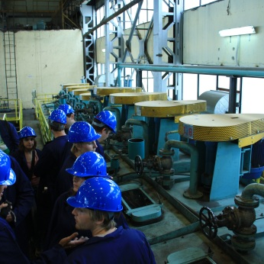
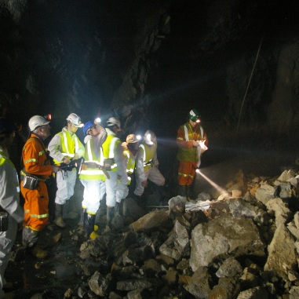
A Strategic Advisory Board
Industrial partners
Mission to
Advise on the structure and content of the courses
Suggesting future developments and orientations
Participating to the evaluation
Offering internships for preparing master theses
Offering industrial visits and case study analyses
Sponsoring specific activities :
International workshops and seminars; Invited speakers;

Slide 14
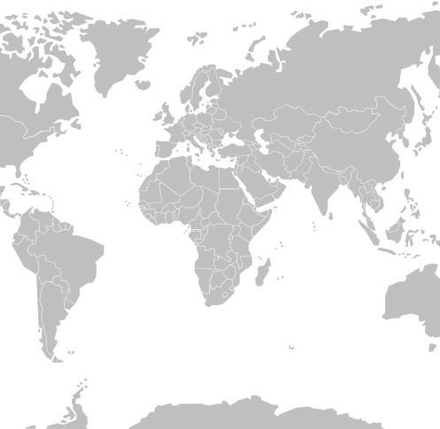
An international network
International partners
Strong visibility of the EMerald Master degree.
Cooperation in terms of research networks, PhD programs, visiting professors,…
UCT - Capetown (ZA)
UQ - Brisbane (AU)
MISIS - Moscow (RU)
UChile - Santiago (CL)
UFMG - Belo Horizonte (BR)
Hacettepe Univ - Ankara (TR)
Univ Oulu (FI)
East Kazakhstan TU (KZ)

Slide 15
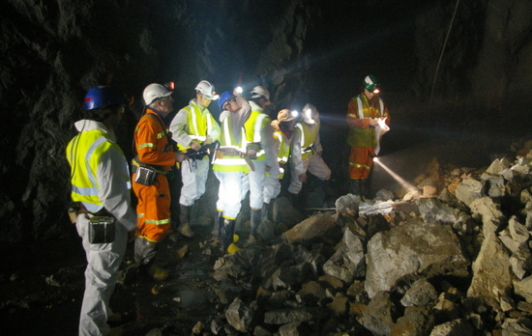
Thank You
www.em-georesources.eu

