Slide 1
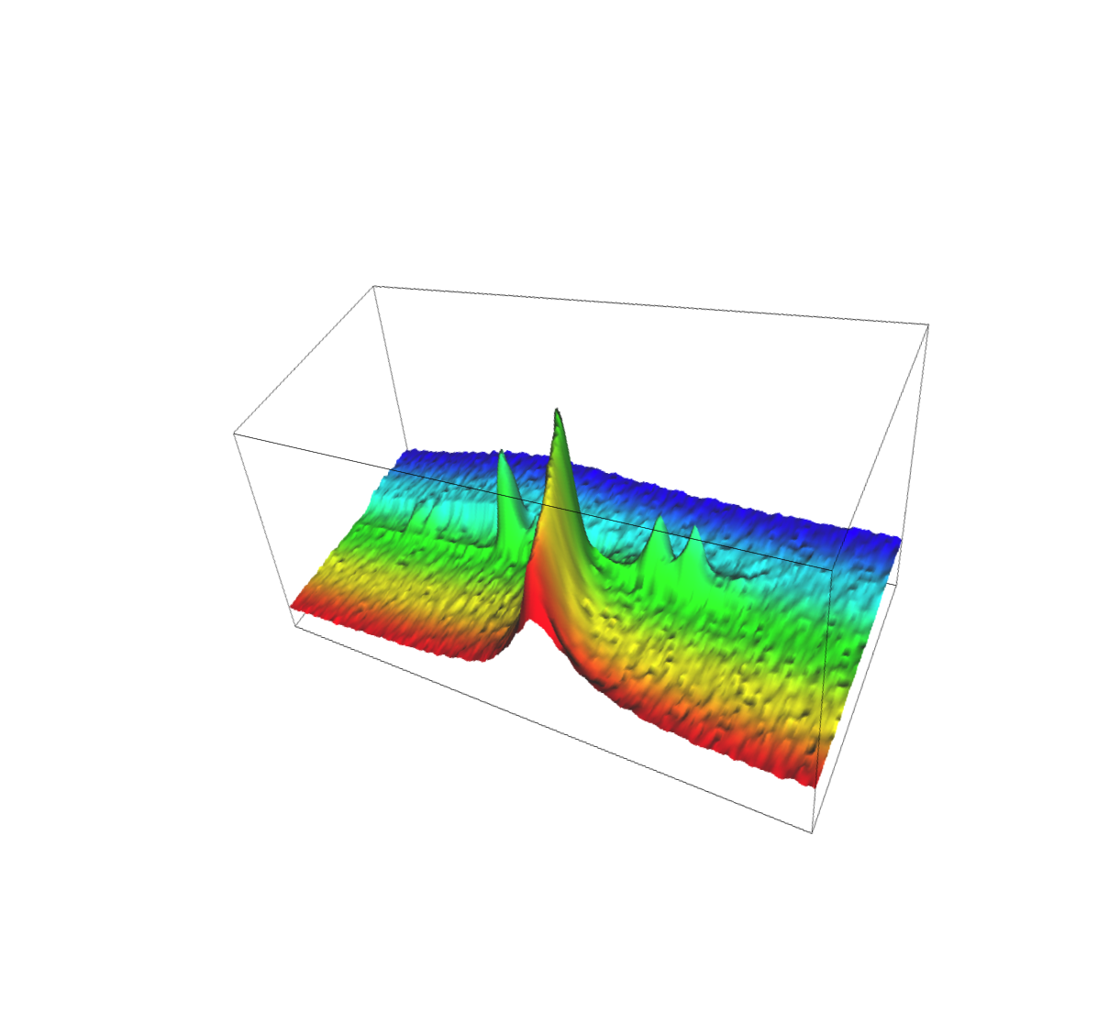
Researches on the physical state of anhydrous food materials
Christophe BLECKER
Gembloux Agro-Bio Tech
University of Liège
Brasil Foods – May 2013

Slide 2
University of Liège
Gembloux Agro-Bio Tech
Food Technology Department
SAF

Slide 3
Human forces
Academics
- Dr Ir Christophe BLECKER
- Dr Ir Sabine DANTHINE
Research staff (50-60 people)
- Research associates
- Postdoctoral fellows
- MSc. And Ph.D. graduate students
- Technicians

Slide 4
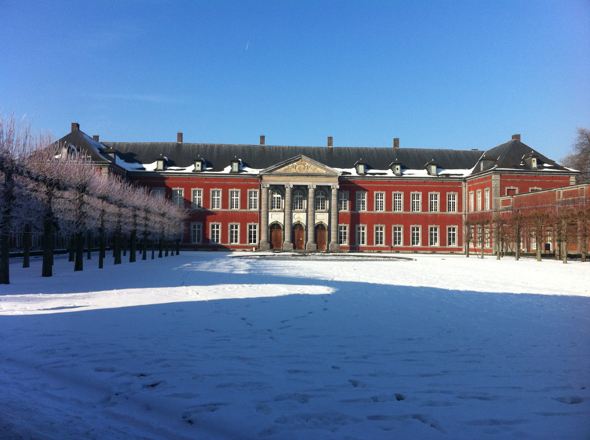
Infrastructure

Slide 5
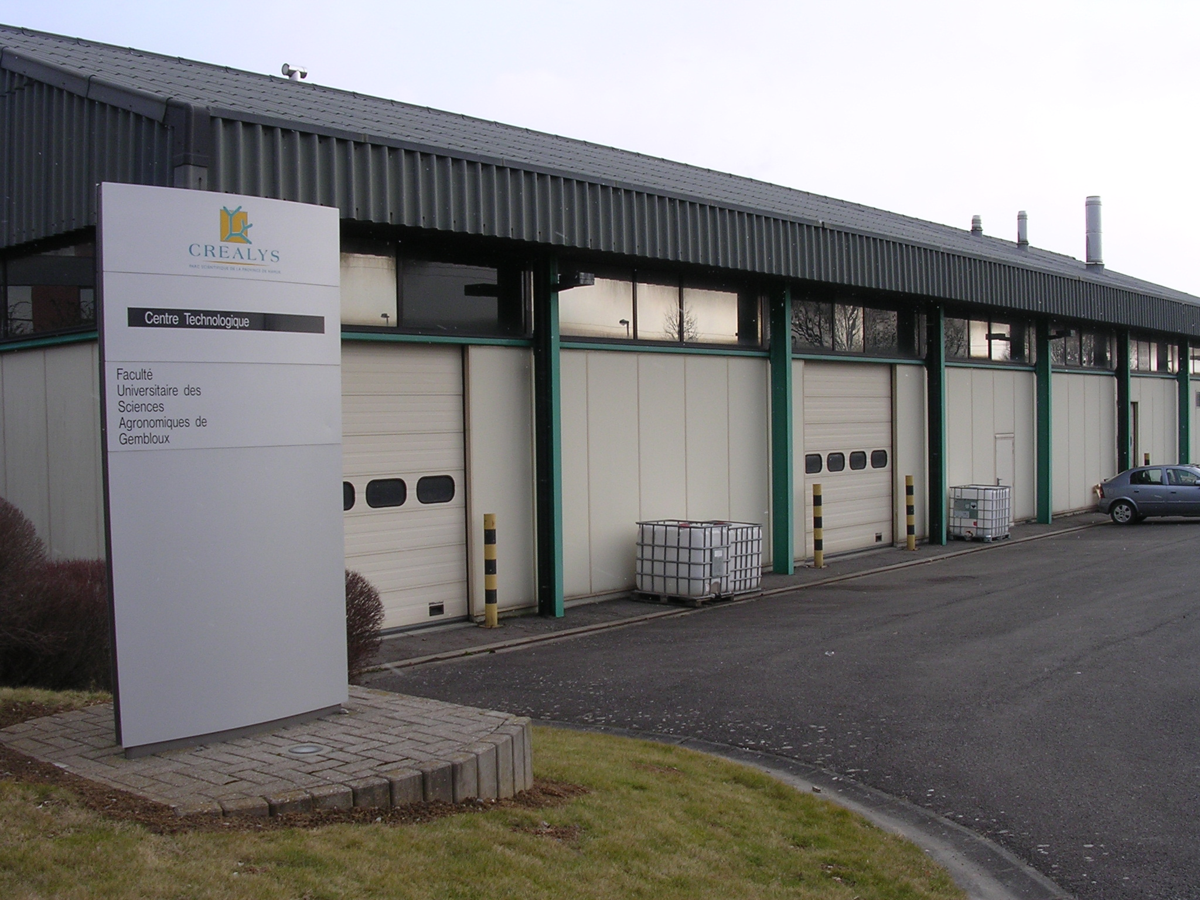
Technological center

Slide 6
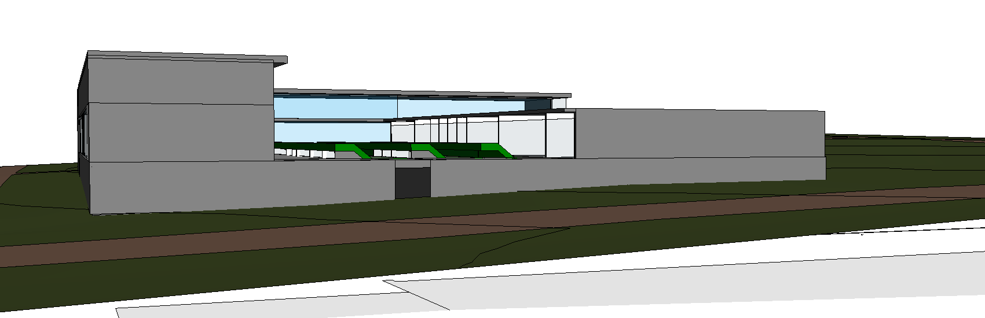
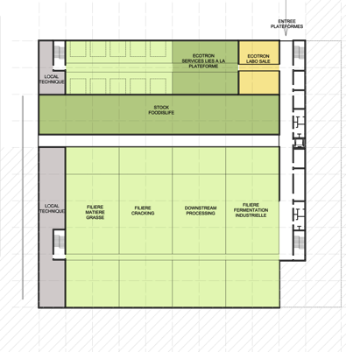
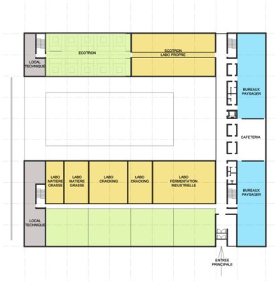
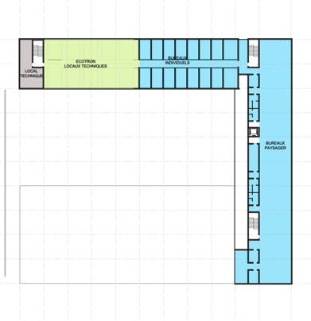
Soon …
Food Is Life

Slide 7
Field of activities
Extraction
Cracking
Transformations
Functionalization of ingredients
Physical and enzymatical modifications
End Products
Formulation engineering
Use of soft technologies
Studies of interactions between ingredients
Full characterization (physical and sensorial properties)
Development of models
Co-products
Researches linked to health and environmental concerns

Slide 8
More specifically
“Cracking” of biological raw materials
Physical state of food materials
Techno-functionality of ingredients
Physicochemical properties of food products
Dairy science

Slide 9
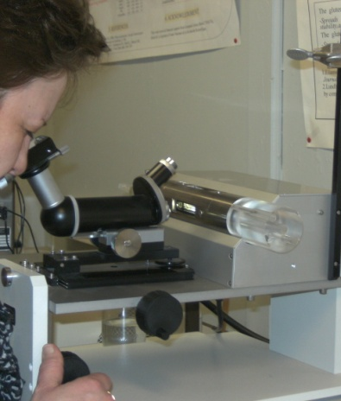
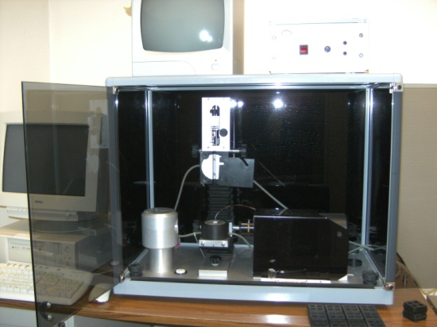
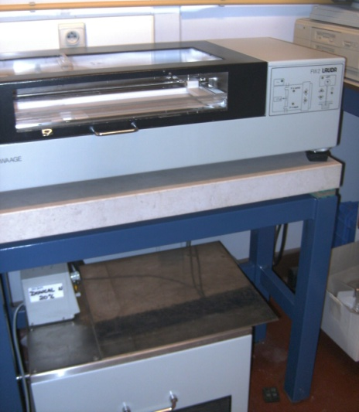
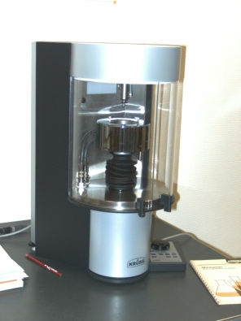
Analytical techniques
Interfacial properties
- Adsorption kinetics, monolayers, interfacial rheology, …
Spinning drop
Hanging drop Tensiometer
Bubble pressure
Langmuir film

Slide 10
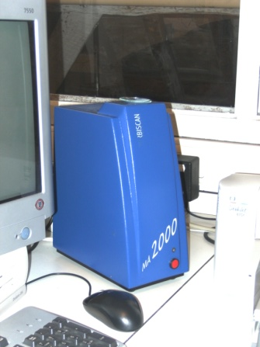
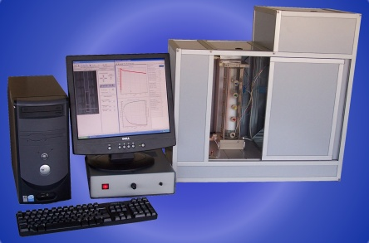
  - Emulsions, foams, …
Turbiscan
Foam scan

Slide 11
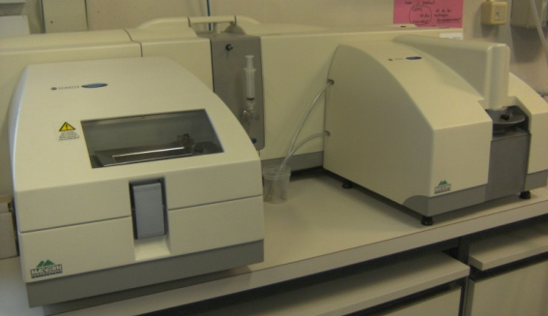
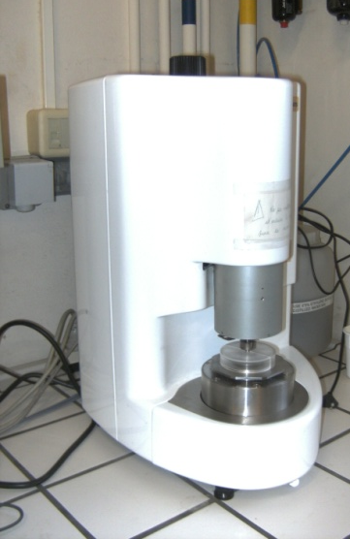
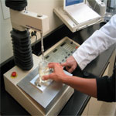
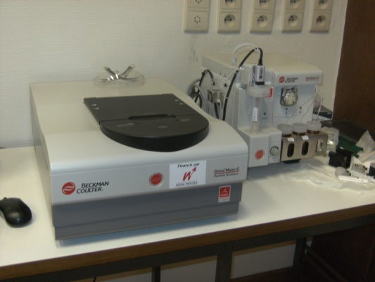
Rheology, texture analysis, particule/globule sizer, zeta potential,…
Master sizer
Rheometer
Texturometer
Beckman coulter-Delsa Nano

Slide 12
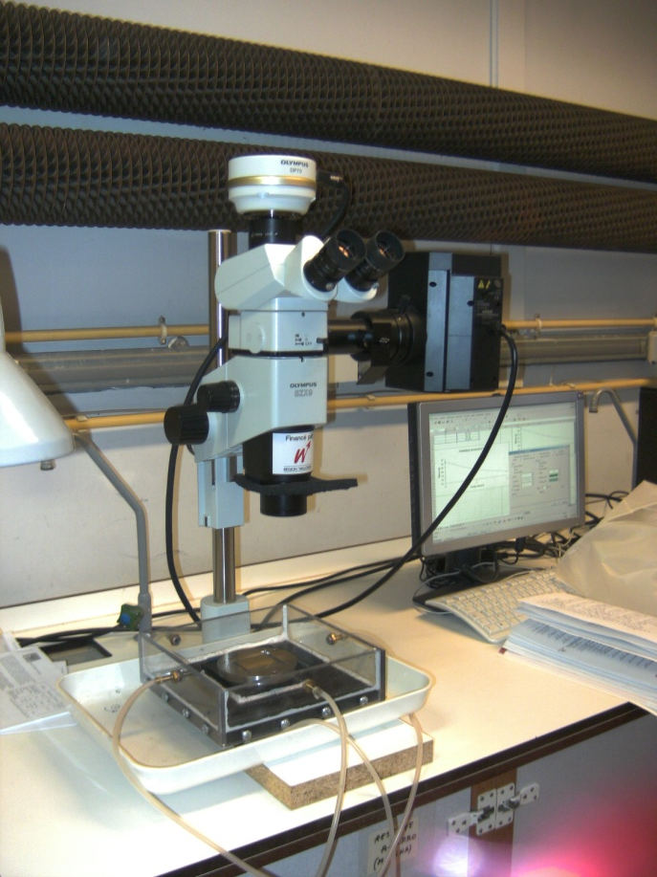
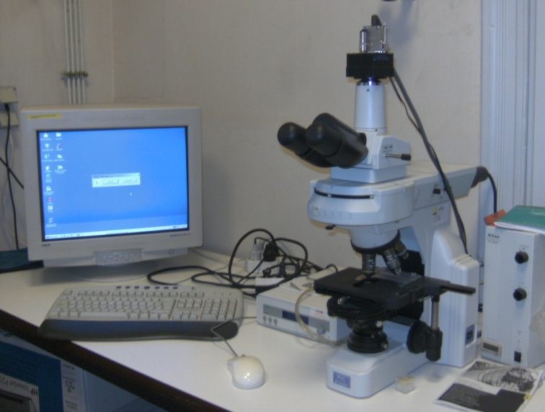
Microscopy

Slide 13
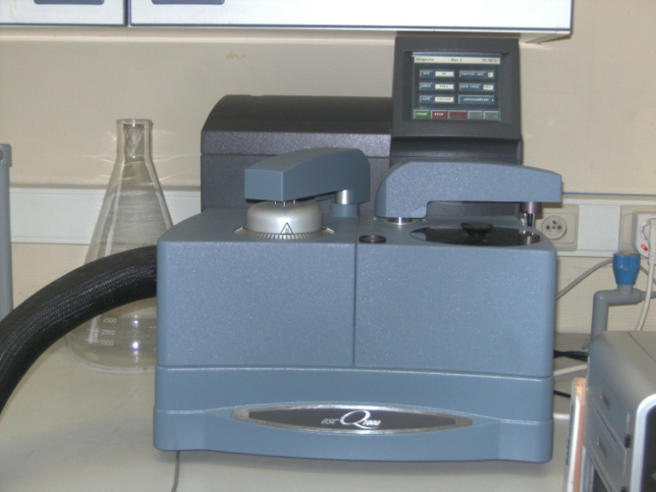
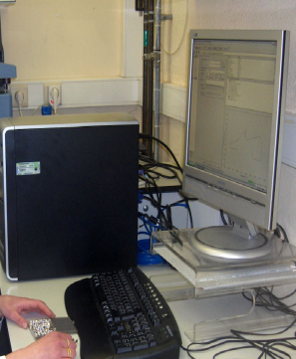
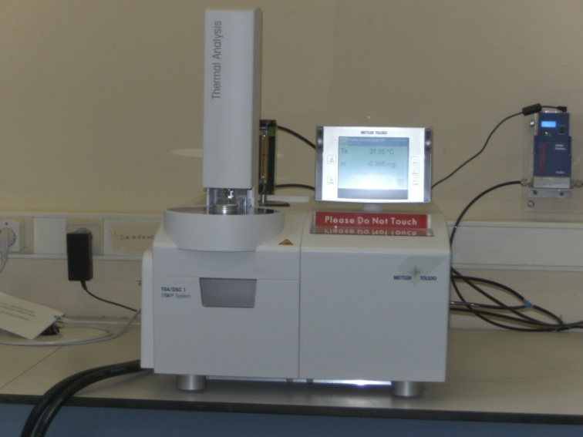
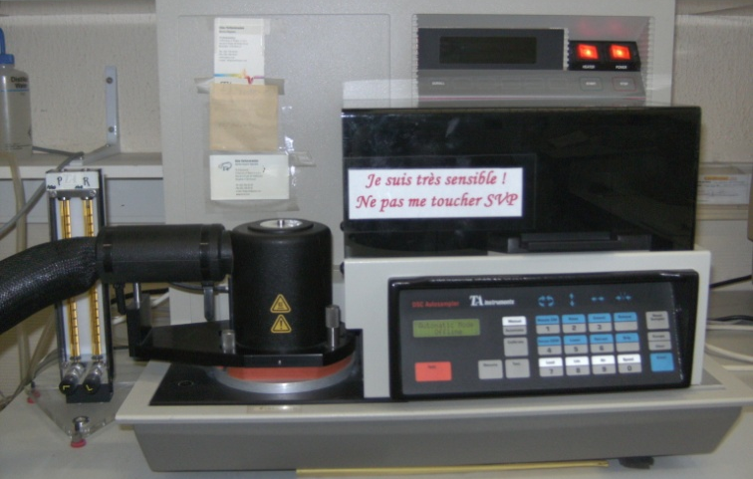
Thermal properties
MDSC Q1000
TGA
MDSC TA2920

Slide 14
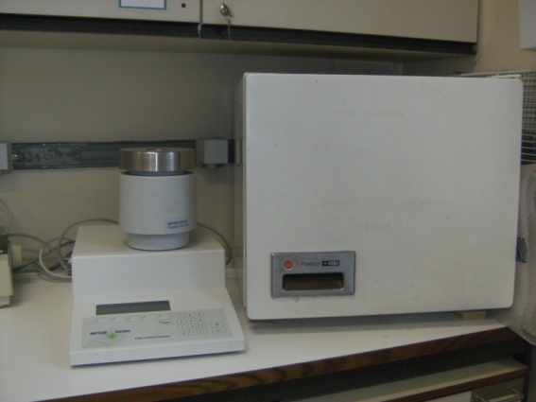
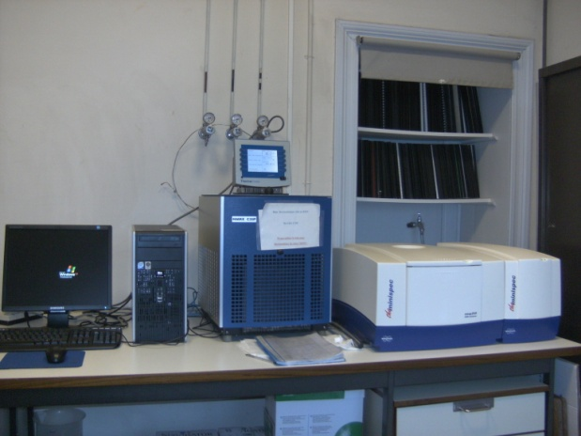
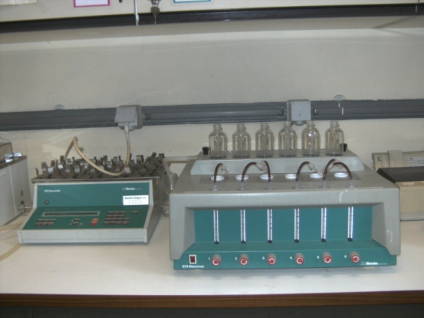
Oils & fats
Mettler (CP-DP-…)
P NMR
Rancimat

Slide 15
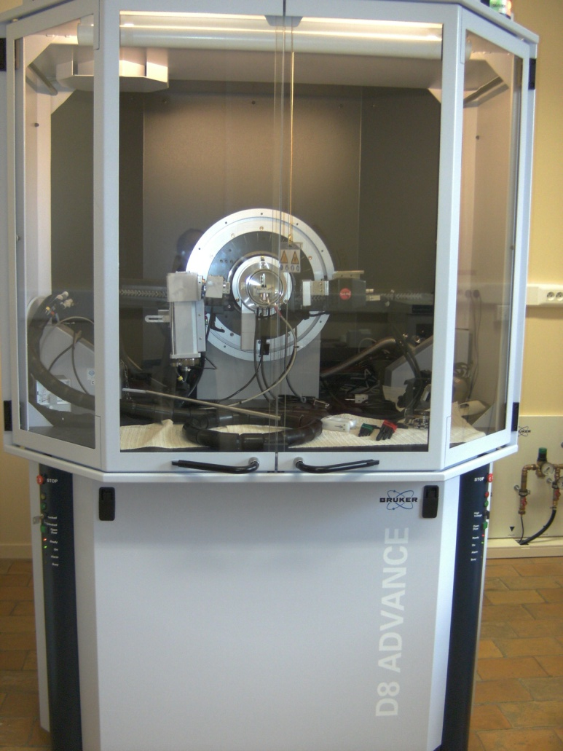
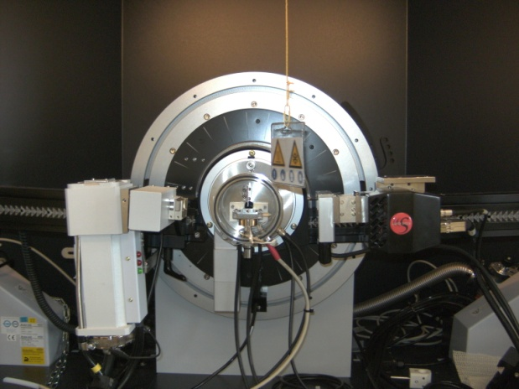
X-Ray diffraction
XRD with controlled temperature

Slide 16
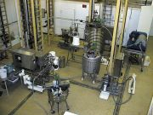
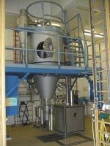
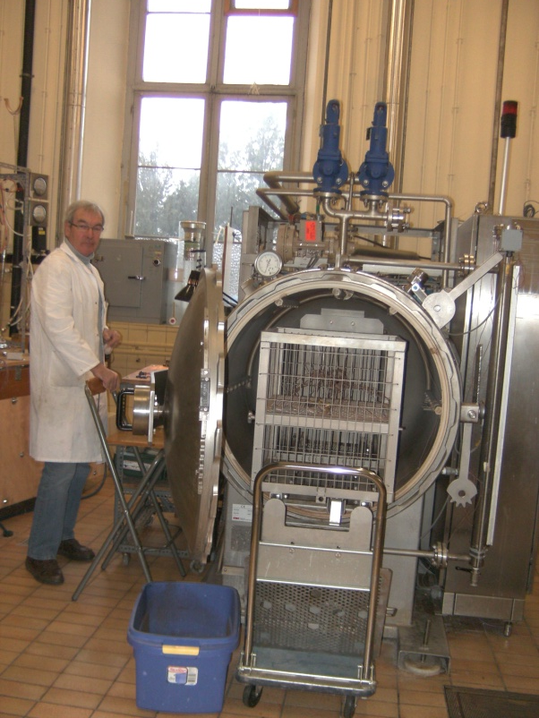
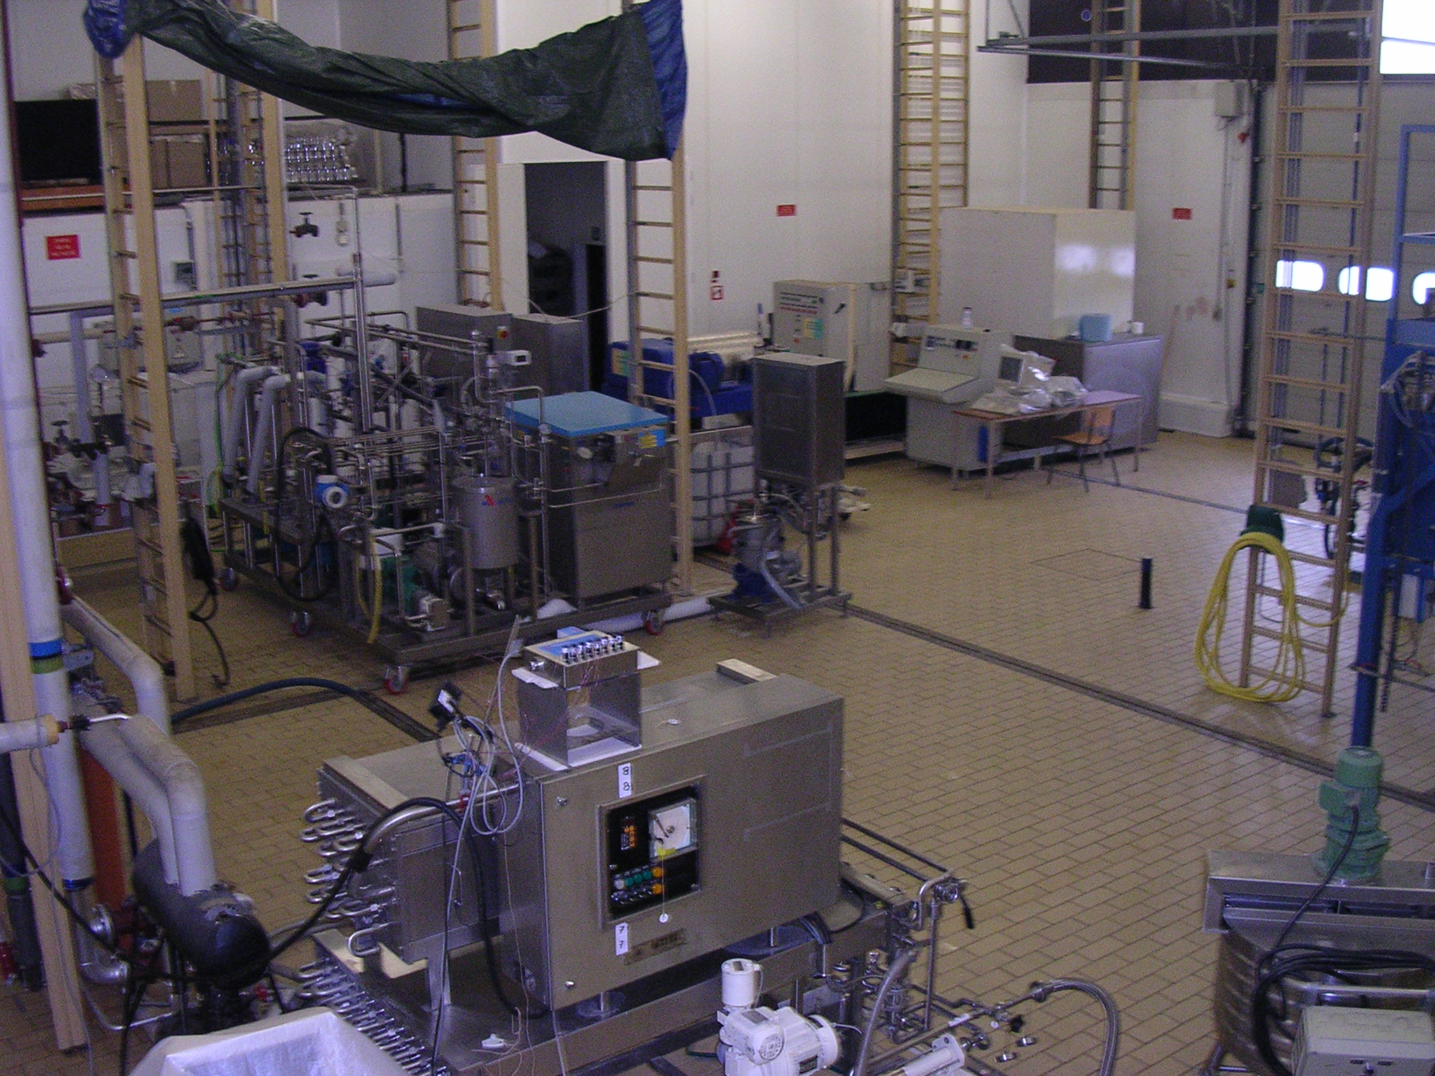
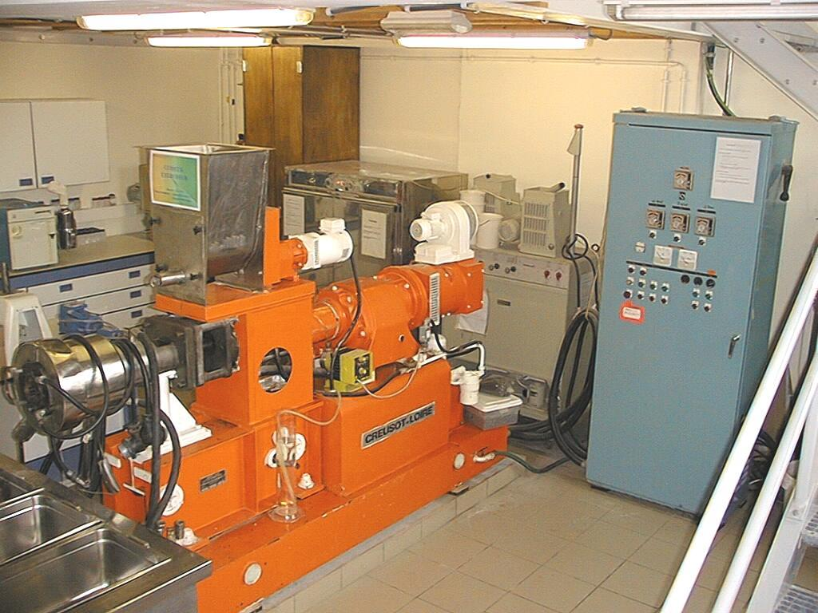
Pilot equipment

Slide 17
Today’s topic
“Cracking” of biological raw materials
Physical state of food materials
- Anhydrous products
- Soft condensed matter
Techno-functionality of ingredients
Physicochemical properties of food products
Dairy science

Slide 18
Physical state of anhydrous food materials
Determination of physical changes of inulin powders
Physicochemical characterization of fat blends

Slide 19
Determination of physical changes of inulin powders
Physical stability of inulin powder during storage
Impact of spray-drying conditions on physical state
Development of properties (functionalization) by physical process

Slide 20
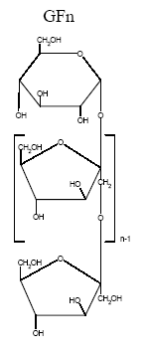
Inulin
A Belgian story ?
Mixture of polysaccharides constituted
of fructose unit chain of various length
Nutritional interests (soluble dietary fiber,
prebiotic, …)
Technofunctional ingredient (fat substitute,
bulk agent, water retention, …)

Slide 21
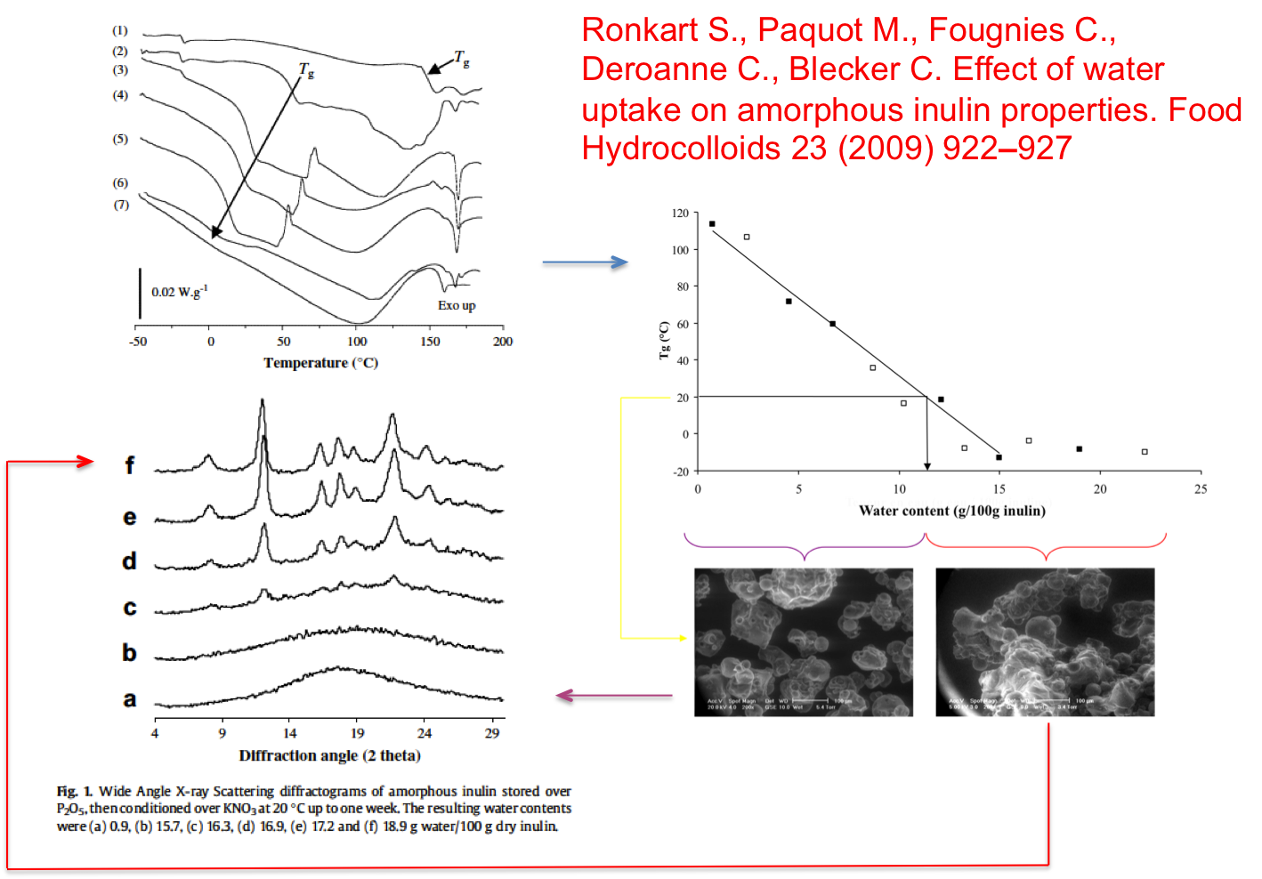
Glass transition, water sorption, caking

Slide 22
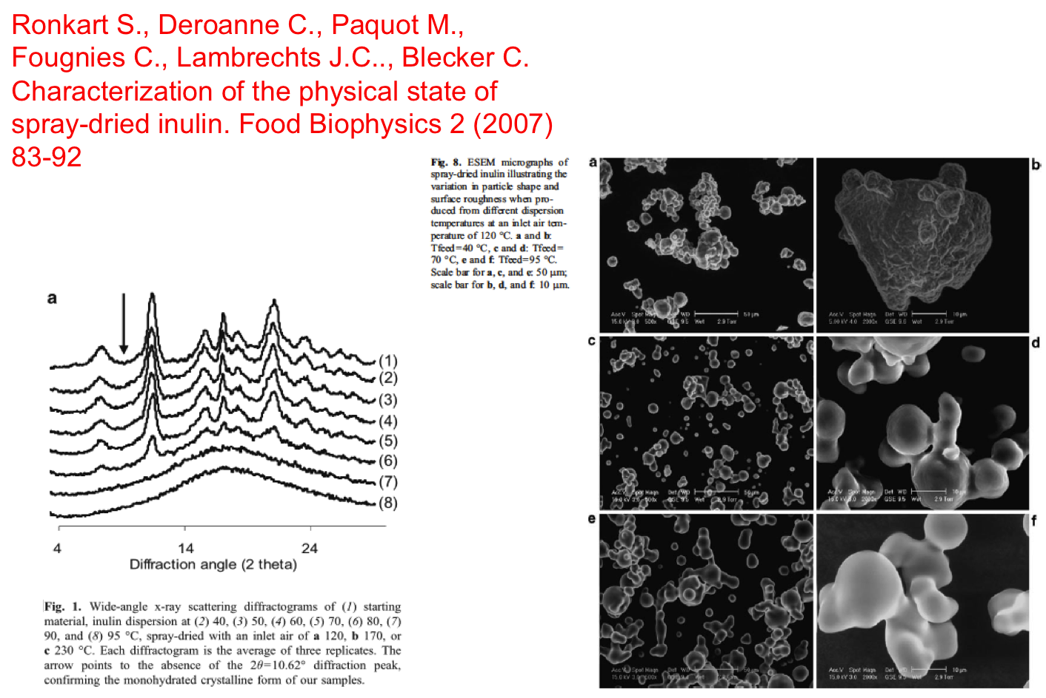
Impact of spay drying conditions

Slide 23
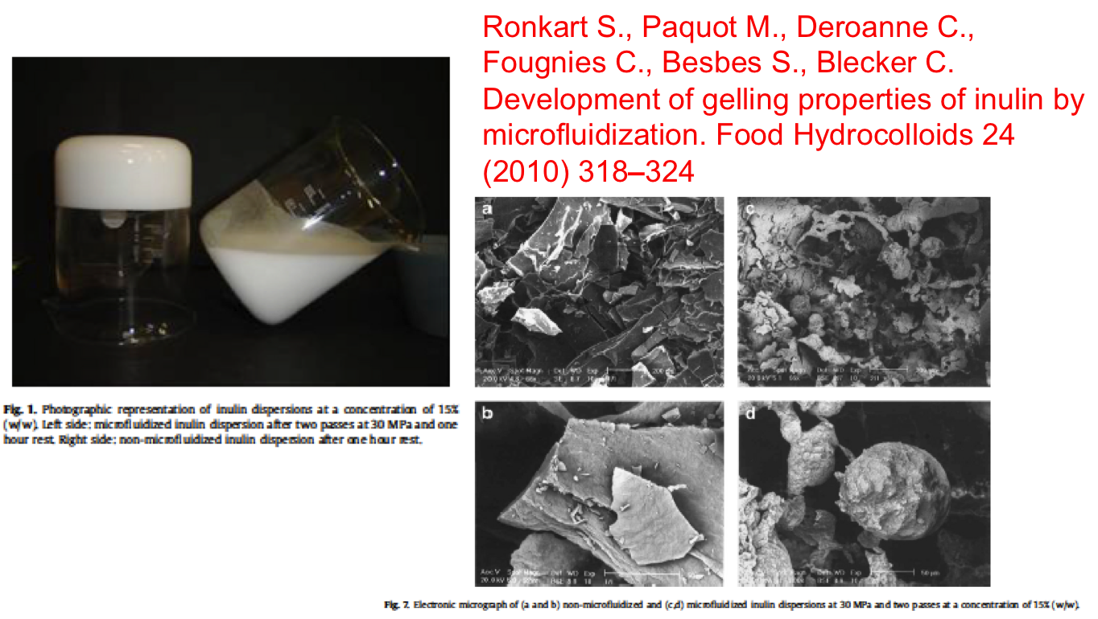
Development of gelling properties by microfluidization

Slide 24
Physicochemical characterization of fat
Phase diagrams
Characterization and discrimination of industrial fats
Influence of composition on melting and polymorphic behavior
Processing and formulation

Slide 25
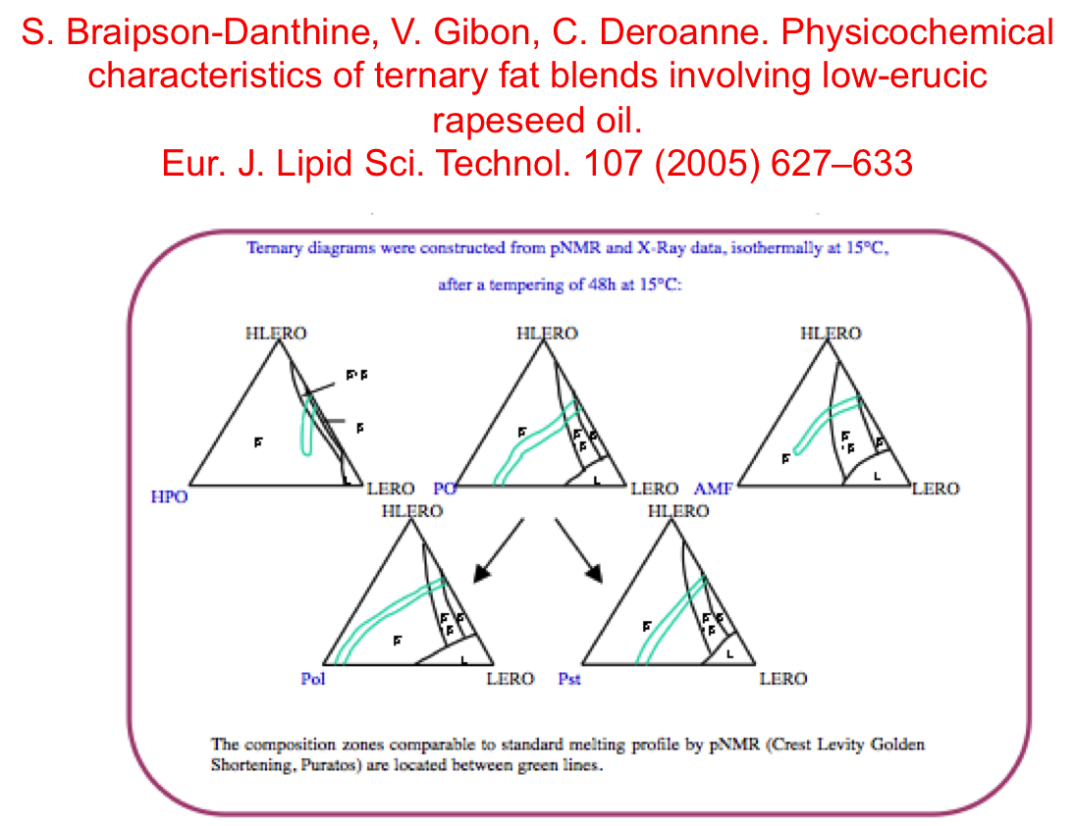
Phase diagrams of fat blends

Slide 26
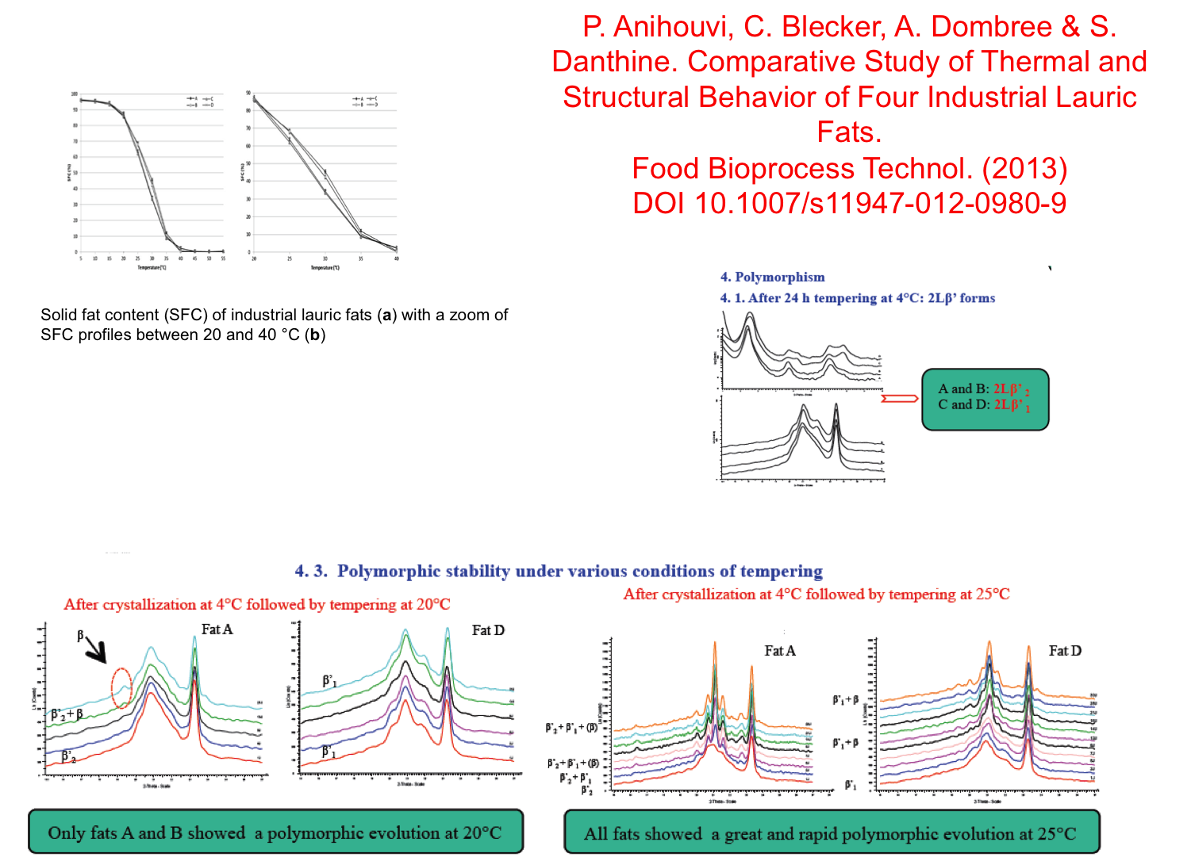
Characterization and discrimination of industrial fats

Slide 27
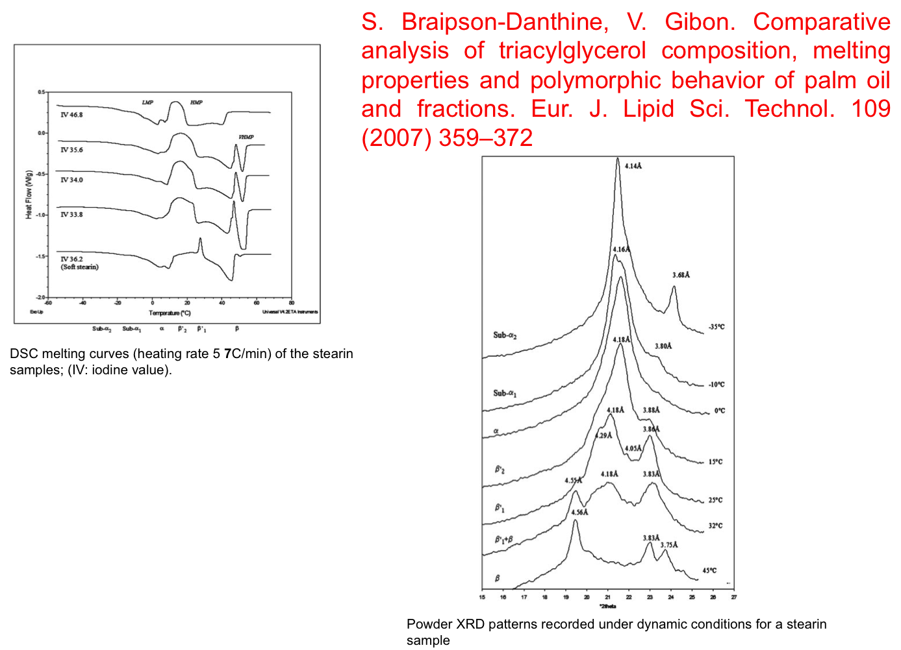
Influence of composition on melting and polymorphic behavior

Slide 28
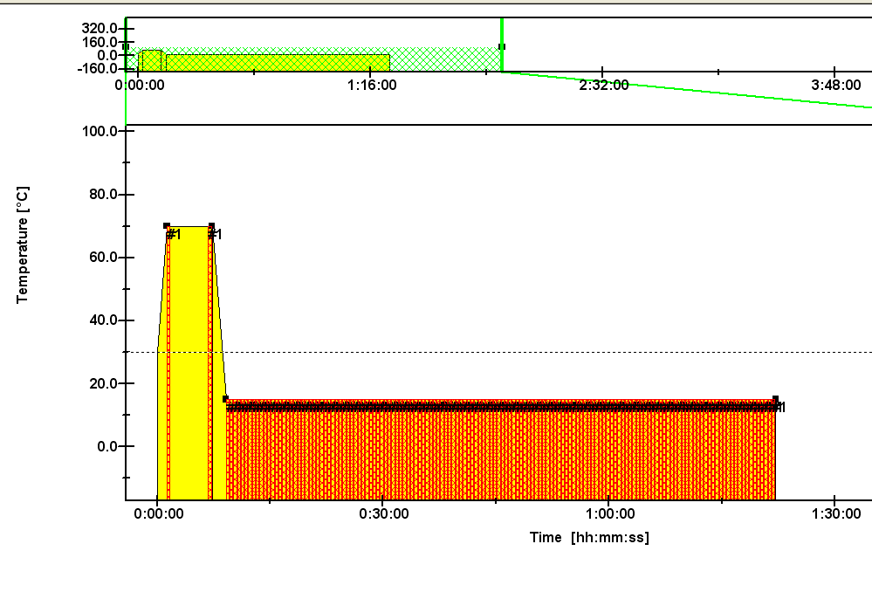
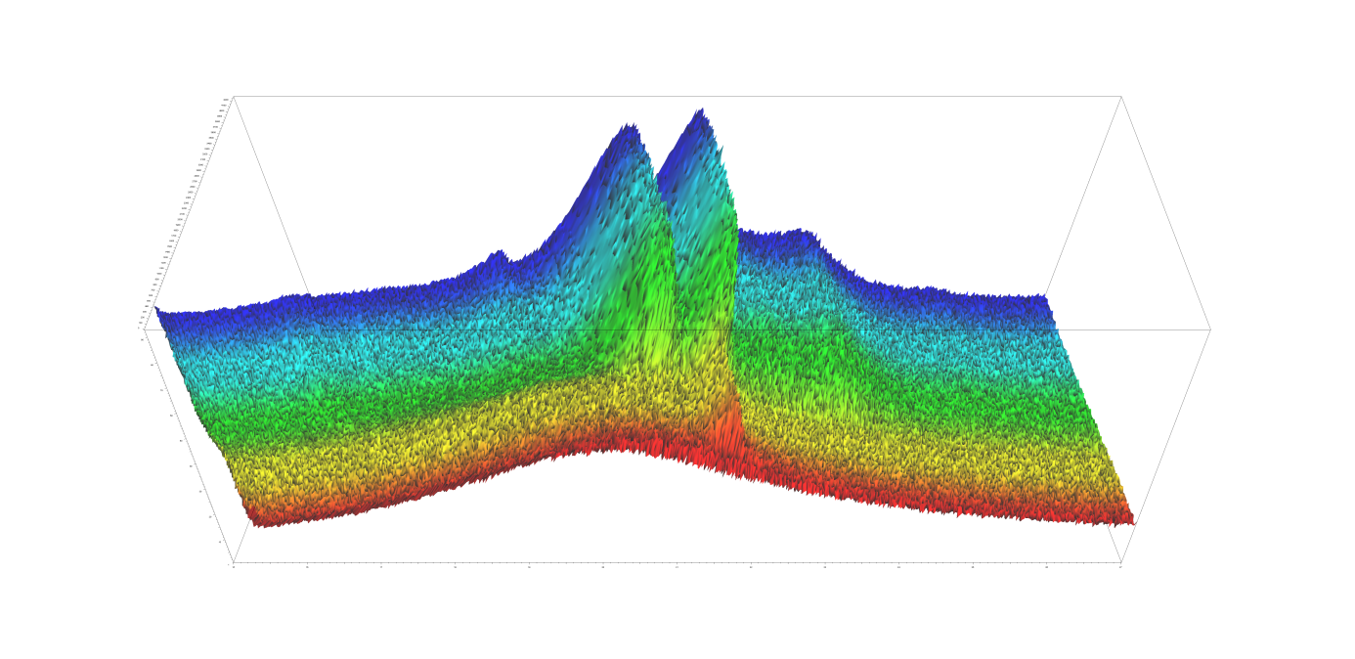
Isothermal crystallization of cocoa butter
Time
β
β’
α
Crystallization process

Slide 29
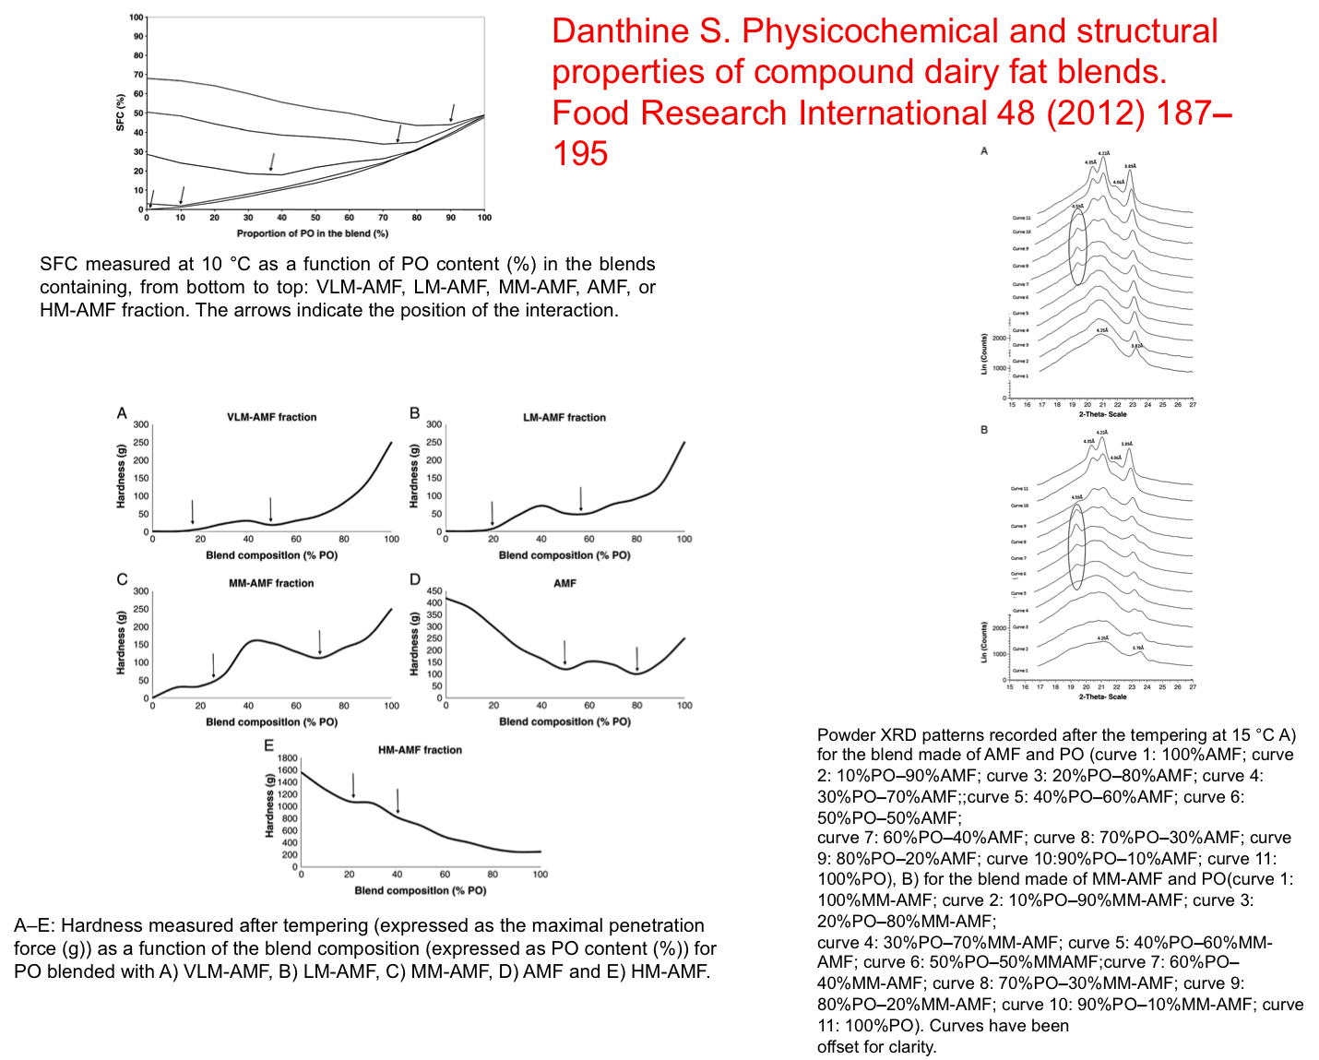
Formulation of compound dairy fat blends

Slide 30
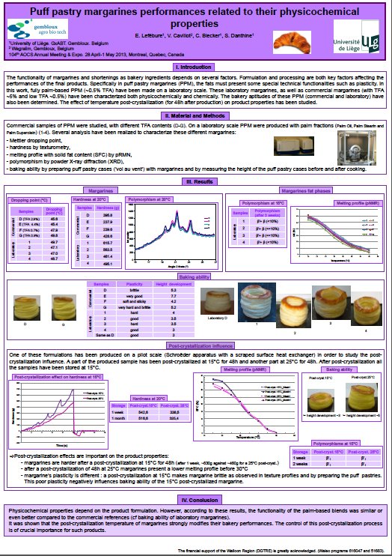
Formulation of puff pastry margarines

Slide 31
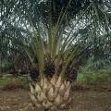




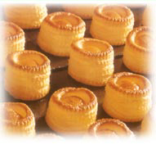
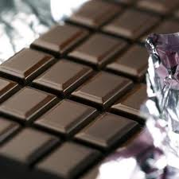

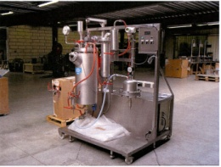
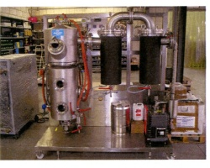

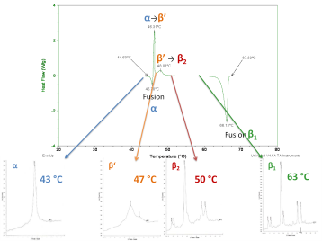




« Extraction, transformation, valorization and utilization of lipids (& by or co-products) »
Fundamental understanding of lipid crystallization (phase behavior diagrams…)
Fundamental understanding of lipid networks building
Elucidation of lipid structures for diversified physical functionalities
Development and/or improvement of soft modification processes (physical/enzymatic) directed towards modulation of lipids functionality
Studies of extraction and refining practices (with valorization of co-products ).
Preservative strategies (oxidation)
Extraction
Refining
Thermal properties
Crystallization
Fat modifications
Polymorphism

Slide 32
Conclusion
Analytical tools from biophysics + pilot scale processing => Better fundamental knowledge on food material + applied results for industrial partners
We are open to collaboration
Contact : christophe.blecker@ulg.ac.be
Phone : 32 81 62 23 08

