Slide 1
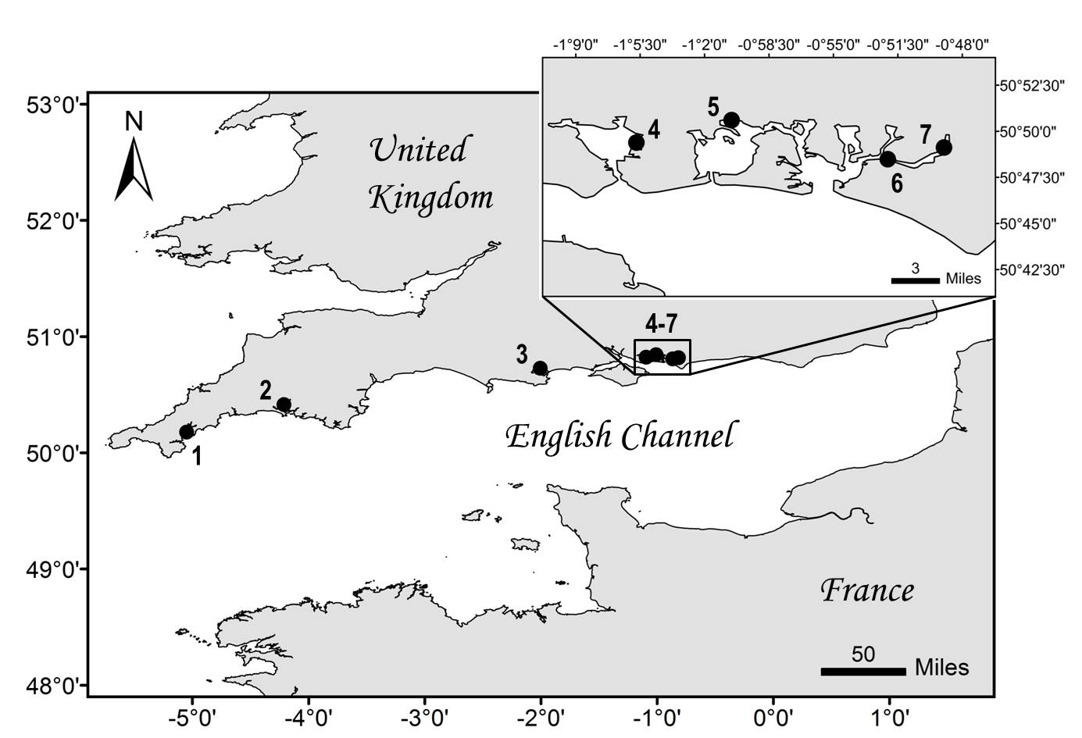
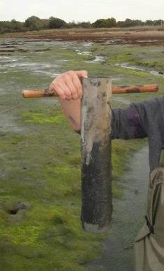
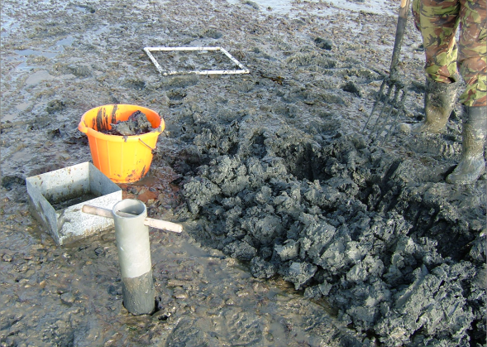
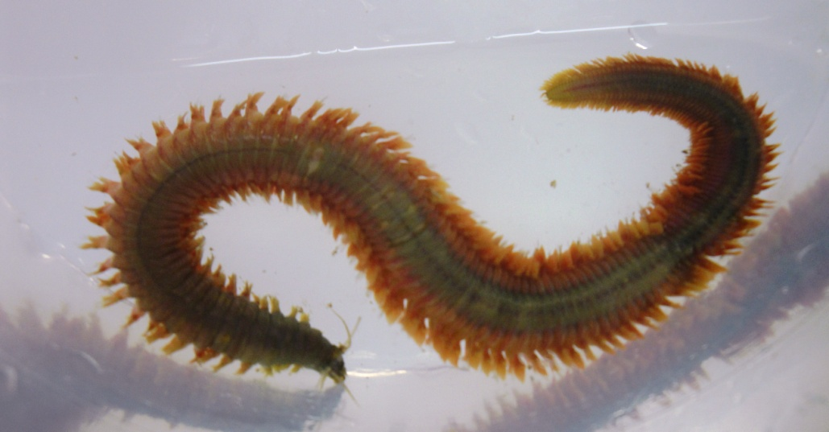
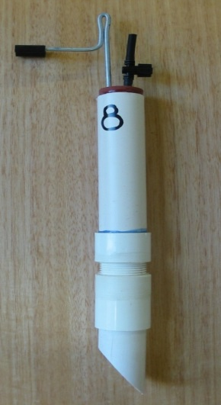
The impact of site specific sediment characteristics on metal bioavailability and bioaccumulation in the polychaete Nereis virens
Pini, J. M., Richir, J. and Watson, G. J.
Institute of Marine Sciences, School of Biological Sciences, University of Portsmouth, UK
Contact: Jennifer.pini@port.ac.uk
Introduction
Materials & Methods
The King ragworm, Nereis virens, is an ecologically and commercially important polychaete species of soft sediment inter-tidal communities of the northern hemisphere and is known to be impacted by various anthropogenic activities.
Metals such as copper (Cu) and zinc (Zn) are naturally present in the ecosystem but can be found at high levels due to industrial activities and are known to be toxic to many marine invertebrates.
Aim: To investigate the relationships between metal bioavailable concentrations in the sediment, the pore water and the tissues of N. virens from sites with different pollution histories.
Samples processing
Sediment
N. virens
Pore water
Organic
content
&
Particle size
analysis
BCR sequential extraction ^{[1]}
Step 1. Acetic acid => Exchangeable phase
Step 2. Hydroxylammonium chloride => Reducible phase
Step 3. Hydrogen peroxide & ammonium acetate => Oxidisable phase
Nitric
acid
extraction
Fig.1 Map showing the location of the 7 sites sampled along the English Channel coast. 1) Mylor, Fal Estuary; 2) Saltash, Tamar Estuary; 3) Holes Bay, Poole Harbour; 4) Tipner, Portsmouth Harbour; 5) Broadmarsh, Langstone Harbour; 6) The Conservancy and 7) Dell Quay, Chichester Harbour.
Flame Atomic Absorption Spectroscopy (FAAS)
Results & Discussion
Weak but significant negative correlation Cu concentrations and worm weight => heavier worms accumulate less Cu in their tissues.
No significant correlation between Zn concentrations and worm weight
Site characteristics and metal bioavailability
Sites | Organic content (%) | Silt particle size distribution (%) |  |  |  | Cu bioavailable conc. | Zn bioavailable conc.
 |  | Very coarse (63-31 µm) | Medium (31-8 µm) | Fine (8-4µm) | Very fine (4-2µm)
Mylor | 8.90 ± 0.35 | 40.92 ± 0.28 | 10.81 ± 0.10 | 37.37 ± 0.47 | 0.09 ± 0.00 | 421.83 ± 63.55 | 670.99 ± 46.00
Saltash | 6.68 ± 0.48 | 33.85 ± 0.59 | 9.55 ± 0.24 | 46.94 ± 1.01 | 0.11 ± 0.00 | 87.84 ± 6.55 | 175.10 ± 23.79
Holes Bay | 8.83 ± 0.18 | 28.75 ± 0.72 | 8.39 ± 0.38 | 54.34 ± 1.44 | 0.13 ± 0.00 | 47.99 ± 5.00 | 159.35 ± 30.97
Tipner | 2.32 ± 0.19 | 26.29 ± 0.97 | 7.62 ± 0.06 | 58.34 ± 1.08 | 0.13 ± 0.00 | 23.35 ± 1.90 | 42.45 ± 9.25
Broadmarsh | 5.20 ± 0.31 | 34.05 ± 1.01 | 11.00 ± 0.28 | 43.90 ± 1.54 | 0.10 ± 0.00 | 10.83 ± 0.57 | 36.43 ± 4.56
Conservancy | 3.96 ± 0.05 | 24.50 ± 1.35 | 7.78 ± 0.45 | 59.80 ± 2.24 | 0.14 ± 0.01 | 31.75 ± 1.41 | 54.02 ± 6.98
Dell Quay | 3.28 ± 0.42 | 33.01 ± 0.80 | 9.28 ± 0.19 | 48.32 ± 1.16 | 0.11 ± 0.00 | 32.76 ± 2.98 | 41.75 ± 7.65
Table.1 Sediment characteristics and metal concentrations from the 7 sites sampled along the English Channel from summer 2011 to winter 2012. Silt particle size distribution determined using the statistical package Gradistat ^{[2]} are given in mean ± SEM. Cu and Zn concentrations (mean ± SEM, in mg kg⁻¹ dry weight) were calculated using the BCR three-step sequential extraction. This procedure assesses the distribution of metals in the following fractions: exchangeable (i.e. water and acid soluble; step 1), reducible (i.e. iron/manganese oxides; step 2) and oxidisable (i.e. organic matter and sulphides; step 3). The sum of the 3 steps is described as the bioavailable concentration of Cu and Zn.
All sites were characterised as very poorly sorted, very coarse skewed muddy sediment composed mainly of fine and very coarse silt.
However, Mylor, Saltash and Holes Bay presented differences from Tipner, Broadmarsh, Dell Quay and The Conservancy in term of sediment characteristics , pollution history & metal bioavailable concentrations.
Organic content for the sediment showed a modest but significant correlation with bioavailable Cu (r = 0.596; p = 0.004) and Zn (r = 0.658; p = 0.001) concentrations.
Particle size showed a strong and significant correlation with both Cu (r = 0.791; p < 0.001) and Zn (r = 0.740; p < 0.001) bioavailable concentrations in the sediment.
Tissue metal concentrations and weight
Metal concentrations in tissues, sediment and pore water
a)
Weak but significant
negative correlation between Cu concentrations and worm weight:
Heavier worms accumulate less Cu in their tissues.
No significant
correlation between Zn concentrations and worm weight.
a)
Cu concentrations in pore
water and Cu bioavailable concentrations in sediment showed a significant and strong positive correlation.
Zn concentrations in tissues
and Zn concentrations in pore water had a significant and strong positive correlation.
b)
b)
Fig.2 Relationships between individual N. virens a) Cu or b) Zn concentrations and their respective wet weight.
Fig.3 Relationships between a) mean Cu concentrations in pore water and mean Cu bioavailable concentrations in sediment and between b) mean Zn concentrations in pore water and in N. virens.
Site-specific Pearson’s correlation coefficients between N. virens individual Cu
concentrations and weight revealed that only Saltash had a significant positive modest correlation (r = 0.585, p = 0.017). All other sites: weak, negative & non significant correlations (p > 0.05).
No correlation between Cu concentrations in tissues and Cu bioavailable concentrations
in sediment (r = -0.054, p = 0.919) or Cu concentrations in pore water (r = -0.054, p = 0.958).
Data for Zn revealed a mixture of positive (Saltash and Dell Quay) and
negative correlations, but all were weak and non-significant (p > 0.05).
No correlation between Zn bioavailable concentrations in sediment and Zn
concentrations in pore water (r = 0.321, p = 0.482) or Zn concentrations in N. virens (r = -0.471, p = 0.346).
Conclusion
Mylor, Saltash and Holes Bay still show high levels of Cu and Zn and are highly polluted sites compared to Tipner, Broadmarsh, Dell Quay and The Conservancy:
Cu and Zn are persistent ;
Metals are still a great concern in terms of water quality, risk management and ecotoxicological risk to marine life.
Sediment organic content and grain size were correlated to metal bioavailability.
Zn in pore water was more readily available than Cu to N. virens.
N. virens did not accumulate metals directly from the sediment bioavailable fraction.
N. virens may respond in a different way than N. diversicolor to metal pollution.
References
[1] Pueyo, M., et al., 2001. Certification of the extractable contents of Cd, Cr, Cu, Ni, Pb and Zn in a freshwater sediment following a collaboratively tested and optimised three-step sequential extraction procedure. Journal of Environmental Monitoring. 3, 243-250.
[2] Blott SJ, Pye K. 2001. GRADISTAT: A grain size distribution and statistics package for the analysis of unconsolidated sediments. Earth Surface Processes and Landforms 26: 1237-1248.

