Slide 1
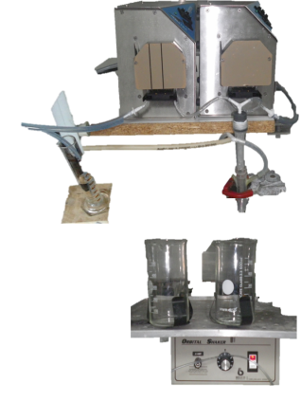
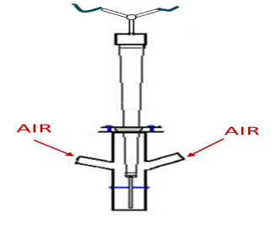
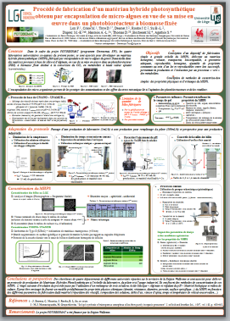
Manufacturing process of a photo-synthetic material obtained by encapsulation of micro-algae in a synthetic matrix (Polysilicate – Alginate )
Poster 08
Frédéric LOX
Laboratoire de Génie Chimique
Promotor : D. TOYE
Design of a pilot device for the large-scale manufacturing
MHPS with a predefined geometry
Laboratory process (manual) → Industrial process (automatic)
Challenge
t_{manufacturing} << t_{gel (Silicic acid)}
Technical solution
Pumps and static mixer
Coaxial airflow
More informations : Poster
(1) (2)
Algae
Droper whith a syringe
Mixed alginate +
silicic acid at pH 5,01
300 mL / h
5 mL / Stop
(2) Alginate + NaOH +
algae (pH ≈ 9)
(1) Silicic acid
pH 2,5 et T_{ambient}

