Slide 1
Dendroecology and Dendroclimatology of a Tasmanian bog forest
Daniel J. Balanzategui, Carolyn A. Copenheaver, David C. Frank,
Liya Jin, Nicolas Latte, Mauro Monteiro, Zhiyuan Shang,
Franziska Slotta, James H. Speer,
Alexander “Zan” Stine and Jen A. Wilkinson

Slide 2
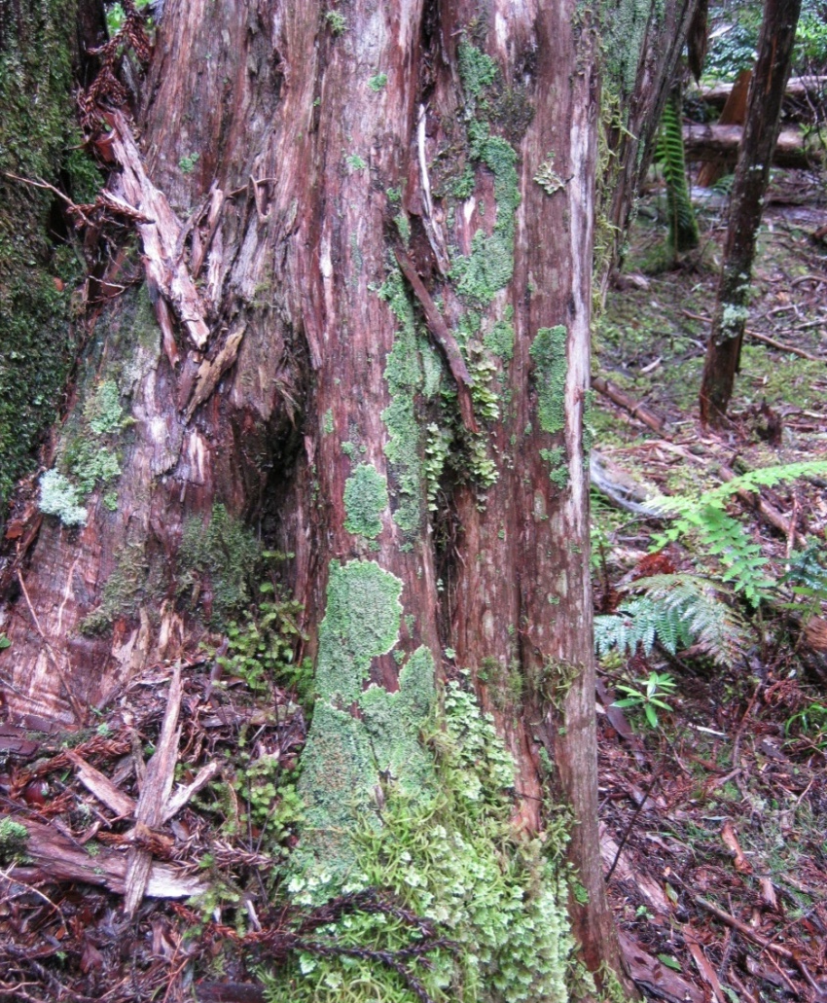
Introduction
Tasmanian montane bog forest
 microhabitat for climate sensitive species
 contributes to regional diversity
Limited understanding of forest dynamics and climatic influences

Slide 3
Objectives
Explore the wood anatomy of all species on the site
Reconstruct the demographic structure and stand dynamics of a mature Tasmanian bog forest
Compare the dendroclimatic response of King Billy Pine and Celery Top Pine

Slide 4
Study Area
Magg’s Mountain in northern Tasmania
West of Lake Rowal (41.71 °S, 146.19 °E, 800 masl)
Publically-owned and managed forestland
Cool climate montane mature bog forest
Dominant species: King Billy Pine (Athrotaxis selaginoides), Celery Top Pine (Phyllodladus aspleniifolius), Tea Tree (Leptospermum sp.), Myrtle (Nothofagus cunninghamii)

Slide 5
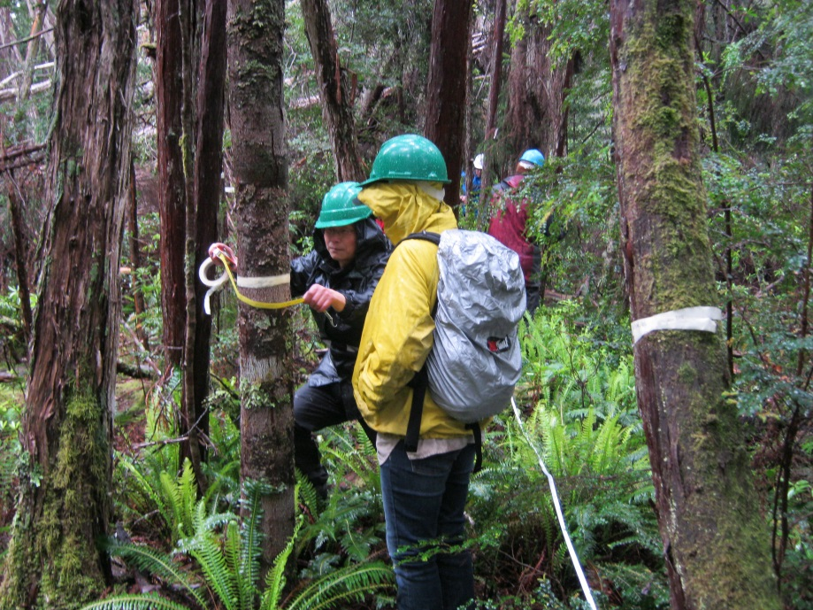
Field methods
38 trees sampled along a belt transect
additional King Billy Pine, Celery Top Pine, and Tea Tree (N=25) were cored from outside of the plot to increase sample size of these species
10 cross sections

Slide 6
Sample design
4 m
All trees > 4 cm
Diameter at breast height
3 cores (2 at 0.3 m and 1 at 1.3 m)
Species
50 m
All trees > 30 cm
Diameter at breast height
3 cores (2 at 0.3 m and 1 at 1.3 m)
Species

Slide 7
Sample preparation
Cores were glued on wooden core holders
Sanded with progressively finer sand paper
Characteristics of wood anatomy were studied

Slide 8
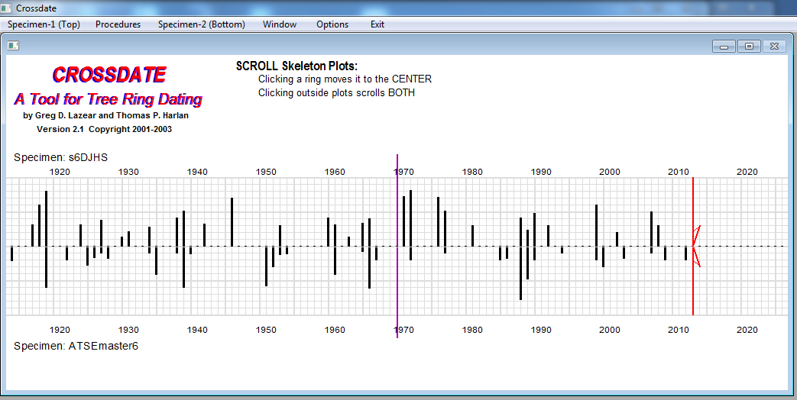
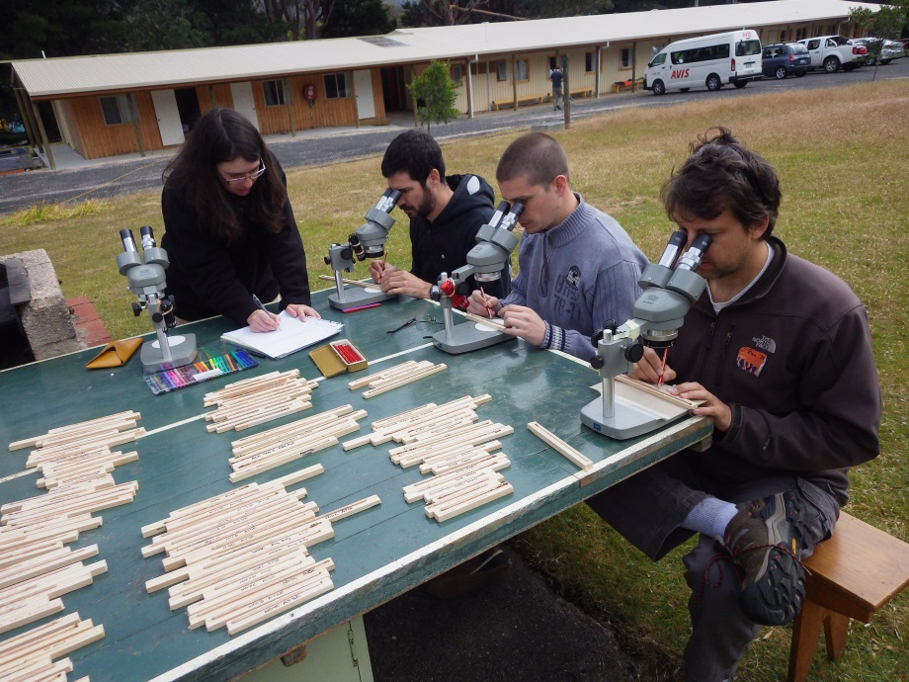
Laboratory Methods
Skeleton plot
Cores dated prior to measuring
Narrow rings used for the list year method of visual crossdating
Skeleton plot for dating samples with missing outermost rings

Slide 9
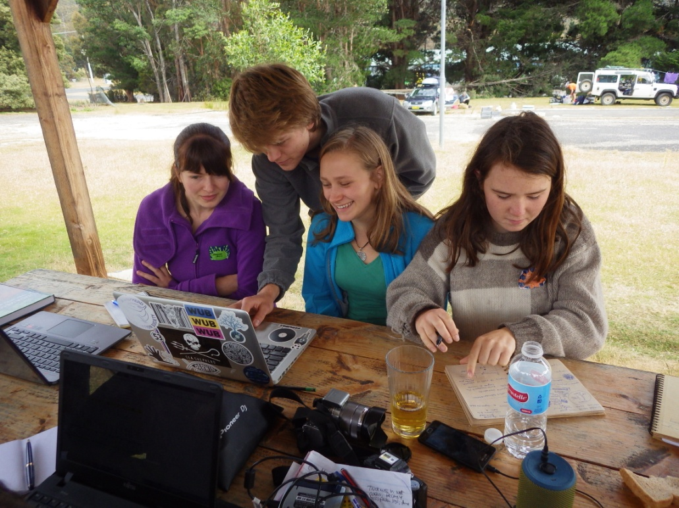
Laboratory Methods
Crossdating was verified with COFECHA
Chronologies of King Billy Pine and Celery Top Pine were detrended by a 30-year spline in ARSTAN
Climate analyses were conducted in RStudio and MATLAB
Growth releases and suppressions were identified with the radial growth averaging criteria developed by Nowacki & Abrams

Slide 10
Data Analyses
Growth release
%growth change year X = (ave. 10 prior years – ave. 10 following years) x 100
ave. 10 following years
Criteria: at least 10 years in a row with %growth change ≥ 25 %
Growth suppression
%growth change year X = (ave. 10 prior years – ave. 10 following years) x 100
ave. 10 following years
Criteria: at least 10 years in a row with %growth change ≤ -25 %

Slide 11
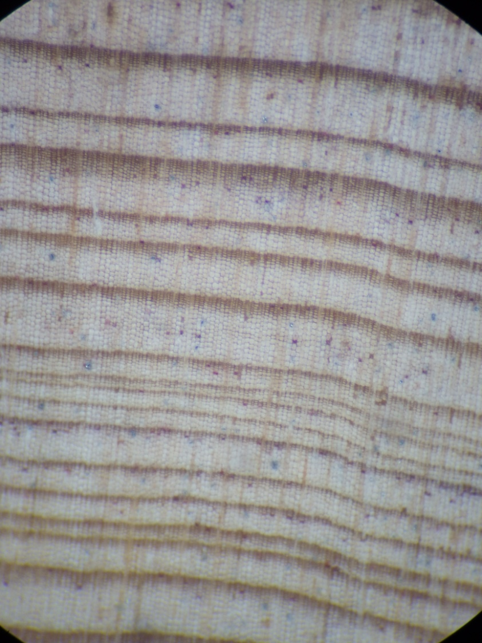
King Billy Pine
Athrotaxis selaginoides
Annual ring
Late wood
Early wood

Slide 12
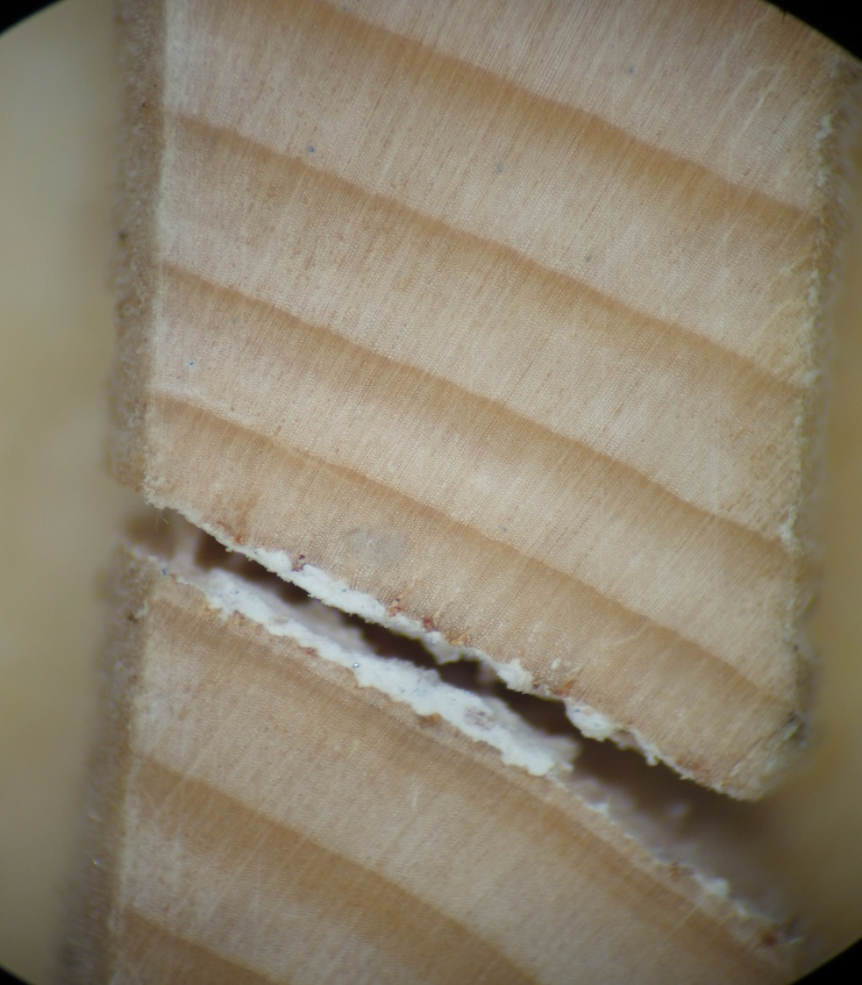
Celery Top Pine
Phyllocladus aspleniifolius
Annual ring
Late wood
Early wood

Slide 13
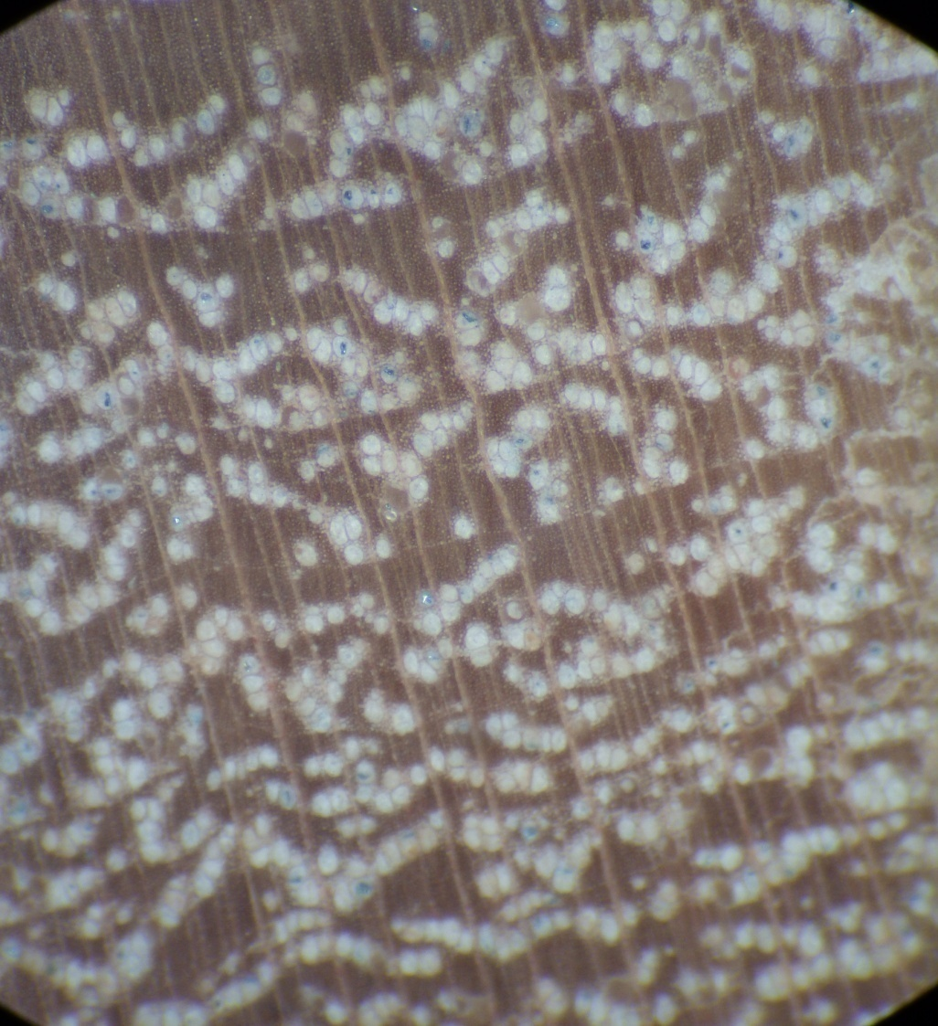
Tea tree
Leptospermum sp.
Annual ring

Slide 14
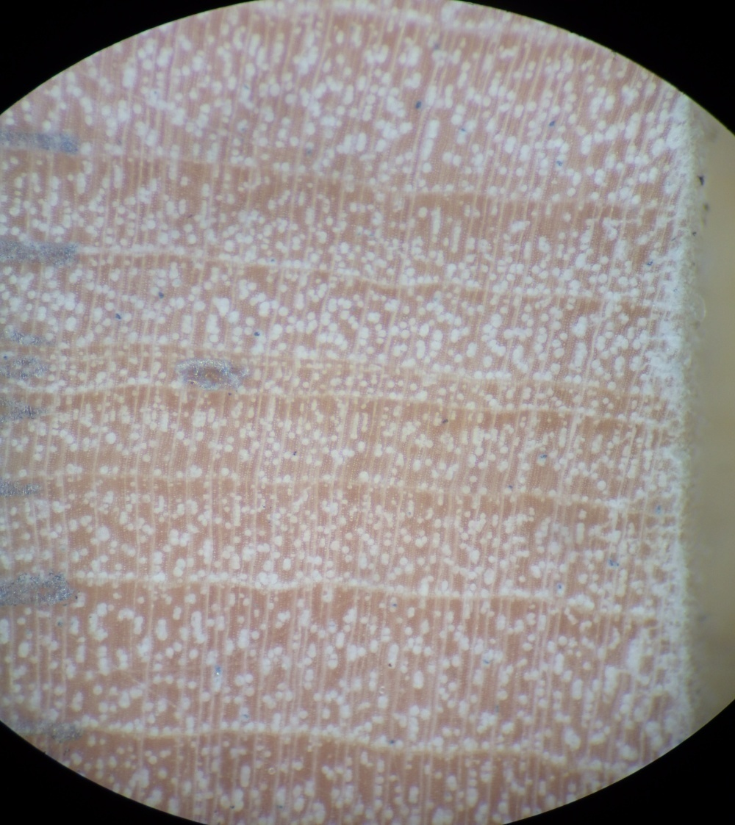
Myrtle
Nothofagus cunninghamii
Annual ring

Slide 15
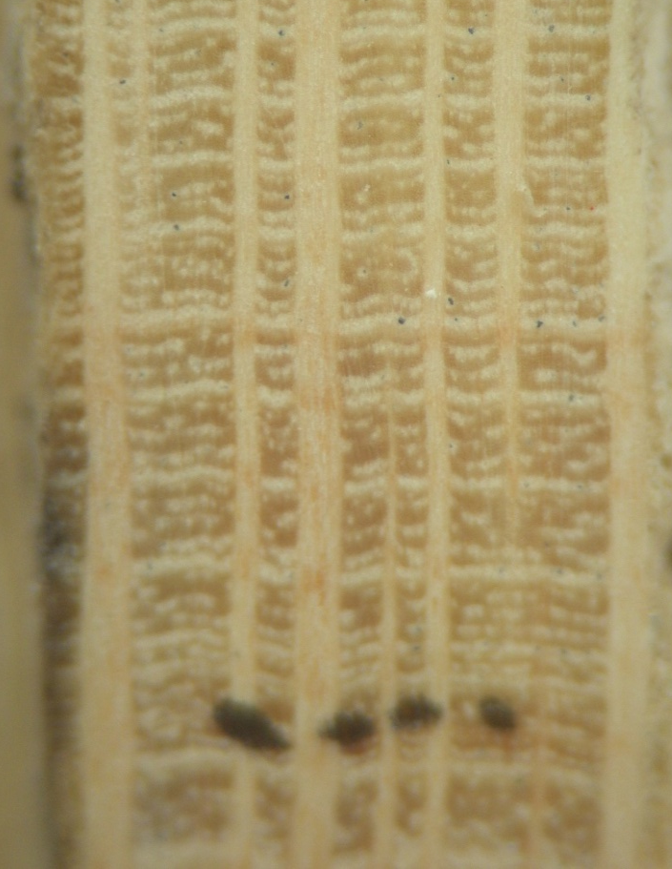
Waratah
Telopea trunctata
Annual ring

Slide 16
Results - Dendroecology
Sample distribution along transect

Slide 17
Results - Dendroecology
Age class distribution
Stems too small to include in study
Stems too small to include in study
Notes:
Using ring countsTo understand the distribution of ages in the tree-stand we first grouped tree species into bins based on our cross-dated chronologies. and then plotted the frequency distribution of each each species and its frebin. Our results show that the stand has a pretty uneven age class distribution. This could be a Looking at the sizes, again there is a

Slide 18
Results - Releases
King Billy Pine

Slide 19
Results - Suppressions
King Billy Pine (light blue) and Celery Top Pine (dark blue)

Slide 20
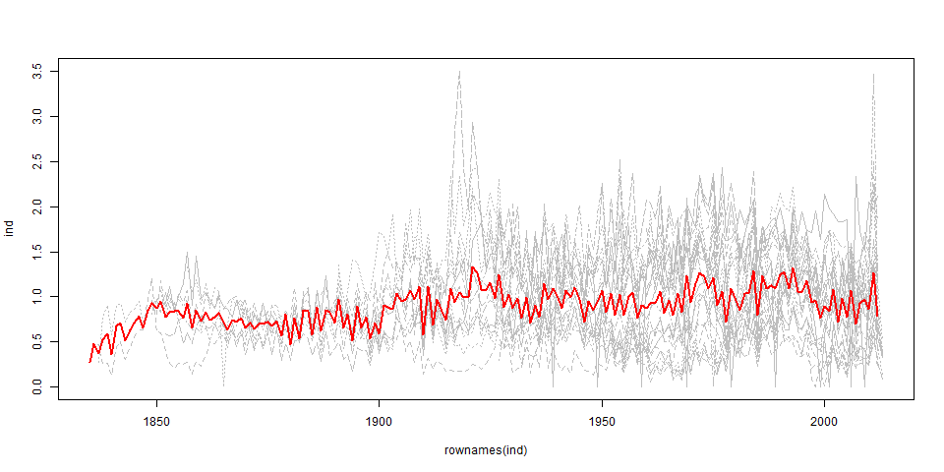
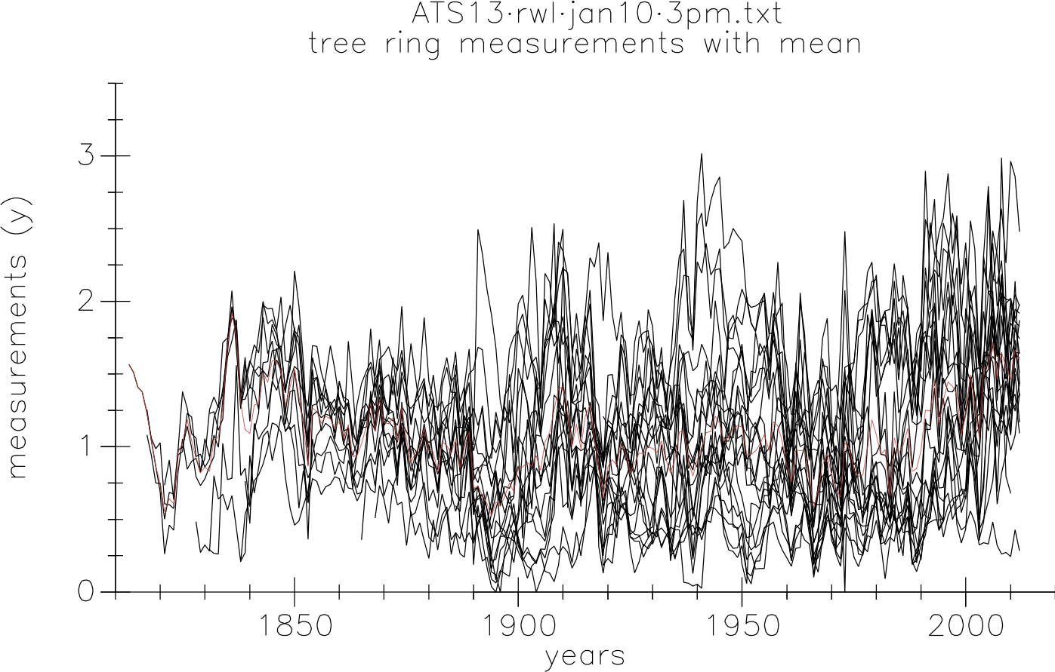
CLIMATE: Raw data
Crossdated series
Celery Top (23 cores / 15 trees)
King Billy (22 cores / 13 trees)

Slide 21
Raw data: King Billy Vs. Celery Top

Slide 22
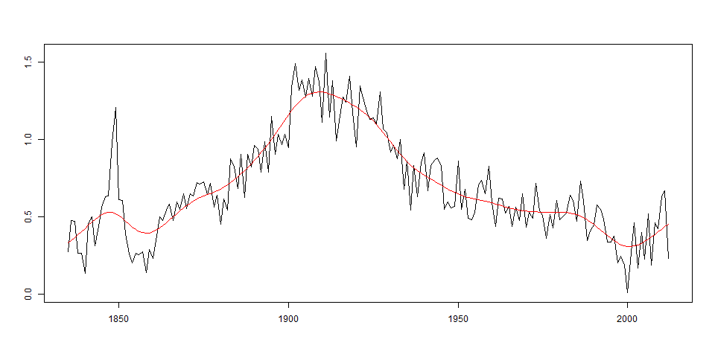
Climate: Detrending
Series detrending with arstan (spline 30 years cutoff)

Slide 23
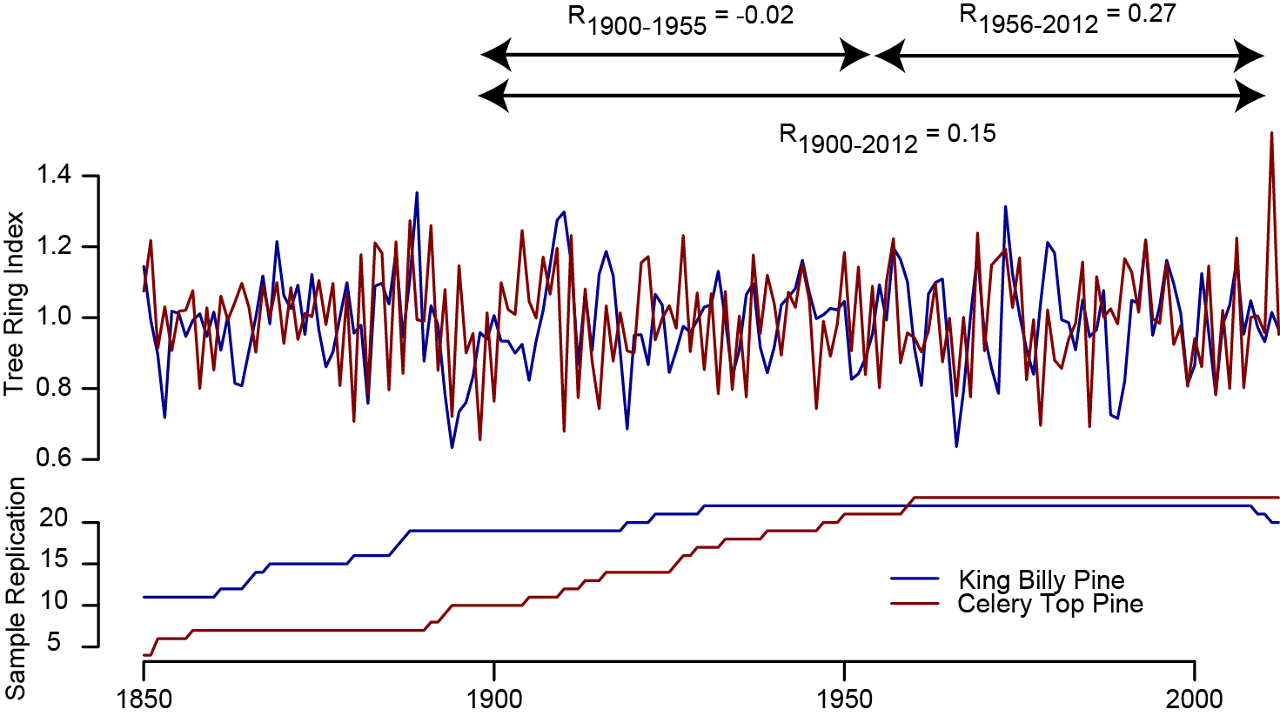
Standard indices King Billy Vs. Celery Top
Standard

Slide 24
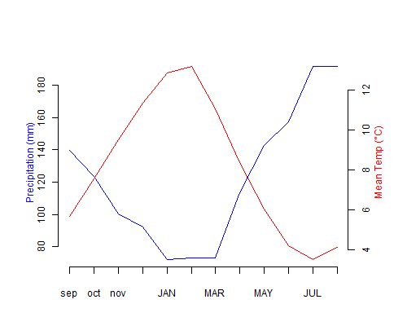
Climate data
Monthly climate data
Regionally-averaged Tasmanian weather stations (1911-2009 )

Slide 25
Climate correlation: Celery Top Precipitation

Slide 26
Climate correlation: King Billy Precipitation

Slide 27
Climate correlation: Celery Top Maximum temperature

Slide 28
Climate correlation: King Billy Maximum temperature

Slide 29
Conclusions
The Tasmanian bog forest established as a stand in the early 1800`s
After establishment, there was a period of high competition and few new trees started growing
Currently, the forest has frequent, local disturbance events

Slide 30
Conclusions
Tree-ring width is positively correlated with the previous year`s precipitation, particularly in Celery Top Pine
Tree-ring width is negatively, correlated with the previous year`s temperature
In Celery Top Pine, tree-ring width is positively correlated with temperature from 2 years earlier

