Slide 1
First International Workshop. Lagashop, September 2013
Study of phase transformation within bimetallic rolls
Ingrid NEIRA TORRES - J. Tchoufang Tchuindjang - J. Lecomte-Beckers - G. Gilles - AM Habraken
September 10th, 2013

Slide 2
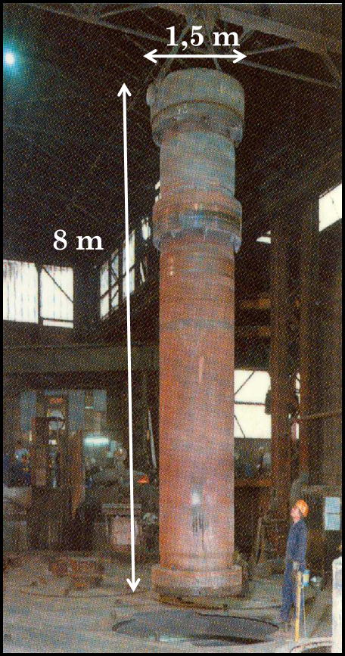
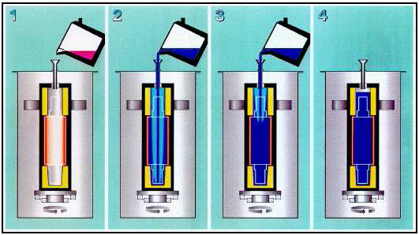
Introduction
Bimetallic rolling mills
High wear resistance in the shell
High toughness in the core
Marichal Ketin industry
Studer L., 2008

Slide 3
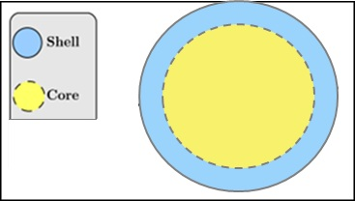
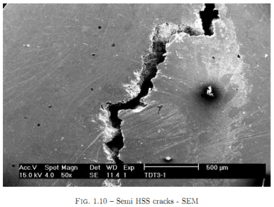
Work motivation
High rate of failure during cooling and heat treatment for radius upper 1200mm.
Simulations using FE code will be performed in order to find the origin of the crack.
Ma
Fe-Pe
Studer L., 2008
Studer L., 2008
Studer L., 2008

Slide 4
Model description
Contribution à la modélisation du formage des métaux par la méthode des éléments finis (A.M.Habraken, 1989)
Coupled thermo mechanical metallurgical analysis during the cooling process of steeel pieces (A.M.Habraken, M. Bourdouxhe, 1992)
Temperature
1 Phase transformation
Metallic structure
2 Latent heat
3
Thermal
stress
Variation
of
mechanical
parameters
6
Mechanical induced
transformation
kinetic modification
4
Transformation
stress and
plasticity
5
Heat generation
due to deformation
Stress and strain

Slide 5
Model description
Thermo metallurgical model
Heat equations
Metallurgical model
Transformations by diffusion (ferrite, cementite, pearlite, bainite)
Sheil’s sum, additivity rule, TTT diagram
Martensitic transformation
Koistinen Marburger’s law
Modification of the thermo metallurgical model due to mechanical interaction.
Mechanical model with thermal and metallurgical interactions.
Coupled thermo metallurgic mechanical finite element

Slide 6
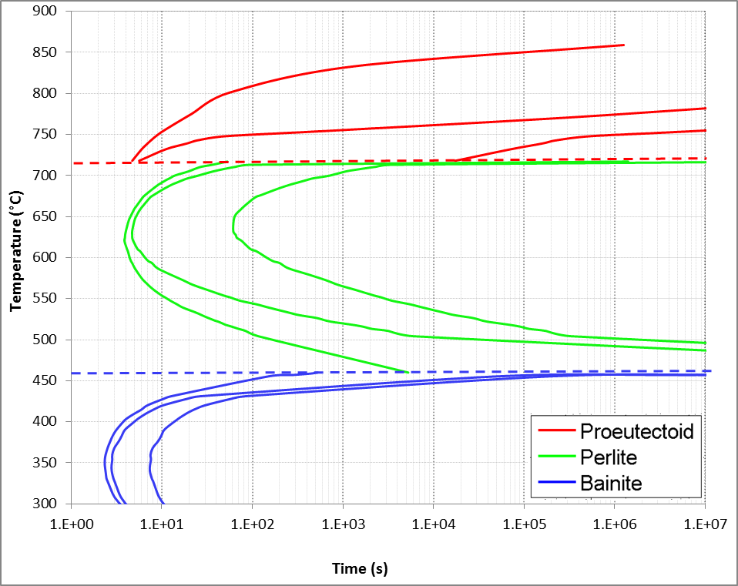
Metallurgical model
Transformations by diffusion (ferrite, pearlite, bainite)
Sheil’s sum
TTT diagram
Additivity rule
Martensitic transformation
Koistinen Marburger’s law

Slide 7
Model requirements
INPUT DATA
FE code
OUTPUT DATA
Thermo physical parameters
(α, ρ, λ, C_{p})
Stresses
(σ_{x ,} σ_{y ,}σ_{z ,} σ_{xy})
Lagamine
Metallurgical parameters
(TTT diagrams)
Strains
(ε_{th}, ε_{p}, ε_{ph}, ε_{ptr})
Phase rates
(%Fe, %Pe, %Ma)
Mechanical parameters
(E, ν, E_{t}, σ_{y})
Analysis of results

Slide 8
Sensitivity analysis
Different simulations performed in order to analyse the impact in the results.
Results published at journal “Computer methods in materials science” and presented at Komplastech conference, Zakopane, January 2013.
Thermal data
Metallurgical parameters
Mechanical parameters
 | Simulation | Convection h(T) | TTT diagram | σ - ε curve
1 | Reference case | Experimental data from industry | Core: Obtained by inverse method Shell: Obtained by inverse method (Only Martensite) | Approach from available data for similar materials and experimental points
2 | Thermal modification | Constant value | Core: Obtained by inverse method Shell: Obtained by inverse method (Only Martensite) | Approach from available data for similar materials and experimental points
3 | Metallurgical modification | Experimental data from industry | Core: Slower ferritic transformation Shell: Bainitic transformation allowed | Approach from available data for similar materials and experimental points
4 | Mechanical modification | Experimental data from industry | Core: Obtained by inverse method Shell: Obtained by inverse method (Only Martensite) | Data from similar materials
Experimental from industry. (Assaker)

Slide 9
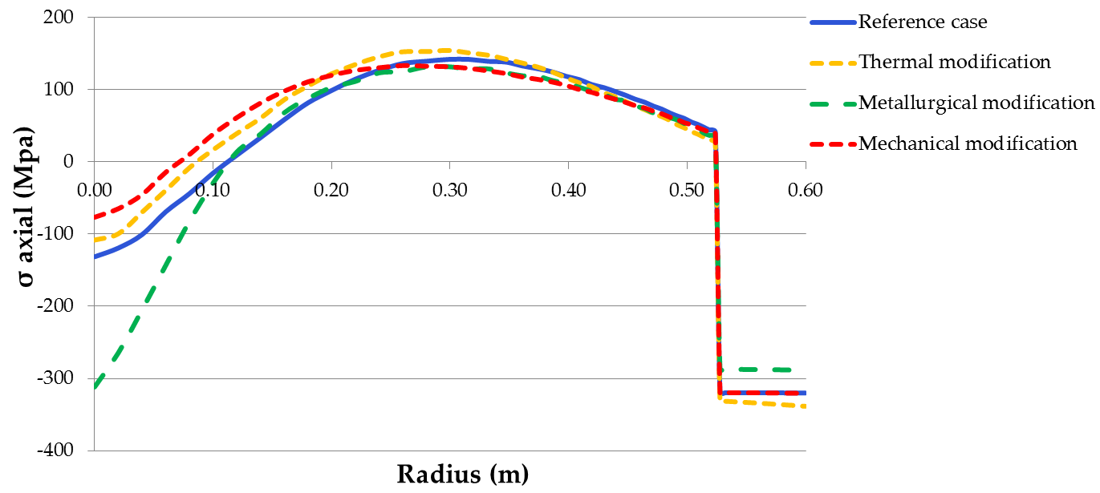
Summary of Results
Residual stress results
Core
Shell
Reference
Core = 82% Fe
18% Pe
Shell = 50%Ma
50%Au
Core
Pe: 33% σ_{ax}
Fe: 67%
Shell
Ma: 42% σ_{ax}
Core
= Pe: 18.3% σ_{ax} =
Core σ_{ax}
Shell σ_{ax} =
Shell
Ma: 51% σ_{ax}

Slide 10
Conclusions From sensitivity analysis
Metallurgical modifications have generated the most important differences in axial stresses obtained at the end of cooling.
Metallurgical parameters are very important to be certain
Thermal modifications through a quicker cooling have generated some effects due do the impact in phase transformations.
Thermal parameters have been determinated through experimental tests
Mechanical parameters doesn’t have an important effect in axial stresses. However it is important in regard to the rupture criteria.
Mechanical parameters are being experimentally determinated

Slide 11
Metallurgical parameters
TTT diagrams
Known
Phase transformations
Thermophysical characterization
Dilatation by transformation ε_{tr}
Experimental dilatometric test
Unknown
σ_{res}
Numerical simulation to reproduce experimental curve
CRACK

Slide 12
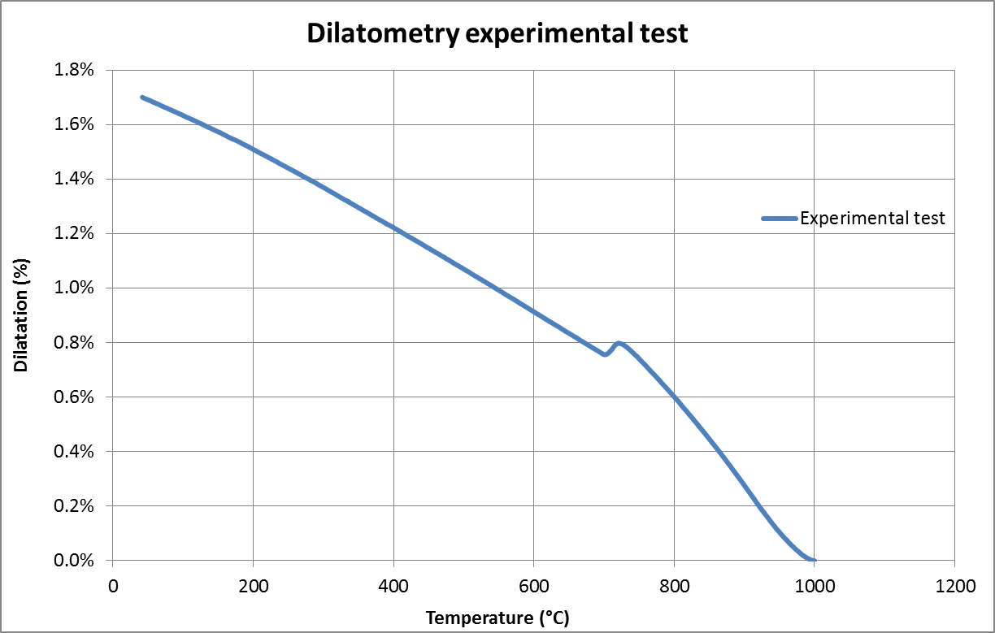
Dilatometry test for core material
Pe-Fe
Au
Thermophysical parameters
(α, ρ, λ, C_{p})
Latent heat
TTT diagram
ε_{tr}
Experimental data
Inverse method from CCT diagram
?

Slide 13
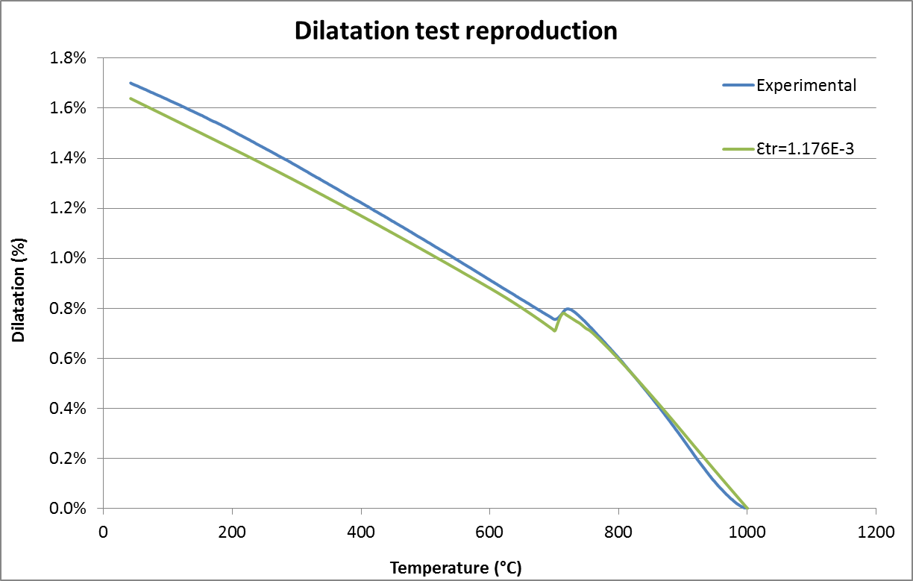
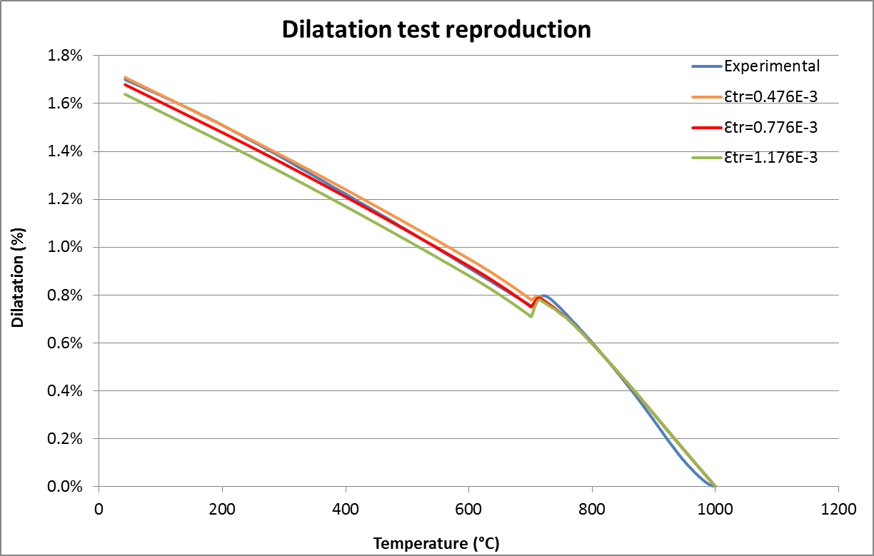
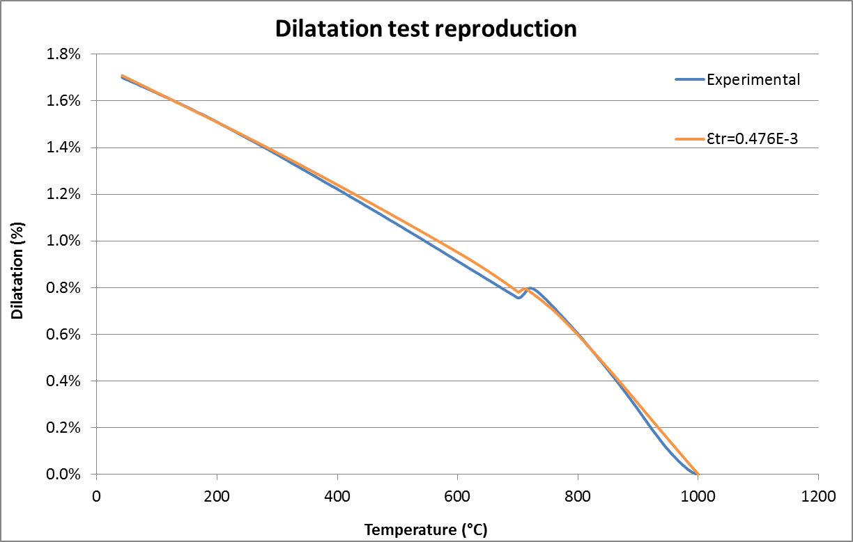
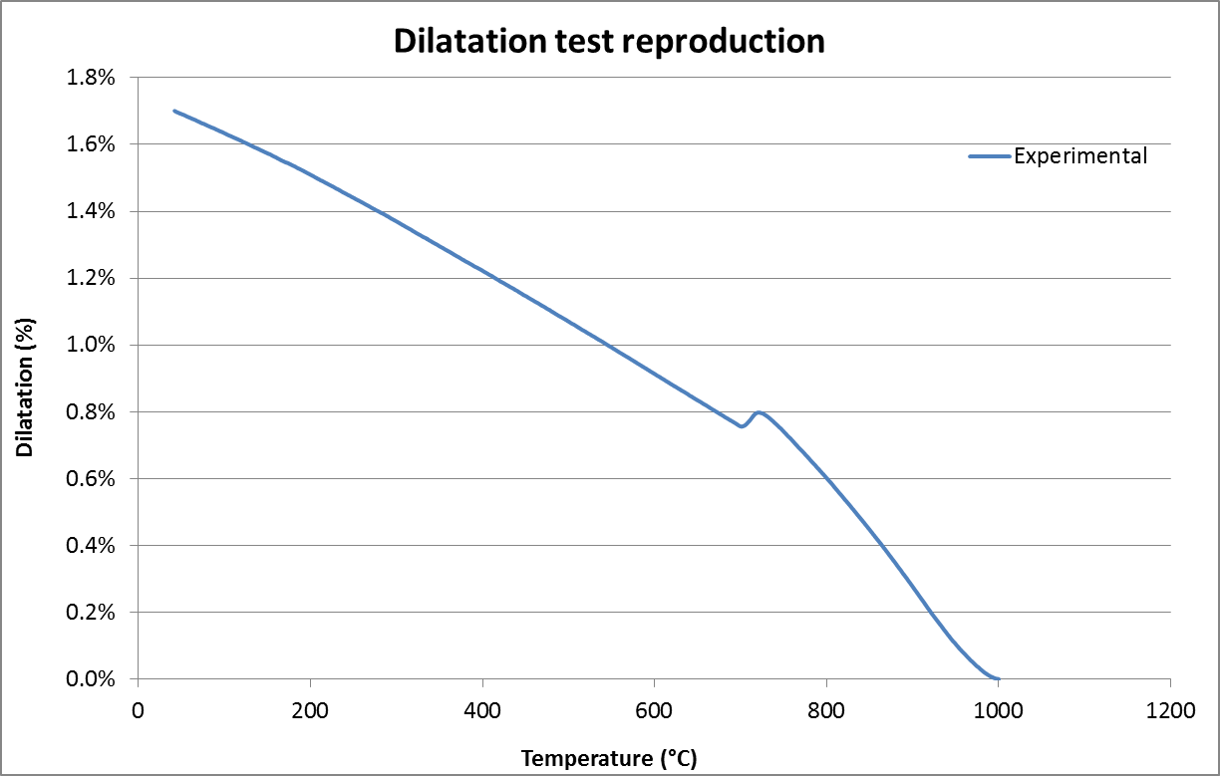
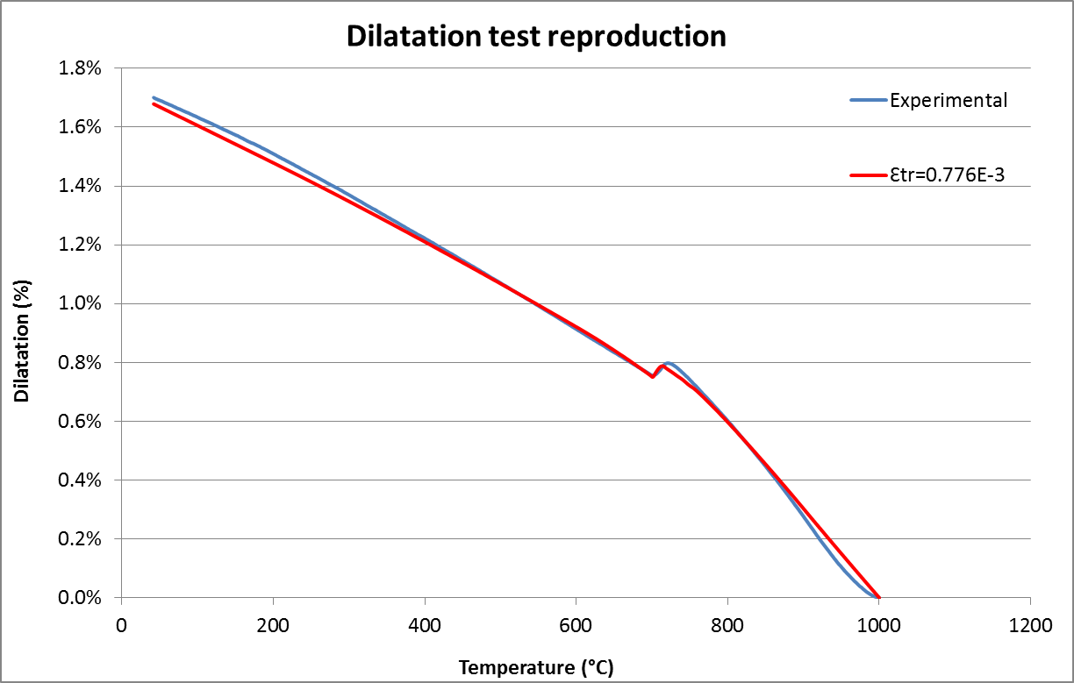
Dilatometry test reproduction

Slide 14
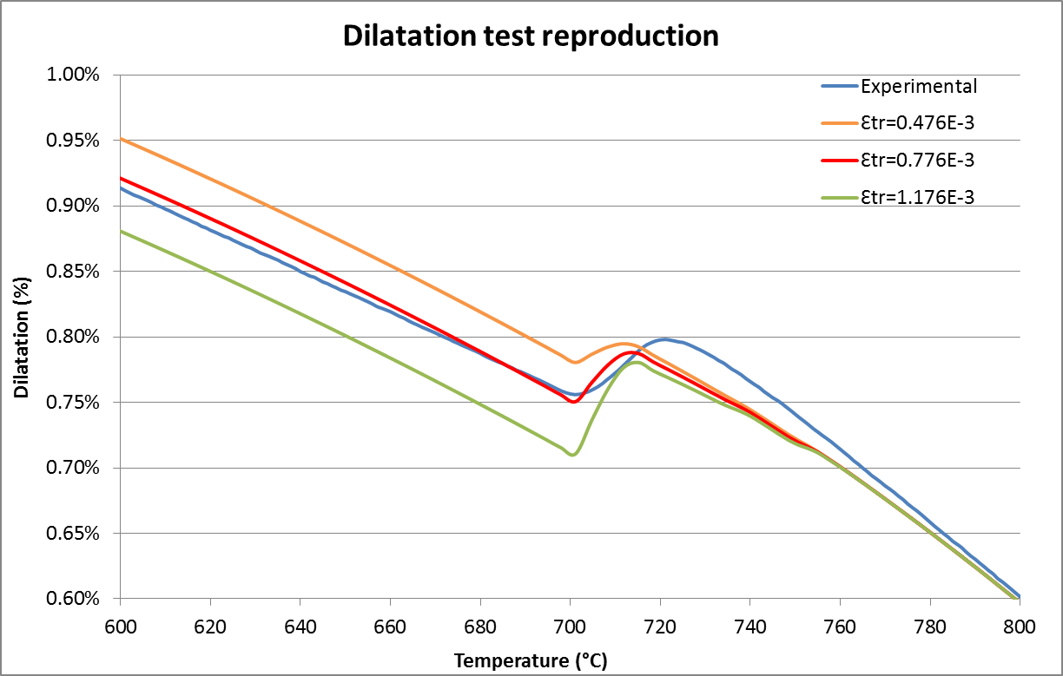
Dilatometry test reproduction

Slide 15
Conclusions and perspectives
Thermo mechanical metallurgical simulations are possible to be performed using Lagamine code, allowing to estimate stresses and strains generated in the rolls during cooling or heat treatment.
Metallurgical parameters are highly important
Lagamine code has been also useful to estimate the unknown value of the parameter ε_{tr.}
It is also possible to use Lagamine code in order to reproduce another experimental tests such as compression tests in order to optimize the experimental conditions.

Slide 16
Thank you for your attention

