Slide 1
UE: an actor of ACN regional integration

Slide 2
Hypothesis
EU’s interregional strategy, of stimulation of Latin-American integration, has evolved. It has moved from an idealized vision of total integration for ACN (at every level: political level, economic level and other levels as physical infrastructure for example) towards a complex and pragmatic approach. It has Americanized.

Slide 3
1. Theoretical introduction of interregionalism,
2. Pure and hybrid interregionalism applied = complex regionalism,
3. Results and conclusions.

Slide 4
Interregionalism
New regionalism
Interregionalism
Pure : the relationship between “two clearly identifiable regions within an institutional framework” (Rigner & Söderbaum, 2010).
Hybrid : the dynamics that liaises one organized region with a country or a group of countries from another (unorganised or dispersed) region (Aggarwal & Fogarty 2004).

Slide 5
Priority
Regional integrations

Slide 6
PURE POLITICAL INTERREGIONALISM APPLIED

Slide 7
UE-AL cooperation
UE - AL cooperation for regional integration
2007 - 2013
LAIF
integration of physical infrastructure
@lis2
coop.: for reducing the information gap
AL-INVEST
coop. : network for internationalisation of Latin-American SMC
Central America
Central America
Andean Community
MERCOSUR
Net of Researchers
Improuving political dialogue
Net of regulators
Coord.: NAFIN
Coord. : CAINCO
Coord. : CNI
Coord.: CEPAL
Coord.: Redclara
Coord.: Regulatel
125000000 € (100 %)
17.494.289 € (80%)
13.750.000 € (80%)
18.750.000 € (80%)
€ 31.25 millions (70.4%)

Slide 8
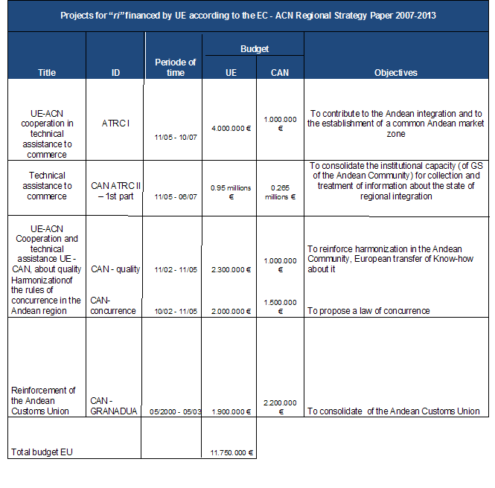
UE – ACN

Slide 9
EU-ACN
Projects for “ri” financed by UE non contained in the EC - ACN Regional Strategy Paper 2007-2013
CAN
INTERCAN
FAT COMMERCE II - second part
SOCICAN
ANDESTAD
Project for economic regional integration of ACN
UE-ACN cooperation facility for technical assistance to commerce
Civil society action for Andean integration
UE-ACN cooperation for statistics
10/12/09 - 09/06/13
EU: 6500000 € (73%)
11/12/06 - 10/06/11
UE: 3050000 € (70%)
25/04/06 - 24/10/10
UE: 4100000 € (88%)
13/06/05 - 14/04/10
EU: 5000000 € (63%)

Slide 10
HYBRID INTERREGIONALISM APPLIED: COMMERCIAL AGREEMENT

Slide 11
UE – Colombia - Peru
1. Failure: Association agreement EU - ACN
Three pillars:
cooperation
political dialogue
commercial association
2. 2008: EU accepts to negociate a commercial agreement,
3. 2010: commercial agreement (EU and Colombia-Peru)

Slide 12
RESULTS, CONCLUSIONS AND PERSPECTIVES
Commercial agreement
1 text and two agreements,
erosion in regional integration in ACN
“ Interregionalism, as practiced by the EU, has the purpose of building and consolidating regional orders, whereas the US regional activities rather have the purpose of preventing strong regional formations to grow” (Hetnne, 2007): Americanisation of EU’s strategy.
Perspectives:
a modernisation of the European strategy,
the erosion of the european influence in Latin-America

Slide 13
RESULTS, CONCLUSIONS AND PERSPECTIVES
Commercial agreement
1 text and two agreements,
erosion in regional integration in ACN
“ Interregionalism, as practiced by the EU, has the purpose of building and consolidating regional orders, whereas the US regional activities rather have the purpose of preventing strong regional formations to grow” (Hetnne, 2007): Americanisation of EU’s strategy.
Perspectives:
a modernisation of the European strategy,
the erosion of the european influence in Latin-America

Slide 14
RESULTS, CONCLUSIONS AND PERSPECTIVES
Interregionalism
New kind of complex regionalism:
new point of view for the analysis of transatlantic relations among international actors and why not for defining new perspectives and new strategies in order to improve the effectiveness of interregional dialogues and actions towards development.

Slide 15
Andrea PARRA
UNIVERSITE DE LIEGE (BELGIUM)
UNU - CRIS

