Slide 1
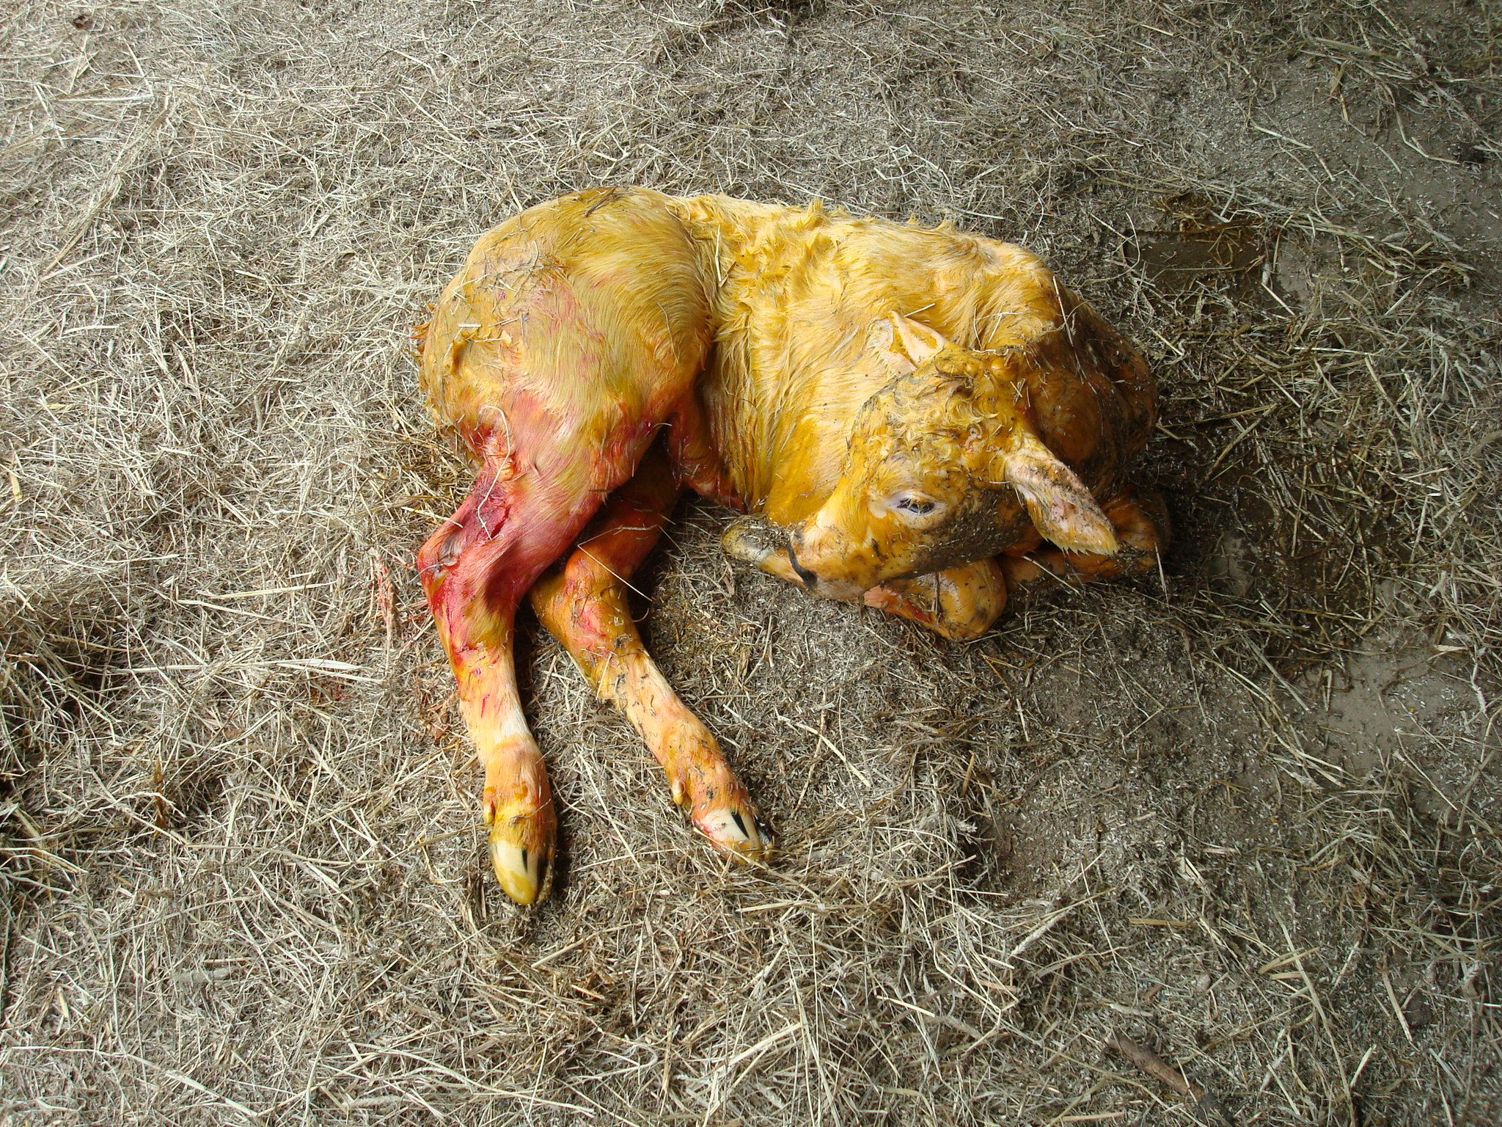
ICPD, 24-28 June 2013, Uppsala, Sweden
INVESTIGATION OF BIOLOGICAL MARKERS TO EVALUATE THE ADAPTATION OF THE NEWBORN BELGIAN BLUE CALF TO THE EXTRAUTERINE LIFE: A PILOT STUDY.
RONZONI A., De Marchin E., Lebrun M., Rao A-S., Rollin F., Hanzen C. and Théron L.

Slide 2
PERINATAL PERIOD
One of the most critical and challenging stages for all the species
Calves:
75% of mortality within the critical one-hour-transition after birth
Adaptation to the extrauterine life is the key point
DAM’S FACTORS
CALF’S FACTORS

Slide 3
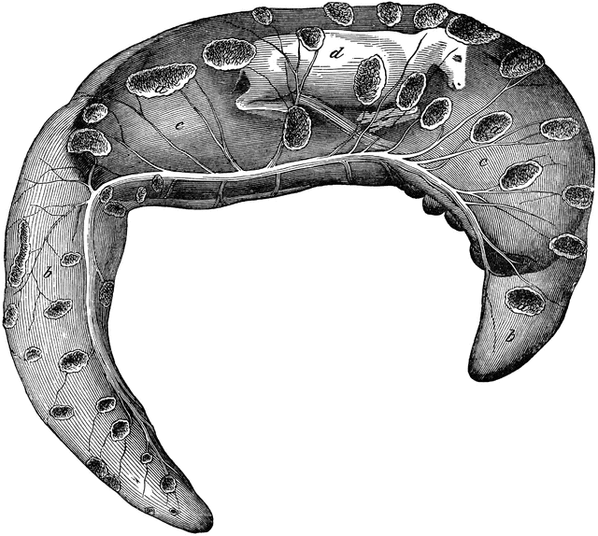
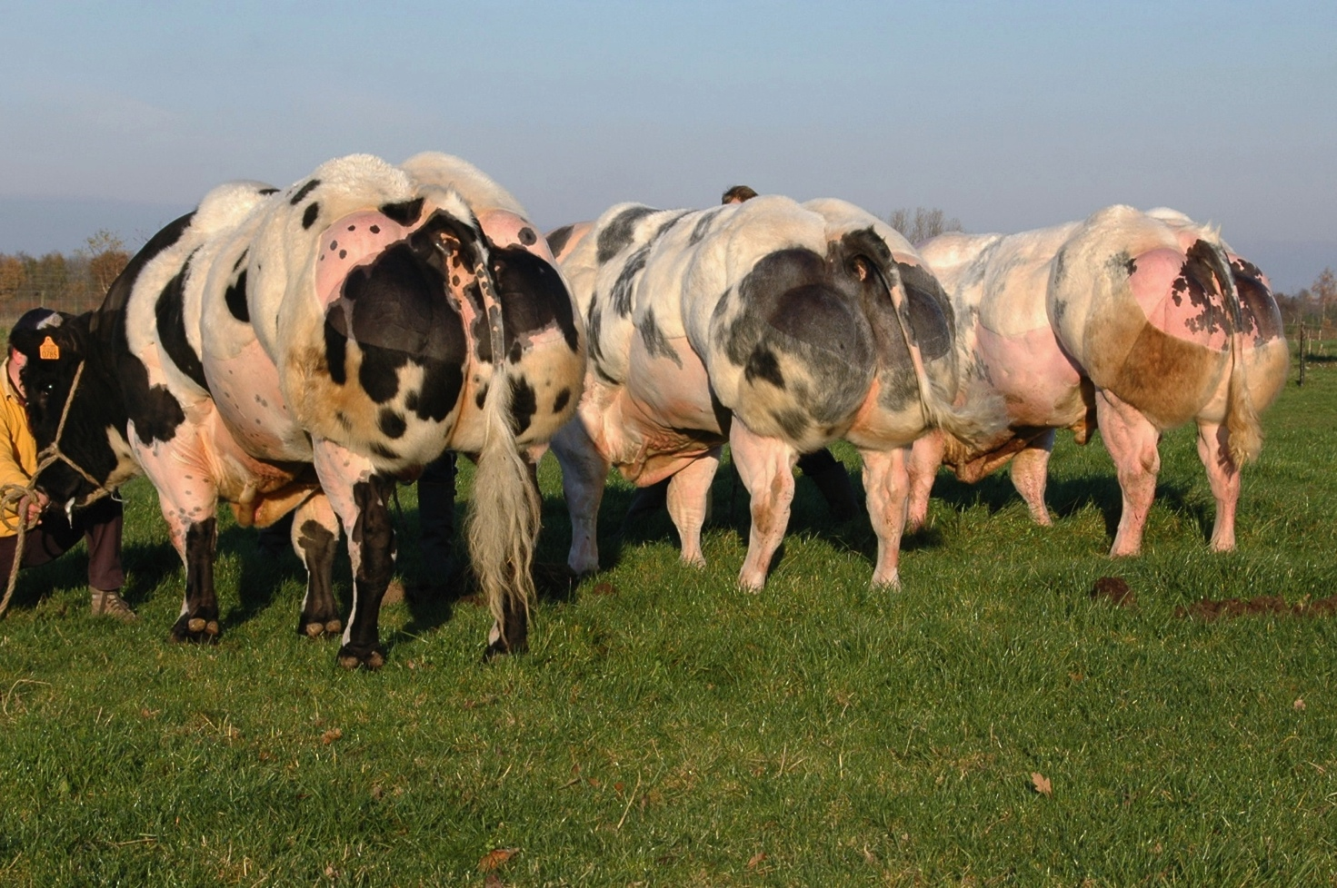
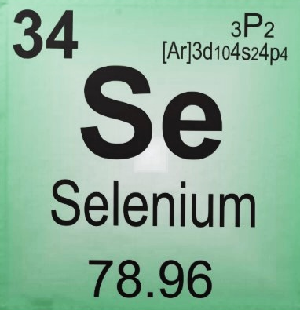
PERINATAL PERIOD
DAM’S FACTORS
Nutritional and energy inadequacy:
calf growth and vitality
passive immunity
Placental insufficiency
⬇ growth and maturity
In BBCB…trace elements deficiency (++Se, I)
weak calves
⬇ thermogenic ability
⬇ IgG absorption
respiratory adaptation

Slide 4
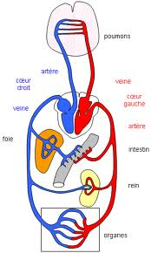
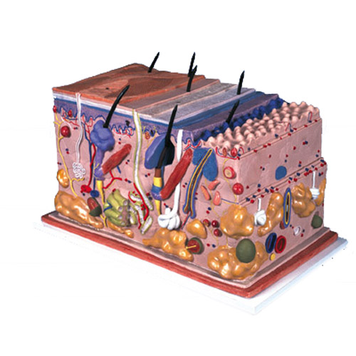
PERINATAL PERIOD
CALF’S FACTORS
Independent circulation
External respiration
Correction of the acid-base balance
Thermoregulation
Energy assimilation
Development of immunity

Slide 5
AIM OF OUR PILOT STUDY
Evaluation of biological markers
in the first hours of life as early markers
to predict calf’s health in the future…
Weak calves
Perinatal morbidity and mortality
Failure of passive immunity transfer (FPT)
Neonatal infections and diseases
Calf mortality still 6-10%
ECONOMICAL LOSSES

Slide 6
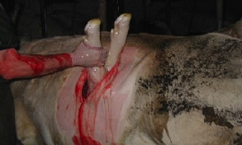
MATERIALS
80 newborn calves
93.6 % BBCB
6.4 % crossbred
10 different farms in Wallonia (BE)
Born between December 2011 and April 2012
All C-sections
51.1 % after rupture of foetal-membranes

Slide 7
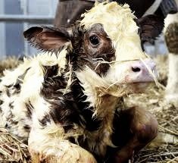
METHODS
CLINICAL EXAMINATION
15 ± 5 min after rupture of the umbilical cord
onset respiration
nursing
time head-right
time sternal recumbence
attempt to stand
meconium
rectal temperature

Slide 8
METHODS
 | Day 0 | Day 1 | Day 3-7
Total proteins | ✔ | ✔ | ✔
Serum IgG |  |  | ✔
Colostrum IgG | ✔
Plasmatic Se | ✔
PASSIVE IMMUNITY TRANSFER
ENERGY METABOLISM
 | Day 0 | Day 1 | Day 3-7
Glycemia | ✔ | ✔ | ✔
Insulin | ✔
Cortisol | ✔

Slide 9
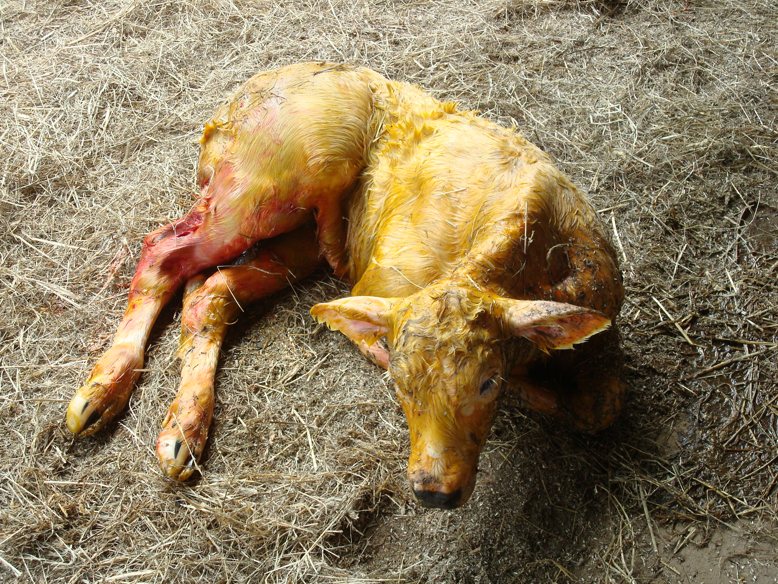
RESULTS
All calves :
Mortality rate:
0 % the first week of life
5 % at 3 months
ALIVE
VIABLE
MATURE
WELL-DEVELOPED
NO NURSING

Slide 10
RESULTS
PASSIVE IMMUNITY TRANSFER
Day 3-7 | Total proteins (g/L) | Serum IgG (g/L)
Threshold | 56 | 16
Average ± SD | 57.7 ± 7.5 | 13.5 ± 7.6
FAILURE OF PASSIVE IMMUNITY TRANSFER (FPT)
43 % LOW TOTAL PROTEINS
67 % LOW SERUM IgG

Slide 11
RESULTS
Serum IgG at day 3-7 of the total cohort
40
30
33% GOOD TRANSFER!!
Proportion of calves (%)
20
10
Serum IgG (g/L)
BBCB problem or classification mistake?

Slide 12
RESULTS
38 % of the calves have received a good quality colostrum
BUT…
good colostrum has been administrated to 30 % of FPT calves…

Slide 13
RESULTS
PASSIVE IMMUNITY TRANSFER
IMPORTANCE OF QUANTITY RATHER THEN QUALITY
Cross sectional analysis
Risk of FPT when given a poor quality colostrum:
NON SIGNIFICANT ODD RATIO
(OR 1,058)
But don’t forget that in the newborn…
Abomasum: 1,5L of capacity
IgG absorption: MAX 2h after birth
24h after birth = 0

Slide 14
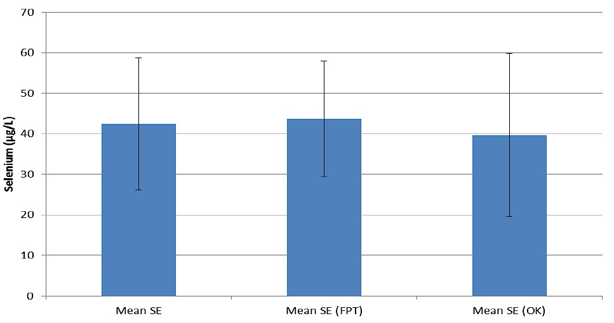
RESULTS
PASSIVE IMMUNITY TRANSFER
Day 0 | Selenium (μg/L) | FPT | Good transfer
Threshold | No bibliography for calves
Average ± SD | 43.9 ± 20.7 | 43.7 ± 14.3 | 39.6 ± 20.1

Slide 15
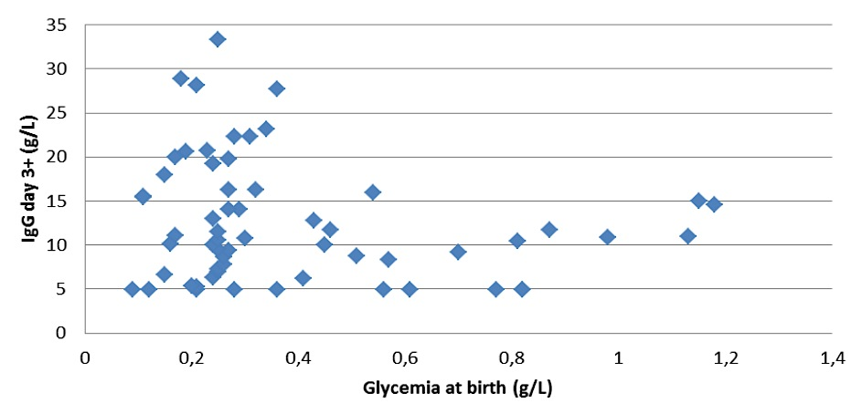
RESULTS
ENERGY METABOLISM
Unpaired T-student
Glycaemia at birth * serum IgG day 3 to 7
SIGNIFICANT DIFFERENCE
(p<0.0001)
At birth | Glycemia (g/L) | FPT | Good transfer
Threshold | 45
Average ± SD | 38.6 ± 26.8 | 41.9 ± 29.4 | 25.4 ± 6.5
Unpaired T-student
Cortisol vs glycemia
NON SIGNIFICANT DIFFERENCE
Insulin vs glycaemia
NON SIGNIFICANT DIFFERENCE
At birth | Insulin (μUI/L) | Cortisol (ng/L)
Threshold | 23.33 ± 10.05 | 70-130
Average ± SD | 16.4 ± 3.4 | 76.1 ± 59.3

Slide 16
DISCUSSION and CONCLUSION
At birth:
LOWER GLYCEMIA at birth
Linked to an early C-section? No…
LOWER INSULINEMIA at birth
No reference in BBCB, in HF (Kirovski et al., 2011)
NORMAL CORSTISOLEMIA
Need more investigation
> N° of calves
< N° of vets to < bias

Slide 17
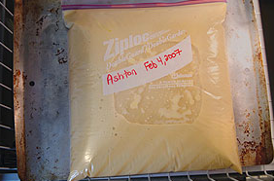
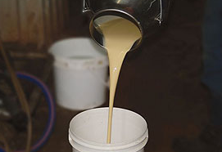
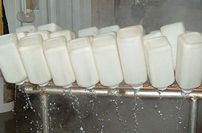
DISCUSSION and CONCLUSION
At day 3 to 7:
67 % of LOW IgG
Average of 13 g/L of IgG
Failure in calves management at birth?
Notes:
Even if we had informations about colostrum quality, not enough for quantity administred

Slide 18
DISCUSSION and CONCLUSION
SELENIUM:
Protection of cell’s membranes
Role in immune protection
Although supplementation become a routine
still deficient dam’s and colostra
Average coherent with LOW SUPPLEMENTATION dam’s group of a recent study
(Guyot, 2008)

Slide 19
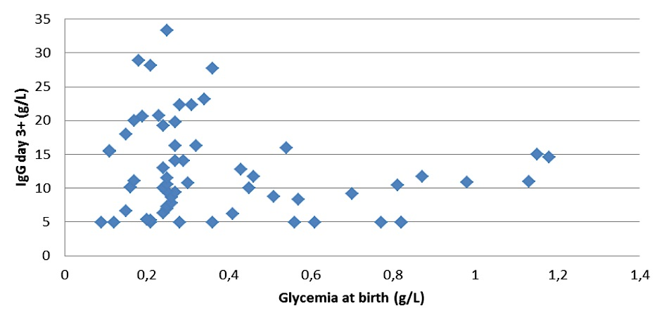
DISCUSSION and CONCLUSION
⬆ IgG transfer with lower glycemia at birth…
< 40 mg/dL
Insulin-induced hypoglycemia delays gut closure (Tyler and Ramsey, 1993)
Further study in BBCB needed!

Slide 20
TAKE HOME MESSAGE…
Glycemia at birth = a good predictor of IgG transfer
but values for GOOD TRANSFER are surprisingly LOW
In modern high productive breeds MORBIDITY should be evaluated rather than MORTALITY
best picture of neonatal calf’s health
Insulinemia in BBCB is LOWER than other breeds

Slide 21
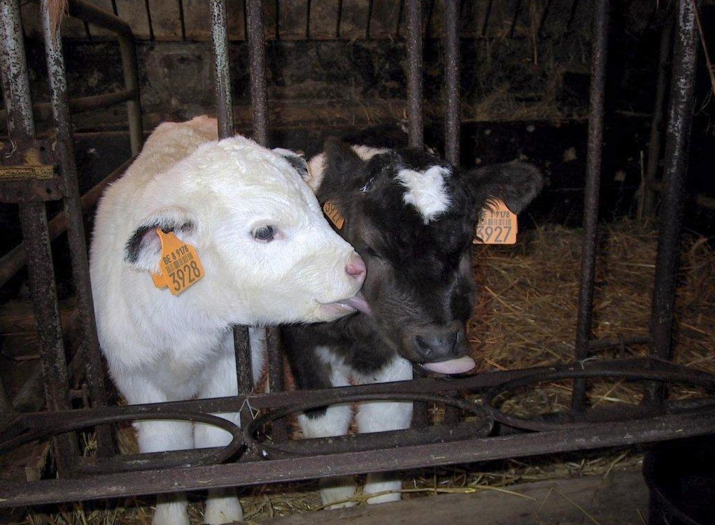
Thank you for your attention!

Slide 22
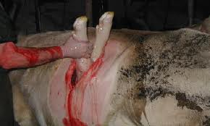
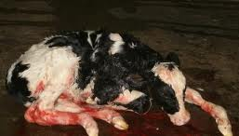
!KEEP IN MIND!
C-SECTION in BELGIUM
ELECTIVE
Feto-pelvic disproportion
Open cervix (91,2%)
After foetal-membranes rupture (83,5%)
RAPID
40 ± 10 min
30 % preparation and 70 % effective surgery

Slide 23
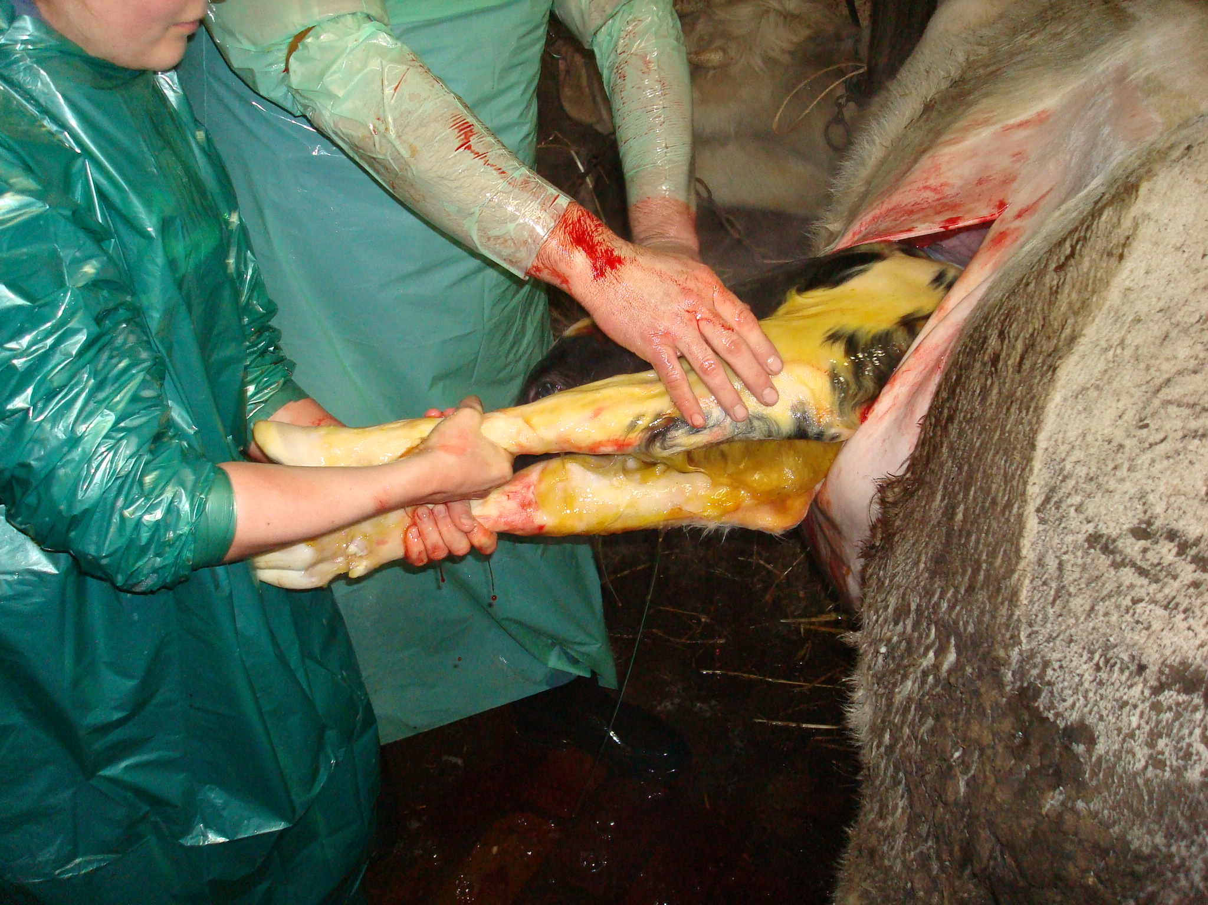
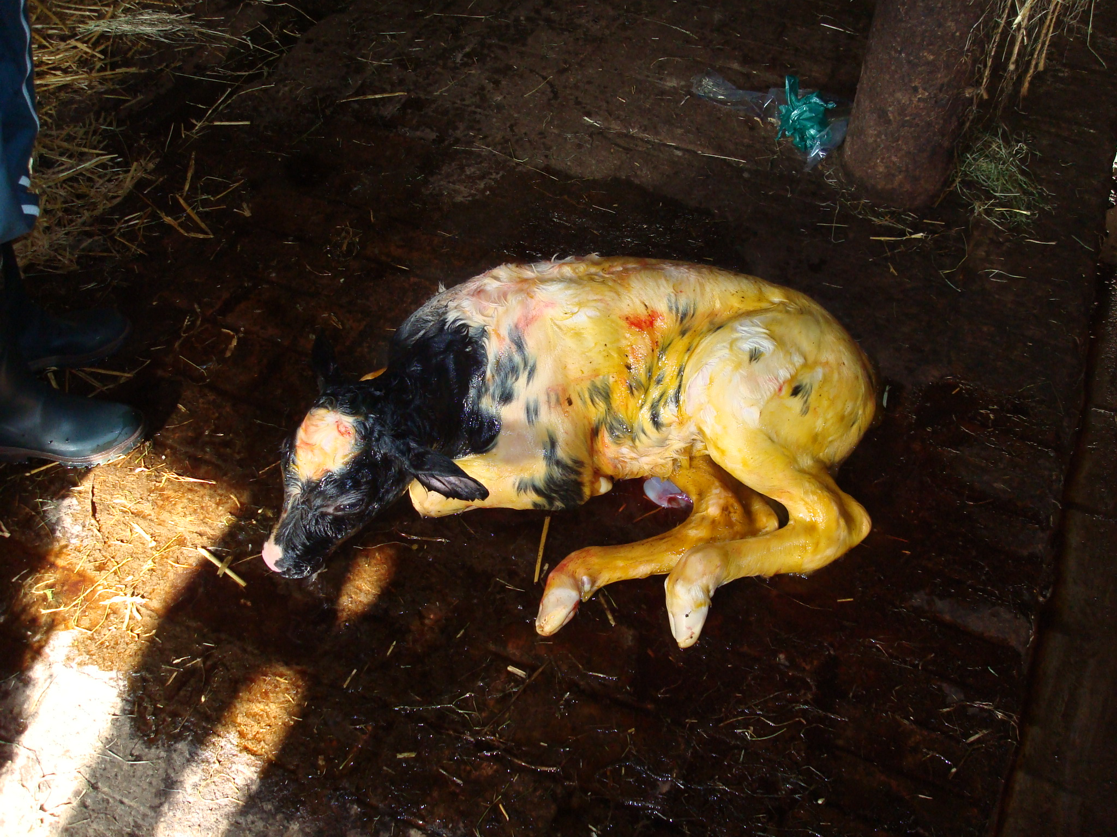
!KEEP IN MIND!
C-SECTION in BELGIUM
MANAGEMENT
Up to 300 C-sections/farm/year
Up to 500 C-sections/vet/year
BEST RESPIRATORY RELEASE
BEST METABOLIC ADAPTATION TO EXTRAUTERINE LIFE

