Slide 1

Transcatheter Aortic Valve Implantation
Marie Erpicum
Perfusionnist
Cardiovascular & Thoracic surgery department
CHU of Liege
Marie Erpicum – Perfusionniste
Département de chirurgie cardiovasculaire et thoracique - CHU de Liège

Slide 2
Since 2002…
…to this day

Slide 3
Evolution of Aortic Valve Replacement
Homograft – 1960
Surgery
Mechanical heart valve – 1960
SAVR
TAVR
Porcine valve – 1965
Edwards/PVT Transapical Beating Heart AVR
Webb, Lichtenstein – November 29, 2005
Pericardial tissue valve – 1969
1960
1970
2002
2004
2006
Edwards/PVT Transcatheter AVR
by Antegrade and Retrograde Approach
Alain Cribier – 2002/2003
CoreValve PURE Percutaneous AVR
Serruys, DeJaegere, Laborde
October 12, 2006
Transvascular
CoreValve Transcatheter AVR
by Retrograde Approach
Laborde, Lal, Grube – 2004
CoreValve Percutaneous AVR
WITHOUT cardiac assist or pacing
Grube, Gerckens – November 6, 2006
tAVR
PAVR

Slide 4
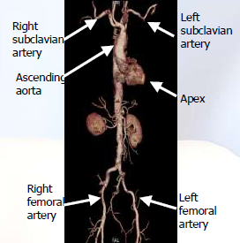

Slide 5
TAVI
Two different types of valves
Marie Erpicum – Perfusionniste
Département de chirurgie cardiovasculaire et thoracique - CHU de Liège

Slide 6
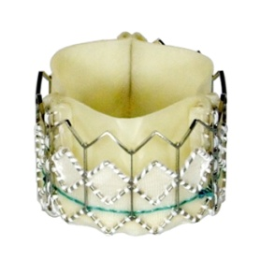
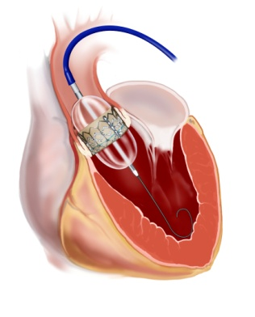
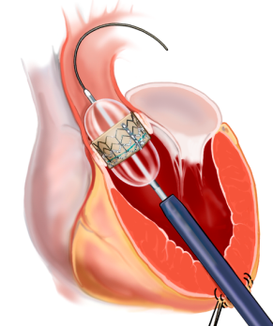
Edwards SAPIEN™ THV

Slide 7
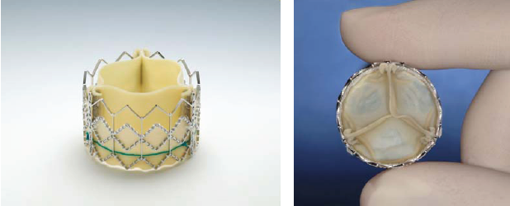
The first human implant was performed in 2002
The initial prosthesis developed by Cribier was made of equine pericardium
The currently used Edwards PAV, is a tri-leaflet bioprosthesis that is made of bovine pericardium
Two different dimensions 23 and 26 mm, that can be advanced trough a 22F or a 24F percutaneous sheath

Slide 8
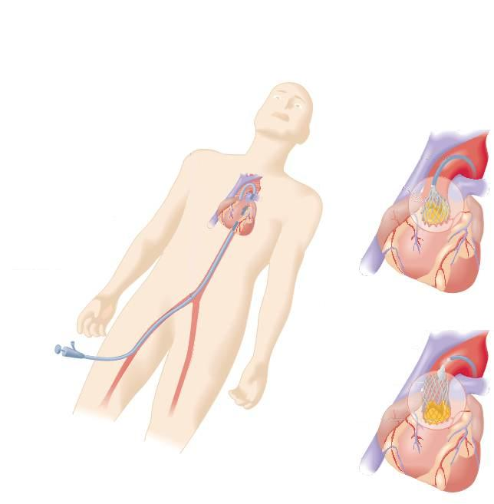
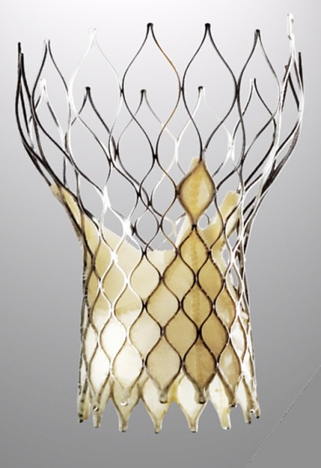
CoreValve Revalving® (Medtronic)

Slide 9
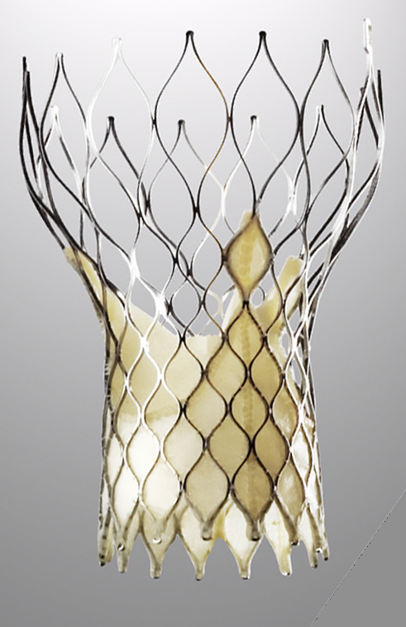
Single layer porcine pericardium
Tissue valve sutured to frame
Tri-leaflet configuration
Skirt
    primary function = sealing
    scalloped for flow dynamics
Designed for transcatheter delivery
Two sizes accommodate 90% of patients

Slide 10
Self-Expanding Multi-Level Frame
With differing circumferential dimensions:
  Largest dimension for ascending aorta contact
  Smallest dimension to preserve coronary blood flow
  Flared intra-annular dimension adapting to a range of annulus sizes
Blood flow
Notes:
10

Slide 11
TAVI
Actual indications
Marie Erpicum – Perfusionniste
Département de chirurgie cardiovasculaire et thoracique - CHU de Liège

Slide 12
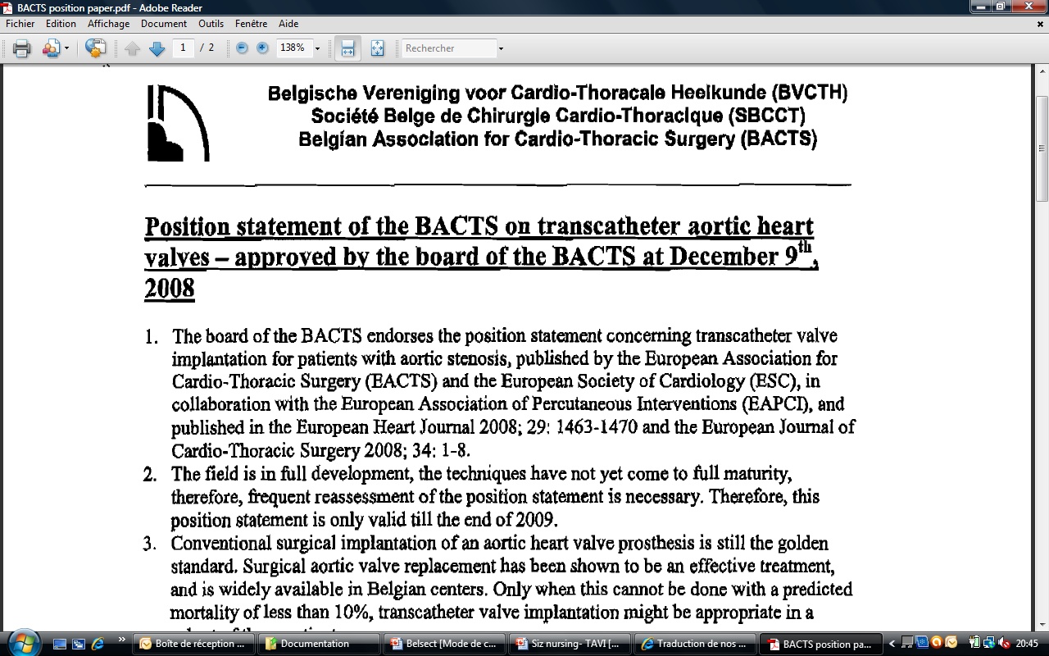
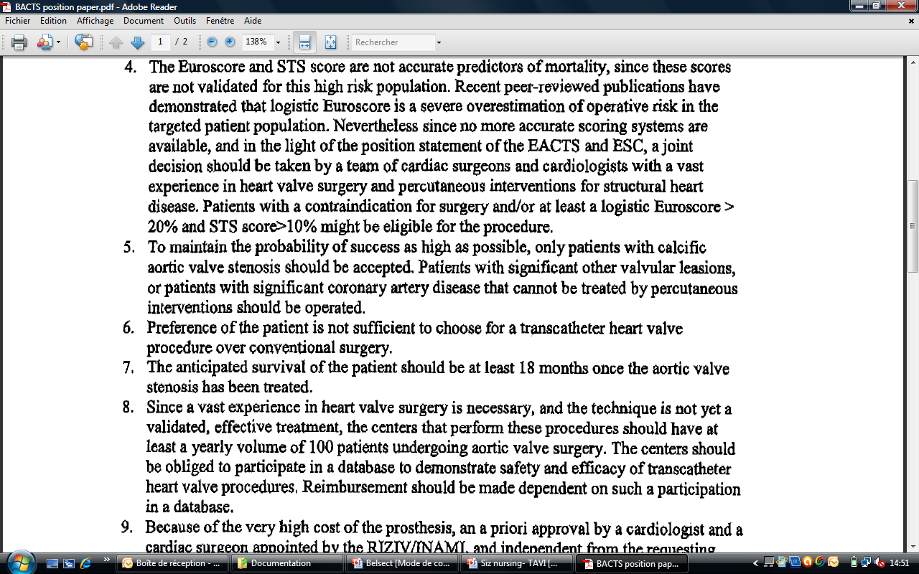

Slide 14
TAVI
Risks and results
Marie Erpicum – Perfusionniste
Département de chirurgie cardiovasculaire et thoracique - CHU de Liège

Slide 15
Conduction deficit
Aorta dissection
Vascular access
pericardial collection
Contrast agents
Valvular regurgitation
Embolism
…

Slide 16
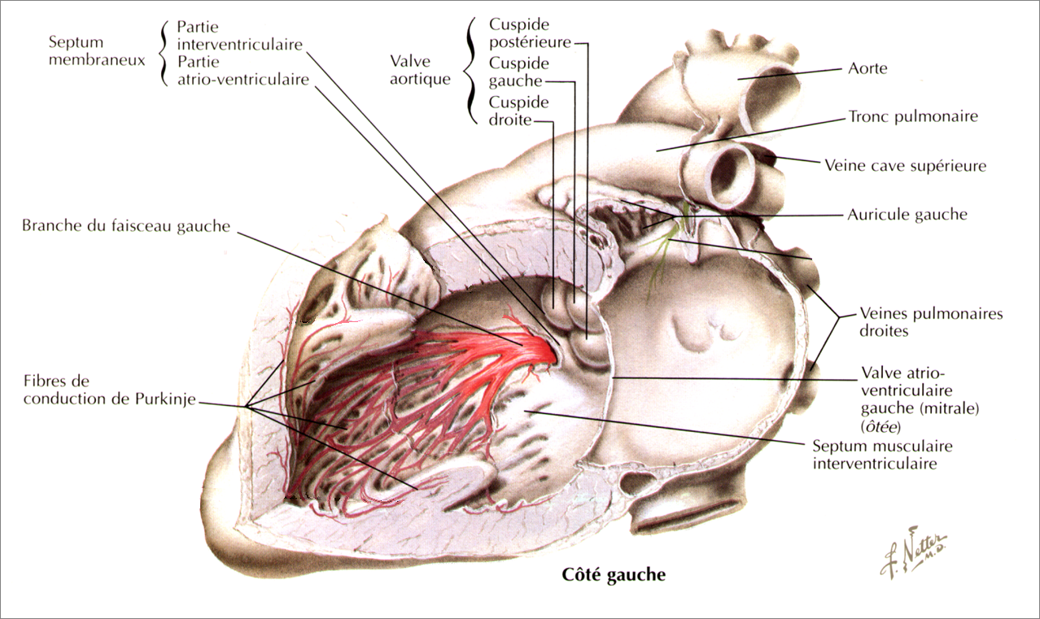

Slide 17
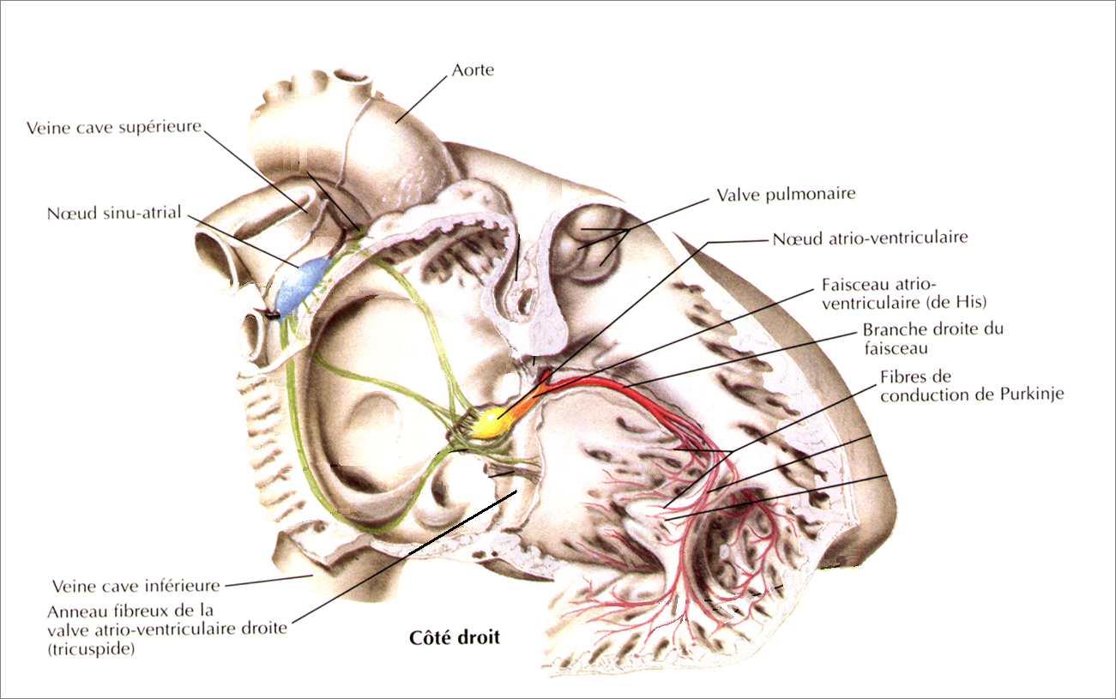

Slide 18
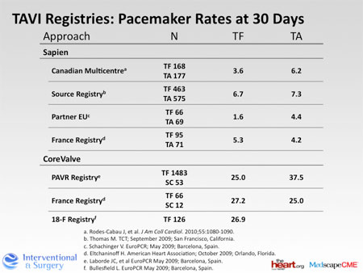

Slide 19
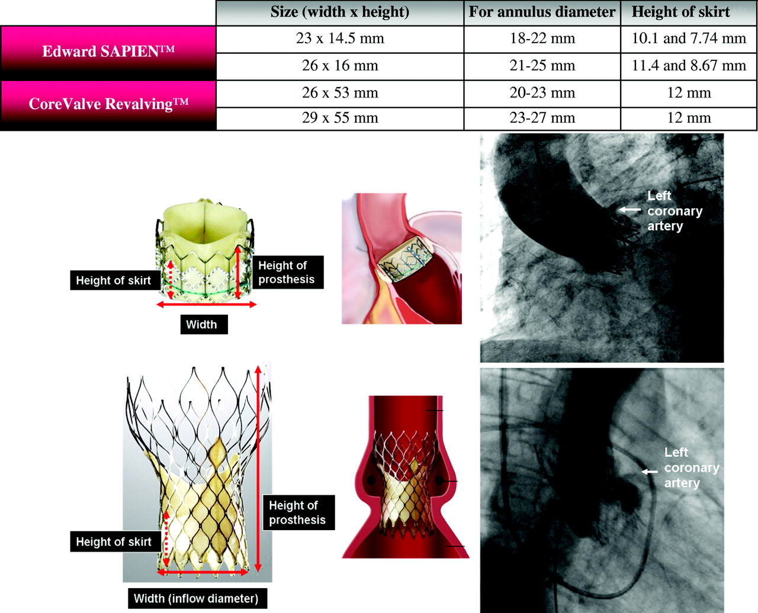

Slide 20
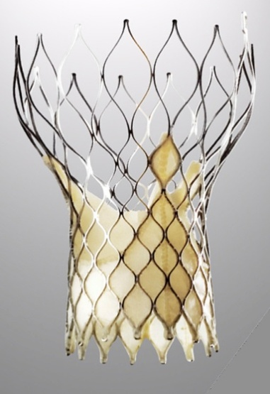
n=43 (100%)
PM
Yes
n=8 (18,6%)
No
n=35 (81,4%)
Anterior
n=7 (16,3%)
For TAVI
n=1 (2,32%)
AVB after TAVI
n= 11 (25,6%)
PM implantation
n=9 (20,9%)
LBB after TAVI
n= 21 (48,8%)

Slide 21
Conduction deficit
Aorta dissection
Vascular access
pericardial collection
Contrast agents
Valvular regurgitation
Embolism
…

Slide 22

Vascular access
Hemorrage
Hematoma
Ischemia
Nervous lesion
Vascular lesion

Slide 23
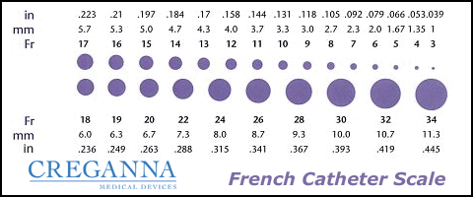

Slide 24

Vascular access : Complications treatment

Slide 25
Conduction deficit
Aorta dissection
Vascular access
pericardial collection
Contrast agents
Valvular regurgitation
Embolism
…

Slide 26
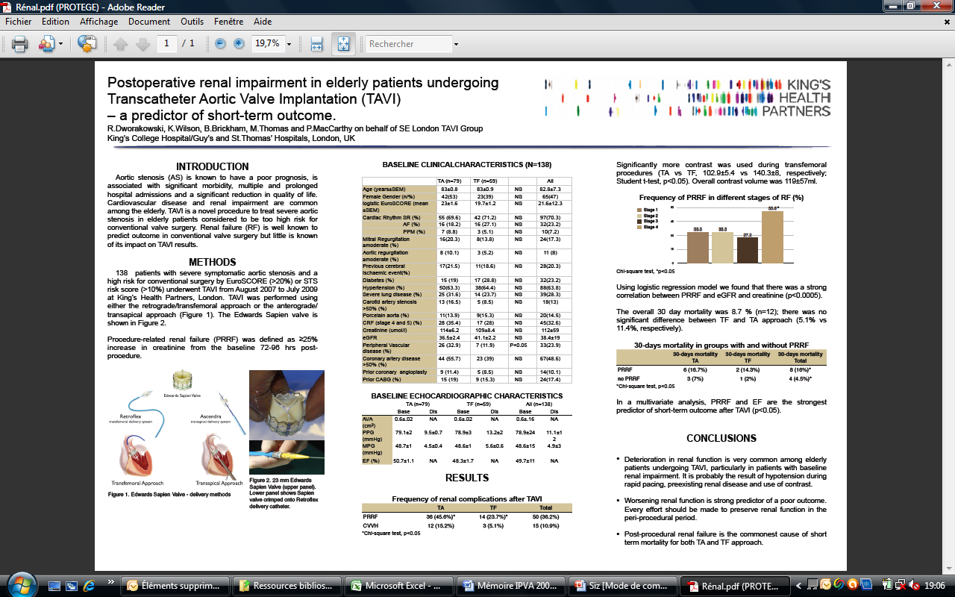
Insuffisance rénale : 2-10 %
Notes:
PRRF= Post operative renal failure = creatinine augmentée de 25% dans les 72-96h par rapport à baseline

Slide 28
Chronic Renal Failure 35%
Contrast agents 257 ± 68 ml
EER post TAVI 1 case (CRF)
Medical Θ modif. With CRF 11%
Without CRF 4%

Slide 29
Conduction deficit
Aorta dissection
Vascular access
pericardial collection
Contrast agents
Valvular regurgitation
Embolism
…

Slide 30
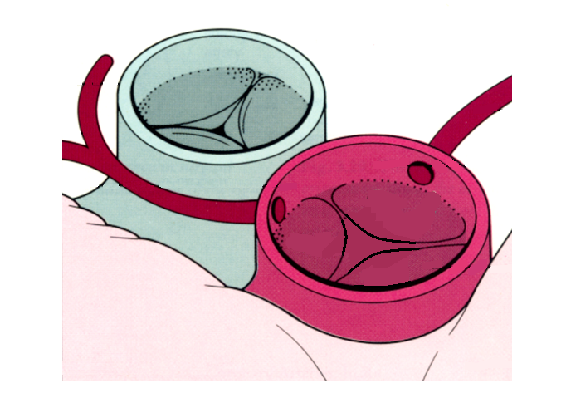
Position aortique
Risque ischémie coronaire

Slide 32
Edwards TAVI Complications
 | POOLED* (503 pts) | SOURCE (1038 pts) | VANCOUVER (250 pts) | PARIS (75 pts) | CA-Multictr (339 pts)
Vascular (maj)** (%) | 18.5 | 10.6 | 10.3 | 11.8 | 13.1
AR >2+ (%) | 10.9 | 4.7 | 5.0 | 5.3 | 7.7
Stroke (%) | 4.0 | 2.5 | 3.0 | 4.0 | 2.3
New Pacemaker (%) | 4.4 | 7.0 | 5.5 | 5.3 | 4.9
Renal Failure (%) | 5.2 | 8.7 | 4.2 | na | 2.6
Coronary Obstr (%) | 0.4 | 0.6 | na | 0 | 0
Martin B. Leon, TCT 2009

Slide 33
Edwards TAVI Complications
 | POOLED* (503 pts) | SOURCE (1038 pts) | VANCOUVER (250 pts) | PARIS (75 pts) | CA-Multictr (339 pts)
Vascular (maj)** (%) | 18.5 | 10.6 | 10.3 | 11.8 | 13.1
AR >2+ (%) | 10.9 | 4.7 | 5.0 | 5.3 | 7.7
Stroke (%) | 4.0 | 2.5 | 3.0 | 4.0 | 2.3
New Pacemaker (%) | 4.4 | 7.0 | 5.5 | 5.3 | 4.9
Renal Failure (%) | 5.2 | 8.7 | 4.2 | na | 2.6
Coronary Obstr (%) | 0.4 | 0.6 | na | 0 | 0
Martin B. Leon, TCT 2009

Slide 34
The incidence of clinically silent peri-interventional cerebral
embolic lesions after TAVI is high, whereas the incidence of
persistent neurological impairment in elderly patients with
multiple high-risk comorbid conditions was low.
Rolf Fimmers, Georg Nickenig, et al., Resonance Imaging Implantation: A prospective Pilot Study With Diffusion-Weighted Magnetic Risk and Fate of Cerebral Embolism After Transfemoral Aortic Valve JACC 2010;55;1427-1432,2010.
Notes:
TAVI is associated with a high rate of clinically silent cerebral embolism (72.7%)
In contrast, clinical symptoms of neurological deficits persisted in only 3.6% of the investigated patients 3 months after TAVI.

Slide 35
Symptomatic stroke 6 % (3 cases)
Delays 8 months
2 months
Direct after TAVI

Slide 36
Conduction deficit
Aorta dissection
Vascular access
pericardial collection
Contrast agents
Valvular regurgitation
Embolism
…

Slide 37
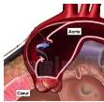
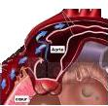

Slide 38
30-Day Adverse Events*
(Site Reported & Non-adjudicated)
Euro PCR 2009

Slide 39
Tamponade 2 cases
  ventricular perforation by the temporary pacing lead (First day after TAVI)
  compressive inflammatory exsudative collection (48 hours after TAVI)

Slide 40
Conduction deficit
Aorta dissection
Vascular access
pericardial collection
Contrast agents
Valvular regurgitation
Embolism
…

Slide 41
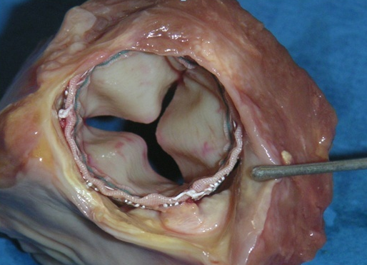
Position aortique – Implant expansible
Risque fuite paravalvulaire
Surcharge pulmonaire - OAP
Martin B. Leon, TCT 2009

Slide 42
Edwards TAVI Complications
 | POOLED* (503 pts) | SOURCE (1038 pts) | VANCOUVER (250 pts) | PARIS (75 pts) | CA-Multictr (339 pts)
Vascular (maj)** (%) | 18.5 | 10.6 | 10.3 | 11.8 | 13.1
AR >2+ (%) | 10.9 | 4.7 | 5.0 | 5.3 | 7.7
Stroke (%) | 4.0 | 2.5 | 3.0 | 4.0 | 2.3
New Pacemaker (%) | 4.4 | 7.0 | 5.5 | 5.3 | 4.9
Renal Failure (%) | 5.2 | 8.7 | 4.2 | na | 2.6
Coronary Obstr (%) | 0.4 | 0.6 | na | 0 | 0
Martin B. Leon, TCT 2009

Slide 43

Self-Expanding Multi-Level Frame
With differing circumferential dimensions:
  Largest dimension for ascending aorta contact
  Smallest dimension to preserve coronary blood flow
  Flared intra-annular dimension adapting to a range of annulus sizes
Blood flow
Notes:
43

Slide 44
 | After TAVI | 1 month
AR >2 | 6,5% | 3 %

Slide 45
Conduction deficit
Aorta dissection
Vascular access
pericardial collection
Contrast agents
Valvular regurgitation
Embolism
…

Slide 46
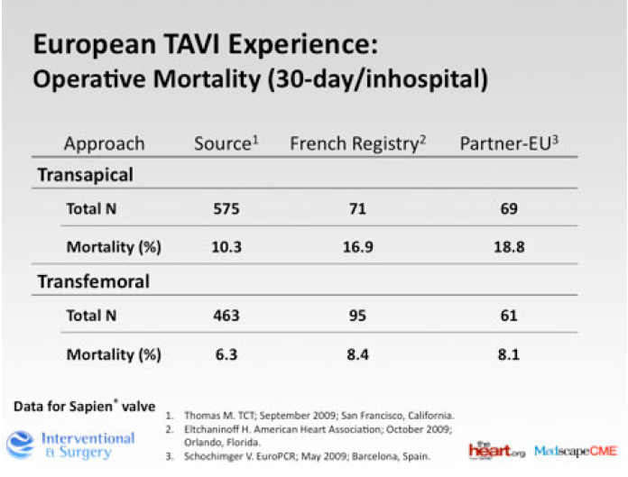

Slide 47
Mortality
1 month 2%
1 year 13 %
2 years 17%

Slide 48
TAVI
The PARTNER trial
Marie Erpicum – Perfusionniste
Département de chirurgie cardiovasculaire et thoracique - CHU de Liège

Slide 49
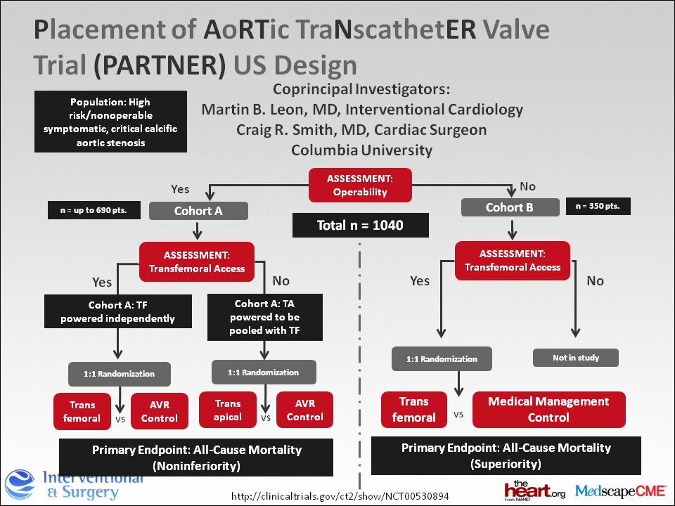

Slide 50
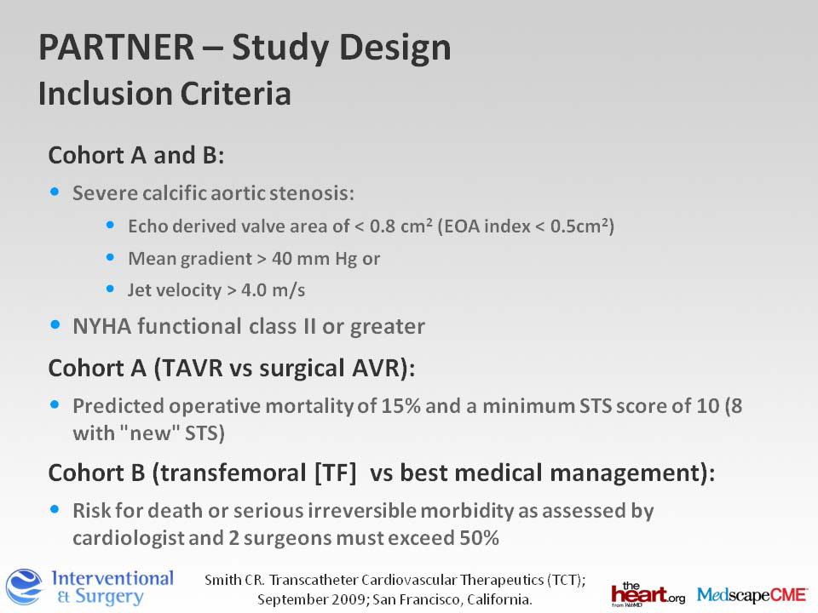

Slide 51
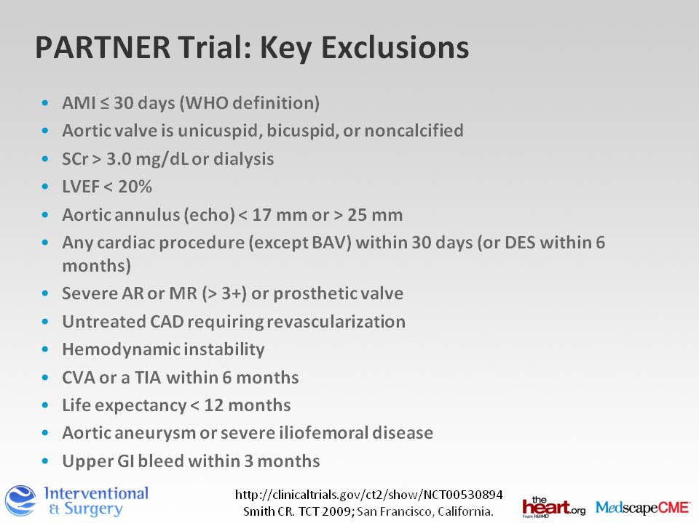

Slide 52
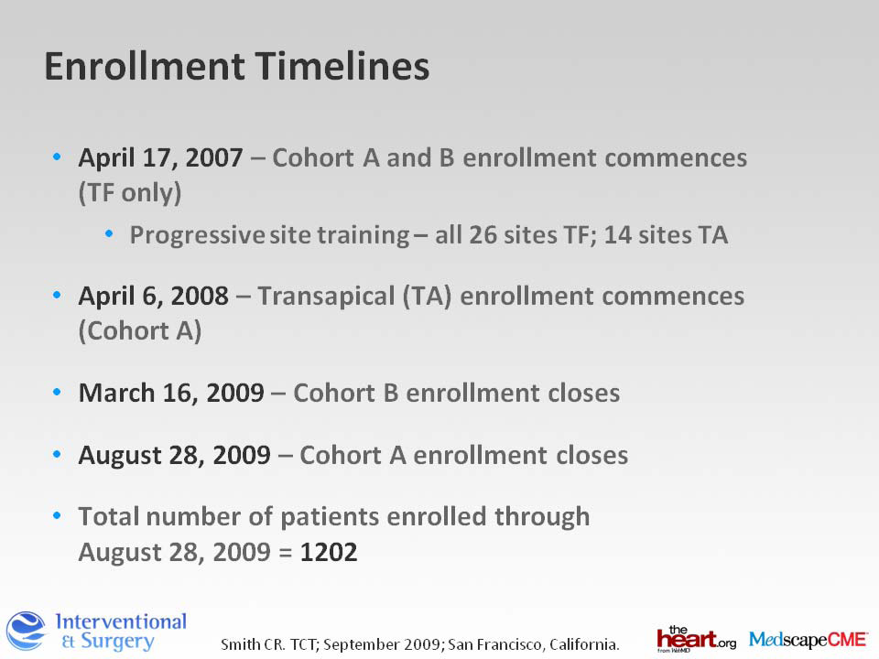

Slide 53
Cohort B: TAVI versus "standard therapy" including BAV
1-year mortality
  30.7% for TAVI
  50.7% for standard therapy (p<0.001).
NYHA class III or IV at 1-year
  25.2% for TAVI
  58.0% for standard therapy (p<0.001).
Major vascular complications
  16.8% for TAVI
  1.1% for standard therapy (p < 0.001).
30-day stroke
  5.0% for TAVI
  1.1% for standard therapy (p=0.06).

Slide 54
Thank you
Marie Erpicum
Perfusionnist
Cardiovascular & Thoracic surgery department
CHU of Liege
Marie Erpicum – Perfusionniste
Département de chirurgie cardiovasculaire et thoracique - CHU de Liège

